Slide 1
Flood Emergency Response Grant Program
John Paasch, Flood Operations Branch Chief
K.C. Richmond, Regional Flood Preparedness Section Chief
Ally Wu, Flood System Analysis Section
State-Federal Flood Operations Center
Division of Flood Management
California Department of Water Resources
Notes:
President Edgar
Vice President Suarez
And Board Members…

Slide 2
Overview
Overview of Flood Preparedness Efforts (John Paasch)
Grant Program, Grant Types, and Delta Grants Highlights (K.C. Richmond)
Statewide Emergency Response Grants Highlights (Ally Wu)
Local Participant Experiences and Products (Local Agency Grant Awardees)
Closing Remarks (John Paasch)
Notes:
Overview of Flood Preparedness Efforts (John Paasch) 2 minutes
Grant Program, Grant Types, and Delta Grants Highlights (K.C. Richmond) 10 minutes
Statewide Emergency Response Grants Highlights (Ally Wu) 5 minutes
Local Participant Experiences and Products (Local Agency Grant Awardees) No time limit
Closing Remarks (John Paasch) 1-2 minutes

Slide 3
DWR Flood Preparedness Efforts & Flood ER Grants
Focus is on Values and Outcomes
  Flood Safety Planning prepares locals, counties, and regions
  Improved operational capacity to respond to flood emergencies
  Increased self-reliance of local agencies and regions under SEMS
  DWR better able to support local response
  Local, County, State Alignment
Notes:
Recall Sep 25 Prep Activities
“Local” flooding is regional in nature, CVFPP Planning Regions
With improved local and regional emergency preparedness, the state is ultimately better prepared to respond to emergencies. Additionally, as each local agency delivers its emergency plan, the State’s library and understanding of local emergency operations grows.
A lot of work, but great value.

Slide 4
Current Flood ER Grant Types
Flood ER Grant Program
Delta Communications
Delta Flood ER
Statewide Flood ER
Delta Communications – $5 Million in Prop. 84 funding
Delta Flood ER - $5 Million in Prop. 1E Funding
Statewide Flood ER – $10 Million in Prop. 84 funding
Notes:
Support improved local flood emergency preparedness and response in California
Two separately-funded project geographic areas: Delta and Statewide.
Two types of grant focused in the Delta and one type focused Statewide.

Slide 5
Eligibility for Flood ER Grant
California public agencies with
primary responsibility for flood emergency response
Reclamation Districts
Local Maintaining Agencies
Flood Control Districts
Joint Power Authorities
Cities
Counties
Notes:
One thing to note is that these Grants mirror and reinforce the State’s Standardized Emergency Management System (SEMS) by requiring local agencies to work through a SEMS-like structure. If you recall, the SEMS structure is such that all emergency response begins at a local level and is elevated to the county and state as resources are drawn down. Grants are awarded to a single lead agency, typically the county, who represents several other local agencies within their jurisdiction.
A great byproduct of this grant structure is that it facilitates stronger working relationships among local responders and improves coordination, communication, mutual aid, and overall speed and effectiveness of emergency response.

Slide 6
Legal Obligations
Water Code 9621
Water Code 9650
A flood preparedness plan for flood-fight materials
A levee patrol plan for high water situations
A flood-fight plan (prior to state/federal involvement)
An evacuation plan and public warning system
A floodwater removal plan
Plan for essential service providers (hospitals, law enforcement, etc…) to be operable quickly after floodwater removal
Water Code 9650 Minimum Requirements:
Notes:
Grants were originally designed to support local agencies in fulfilling legal obligations to prepare local flood emergency plans.
For Example,
Water Code 9621: Counties within the Sacramento-San Joaquin Valley are required to collaborate with cities within its jurisdiction to develop a flood emergency plan
Water Code Section 9650:
Applies to project levee protected basins in which more than 1,000 people reside
Local jurisdiction shall approve a resolution committing the preparation of a safety plan within two years
Each of the plans developed through this grant program fulfill the minimum requirements of WC 9650, but some go above and beyond those requirements.

Slide 7
Funded Activities
Statewide/Delta Flood ER Grant (Prop. 84 & 1E)
Funding activities prioritized by 3 steps
Step 2
Training & Exercises
Step 3
Facilities, Equipment, & Supplies
Step 1
Planning and Coordination

Slide 8
Flood ER Grant Process
Release Proposal Solicitation Package & Receive Applications
Release Funding Recommendations & Begin Public Comment Period
Review Applications
Final Funding Awards & Award Letters
Develop & Execute Contract Agreements
Notes:
Following the release of the PSP, DWR holds public workshop and staff are also available by appointment to assist locals with developing applications.

Slide 9
Delta Communications Grants
Delta Communications Grant (Prop. 84)
Solicitation for $5M to the 5 Delta Counties
SB 27 Task Force Recommendation
Funded Activities include purchase and installation of communications equipment and communications plans.
6 projects Funded for 6 Participating Agencies
Grant close out in 2016.
Notes:
One-time Solicitation to assist with addressing Senate Bill 27 recommendation to develop and implement a Delta region specific Interoperability Communications Plan that supports communication between emergency response agencies
No future solicitations will occur for this grant type
Interoperable communications are an essential part of a quick and coordinated emergency response. The speed at which emergency staff are able to respond and communicate can mean the difference between a flood fight and a catastrophic event. During emergencies, go-to communication systems can become unreliable due to service limitations, high levels of usage, tower outages, or interference and other issues. Emergency responders need a quick and reliable way to communicate with one another not only within their own county or jurisdiction, but throughout the Delta region as many local responders pull from the same resources and Delta island levees can be affected by neighboring island levee failure or damage.
The Delta Communications Grants fund the purchase of equipment required to provide interoperable emergency communication between all 5 counties within the Delta
Equipment includes radios, radio consoles, base stations, satellite phones, antenna systems, repeaters, microwave equipment, mobile communications equipment (including vehicles and trailers), communications software.
Grant also funds the development of communications plans and training for use of the newly acquired equipment.
6 projects were funded for 6 participating agencies
Bethel Island Municipal Improvement District
Contra Costa County OES
Sacramento County
San Joaquin County
Solano County OES
Yolo County

Slide 10
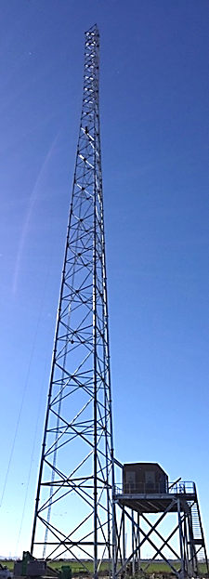
Delta Communication
Grants Highlights
Twitchell Radio Tower
  Installed by Sacramento County
  Total Cost $2.2M, $1.5M provided by DWR Grant
Prior to installation, reliable communications in this part of the Delta did not exist.
Reliably connects all 5 counties and DWR.
Notes:
Twitchell Tower along with an existing tower in Solano County, and the new radio equipment purchased through this grant, will create a two zone (northern and southern) high level communication system for the Delta Region.
This radio tower works in tandem with mobile communications vehicles and other radio equipment owned by Contra Costa, Solano, Yolo, Sacramento, and San Joaquin counties to support better coordinated, aligned, and more effective local overall emergency response in the Delta. Additionally, State responders can now quickly “tie into” emergency response, reliably contact local emergency responders, and more effectively provide support where it is needed.

Slide 11
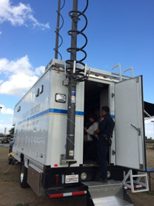
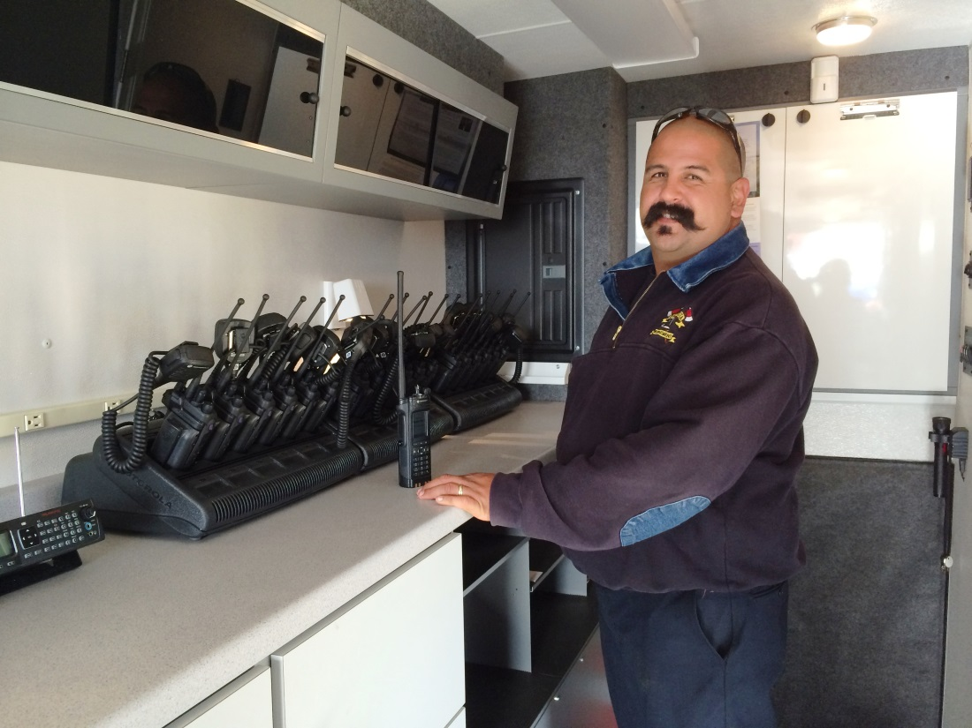
Delta Communication
Grants Highlights
Communications on Wheels (COW)
Notes:
This is an example of a mobile communications vehicle that can be strategically placed in the Delta for emergency interoperability during emergency responder deployment.
This COW was purchase by Solano County under their Delta Communications Grant with DWR

Slide 12
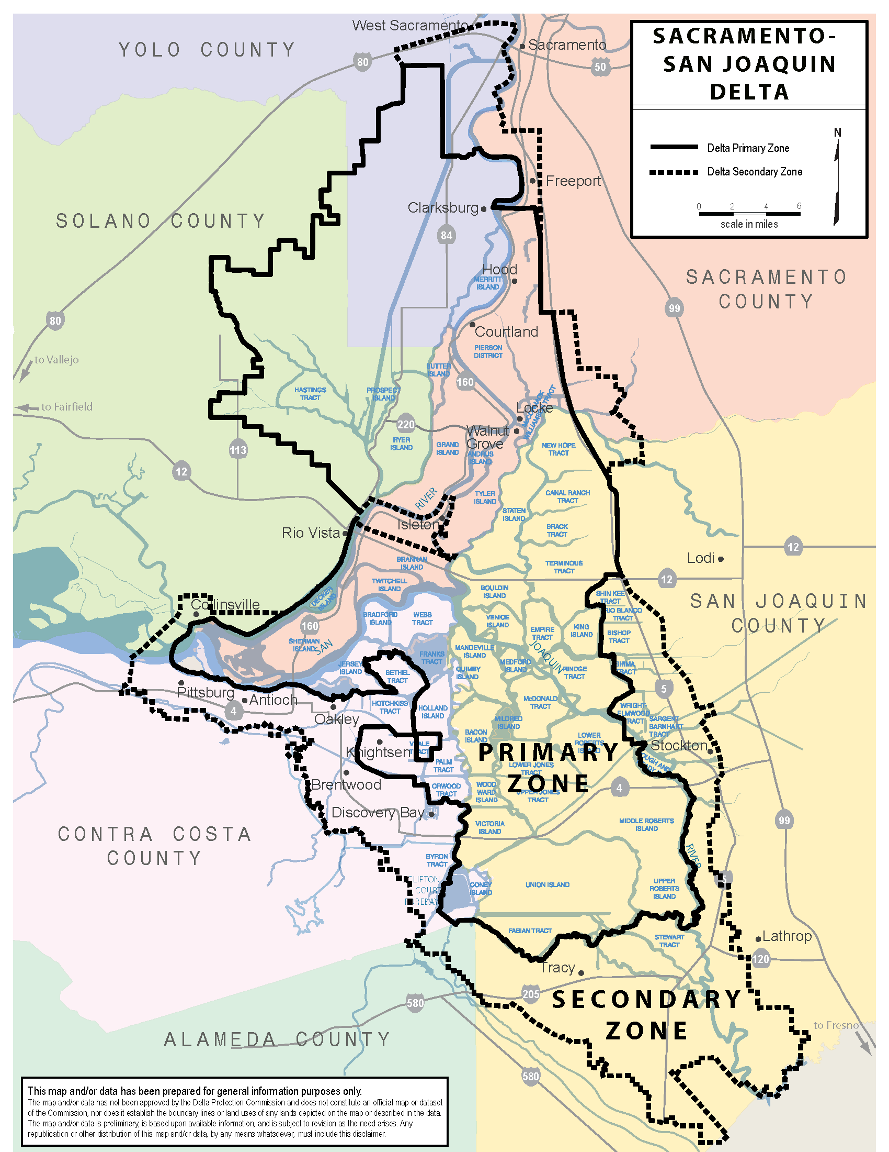
Delta Flood ER Grants
6 Projects Funded
125 Participating Agencies
Over $8.5 million in requested funds
Focused on Planning & Coordination
Notes:
The second type of Delta Grant is the Flood Emergency Response Grant
The first round solicitation for this grant funded work to update and improve emergency response plans, maps, and warning systems. This work improves local flood emergency response and increase public safety by allowing for faster response, evacuation, and coordination during emergency events. Training held for emergency personnel in emergency management systems brings agencies into compliance with FEMA requirements and will allow for better cost recovery following an event

Slide 13
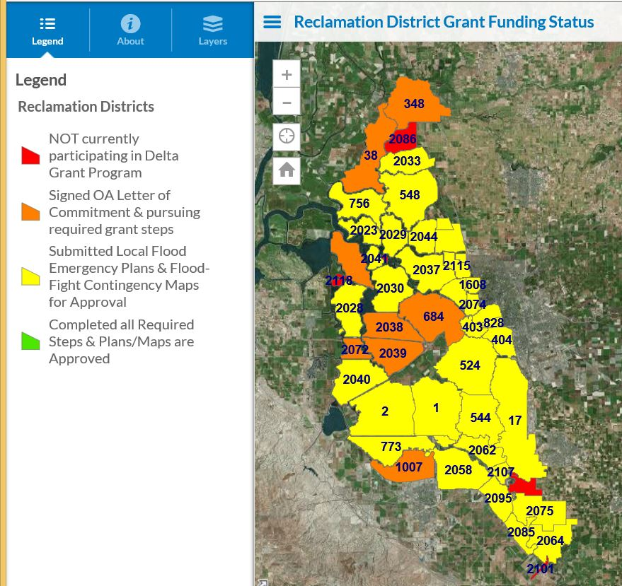
Delta Flood ER Grants Highlights
San Joaquin County Coordination
Notes:
SJC OES grant is a great example of the benefits of the Grant structure to reinforce the SEMS relationships within the region. DWR is contracted with SJC who is the lead agency representing 53 participating local agencies.
This map shows that most of the districts are participating and coordinating through their county

Slide 14
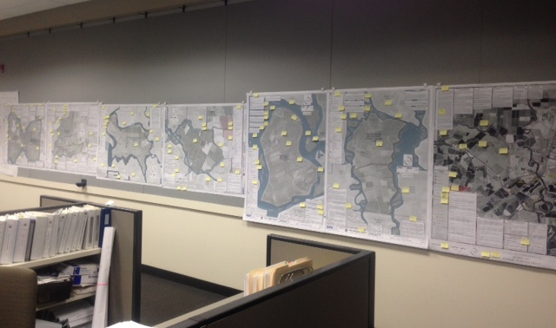
Delta Flood ER Grants Highlights
San Joaquin County Coordination
Notes:
Districts and County did a lot of back and forth coordination to review and finalize these flood emergency response maps
These Maps and subsequent plans fulfill the requirements of WC Section 9650 and include such things as:
Historic problem areas (levee breaches, boil/seepage sites, erosion sites, etc)
100 year floodplain elevations
Critical infrastructure
Levee Patrol Routes
Emergency Command Post Locations
Staging Areas
Evacuation Routes
….and much more.

Slide 15
Delta Flood ER Grants Next Steps
Future Solicitations
Up to $5000 in application cost reimbursement for successful applicants
  Second Delta Grant proposal solicitation package anticipated spring 2016
  Funding focused on Step 2 Tasks for agencies who have completed plans
Notes:
A third solicitation would focus on step 3 tasks, which support improvement of emergency response facilities and the purchase of emergency response and flood fight materials for stockpiling.

Slide 16
Statewide Flood ER Grant Awardees
34 Projects Funded
189 Participating Agencies
Over $24 million in requested funds
Focused on Various Activity Areas
Notes:
There are different activity areas were funded by this program, including preparing or updating local flood emergency plans, coordinating flood emergency planning and preparedness including training and exercises, purchase and installation of emergency communication and etc.

Slide 17
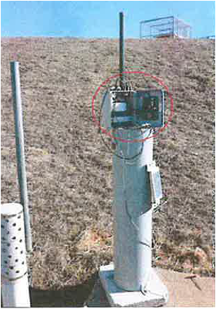
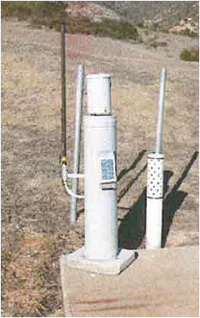
Statewide Flood ER Grants Highlights
Ventura County Project
  Total awarded $840K for round 1 and $780K for round 2 by DWR Grant
  For round 1, contract executed in 2014, to be completed by 2017
  Update the Automated Local Evaluation in Real Time (ALERT) 2 system
  Consist of gages, radio towers and receivers to monitor river and stream water levels, rainfall and others
  Use as an emergency communications tool
Notes:
The value of upgrading this product will eliminate of data loss due to overlapping transmissions and radio interference across agency boundaries. This product will be beneficial to all emergency responders because they will provide higher quality information for decision makers and improved capacity during major weather events and system reliability.
In addition to the NWS, the ALERT 2 system data can be used to warn residents, increasing evacuation time.

Slide 18
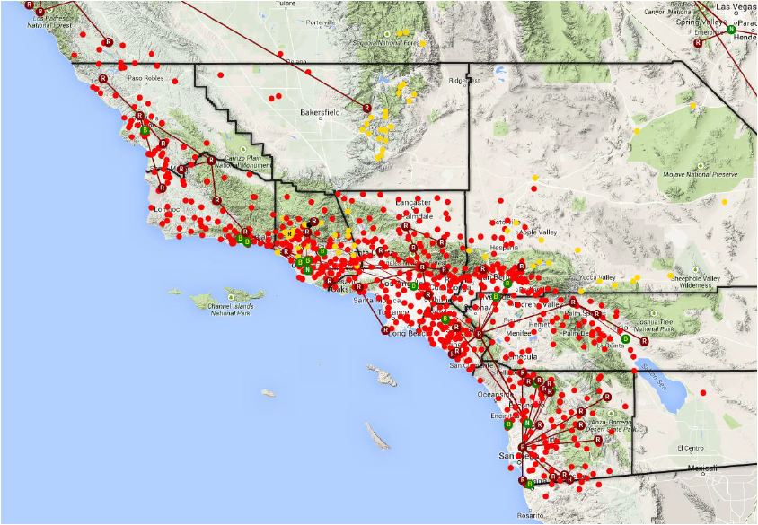
Ventura County Project Grants Highlights
Notes:
This map shows the extend of all the Alert 2 systems installed in southern CA. Only a portion of areas are funded by DWR.

Slide 19
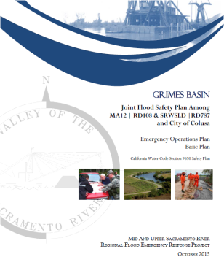
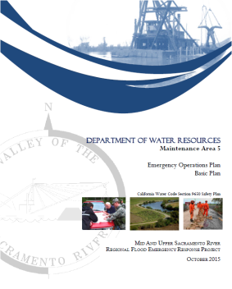
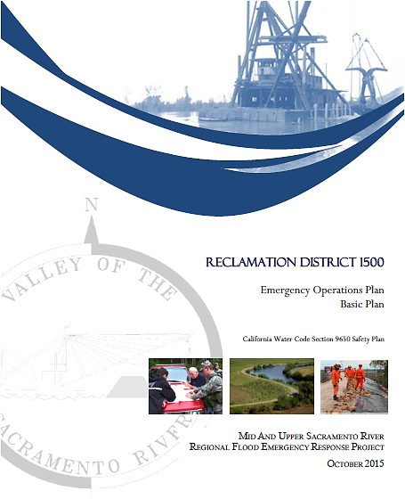
Statewide Flood ER Grants Highlights
Reclamation District (RD) 108 Project
  Total awarded $1.2million for round 1 and $680k for round 2 by DWR Grant
  For round 1, contract executed in 2014, to be completed by 2017
  Update and develop Emergency Operations Plans
  Create a Unified Flood Fight Command System Operations Manual
  Develop flood contingency maps
  Develop a training plan for FEMA reimbursement
Notes:
The above efforts will provide levee patrol plans, evacuation plans, contingency options, delivery points and staging areas, communication plans and flood fight histories.
These efforts provide increased emergency coordination, preparedness, and response levels for the region.

Slide 20
Statewide Flood ER Grants Next Steps
Future Solicitations
  Third Statewide Grant proposal solicitation package expected 2017
Up to $5000 in application cost reimbursement for successful applicants
  Increased potential for non-planning project activity type funding

Slide 21
Local Agency Participants
Notes:
Yolo County (Dana Carey)
Dana will talk from the County’s point of view on the benefits this grant has had related to coordination with LMA’s and will share some product this grant has supported.
KSN Representatives
Chris Neudeck will talk from the District Engineer Point of view on the benefits of these grants
Ron Baldwin will talk from the RD 108 point of view on the products this grant has supported

Slide 22
Available Resources
Webpage:
www.water.ca.gov/floodmgmt/hafoo/fob/floodER
For more information or to be added to the email notification list contact
Statewide Grants:
Liz Bryson
(916) 574-1358
Elizabeth.Bryson@water.ca.gov
Delta Grants:
William Wong
(916) 574-2305
William.Wong@water.ca.gov
Notes:
John to give closing remarks while this slide is up.

