Slide 1
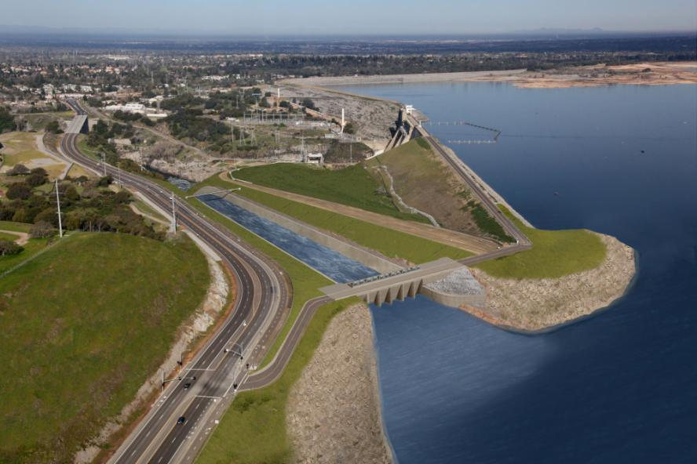
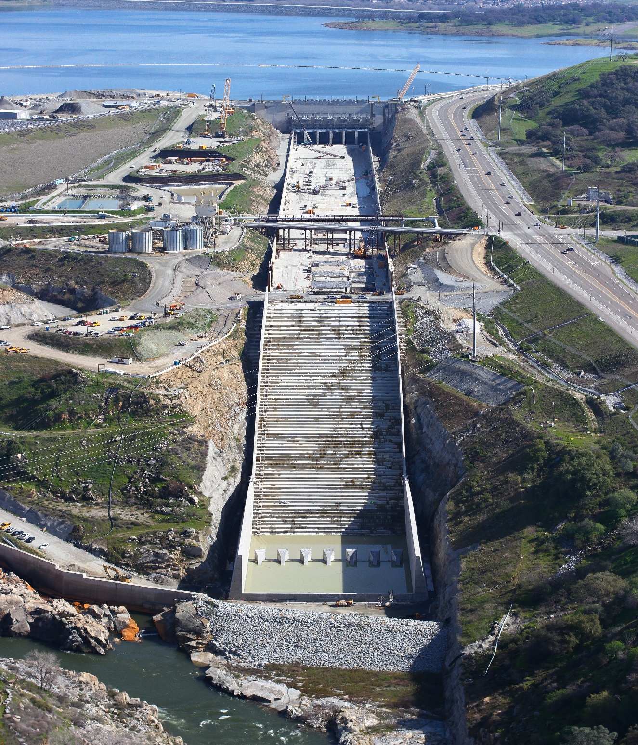

Joint Federal Project, Folsom Dam
Phase III – Control Structure
Phase IV – Approach Channel; Chute & Stilling Basin
Phase V – Commissioning & Site Restoration
Chute
Control Structure
Approach
Channel
Water Control Manual Update
24 Feb 16
03/08/16 KC
Notes:
1

