Slide 1

CVIFMS UPDATE
March 25, 2016

Slide 2



Study Sponsors
Federal Sponsor
United States Army Corps of Engineers (USACE)
  Project Management by Sacramento District (USACE-SPK)
`
Non-Federal Sponsors
Central Valley Flood Protection Board (Board)
Department of Water Resources (DWR)

Slide 3
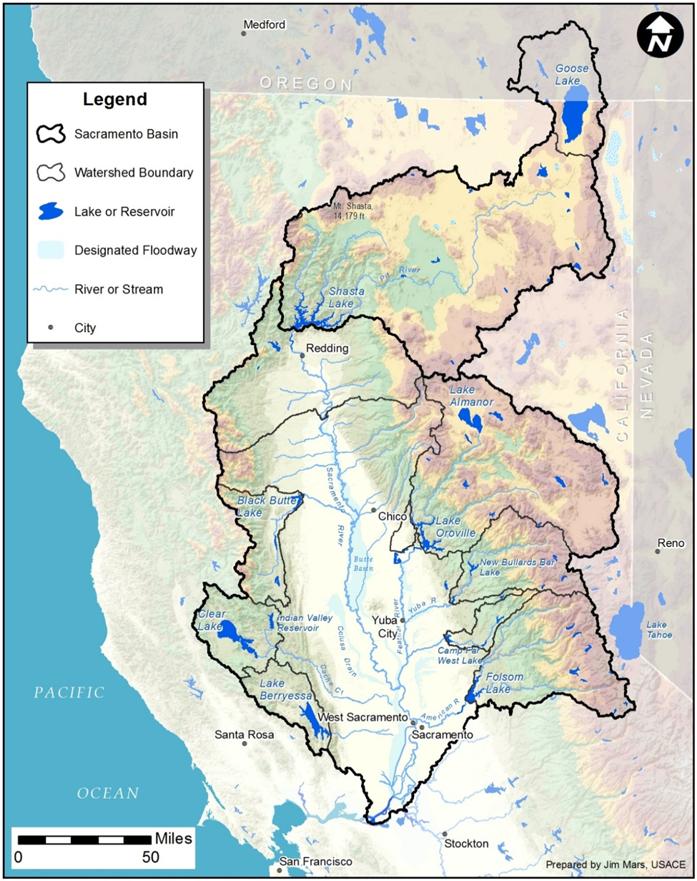
Area of Study

Slide 4
Key Points
Collaborative Sacramento River Watershed Assessment
3-partners USACE, BOARD, DWR
3-purposes FloodRiskManagement, EcosystemRestoration, WaterSupply
Will result in Final Watershed Plan in 2016
Main Finding: Potential Federal interest within any of the conceptual alternatives and purposes
Mechanism for USACE to align its ongoing projects and investigations in the Central Valley with the CVFPP and with other potential partners
Establishes strong basis for future partnership with USACE in Sacramento Basin
Positive comments and support received

Slide 5
Study Objective
Develop a comprehensive basin-wide management plan that;
Incorporates public input and involvement,
Assesses existing watershed characteristics and conditions,
Utilizes technical work already completed by the State
Identifies watershed issues and concerns,
Supports the CVFPP effort as a companion study,
Develops, evaluates and prioritizes conceptual plans including both structural and non-structural measures, in support of watershed needs, and
Identifies potential “spin-off” and “off-shoot” projects that may fall under appropriate Federal, State and/or local authorities.

Slide 6
Previous Board Actions
21 July 2010 – Signed a Feasibility Cost Sharing Agreement (FCSA) to initiate study
30 August 2013 – Signed a FCSA Amendment to reshape the study in line with the SMART Planning (3x3x3) initiative
20 November 2015 – Motion passed to modify letter of support from the Board and delegate it to the executive committee for approval and signature
17 December 2015 – Support letter signed and submitted

Slide 7
Next Steps
Submit Final CVIFMS Watershed Plan to South Pacific Division, Headquarters US Army Corps of Engineers, and the Assistant Secretary of the Army (Civil Works) for approval starting in April
Initiate “spin-off” and “off-shoot” studies under Federal, State and/or local authorities
  San Joaquin River Watershed Study
  Middle and Upper Sacramento River Basin Comprehensive Study
  Climate Change Assessment
  Reservoir Re-Operation Study

Slide 8
Contacts
USACE: Public Affairs Office
CVIFMS@usace.army.mil
Glen Reed, Project Manager
(916) 557-5332
anthony.g.reed@usace.army.mil
Rhiannon Kucharski, Lead Planner
(916) 557-7258
rhiannon.l.kucharski@usace.army.mil
DWR: Christopher Williams, Project Manager
(916) 574-2375
christopher.williams@water.ca.gov
CVFPB: Nancy Moricz, Senior Engineer, CVFPB,
(916) 574-2381
nancy.moricz@water.ca.gov

Slide 9
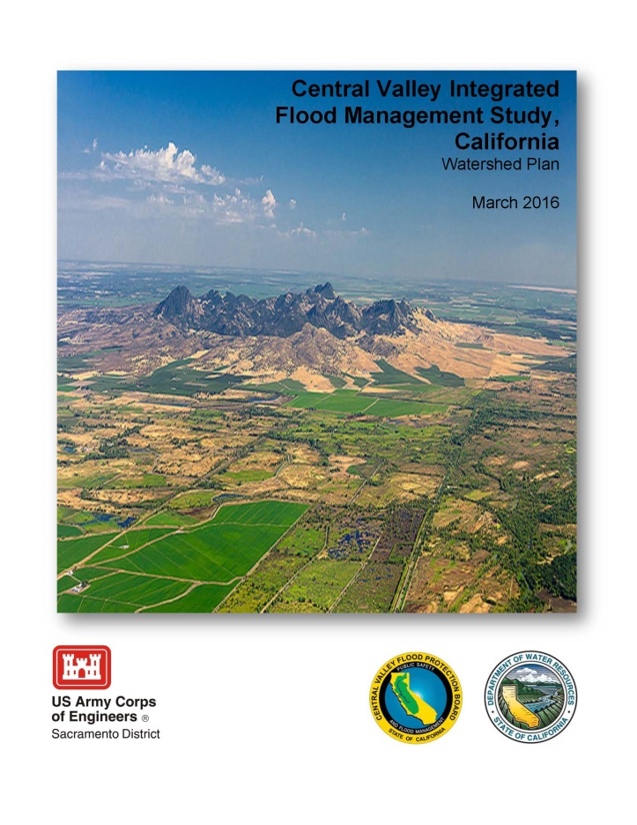
Questions?

