Slide 1
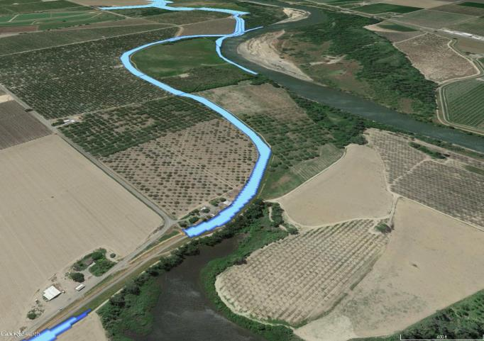
Accela Land Management Software for DWR
Daniel K. Mardock
Geodetic Branch Chief/DOE
SSJDD Rights Along Sacramento River Colusa County

Slide 2
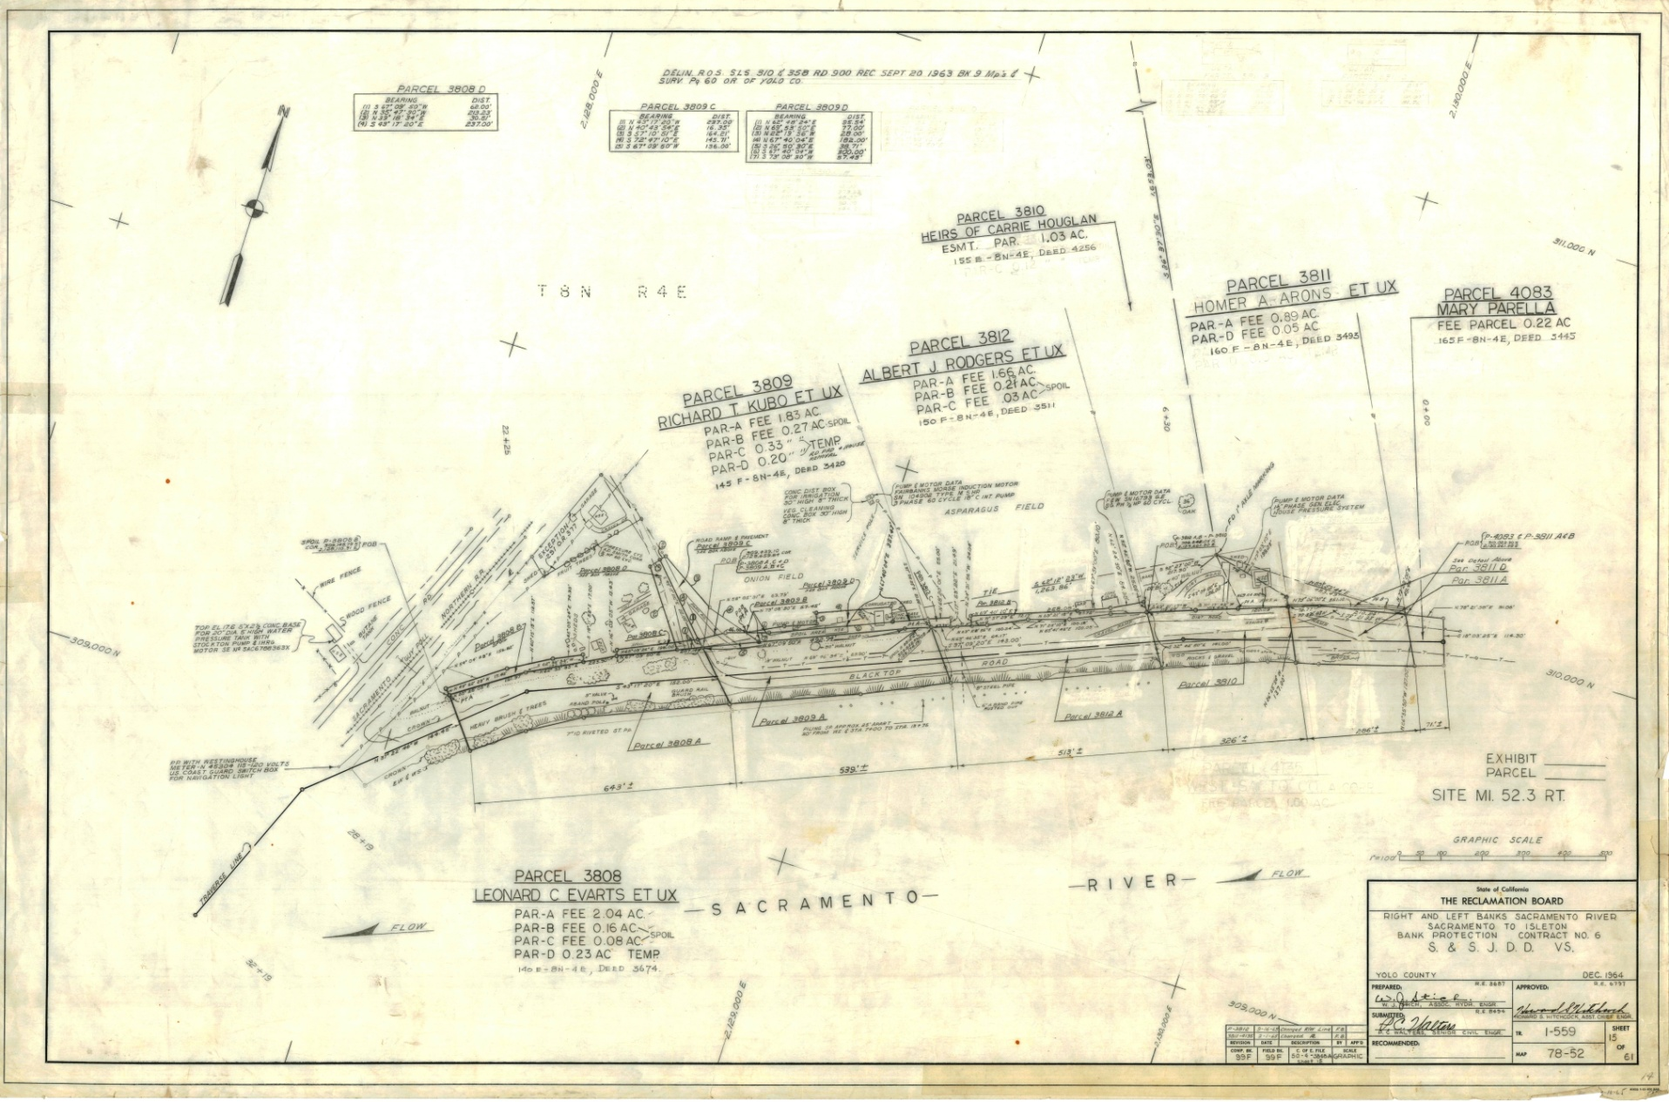
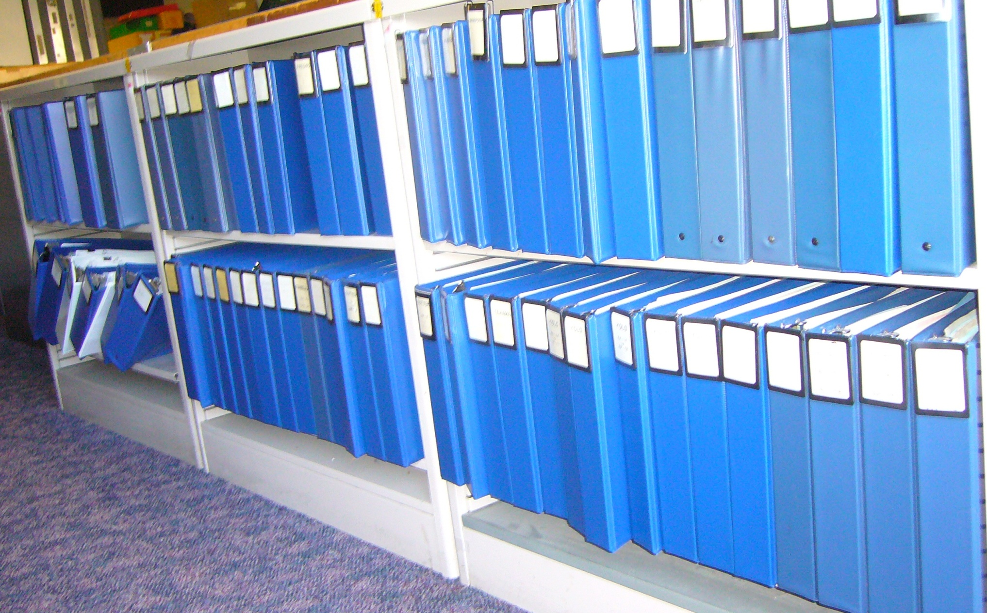
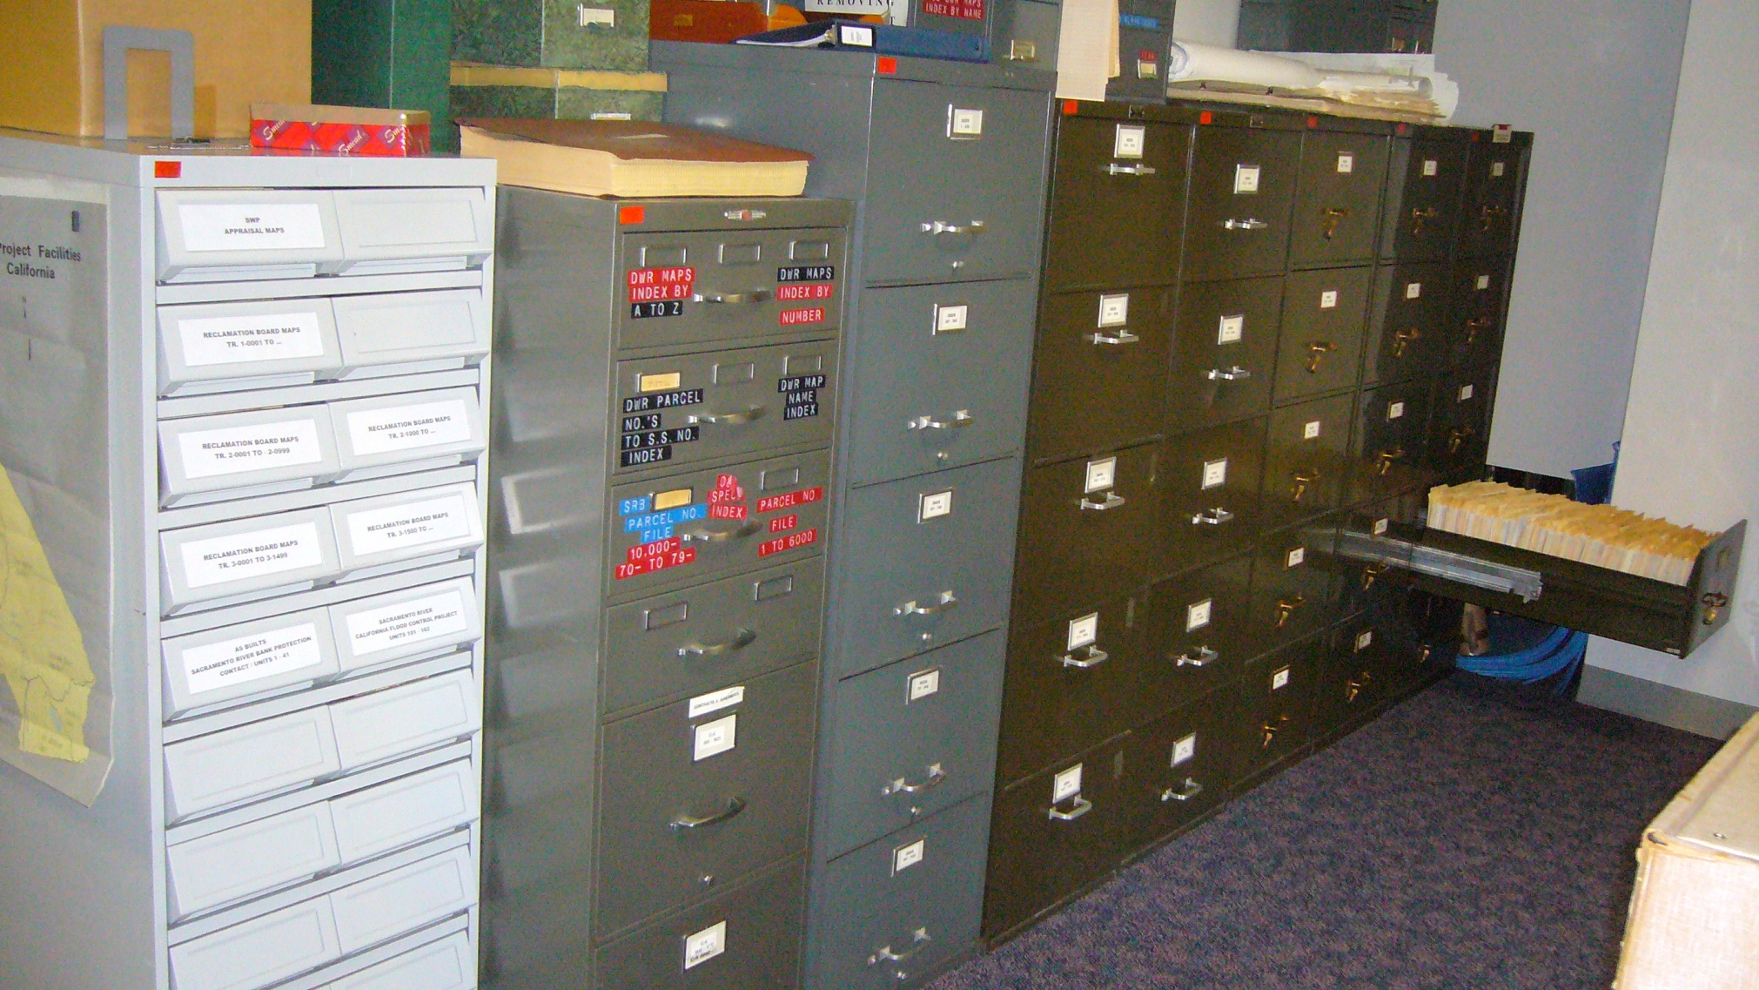
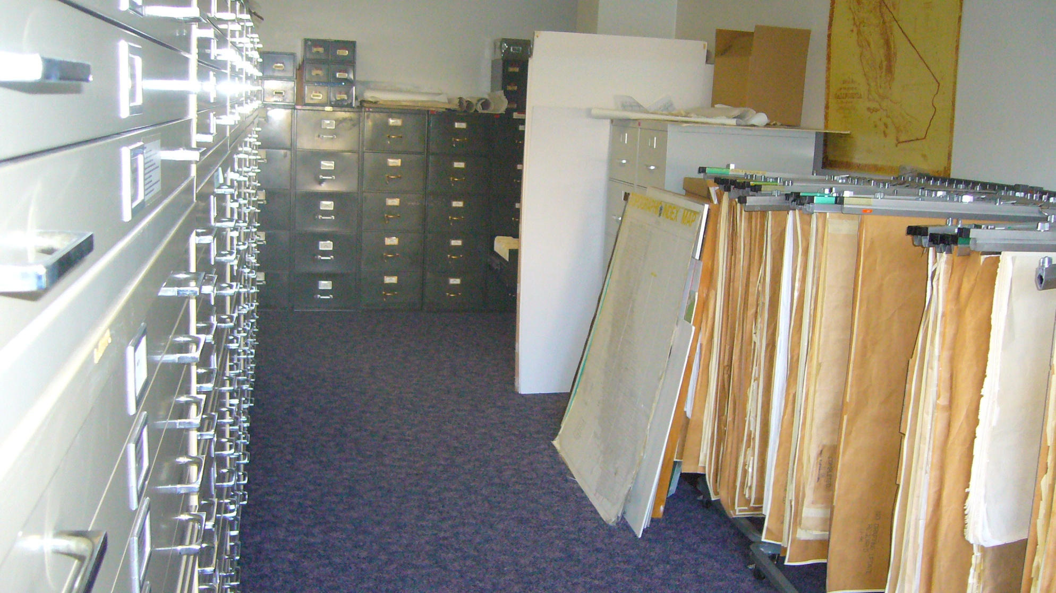
Converting Your Records From This…

Slide 3
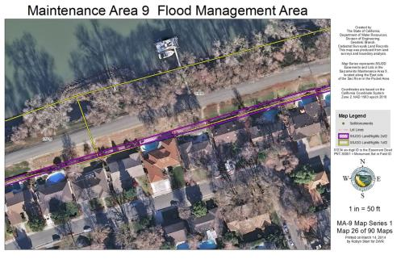
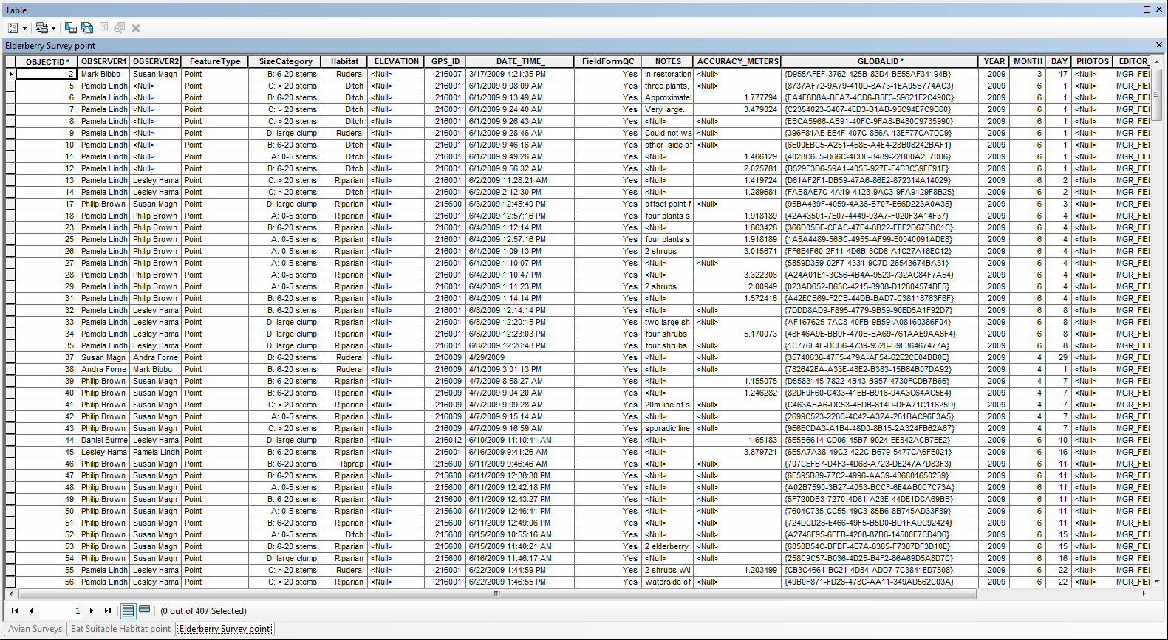
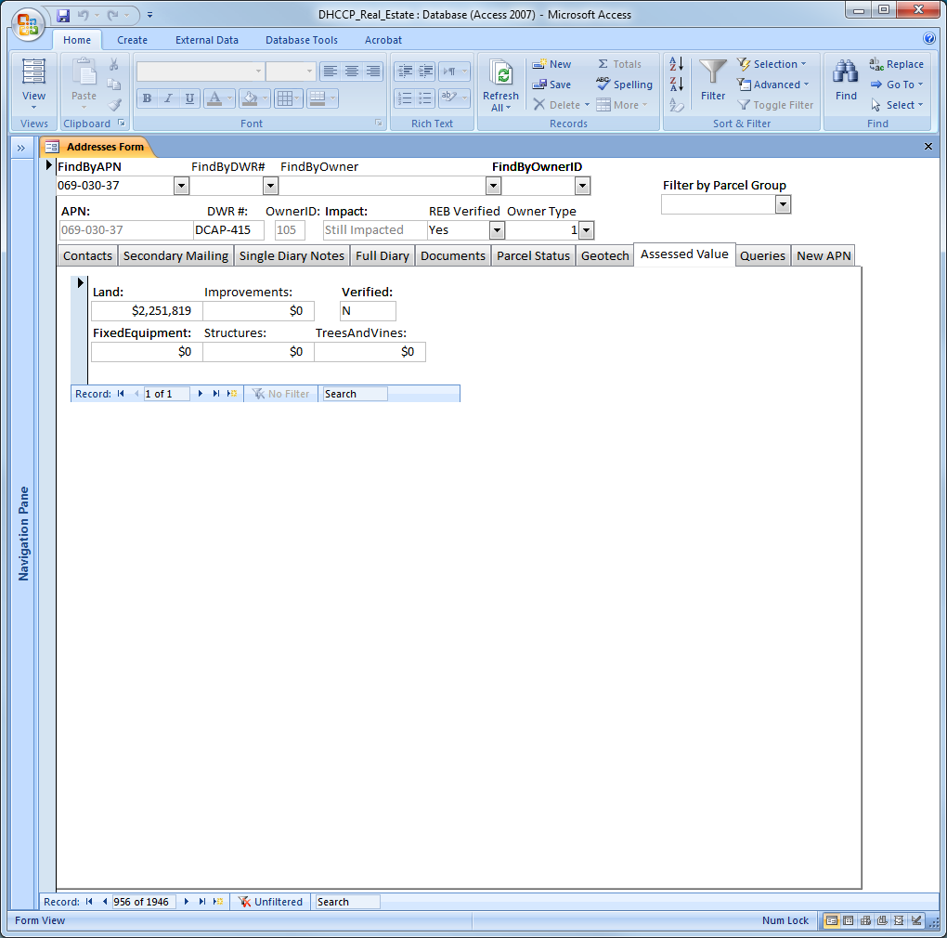
To This…
State Maintenance Area No. 9

Slide 4
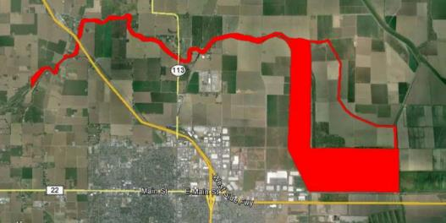
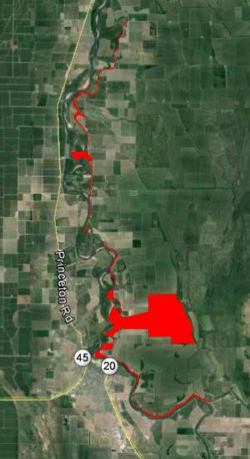
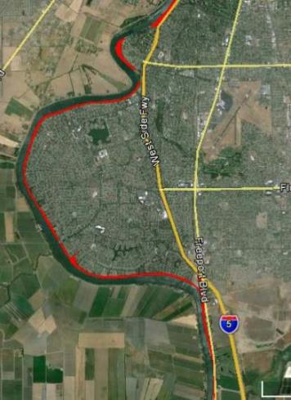
Survey Grade Projects
Working on
Proposal for
Records
Conversion
Resource Grade

Slide 5
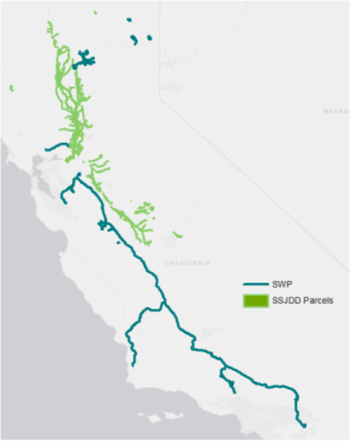
What is Accela?
- Integration of Data
- Collaboration with Clients
- Communication with Users

Slide 6
What Does Accela Bring?
Database Inventory of Land & Land Records
Interactive Parcel Layer Using Link to GIS
  Track every Project and workflow to the life and history of the parcel
Associated Land Rights
  Temporary Rights: Temporary Entry Permits
  Rights acquired: Fee, Easement
  Rights granted: Lease, Encroachment Permits (EPs), License
Relevant Document Attached
  Deed, Memorandum of Settlement, Policy of Title Insurance
*SWP only at this time. Board handing own property management.
Notes:
Searchable library of rights and projects
Reduce duplication and increase transparency among Programs

Slide 7
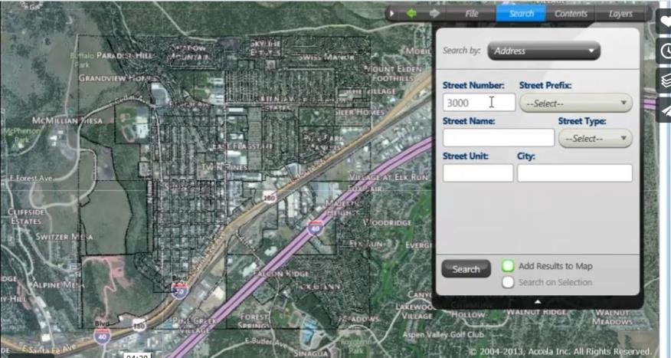
Searches…

Slide 8
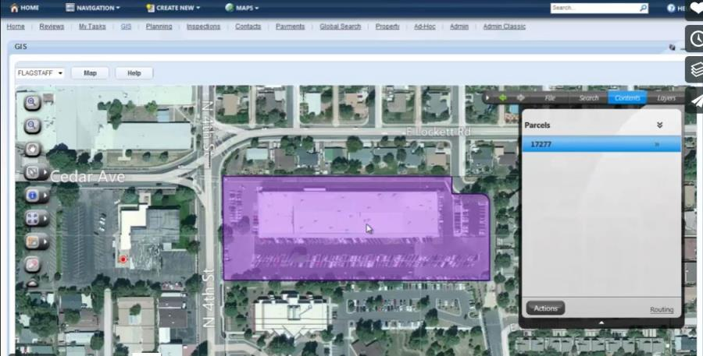
Zooms To Parcel…

Slide 9
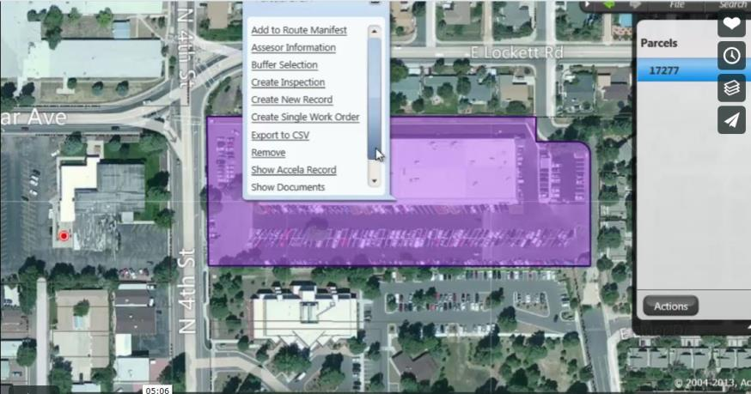
Menu of Available Information…

Slide 10
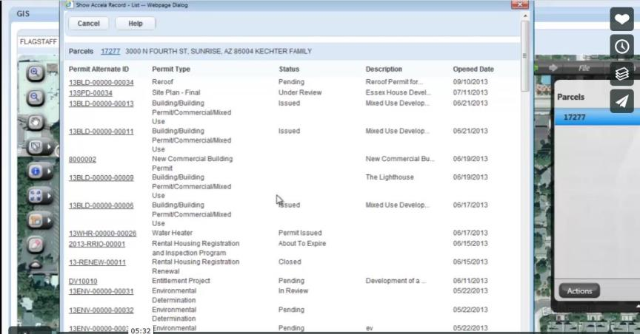
Property Record…

Slide 11
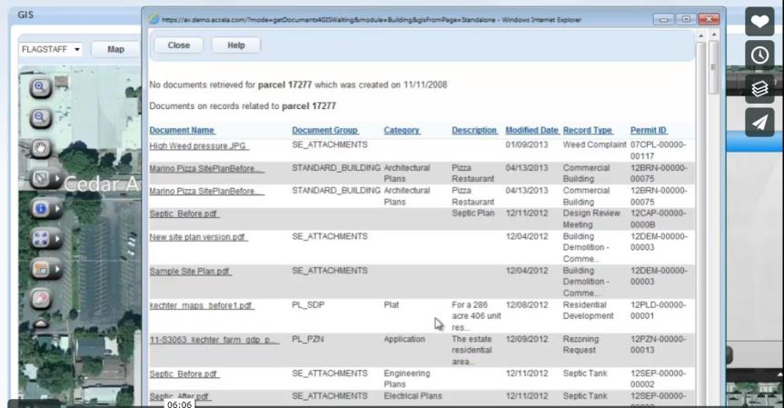
Property Documents…

Slide 12
What Does Accela Bring?
Database to monitor and track workflows
Identify and document steps in Real Estate Branch (REB) and Geodetic Branch (GB)workflows
Efficiencies in workflows
  Finding shortcuts
  Automating actions
  Identifying next steps
  Automatic notifications
  Deadline reminders
Notes:
Database to monitor and track our workflows
Identify and document steps of the workflows, find short cuts, automate actions

Slide 13
What Does Accela Bring?
Quick and easy reporting
Customizable reporting examples
  Attribute
  Workflow
  Step in Workflow
  Program
  Project
  Parcel
  Client
  Agent assigned
Accela Demo
Notes:
Ability to generate reports by a variety of variables; CVFPB to have high level reporting ability, with REB/GB more detailed and multi level reporting
Attribute eg: A report of all SSJDD fee-owned parcels in Sac Co
Workflow eg: A report of all active Temporary Entry Permits
Step in Workflow eg: A report of all acquisitions in the Appraisal step for X Project
By Program/Project eg: A report of Final Accounting Packages for EIP, TRLIA, Upper Yuba
Parcel eg: A report of the life of Parcel No. 12345 from Temporary Entry Permit during pre-project surveys, through Acquisition workflow
Client: A report of all work related to DFM
Agent Assigned = internal REB/GB workload tracking tool

Slide 14
What will this Accela build do for you?
View SSJDD property right information (database inventory)
View CVFPB Acquisition Project status
Workflow tracking REB & GB perform on behalf of CVFPB
  SSJDD Acquisitions
Notes:
CVFPB will be a client with viewable permissions
REB/GB will build workflows in support of those actions we perform on behalf of SWP and CVFPB

Slide 15
What will this Accela build NOT do for you?
Ability to manipulate property right information
Ability to modify workflows beyond REB & GB
  CVFPB EP workflows
Notes:
Geodetic/REB are only imputers into database in this build
Typically REB/GB have no role currently in CVFPB EP workflows, therefore no CVFPB EP workflows will be created and tracked in this build

Slide 16
Phase II build / add-ons (Future)
How users outside REB/GB will interface with the database
Accommodate workflows of others outside REB/GB
  CVFPB EPs
Notes:
Workflows outside REB/GB will need to be developed and created by those users, to be added on to the current build

Slide 17
Questions?

