Slide 1
Hydraulic Screening and Analysis Needed for USACE Review
Greg Kukas, P.E.
Chief, Hydrology and Hydraulics Branch
U.S. Army Corps of Engineers (USACE), Sacramento District
July 25, 2014

Slide 2
Overview
USACE role
Encroachment permit review process
Hydraulic analysis review
Risk impact assessment
Thresholds used
Screening-level analysis approach
Additional analysis requirements
Concerns and challenges

Slide 3
USACE Role
Why does USACE review CVFPB permits?
As a requirement of:
Project Partnership Agreements & O&M manuals
33 USC 408
33 CFR 208.10
To assure ongoing performance of a federal project – i.e. acceptable flood risk impacts of proposed ‘encroachments’

Slide 4
Encroachment Review Process
How does USACE fulfill its role?
Geotechnical engineering review – assures the integrity of effected levees
Assess flood risk impacts of the encroachment
Hydraulic analysis review: verify the hydraulic changes expected to result from an encroachment
Flood risk impact assessment: evaluate the acceptability of those changes from flood risk perspective

Slide 5
Hydraulic Analysis Review
Fundamental concerns:
Representative flow condition considered?
Appropriate modeling tool and approach applied for the encroachment scenario?
Sufficient detail used?
Results accurate?

Slide 6
Hydraulic Analysis Review
Representative flow conditions:
Required:
Original 1955/57 project design flows or
O&M Manual specified flow
Supplemental:
Published 1/100 and/or 1/200 annual chance exceedance flows (i.e. “100-yr” or “200-yr” floods)
USACE hydrology study
FEMA base flood

Slide 7
Hydraulic Analysis Review
Standard hydraulic modeling procedures:
Select appropriate, relatively current model*
Multiple sources: Corps, DWR, Consultants
Multiple platforms: HEC-RAS, RMA2, FLO-2D, TuFlow
Multiple versions accepted
Refine model in vicinity of the proposed encroachment represent current condition
Revise model to reflect ‘encroached’ conditions
Physical obstructions: geometry changes
Vegetative conditions: roughness coefficients
Operational assumptions: debris loading
Compare results
* - Key assumption: current conditions used as a baseline

Slide 8
Hydraulic Analysis Review
Key hydraulic results:
Water surface elevations (i.e. flood stages)
Flow velocities and shear stress (relates to erosive force)
At locations of maximum increase
Usually located just upstream of the project
Diminish in upstream direction
Adjacent to levees or floodwalls
Notes:
Highway traffic analogy

Slide 9
Flood Risk Impact Assessment
How do hydraulic changes effect flood risk in the federal/state system?
Risk = probability x consequences
Flooding probability factors:
Hydrology & hydraulics – frequency of flows with flooding potential
Levee performance – factors: slope/stability, seepage, erosion, maintenance, flood fighting, visibility, etc.
Flooding consequence factors:
Population & damageable property
Critical infrastructure and egress routes
Floodplain depths & warning times
Available freeboard
Answer: it varies depending on setting-specific factors
Notes:
Models available to more completely assess flood risk are cost-prohibitive and have their own limits.
USACE risk analysis requirement imposed on Section 408 permit situations is not applied.

Slide 10
Flood Risk Impact Assessment
How do we assess how hydraulic changes affect flood risk associated with the federal/state system?
Recognize the reliability of computed hydraulic effects
Treat all settings as equal
Apply professional judgment
Adopt a prudent threshold criteria to account for the uncertainties and simplifying assumptions involved
Assume negligible increase in flood risk if maximum increase in flood stage < 0.1’

Slide 11
Flood Risk Impact Assessment
Why does USACE use 0.1’ as its acceptance threshold?
It’s significantly less than the levee freeboard values incorporated into the design of the system
It mitigates the potential for significant cumulative effects
It’s comparable to the effects of the natural and dynamic characteristics of our system
Because greater flood stage increases may be determined acceptable on a case by case basis with additional analysis and/or evaluation

Slide 12
Screening-level Analysis
Simplified approach developed by USACE:
For physical obstructions, if blocked area is < 1% of total cross-sectional area:
Negligible flood risk increase is assumed
No hydraulic analysis is required
Supported by USACE-conducted hydraulic analysis
Allows most truly minor encroachments to pass a “common sense”-type test with little less effort

Slide 13
Additional Analysis Requirements
Detailed in USACE July 21, 2014 letter to CVFPB
Closely coordinated with CVFPB staff
Formalizes screening process and criteria
Establishes 30-day window for USACE to request additional info
Specifies debris loading assumptions for vertical blockage elements (e.g. bridge and dock piers)

Slide 14
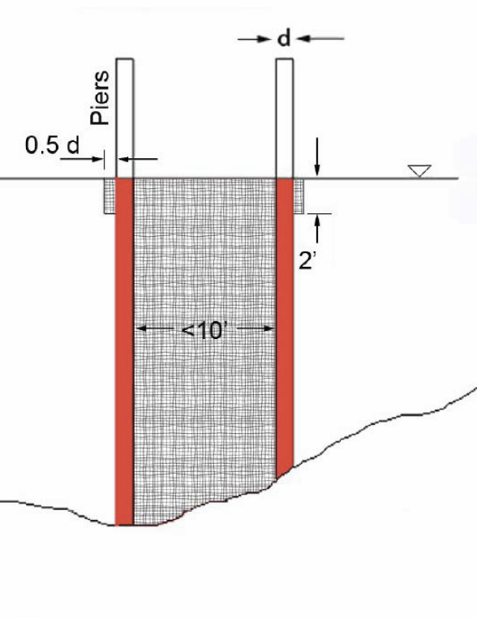
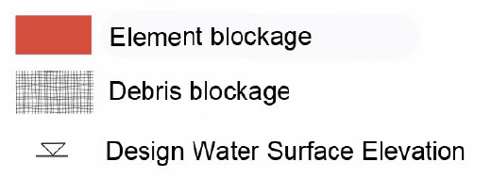
Additional Analysis Requirements
Debris loading assumptions:

Slide 15
Concerns & Challenges
Cumulative impacts
When additional info needed
Borderline results:
slightly > 1% blockage
slightly > 0.1’ stage increase
Unique physical situations
Staff turnover and other resourcing demands
Constrained funding
Notes:
DWR-developed library of models concept.

