Slide 1
Regional Permitting for the CVFPP
Presented by:
Terri Gaines
DWR FESSRO
February 28, 2014

Slide 2
Outline
What is Regional Permitting?
What is an HCP?
Feather River HCP Pilot
FAQs
2

Slide 3
What is Regional Permitting?
One large permit for multiple projects within a specified region.
More efficient process
Specifies covered activities, projects and species
Sometimes referred to as Programmatic Permitting
3

Slide 4
What is Regional Permitting?
Provides regional environmental compliance for:
ESA/CESA
F&GC Section 1600
CWA Section 404/401
NHPA Section 106
CWA Section 402
RHA Section 14
Established mitigation ratios
Established avoidance and minimization measures
4

Slide 5
ESA Section 7 vs. Section 10
Section 7
Requires a federal nexus
Faster in short term
Can be used for multi. projects similar in nature
2-5 years to complete
2-10 year duration
Does not include non-listed species
Section 10
No federal nexus required
Public review process
Multi. Projects and permittees
2-5+ years to complete/30-50 year duration
Can add future unknown projects if take limits not exceeded
‘No Surprises’ Assurances
5

Slide 6
What is a Habitat Conservation Plan (HCP)?
A planning document prepared by non-federal parties as part of an application for an Incidental Take Permit (ITP).
An HCP includes:
An assessment of the likely impacts on protected species
Measures that will be taken to monitor, minimize and mitigate for impacts
6

Slide 7
What is a Habitat Conservation Plan? (con’t.)
HCPs include:
Biological goals/objectives
Adaptive management
Monitoring plan
Long-term permit duration
Public participation
7

Slide 8
Why an HCP in general?
HCP widely used for regional permitting
A well established process, many completed
Multiple stakeholder involvement (e.g. permit holders, participating special entities)
8

Slide 9
Why use an HCP for the SPFC?
Will provide 20-30 year “take” authorization under ESA Section 10
(GGS, VELB, Salmonids, Swainsons hawk, etc.)
Will allow for multiple activities and projects (routine maintenance, non-routine maintenance, capital projects)
Will provide for public safety and ecosystem benefits
9

Slide 10
Why use HCP for the SPFC?
A Section 7 nexus is not possible for all flood
management actions (e.g. veg. removal, grouting)
Faster project approvals
“No surprises” assurances
Beyond project by project permitting
Will facilitate approvals of other permits
10

Slide 11
Consequences without Regional Permit
Business as usual which isn’t working
Continued project by project permitting
- costly, time consuming, unpredictable
Increased regulatory pressure
regarding flood management activities
Risks to public safety
11

Slide 12
CESA Compliance for Feather River HCP
2081 Permit Approach
Project is linear in nature
Less time to complete than NCCP
DWR has Right of Way Control where majority of actions and activities will occur
Agency endorsement of approach
12

Slide 13
Feather River HCP/2081
A “Pilot” for regional permitting for the SPFC
To support operations, maintenance and project construction for DWR and LMAs
Can include future (unknown) projects
Completion in 2017
13

Slide 14
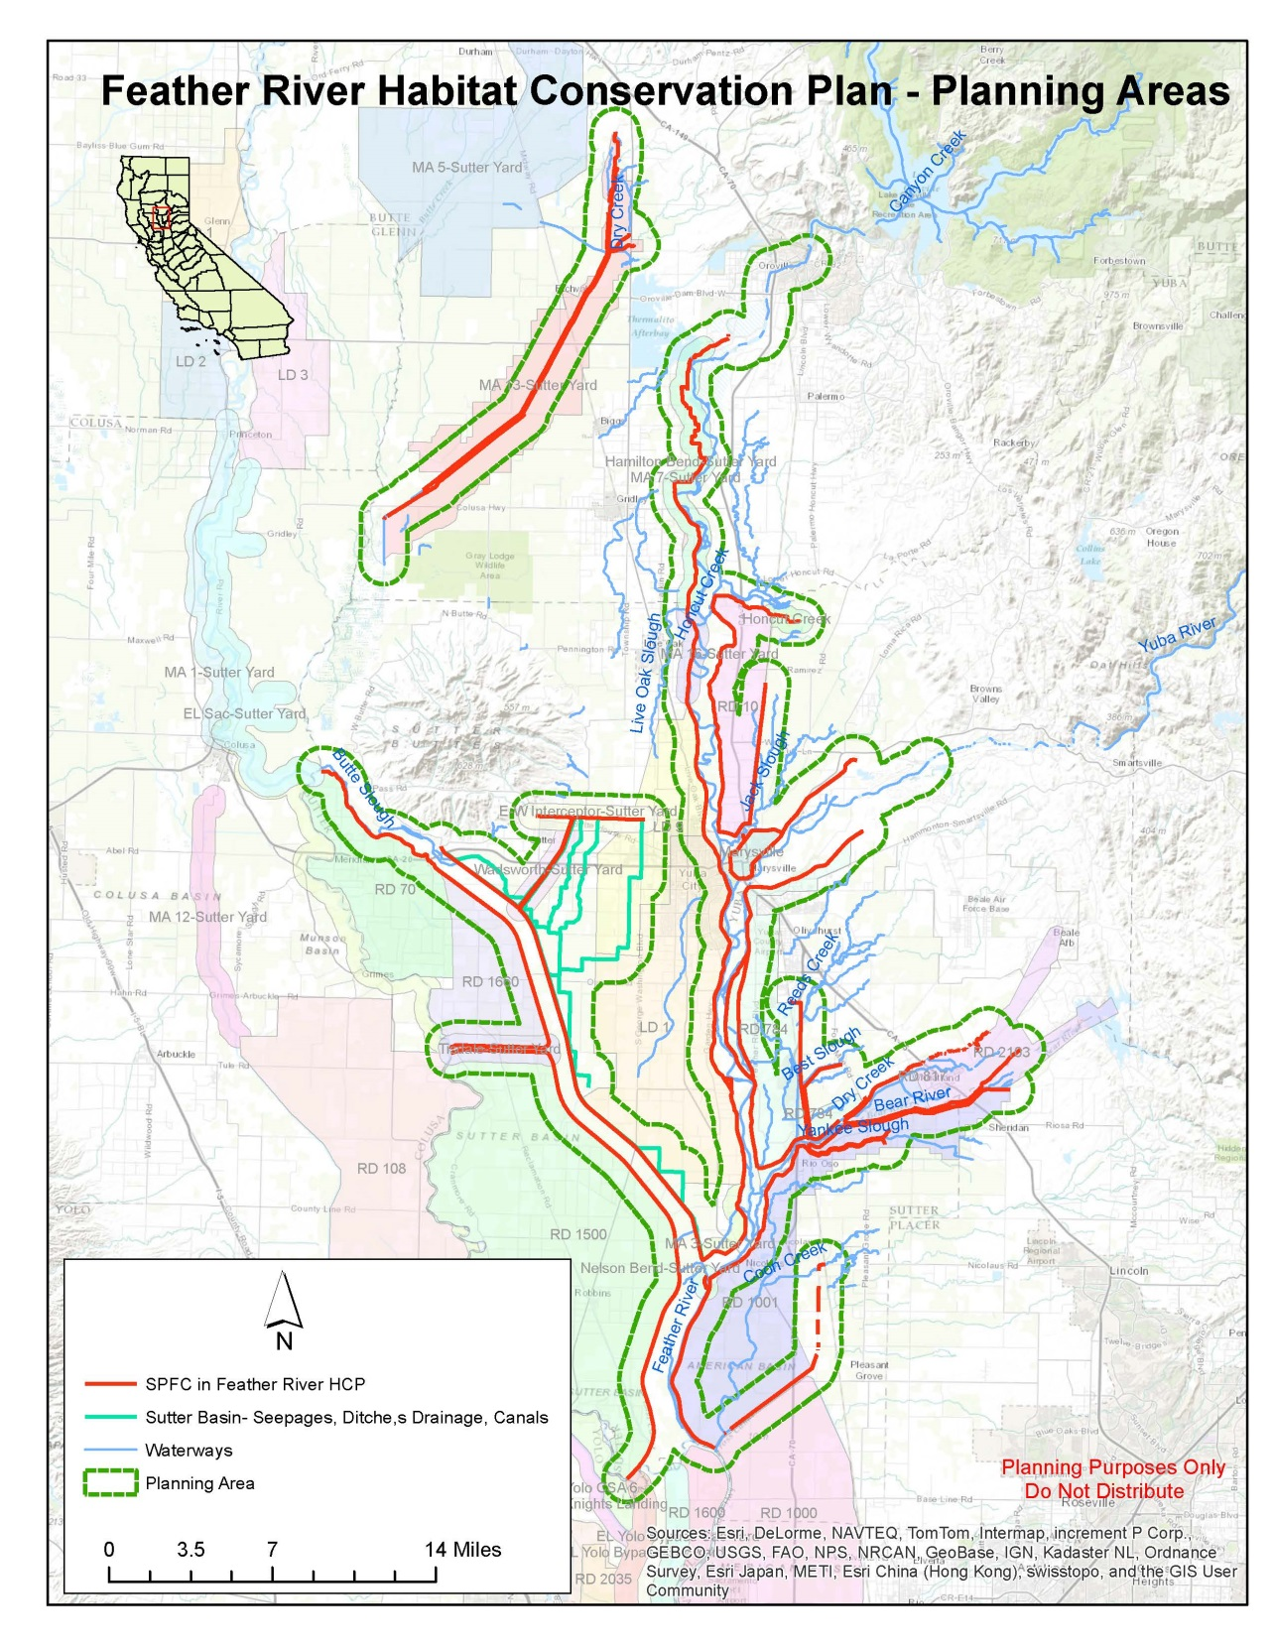
14

Slide 15
Feather River HCP/2081 Status
HCP Development Team meetings
Outreach to Locals
Technical Advisory Committees
Aquatic and Terrestrial
Steering Committee Meetings
Public Meetings
15

Slide 16
Feather River HCP/2081 Status
Refining Covered Activities and Covered Species
Refining Goals/Objectives for Fish
Baseline data
Species models
Informal Stakeholder meetings
Applying for ESA Section 6 Funds
16

Slide 17
Feather River HCP/2081 Milestones
Begin CEQA/NEPA
Admin. Draft HCP
Public Draft HCP
Final HCP/2081
Draft HCP
2014
2015
2016
2017
17

Slide 18
Questions
Questions??
18

Slide 19
FAQs
Q: Why was the Feather River chosen for this ‘pilot’ HCP?
A: - CMP Planning data/information/analyses
- Abundance of knowledge on area (LFRCMP)
- 3 other HCPs in development
- Current and recently used funds for flood related projects
- Restoration opportunities
- Vetted through the IAC and Permitting Subcommittees
19

Slide 20
FAQs
Q: Will we do HCPs throughout the system?
A: Depends…We are meeting with the Resource Agencies to brainstorm options and are talking to the other regions to assess needs and interest
20

Slide 21
FAQs
Q: Why aren’t we using systemwide improvements (bypasses) as the pilot?
A: 408 Modification will provide nexus for Section 7
Need design and project description, and we aren’t quite there yet.
Current integration efforts on design are first steps to efficient permitting.
With existing funding, must complete by 2017
21

Slide 22
FAQs
Q: Once an HCP is completed, are other permits easier to obtain?
A: Yes, chances are, the information is already there for other permits to draw from and current agency involvement helps with this process.
22

Slide 23
FAQs
Q: How will we use existing HCPs for
flood mitigation needs?
A: We are working with HCPs that are still in early stages of planning so they can include flood activities, can coordinate for off-site mitigation, can share data and analyses
23

Slide 24
FAQs
Q: What are specific challenges to successful implementation of regional permitting for the SPFC?
A: - LMA participation
- perceptions on “need” for permitting
- LMAs lack funds for compliance
- Lack of enforcement
24

Slide 25
FAQs
Q: How can we complete the Pilot HCP in 3 Years?
A: Dedicated FESSRO funds
- Funding Wildlife Agency Staff participation
- Continued evaluation of project scope
25

Slide 26
FAQs
Additional
Questions?
26

Slide 27
Take Home Messages:
Programmatic/Regional permitting is more efficient than project by project permits, and will provide long-term coverage
An HCP/2081 within the Feather River region will meet the future maintenance and project needs of DWR and LMAs who participate
Will use Feather Pilot to inform Regional Permitting for the remainder of the SPFC
27

Slide 28
The End
Thank You!
28

