Slide 1
Rural Levee Repair Guidelines
Informational Briefing on Rural Levee Repair Guidelines
Central Valley Flood Protection Board Meeting
January 10, 2014
Dave Wheeldon, Flood System Sustainability Branch Chief
Department of Water Resources, Division of Flood Management

Slide 2
Resolution No. 2012-25. Section 11 (h)
The Board will create an advisory committee, or other appropriate group, working with DWR, local maintaining agencies, interested stakeholders, and the USACE to develop rural levee repair and improvement criteria, to be applied to planned or emergency work. The Board intends for the advisory committee or group to produce draft criteria to be available by July 1, 2013.

Slide 3
RLRG Framework
Applies to non-routine maintenance or repair activities of rural levees.
Does not apply to new levee construction.
Develop a ‘template’ or ‘guidebook’ approach to streamline project implementation.
Will not define a specific level of protection for rural levees, and will not change Title 23 or USACE 408 requirements.
Reduce site specific flood risk at critical locations.
1
2
3
4
5
Notes:
Key principles guiding the development of RLRG

Slide 4
Diverse Work Group Membership
DWR: Flood Maintenance Office, FESSRO, Legal
DWR Support: CSUS Center for Collaborative Policy, MWH, URS
CVFPB: Joe Countryman and Ali Probaha (staff)
USACE: Mary Perlea, Ryan Larson
Industry: PMA Sacramento, GEI Consultants, NV5 Inc., MBK Engineers, HDR, Hartmann Law Firm, Baack & Veatch Corp., DCC Engineering, Peterson Brustad, Inc., Storesund Consulting, Mead & Hunt, Inc., Hultgren-Tillis Engineers,
NGO: John Cain, American Rivers; Julie Rentner, River Partners
LMA: RD 108, Lower San Joaquin Levee District, RD 2092, RD 1500
Notes:
FloodSAFE Email Blast on March 7, 2013 for work group participants
3000 recipients from industry, regulatory agencies, state and federal agencies, DWR

Slide 5
Outreach During RLRG Development
CVFPB: Status Updates at two Board Meetings
Coordinating Committee: Status update provided at two CC meetings
Interagency Flood Management Collaborative: Status updates provided at two IFMC meetings
FloodSAFE Newsletters: Program information, status updates have been included in several FS newsletters.
DWR RLRG Website: Website frequently updated, including information on work group participation, interested parties, project charter and draft RLRG document.
Interested Parties and Work Group emails: Frequent notices to WG members and IPs on status and upcoming meetings.
Numerous Status Updates: DWR monthly report to CVFPB, report to Resources Agencies and Governors Office.

Slide 6
Current Status of RLRG Document
RLRG Document has been developed through the working group process which included DWR, local maintaining agencies, interested stakeholders, and USACE.
RLRG Status updates and informational briefings have been conducted throughout the development process.
RLRG has undergone DWR internal and external Key Stakeholder Review
Work Group has prepared Draft RLRG per CVFPB resolution 2012-25 11(h)
Notes:
We do not anticipate another WG meeting at this time

Slide 7
Key Components of RLRG Document
General Guidance:
Environmental Stewardship
Local Conditions
Application of Existing Law and Regulations
Delta Levees
Standard Levee Repair Descriptions and Templates
Erosion
Underseepage
Through Seepage
Slope Stability
Crown Depression
Notes:
We do not anticipate another WG meeting at this time

Slide 8
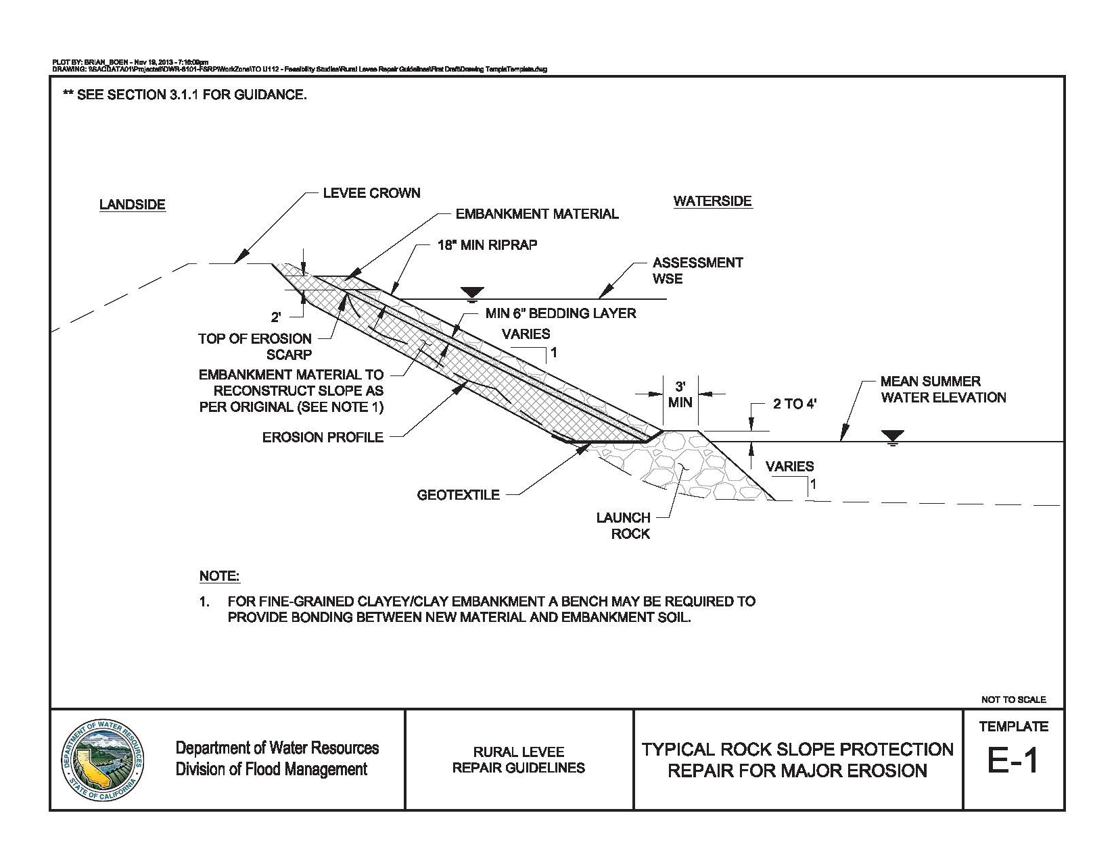
Sample RLRG Levee Repair Template
Notes:
Not design level
Not to scale

Slide 9
How Will RLRG be Used?
This Rural Levee Repair Guidelines document is anticipated to be used by the following entities:
Assists Rural Reclamation Districts to implement levee repairs.
DWR Flood System Repair Program (FSRP) participants will likely implement RLRG based designs.
Provides Design guidance for LMAs outside of the SPFC.
Regional Planning groups can encourage RLRG repairs for use in rural leveed areas.

Slide 10
Document Review – DWR and External
DWR Internal Reviews:
Flood Maintenance Office Staff
DFM Senior Management and Legal
External Reviews:
Central Valley Flood Control Association
State Farm Bureau Federation
Coordinating Committee Members
Work Group Members affiliations and Interested Parties
External review resulted in comments from the following:
California Department of Fish and Wildlife
County of Lake, CA
Ventura County Watershed Protection District
Notes:
The following stakeholders were given the opportunity to review the draft RLRG document.
Coordinating Committee will be briefed on Jan 22, 2014

Slide 11
Summary of Key Comments
Thomas R. Smythe, County of Lake Water Resources
COMMENT: The details showing fill placement against the existing levee prism for erosion repair, seepage and slope stability do not show the fill being “benched” into the existing levees.
RESPONSE: Some of the templates showed benching in the repair section, while others mentioned it in accompanying notes. The templates and text will be modified to be consistent and to re-iterate the need for keying into the adjacent slope.
California Department of Fish and Wildlife
COMMENT: Identify the specific or most likely requested requirements by permitting agencies to assist the LMAs in project planning and implementation.
RESPONSE: As the RLRD is intended as a preliminary design guide, it is beyond the scope of the document to identify specific permitting requirements. However, text will be added to the Environmental Stewardship section encouraging the LMA to engage the permitting agencies as early as possible.
Notes:
Many of the comments received were editorial, or required simple changes to the document not significant enough to be discussed here. These summarized comments reflect issues important enough to point out our responses.

Slide 12
Summary of Key Comments
California Department of Fish and Wildlife (continued)
COMMENT: Include specific language about aquatic ecosystems of concern within the levee footprint; management, protection and restoration of Shaded Riverine Aquatic habitat and levee vegetation; and native plant species.
RESPONSE: It is beyond the scope of the document to identify specific environmental enhancement measures such as these. Early engagement with the permitting agencies will identify these measures appropriate to the site specific work proposed. Language to this effect will be added to the environmental stewardship section.
COMMENT: Coordination with permitting agencies early in project planning will improve project efficiency and reduce costs associated with permitting and mitigation for environmental impacts.
RESPONSE: Text will be added to the Environmental Stewardship section encouraging the LMA to engage the permitting agencies as early as possible, describing the potential benefits to doing so.

Slide 13
Summary of Key Comments
California Department of Fish and Wildlife (continued)
COMMENT: The causes of the different levee distress mechanisms should be investigated as part of the repair process.
RESPONSE: Text will be added to the introduction to Section 3 suggesting the cause of the distress should be investigated, if possible, to identify any avenues to reduce future problems.
COMMENT: Were in-water repair alternatives such as bendway weirs, rock vanes or bio-technical measures considered?
RESPONSE: The RLRG describes commonly used repair alternatives. While the use of additional repair alternatives is not precluded by the RLRG, features such as these were not considered as they are not frequently used, would likely require additional technical analysis, and have questionable effectiveness.
Notes:
Other comments not listed here related to conservation easements, not letting CDFW be a part of the WG, application to multi-benefit projects,

Slide 14
Next Steps
Finalization of the Rural Levee Repair Guidelines will include:
Received comments will be addressed and incorporated as necessary into the final document.
Finalized RLRG and key comments summary will be posted on DWR Website, announced through FloodSAFE newsletter and distributed to WG members, CVFPB Members, Key Stakeholders, DFM Management, and Coordinating Committee members.

Slide 15
Acknowledgements
DWR would like to acknowledge the following individuals who, in addition to the Work Group Members, provided valuable and effective support to the RLRG development process:
Adam Sutkis and Orit Kalman, CSUS Center for Collaborative Policy
Khaled Chowdrey, Brian Boen and Rich Millet, URS Corporation
Yung-Hsin Sung and Mary Jimenez, MWH

Slide 16
KEY CONTACT INFORMATION:
http://www.water.ca.gov/floodmgmt/fmo/rlrc/
RLRC@water.ca.gov
DWR: David J. W. Wheeldon, P.E.
(916) 574-1243
Dave.Wheeldon@water.ca.gov
http://www.water.ca.gov/floodmgmt/fmo/rlrc/

Slide 17
RLRG Levee Repair Descriptions
Section 3 contains descriptions and guidance for implementation of Common Levee Distress Repair Alternatives identified in the RLRG.
Repair type descriptions contain the following information:
Major Levee Repair Type (e.g. Erosion)
Repair Sub-Category (e.g. RSP for Major Erosion)
Applicability
Major Activities
Implementation Guidance
Notes:
Major Levee Repair Type (Erosion)
Repair Sub-Category (RSP for Major Erosion)
Applicability
Major Activities
Implementation Guidance

Slide 18
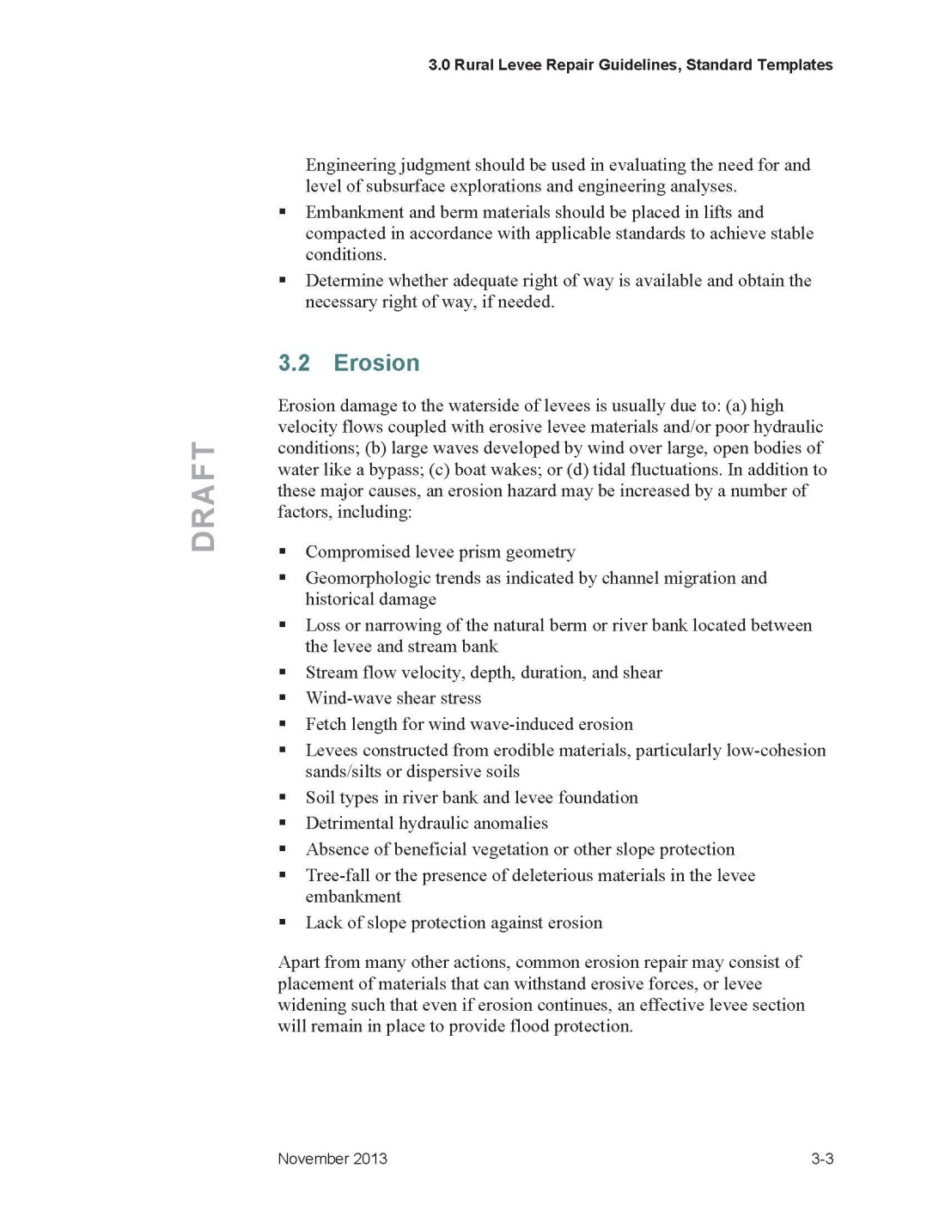
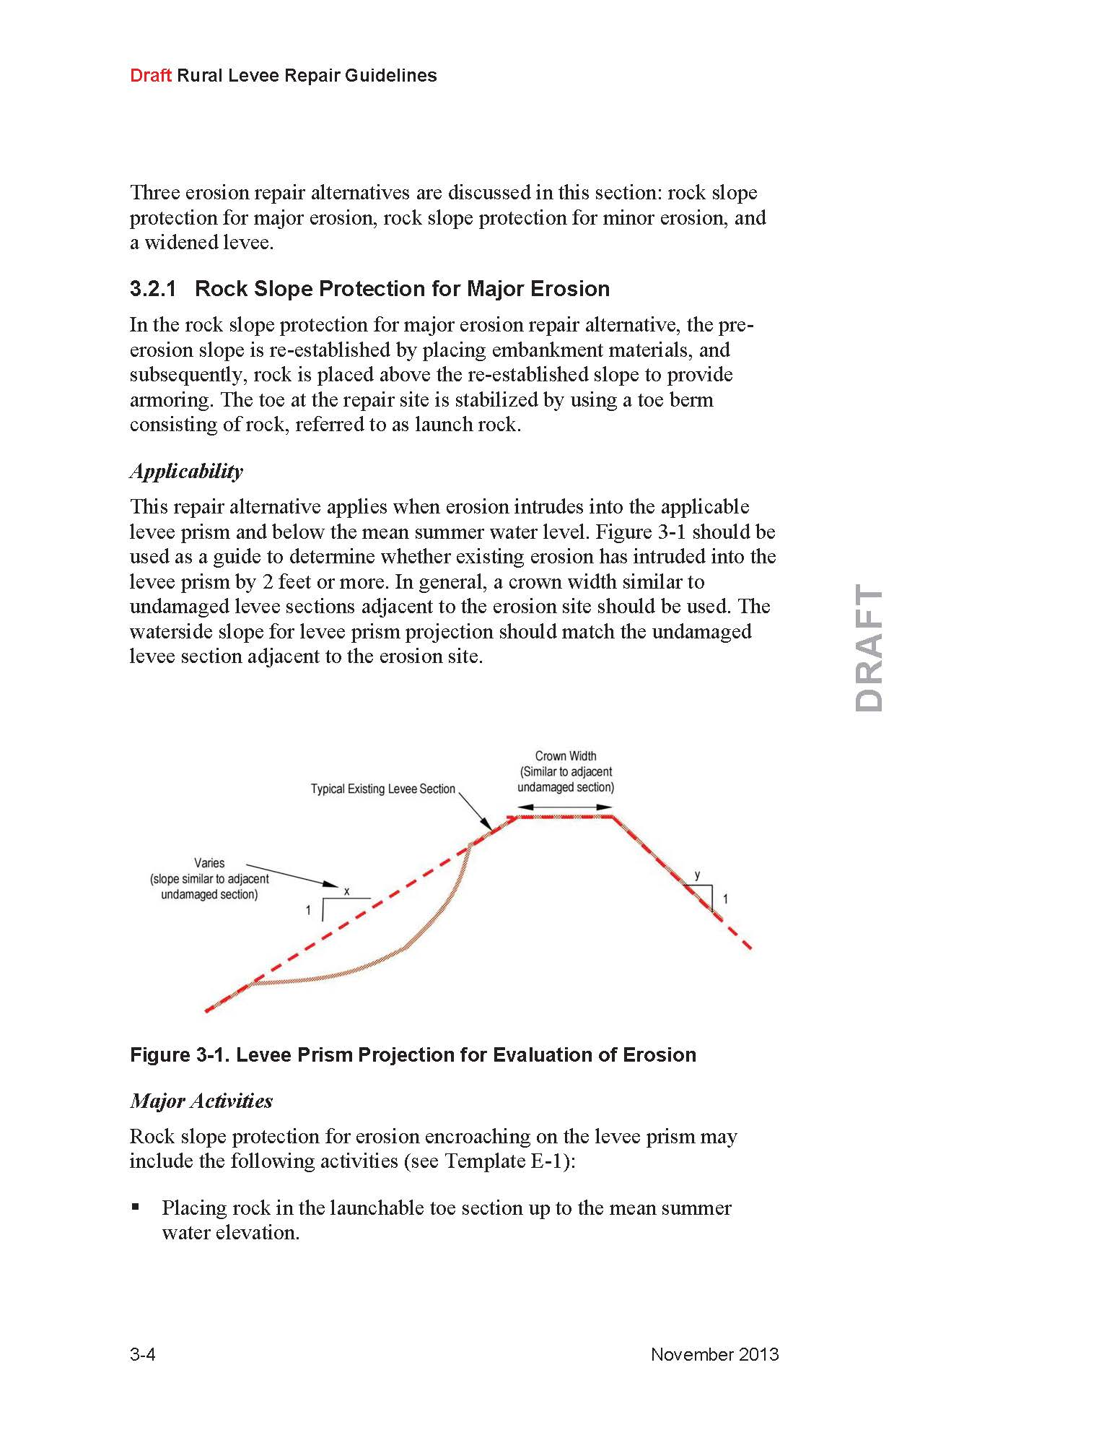
Sample RLRG Levee Repair Description
Notes:
Major Levee Repair Type (Erosion)
Repair Sub-Category (RSP for Major Erosion)
Applicability
Major Activities
Implementation Guidance

Slide 19
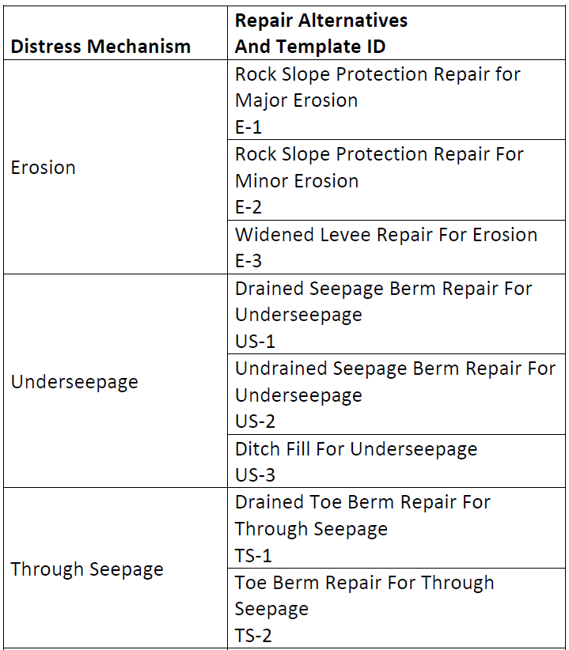
Repair Alternatives for Common Distress

Slide 20
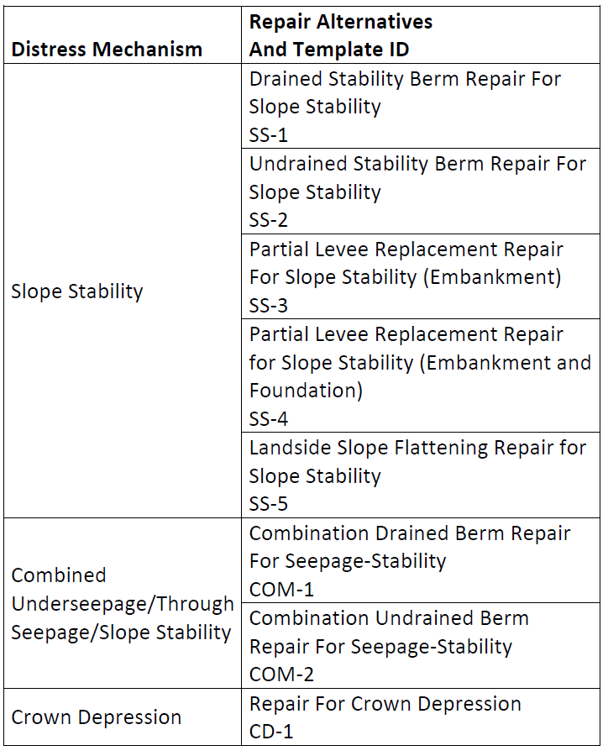
Repair Alternative for Common Distress (contd.)

