Slide 1
CVFPB MEETING – July 25, 2014
AGENDA ITEM 12-A
Resolution 2014-25
Application No. 18882
Abbott Lake Restoration Project
Applicant: California Department of Fish and Wildlife

Slide 2
BOARD ACTION
Consider Adoption of Resolution No. 2014-25 and Approval of Permit No. 18882 to:
Remove invasive vegetation from 96-acres and plant approximately 17,341 plants to include woodland, shrubland, and grassland on 150-acres of the 439-acre Abbott Lake Unit of the Feather River Wildlife Area on the right (west) overflow bank of the Feather River near River Mile 20.

Slide 3
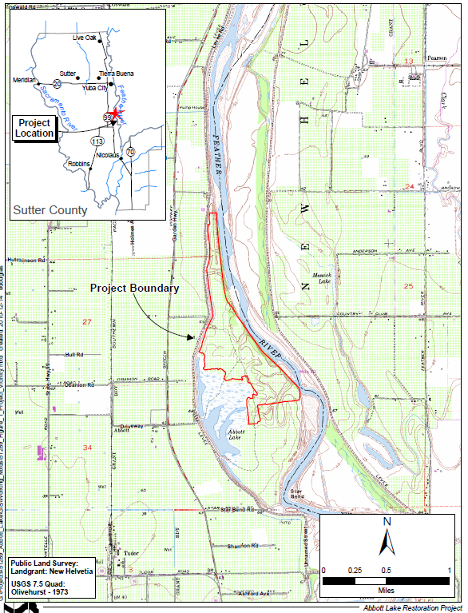
PROJECT VICINITY MAP
Project site is located:
Approximately 7-miles south of Yuba City and 1.5-miles east from the intersection of Highway 99 and Obanion Road.
Abbott Lake is one of five Units of the Feather River Wildlife Area that is owned and managed by the CDFW.

Slide 4
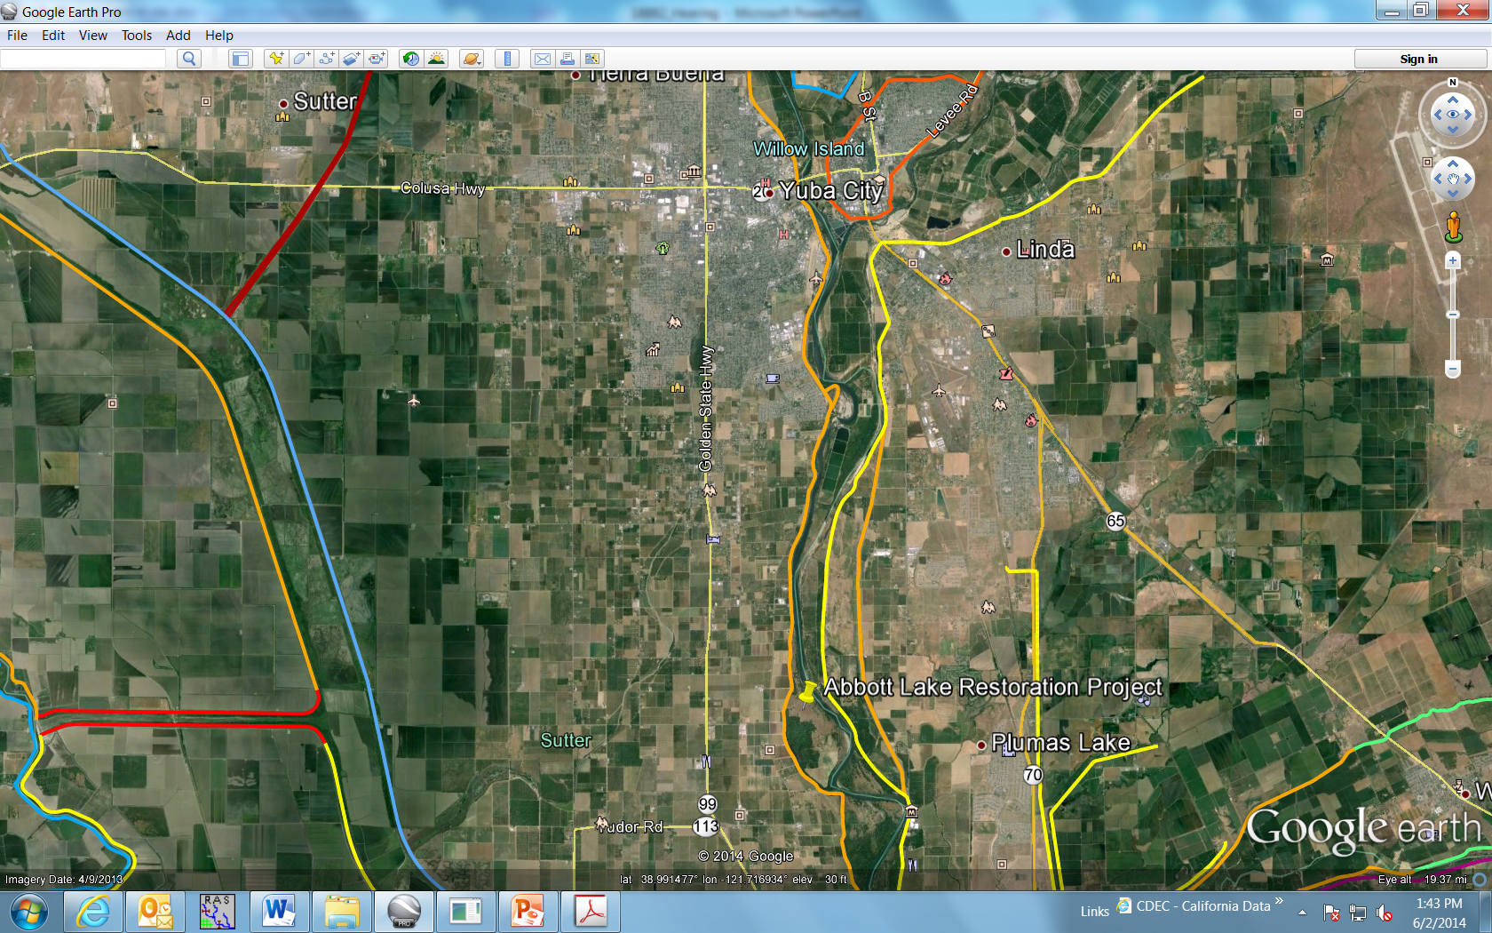
AERIAL VIEW

Slide 5
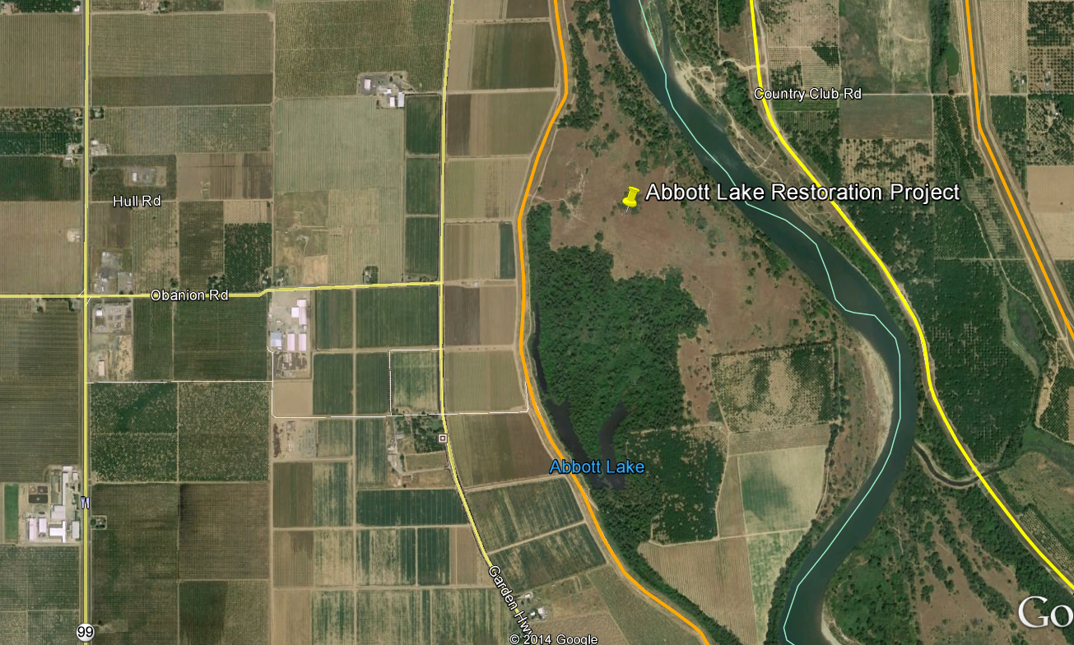
PROJECT LOCATION

Slide 6
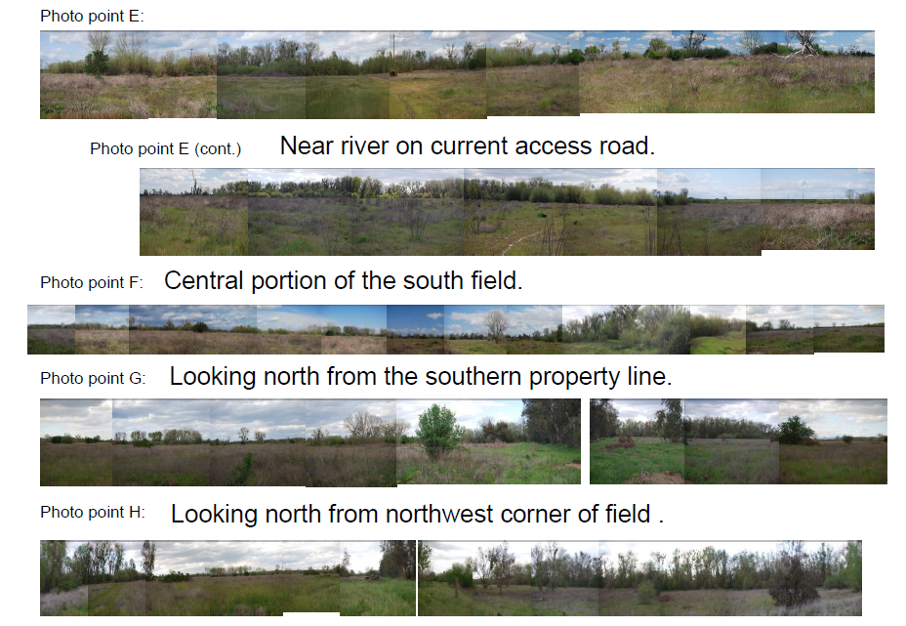
PROJECT SITE PHOTOGRAPHS

Slide 7
PROJECT ANALYSIS
The project site is located across the river from the left (east) bank levee setback project that was completed by TRLIA in 2009 and 2010 and immediately upstream from the Star Bend setback levee ;
The 150-acre restoration site consists of abandoned agricultural lands;
Restoration of Abbott Lake will include the removal of invasive vegetation and the planting of approximately 17, 341 plants to include woodland, shrubland, and grassland varieties;
Flood control was considered in the design of the planting plan;
Rows will be oriented parallel to flood flows;
100-foot spacing between every fifth row of low shrub;
35-acres of native grassland areas;
No plantings within 60-feet of the waterside levee toe, 100-feet for trees;
There are three (3) SSJDD easements on the proposed site that allow for the clearing of vegetation to facilitate the free flow of water. LD-1 of Sutter Co. is identified as a co-grantee on one of the easements.

Slide 8
PROJECT ANALYSIS
CDFW has coordinated with River Partners who will execute the maintenance schedule for the three year establishment period that is detailed in the Vegetation Management Plan and includes;
Watering;
Controlling weeds through the use of herbicides and mowing;
Monitoring to ensure a 70% survival rate;
Periodic mowing to reduce potential fire risks;
Removing all equipment prior to flood season;
Removing debris following the flood season.

Slide 9
PROJECT ANALYSIS
CDFW will maintain the site as designed following the three year establishment period per the following:
The Vegetation Management Plan submitted by CDFW which will be attached to the permit as Exhibit A, includes:
Consultation with LD-1 and DWR at least annually,
Invasive weed spraying and tree pruning as needed,
Monitoring with annual photo-updates.
Special Condition TWENTY-EIGHT - requires removal of all woody species greater than three (3) inches in diameter within the designated grassland areas, the 60-foot levee buffer zone, and the 100-foot hedgerow spacing for the low shrub community;
Special Condition TWENTY-NINE – requires removal of elderberry plants within the 60-foot levee buffer zone prior to the stems reaching one (1) inch in diameter at ground level .

Slide 10
HYDRAULIC ANALYSIS
A two dimensional hydraulic model (RMA2), was used to assess the potential hydraulic impacts from the project;
Both the 19-acre north field and the 150-acre south field were included in the 2009 analysis;
The 1-in-100 event (281,000-cfs) and 1-in-200 event (353,000-cfs) were modeled. The 1957 USACE project design flow is 300,000-cfs;
The analysis resulted in a localized water surface elevation increase in of approximately 0.15 feet for both the 1-in-100 and 1-in-200 events, most of the impacts were due to the changes in the north field;
There was no significant increases in water velocity for either event.

Slide 11
AGENCY COMMENTS/ENDORSEMENTS
The Department of Water Resources Flood Maintenance Office (FMO)/Sutter Maintenance Yard has endorsed the project with conditions; these conditions will be incorporated into the permit as Exhibit B.
Levee District 1 – Sutter has endorsed the project with conditions; these conditions will be incorporated into the permit as Exhibit C.
The U.S. Army Corps of Engineers no-objection letter has been received for this application. The USACE District Engineer has no objection to the project, subject to conditions which will be incorporated into the permit as Exhibit D.

Slide 12
8610.5 CONSIDERATIONS
Admission of Records
The Board will make its decision based on the evidence in the permit application and attachments, the staff report, and any other evidence presented by any individual or group.
Use of Best Available Science
The accepted industry standards for the work proposed under this permit as regulated by Title 23 have been applied to the review of this permit.
Effects on the State Plan of Flood Control
There will be no adverse effect to the entire State Plan of Flood Control as the hydrologic impacts from the proposed project are considered to be insignificant. The project site will be managed by the California Department of Fish and Wildlife for both habitat benefits and to ensure that there are no negative hydraulic impacts due to the project. The proposed project is compatible with the Central Valley Flood Protection Plan as it will promote ecosystem functions which are a supporting goal of the Central Valley Flood Protection Plan.
Effects of Reasonable Projected Future Events
There will be minimal impacts to the proposed vegetation from reasonable projected future events.

Slide 13
STAFF RECOMMENDATION
Staff recommends that the Board:
Adopt, in substantially the form provided:
Draft Resolution No. 2014-25, including the CEQA findings and Water Code 8610.5 Considerations.
Approve, in substantially the form provided:
Draft Permit No. 18882
Direct the Executive Officer to:
Take the necessary actions to prepare and execute Permit No. 18882; and
File a Notice of Determination pursuant to CEQA with the State Clearing House.

Slide 14
QUESTIONS
Presented by: Gary W. Lemon P.E.
CVFPB, Staff

