Slide 1
Sutter Butte Flood Control Agency (SBFCA) Feather River West Levee Project (FRWLP) Project Areas B and D, Sutter and Butte Counties February 28, 2014
APPLICATION NOS. 18793-2 and 18793-3

Slide 2
BOARD ACTION (1 of 2)
Consider approval of Permit No. 18793-2 (Project Area B) to: construct approximately 6.1 miles of levee improvements on the west levee of the Feather River (Reaches 7 through 12) from Station 512+00 to 832+40, including the following proposed work:
degrading of the levee by approximately one third of its overall height;
construction of a cutoff wall (47 to 78 feet in depth) along the levee centerline;
reconstruction of the levee;
installation of 28 new relief wells between Station 543+60 and 568+30;
reconstruction of approximately 3,100 linear-feet of an existing concrete relief well drainage ditch;
construction of an additional 2,500 linear-feet of new concrete relief well drainage ditch;
and correction of various encroachments which do not comply with California Code of Regulations, Title 23

Slide 3
BOARD ACTION (2 of 2)
And Consider approval of Permit No. 18793-3 (Project Area D) to: construct approximately 11.4 miles of levee improvements on the west levee of the Feather River (reaches 29 through 41) from Station 1765+00 to 2368+26, including the following proposed work:
degrading of the levee by approximately one third of its overall height;
construction of a cutoff wall (17 to 99 feet in depth) along the levee centerline;
reconstruction of the levee;
construction of seepage berms from 100 to 170 feet in width;
and correction of various encroachments which do not comply with California Code of Regulations, Title 23

Slide 4
AUTHORITY OF THE BOARD
California Code of Regulations, Title 23, Division 1 (Title 23)
§ 6 – Need for a Permit
§ 11 – Variances
§ 12 – Protests
§ 13 – Evidentiary Hearings
§ 108 – Existing Encroachments
§ 112 – Streams Regulated and Nonpermissible Work Periods
§ 116 – Borrow and Excavation
§ 120 – Levees
§ 121 – Erosion Control
§ 123 – Pipelines, Conduits, and Utility Lines
§ 124 – Abandonment of Pipelines
§ 128 – Bridges
§ 130 – Patrol Roads and Access Ramps
California Water Code, Division 5, Part 4, Chapters 3 and 4
Rivers and Harbors Act of 1899, Title 33, § 408 (Section 408)

Slide 5
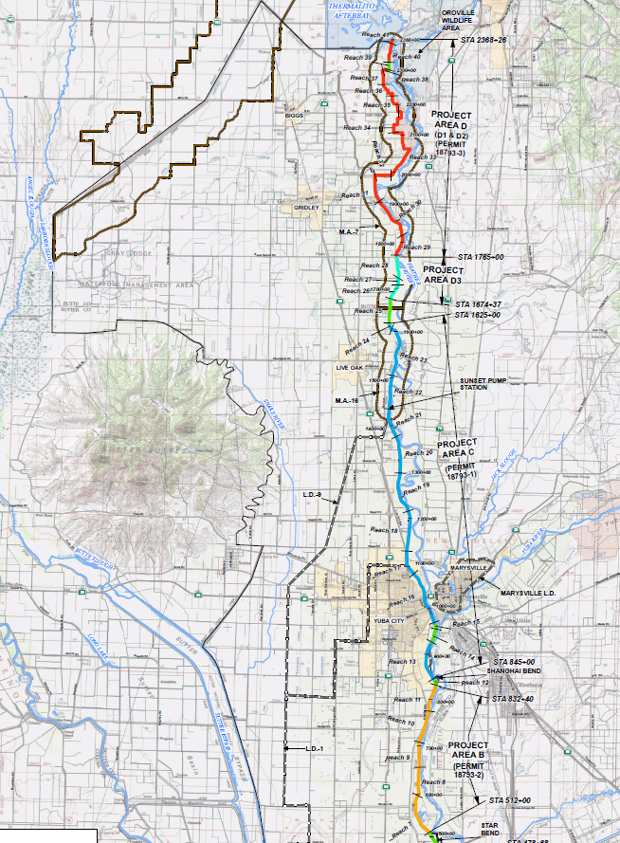
PROJECT LOCATION
Thermalito Afterbay
The FRWLP extends from:
Thermalito Afterbay downstream 41 miles to a point 3.5 miles north of the Feather River’s Confluence with the Sutter Bypass
Project Area B (approx. 6.1 miles) south of Yuba City
from Shanghai Bend to Star Bend, in Sutter County
Project Area D (approx. 11.4 miles)
from Gridley upstream to the Thermalito Afterbay, in Butte County
Project Area D
FRWLP
Gridley
Previously permitted Project Area C (18793-1)
Yuba City
Project Area B
3.5 miles north confluence

Slide 6
COMMENTS & ENDORSEMENTS
Project Area B
U.S. Army Corps of Engineers (USACE) Washington DC headquarters Section 408 Record of Decision (ROD) – September 13, 2013 (Exhibit A)
USACE Sacramento District Letter of Permission (LOP) – anticipated late February (Exhibit B)
LD 1 Endorsement (Exhibit C)
Project Area D
USACE Washington DC headquarters Section 408 ROD – September 13, 2013 (Exhibit A)
USACE Sacramento District LOP – anticipated late February (Exhibit B)
MA 7 Endorsement (Exhibit C)

Slide 7
PROJECT BACKGROUND
Levee performance problems have included such issues as: through- and under-seepage, landside and waterside instability, and erosion
SBFCA was formed as a JPA in 2007
SBFCA’s project goals are to achieve a minimum 200-year level of flood protection for urban and urbanizing areas within the Sutter Basin
October 30, 2012 – Board sent a letter to USACE requesting Section 408 approval
May 24, 2013 – Board conditionally approved Permit No. 18793-1 (Project Area C)
July 19, 2013 – ROD for Project Area C (Reach 13 only) issued
July 22, 2013 – LOP for Project Area C (Reach 13 only) issued
July 23, 2013 – Board Permit for Project Area C (Reach 13 only) issued
September 13, 2013 – ROD for the remaining reaches of the FRWLP issued
September 19, 2013 – LOP for the remaining reaches of Project Area C issued
September 27, 2013 – Amended Permit for Project Area C approved and issued by Board to authorize construction of the entire Project Area C (Reaches 13 through 24) and authorize a Project Design Change for construction field conditions
Oct – Dec 2013 – Permit applications for Areas B (18793-2) and D (18793-3) and 90% and 100 % plans and specifications received by Board staff

Slide 8
PROJECT BENEFITS
The proposed projects are expected to provide the following benefits:
Address major geotechnical concerns such as through- and under-seepage, slope stability, and the condition and impact of existing encroachments
Reduce the risk of flooding for existing urban areas, agricultural commodities, infrastructure, and other properties
Increase the level of flood protection to a targeted 200-year level, which is consistent with the adopted CVFPP and pursuant to the legislative mandates of the Central Valley Flood Protection Act of 2008 (Water Code §§ 9600 – 9625), for the City of Yuba City (Project Areas B and D) and the cities of Biggs, Gridley, and Live Oak (Project Area D)
Bring existing encroachments surveyed by SBFCA into compliance with Title 23, while addressing 100 percent of the encroachment issues categorized by the USACE in their 2010 periodic inspections as “Unacceptable – likely to prevent performance in the next flood event”

Slide 9
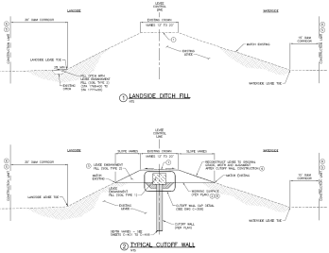
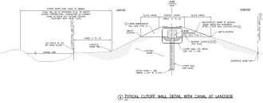
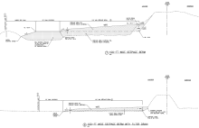
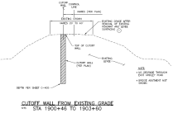
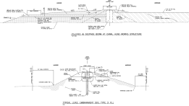
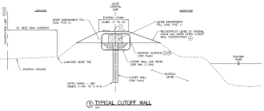
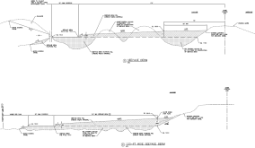
PROJECT DESIGN
Board staff has reviewed the following technical documents provided by SBFCA:
90 % plans and specifications
Permit Application Packages (October 2013)
100 % plans and specifications
Note: Any subsequent plans and specifications or addenda shall be handled in a manner consistent with Special Conditions FORTY-TWO and FORTY-THREE
Project Area B (18793-2) Project Area D (18793-3)

Slide 10
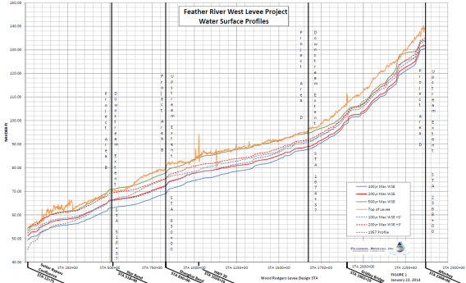
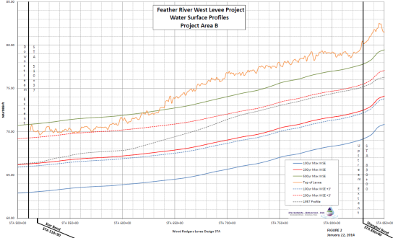
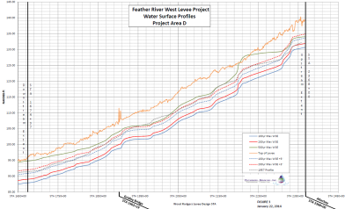
HYDRAULIC SUMMARY
Hydraulic Summary for the FRWLP:
Included the entire FRWLP (44 miles from Thermalito Afterbay to Sutter Bypass)
Designed to achieve 200-yr level of protection (urban/urbanizing)
Designed to achieve 100-yr level of protection from Star Bend south of Yuba City
Modeled using HEC-RAS one-dimensional model
Flows used: 150,000 cfs (100-yr); 174,000 cfs (200-yr); 327,000 cfs (500-yr)
1957 Profile flows of 210,000 cfs (above Yuba River) and 300,000 cfs (below Yuba River)
Both 100- and 200-yr events plus 3-ft of freeboard are below the existing levee crown
Based on SBFCA’s results, staff expects no adverse hydraulic impacts
Overall FRWLP
Project Area B (18793-2)
Project Area D (18793-3)
Notes:
What is the incremental reduction in WSE with the exception of the bump?

Slide 11
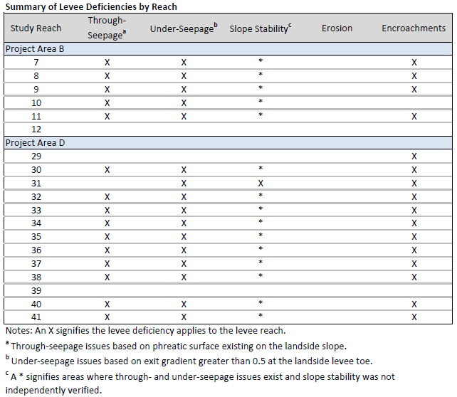
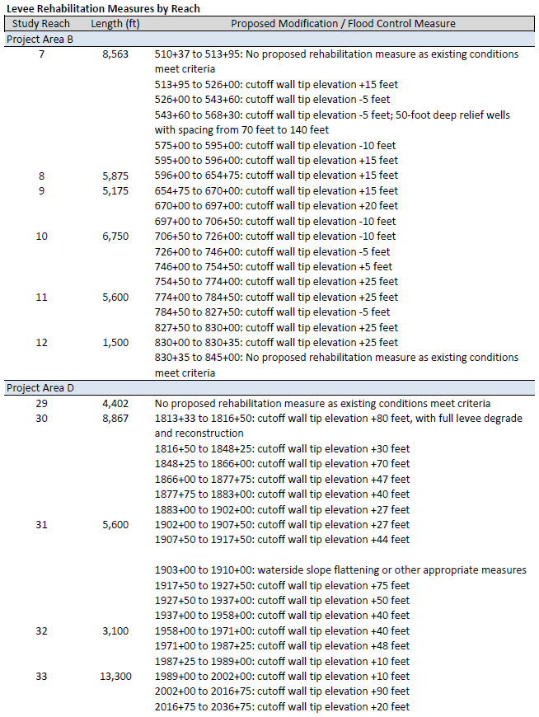
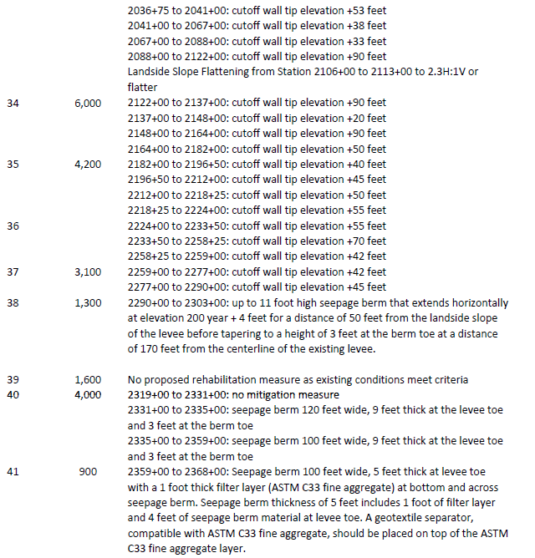
GEOTECHNICAL SUMMARY
Project Area B
Divided into 5 Reaches (7 – 12)
Predominant deficiencies are through- and under seepage
Approximately 6 miles of cutoff wall
Depths vary from 47 to 78 feet
28 relief wells (southern Reach 7)
NOTE: Variances discussed on next slide
Project Area D
Divided into 13 Reaches (29 – 41)
Predominant deficiencies are through- and under seepage
Approximately 9 miles of cutoff wall
Depths vary from 17 to 99 feet
Approximately 0.93 miles of seepage berm
From 100 to 170 feet wide landside berm (Reaches 38, 40, 41)
Levee Deficiencies and Remediation by Reach

Slide 12
VARIANCES TO TITLE 23
Pursuant to Title 23, § 11(a) and (b) – the Board may grant variances to its standards for non consistent uses, and the applicant must state why the project is infeasible or not appropriate
SBFCA submitted a Variance Request Package outlining their request for variances to Title 23 on grounds that the standards are infeasible due to specific project constraints
SBFCA has requested variances to Title 23, § 108, 120, and 123 (B and D) and 112 (D), as outlined in the Staff Report Section 7.7 and Attachment H
Board staff has added or modified Special Conditions TWENTY-SIX, FIFTY-FIVE, SIXTY, SIXTY-ONE, SIXTY-TWO, SIXTY-THREE, SIXTY-SEVEN, SEVENTY-TWO, and EIGHTY-TWO to incorporate the variances into the permit
Board staff has also added Special Condition NINETY-THREE to require post construction monitoring to assess levee performance
Board staff has determined that the project will result in an improved levee system, ensure continuity with Project Area C, and is not expected to pose a threat to stability

Slide 13
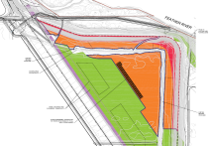
AUTHORIZATIONS / UTILITIES
Advance Elderberry Transplant Authorization:
On January 16, 2014 the Board’s Chief Engineer authorized relocation of elderberry shrubs from 49 locations throughout Project Areas B, C, and D
Required prior to construction because of restrictive planting windows
Incorporated into both permits through Special Condition SEVENTY-THREE
Utility Relocations:
There will be several utility relocations that will require separate encroachment permits or Board Chief Engineer authorizations (Attachment J)
SBFCA will assist the utilities to prepare and submit encroachment permit applications and will coordinate relocation with the levee construction schedule

Slide 14
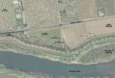
PROTESTS
Four protest letters have been received:
All letters protest the need to acquire private property for project right of way
Project Area B
Ms. McFeely, received January 27, 2014 (0.48 acres fee, 0.19 acres easement)
Project Area D
Mr. Peekema, received February 3, 2014 (2.0 acres fee, 0.23 acres easement*)
Mr. Fredericks, received February 11, 2014 (1.0 acres fee, 0.27 acres easement*)
Mr. Manning, received February 11, 2014 (2.0 acres fee, 0.8 acres easement*)
Staff’s findings:
All protests were submitted pursuant to Title 23, § 12, Protests
Board staff determined that the protests were not of a flood control nature
Special Condition EIGHTEEN of both permits require SBFCA to acquire the proposed lands prior to construction in that area
Board staff agrees with the need to acquire the proposed land (in fee or easement) to ensure successful project completion

Slide 15
CEQA / WATER CODE 8610.5
The CEQA Analysis is included in Staff Report Section 8.0
References the approved CEQA Findings made in May 2013 (Project Area C)
The Water Code § 8610.5 Considerations are included in Resolution 2014-01

Slide 16
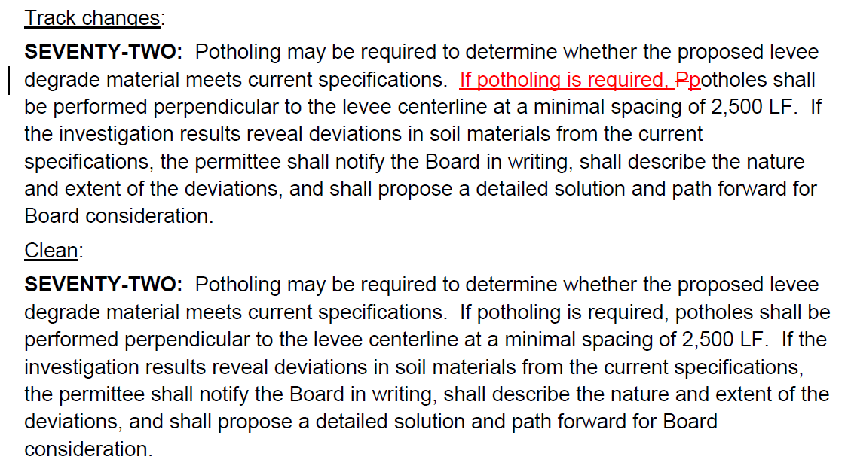
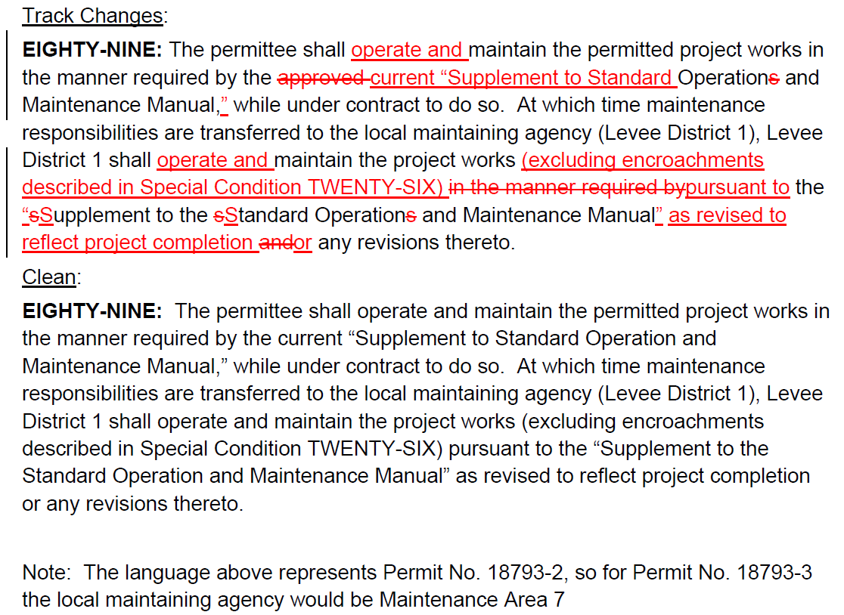
RECOMMENDED PERMIT EDITS
Board staff is recommending the following changes to the Special Conditions below:
SEVENTY-TWO: the changes are for consistency within the condition and to reflect that potholing may not be required
EIGHTY-NINE: the changes are to properly reference the title of the O&M Manual and to properly reflect responsibility of project works excluding the work done under separate permits to bring encroachments into compliance with standards

Slide 17
STAFF RECOMMENDATION (1/2)
Board Staff is Recommending that the Board:
Adopt (in substantially the form provided):
the CEQA findings and Resolution 2014-01
Approve:
the requested construction variances to Title 23, § 108, 120, and 123 (Project Areas B and D) and § 112 (Project Area D only) pursuant to § 11(a) and (b) summarized in Section 7.7, and further detailed in Attachment H, of the submitted staff report;
Draft Flood System Improvement Permit No. 18793-2, conditioned on receipt of Section 408 Letter of Permission from the USACE Sacramento District (in substantially the form provided including the changes recommended today); and
Draft Flood System Improvement Permit No. 18793-3, conditioned on receipt of Section 408 Letter of Permission from the USACE Sacramento District (in substantially the form provided including the changes recommended today);
Delegate:
authority to the Executive Officer to make non-substantive changes to the draft permits as needed to incorporate additional design changes submitted by SBFCA prior to receipt of the Letter of Permission, and that if substantive changes to the draft permit(s) are required, the Board staff will bring the permit(s) back to the Board at a future meeting to seek approval for substantive changes

Slide 18
STAFF RECOMMENDATION (2/2)
Direct the Executive Officer:
to take the necessary actions to prepare and execute Permit Nos. 18793-2 and 18793-3 and all related documents;
to prepare and file a Notice of Determination pursuant to CEQA with the State Clearinghouse;
to process applications to amend existing or request new encroachment permits to owners of utilities within the project areas that will be reconstructed as part of the projects, as detailed in Staff Report Sections 7.7 and 7.10; and
that if, during construction, additional non-conforming encroachments or constructability issues are discovered by any party SBFCA will consider whether or not they can be brought into compliance during construction. Board staff will evaluate subsequent proposals for Board approval to be made either by direct Board action or by delegation to the Executive Officer as appropriate; and
authorize any additional utility relocations and / or elderberry shrub transplants deemed necessary for the project.

Slide 19
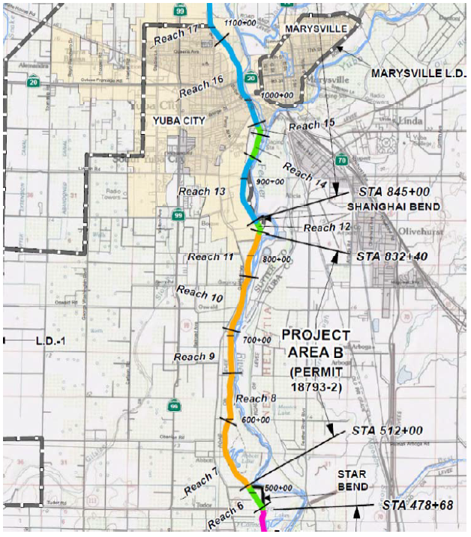
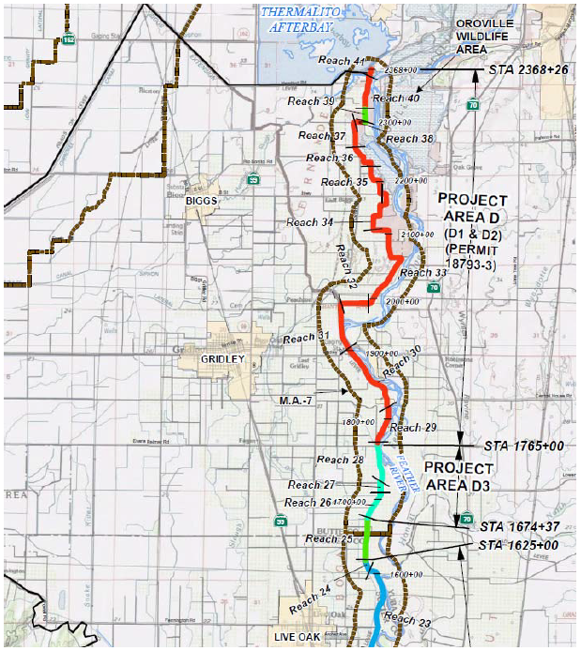
QUESTIONS
Presented/prep/reviewed: Nancy C. Moricz, P.E. – Senior Engineer

