Slide 1
CVFPB Meeting April 5, 2013 USACE INSPECTION RESULTS Meegan G Nagy, PE Levee Safety Program Manager
Notes:
LSJLD 5, 14, 15 – inactive
Maintenance Area 05 Unit 1 – Inactive
Maintenance Area 05 Unit 2 – Inactive
Brannan – Andrus LMD and RD 556 - Inactive

Slide 2
Maintenance Area 05

Slide 3
Maintenance Area 05 – Unit 1
Notes:
Signed March 26, 2013
Inactive

Slide 4
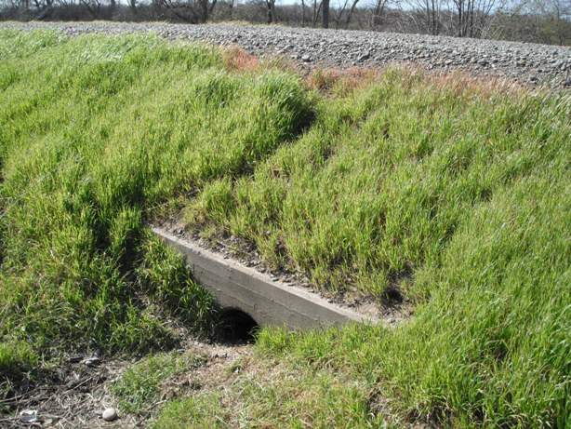
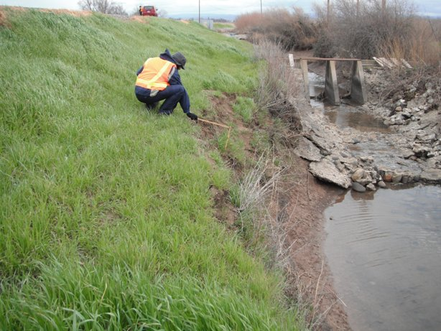
Notes:
Bottom Left: Culvert through levee; unable to locate waterside outlet; landside is silted in.
Bottom Right: Erosion and bank caving on the landside at ditch about 35 feet long and 4 to 6 feet vertically above water elevation

Slide 5
Maintenance Area 05 – Unit 2
Notes:
Signed March 27, 2013
Inactive

Slide 6
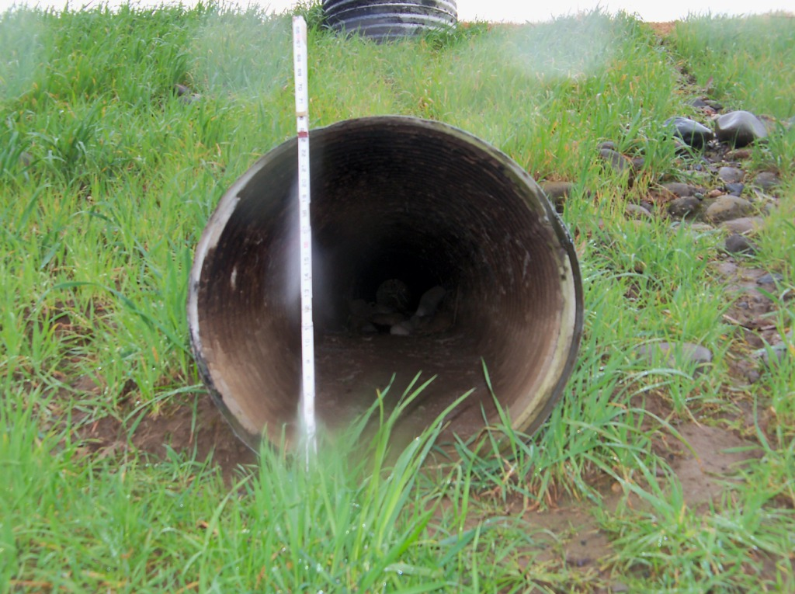
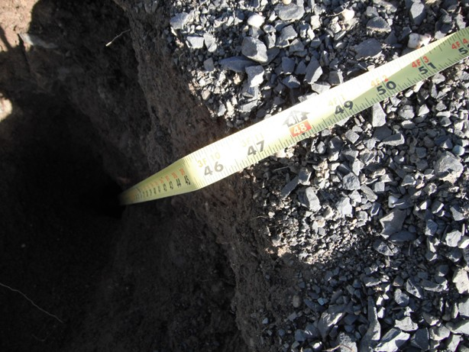
Notes:
Top Left: culvert is missing both flap and sluice gates
Bottom Left: Waterside flap gate is missing
Bottom Right: Animal Burrows were up to 48 inches deep.

Slide 7
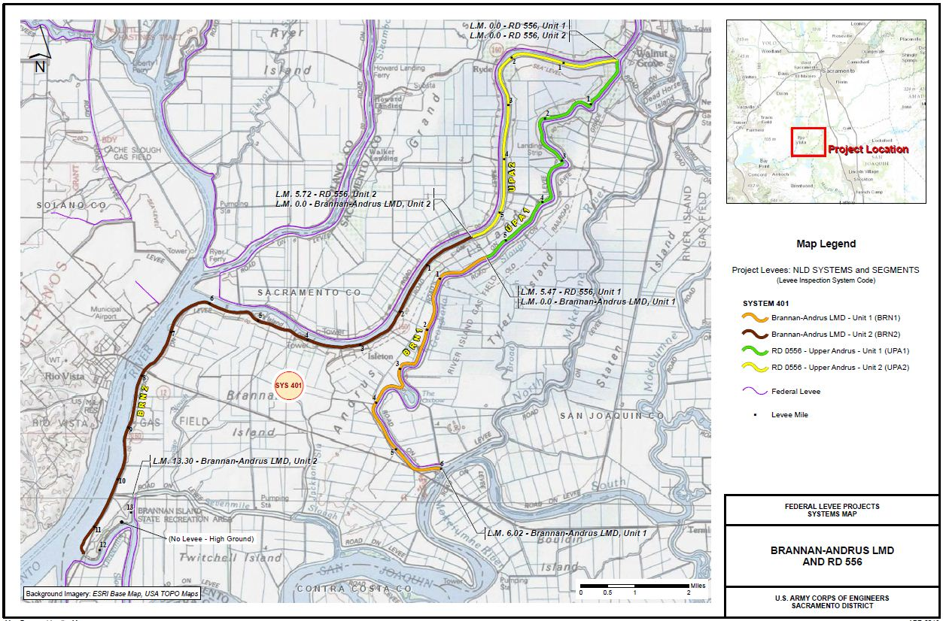
Brannan-Andrus LMD – RD 0556

Slide 8
Brannan-Andrus LMD – RD 0556
Notes:
Signed March 26, 2013
Inactive

Slide 9
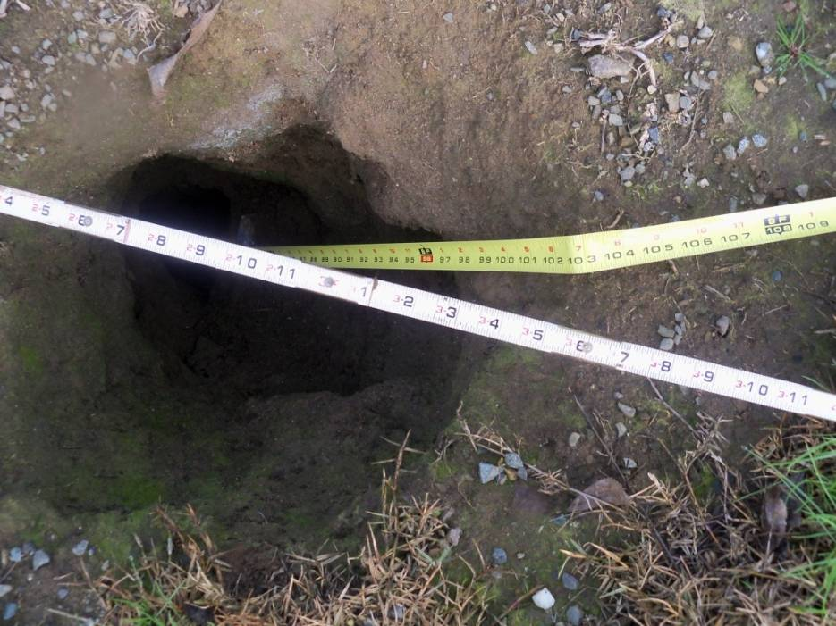
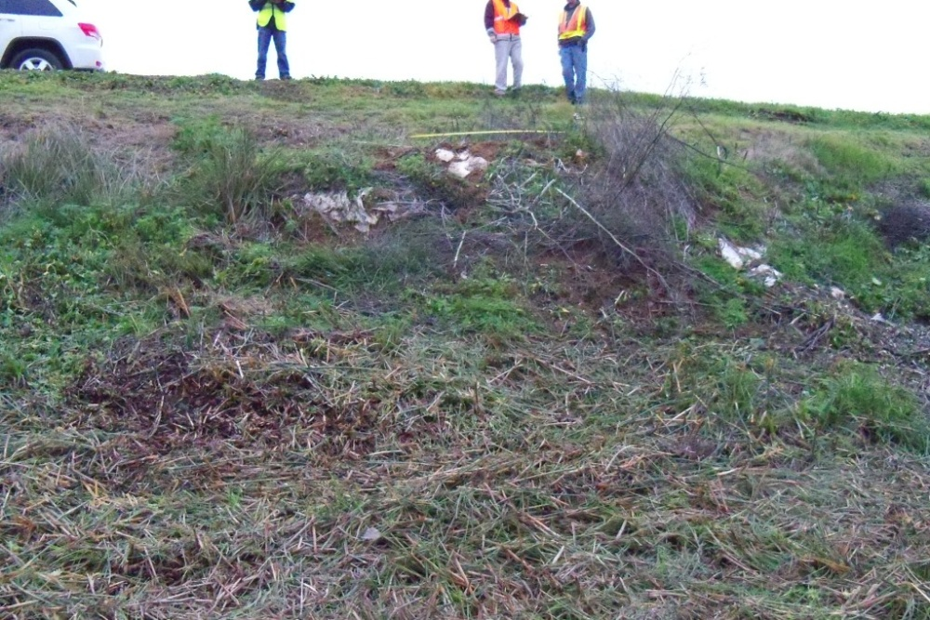
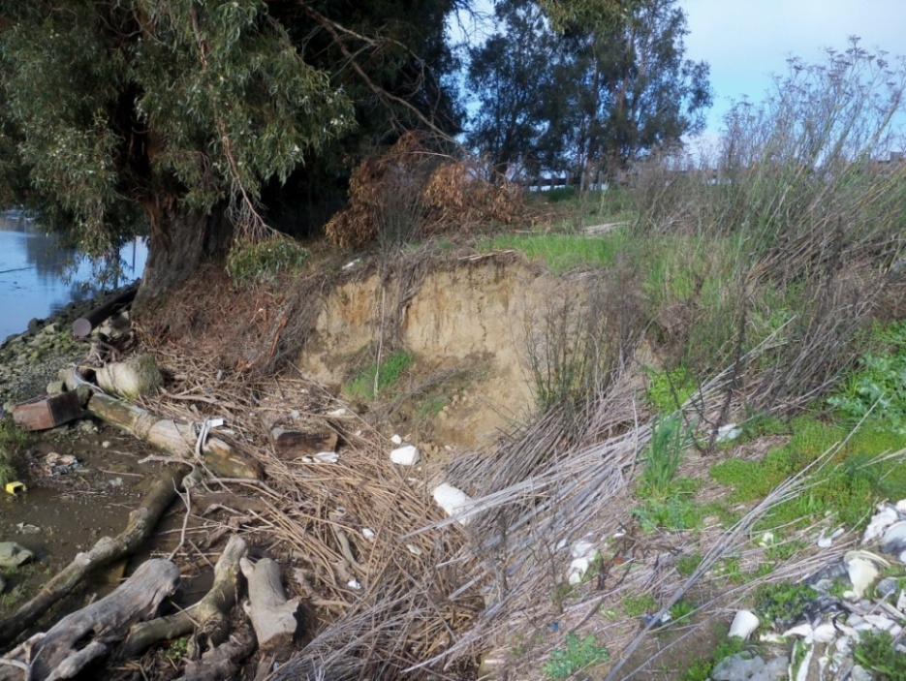
Notes:
Top: Single burrow on the levee crown;5 inches wide; 8.5 feet deep. Few small burrows on waterside
Bottom Left: historical sand boils. Two sites, one at mid LS slope, another 2 ft above toe, with sandbag ring barriers. According to LMA this boil spot was from 1997 flood and no further mitigation has been made.
Bottom Right: Extensive erosion and slope failure site on the waterside slope and bank. 70 feet wide, up to 12 feet deep and extends up to 30 feet into the slope

Slide 10
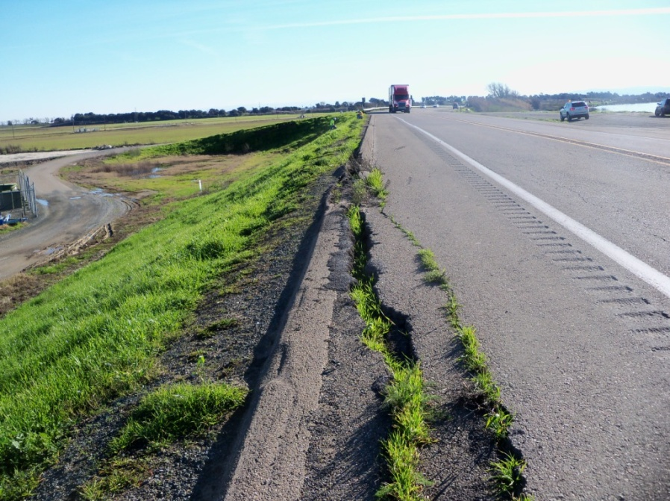
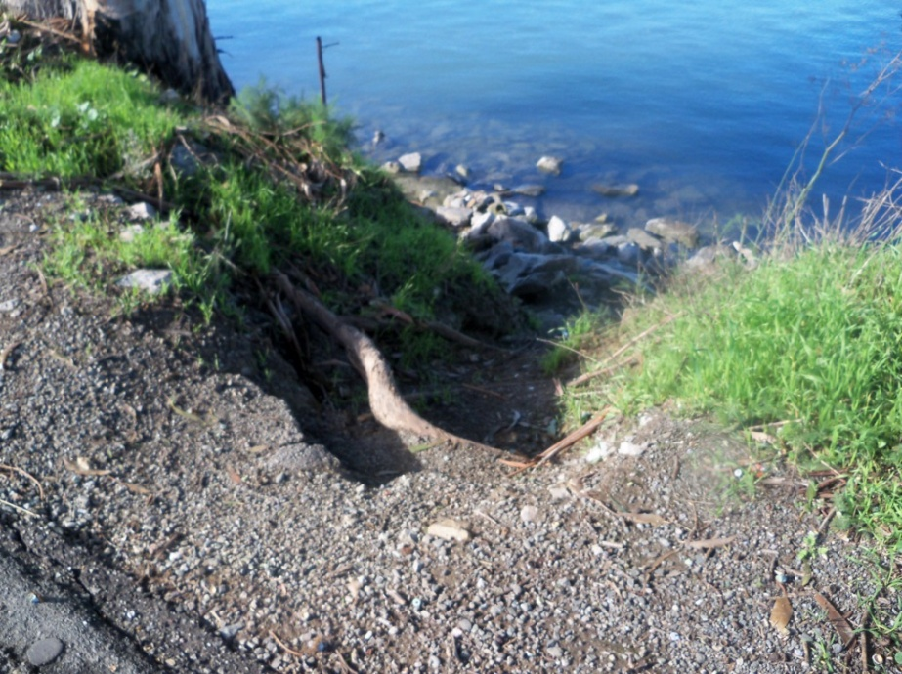
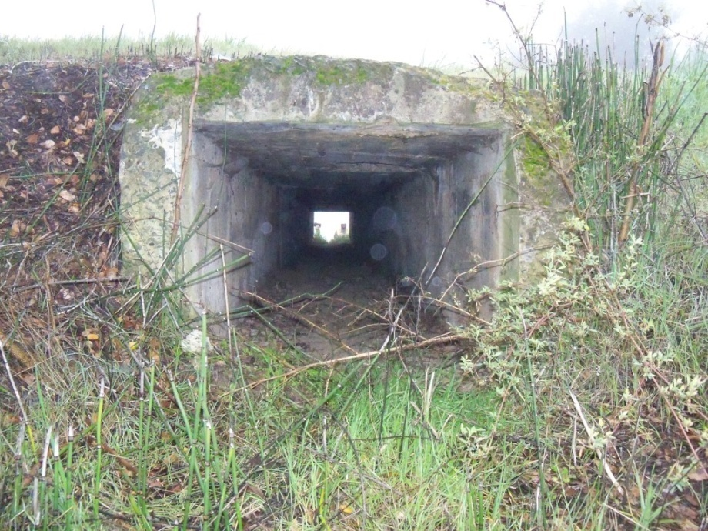
Notes:
Top Left: Crack on the LS shoulder below the guard rail and along the asphalt surfacing about 200 ft long, 14 inches wide, up to 18 inches deep, with about 3 inches of vertical displacement.
Top Right: Surface runoff erosion rills on the WS slope from crest to bank up to 5 ft wide and up to 24 inches deep every 25 to 50 ft. Condition extends for 300 ft.
Bottom Left: Abandoned concrete box culvert crossing through the levee, with the culvert invert about 6 feet below the crown.
Bottom Right: Concrete brick shed cuts into the lower half of the LS slope. Utility pole located 5 ft from LS toe.

Slide 11
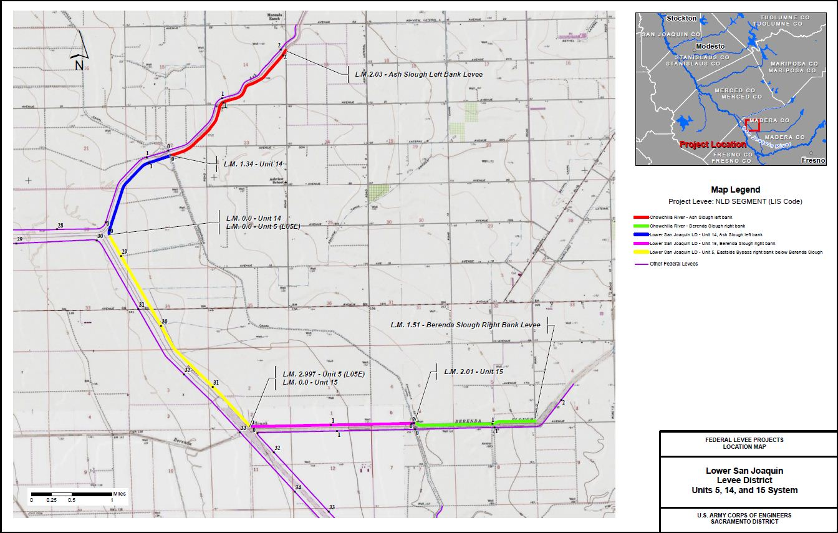
LSJLD – Units 5, 14, 15
Notes:
Signed March 26, 2013
Inactive

Slide 12
LSJLD – Units 5, 14, 15
Notes:
Signed March 26, 2013
Inactive

Slide 13
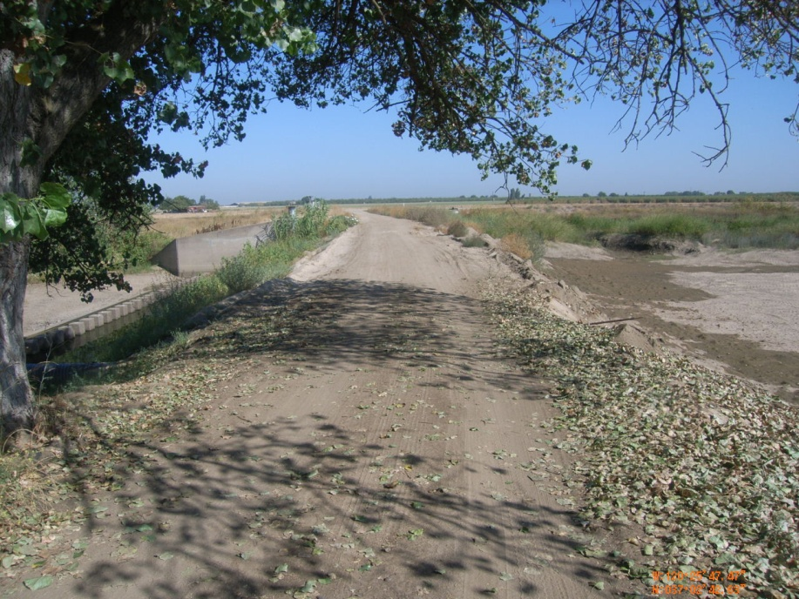
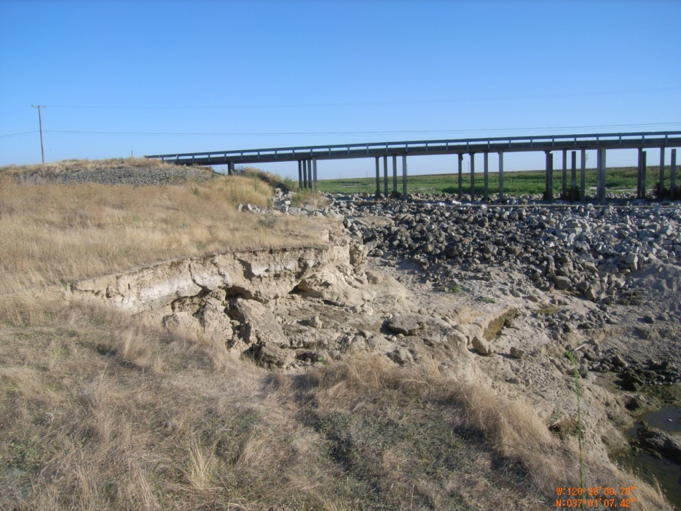
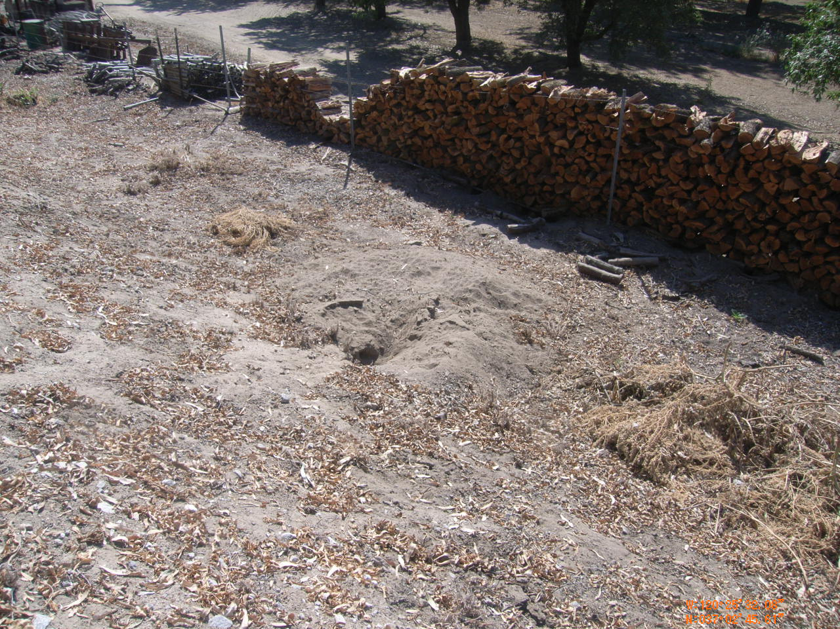
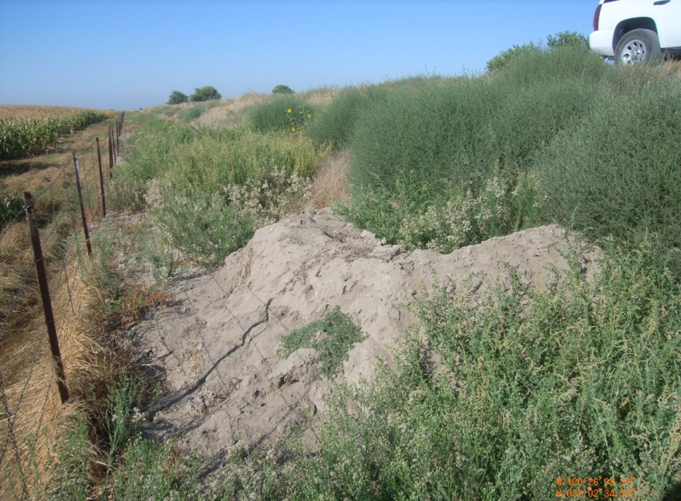
Notes:
Top Left: Fill placed above and upstream of drop structure. 2 pipes placed thru fill, but filled in with sediment. Only way for water to pass the drop structure is thru culverts on headwalls of the drop structure. Channel design flow is 5,000 cfs.
Top Right: Head cutting in channel downstream of bridge. Bottom of channel to bottom of scour is about 40 feet.
Bottom Left: Animal Burrow
Bottom Right: Ring berm on LS slope. Possible seepage location. Vegetation obscures ring berm

