Slide 1
Status Update on ENFORCEMENT staff’s ACTIVITY Michael C. wright chief, enforcement Section december 20, 2013
ENFORCEMENT REPORT

Slide 2
ENFORCEMENT REPORT

Slide 3
ENFORCEMENT REPORT

Slide 4
ENFORCEMENT REPORT

Slide 5
ENFORCEMENT REPORT

Slide 6
ENFORCEMENT REPORT
Letter of Intent for SWIF Update:
Lead LMA | Status | Date | No. of Levee Systems
RD 1000 | Approved by USACE | May 16, 2013 | 1
RD 1001 | Approved by USACE | November 18, 2013 | 2
SBFCA | Submitted to USACE | March 11, 2013 | 1
City of Sacramento | Submitted to USACE | October 1, 2013 | 1
RD 108 | Draft (Staff Review) | Sept. 24, 2013 | 1
Knights Landing DD | Draft (Staff Review) | October 3, 2013 | 1
Tehama County | Draft (Staff Review) | October 11, 2013 | 3
RD 1500 | Draft (Staff Review) | October 31, 2013 | 1
RD 1660 / RD 70 | Draft (Staff Review) | November 15, 2013 | 1
 | Pre-Draft | N/A | 22

Slide 7
ENFORCEMENT REPORT

Slide 8
USACE’S RIP LEVEE STATUS

Slide 9
ENFORCEMENT REPORT
Questions?

Slide 10
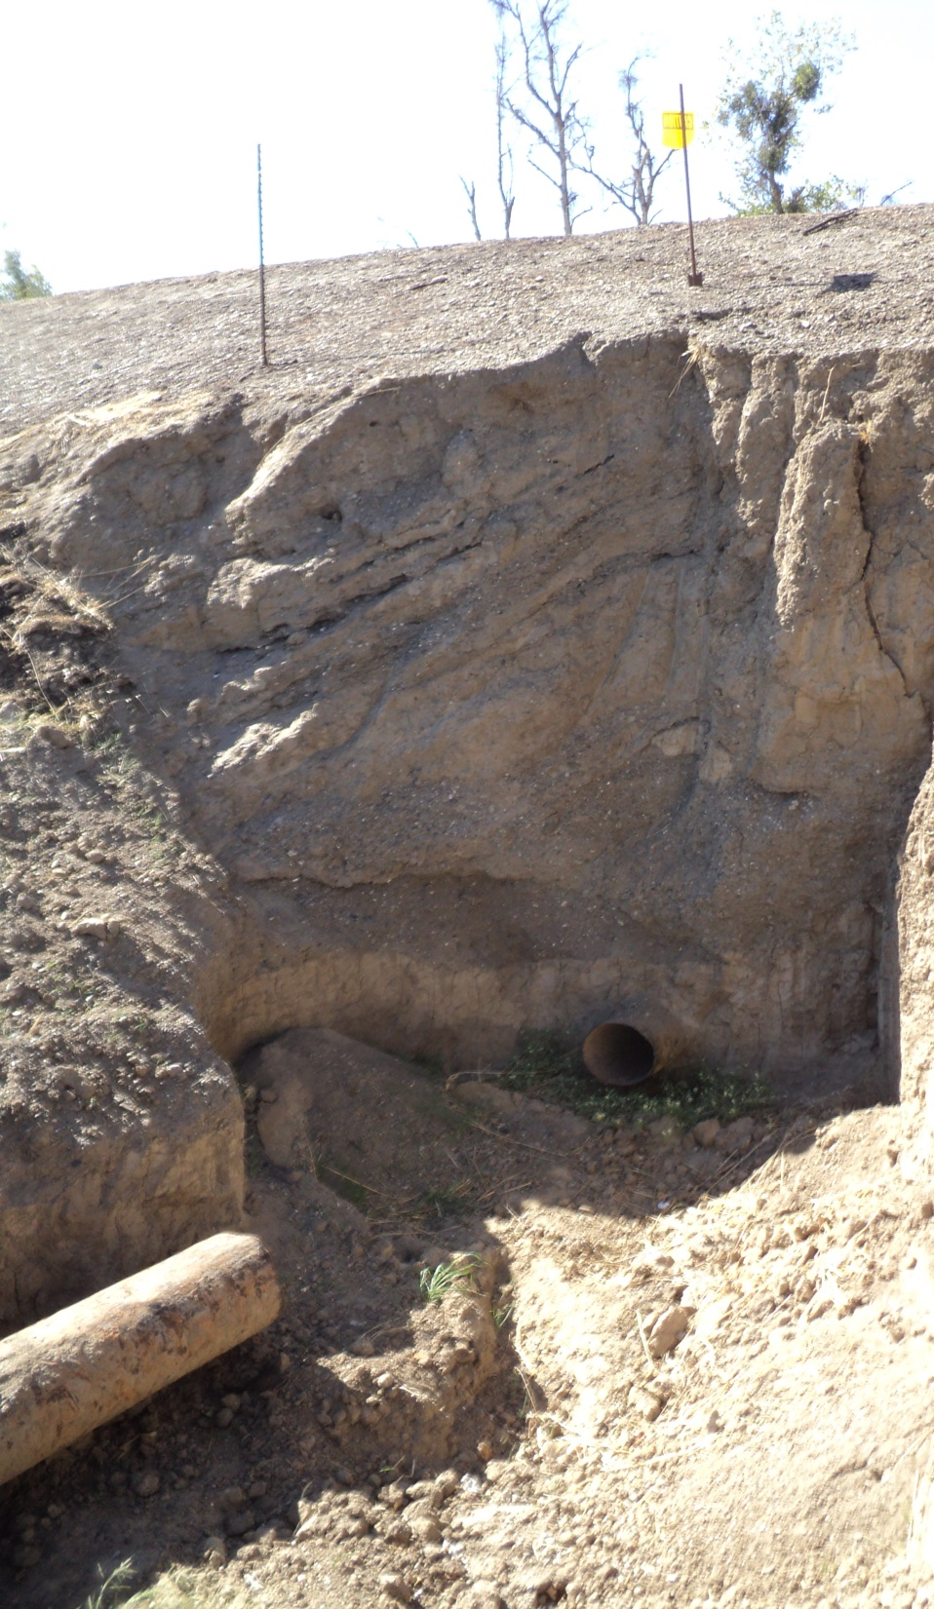
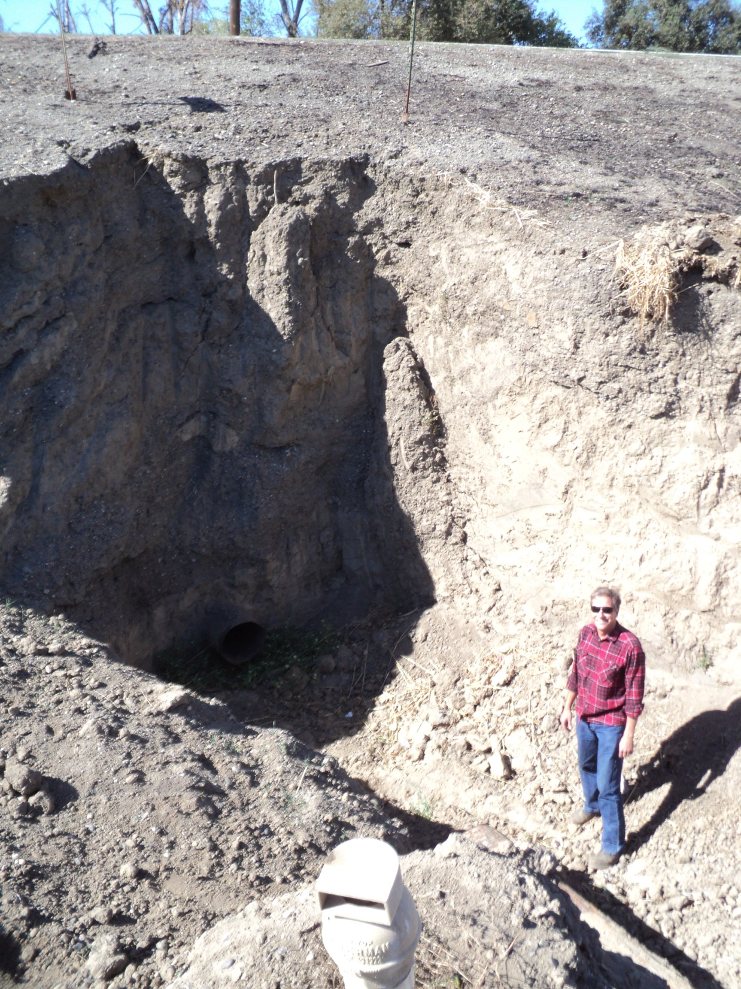
Enforcement Action No. 2013-353 (BEFORE):
Sacramento River – Colusa County
October 15, 2013

Slide 11
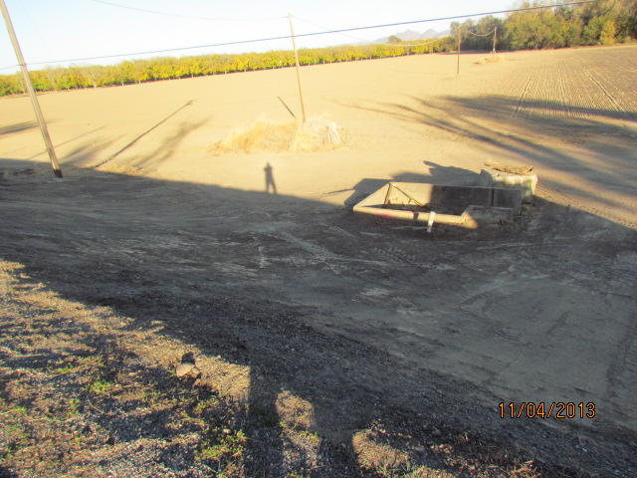
Enforcement Action No. 2013-353 (AFTER):
Sacramento River – Colusa County

Slide 12
ENFORCEMENT REPORT
Questions?

Slide 13
ENFORCEMENT REPORT
SURVEY SUMMARY:
TOTAL NUMBER OF SYSTEMS = 116
NUMBER OF SYSTEMS ISSUED A GOAL FORM = 83
NUMBER OF GOAL FORMS RETURNED = 65 (78%)
LOI’S PLANNED OR SUBMITTED (OF 65 RETURNED FORMS) = 28
TOTAL # OF LOI’S PLANNED, DRAFT, SUBMITTED OR APPROVED = 34
NO LOI PLANNED (OF 65 RETURNED FORMS) = 25
LMA REQUESTED AN EXTENSION TO RESPOND = 12

