Slide 1
Hydrologic Conditions Update and Outlook for 2013-14 Flood Season
December 2013
Hydrology and Flood Operations Office
Division of Flood Management
Department of Water Resources

Slide 2
Overview
Precipitation
Runoff
Storage
Outlook

Slide 3
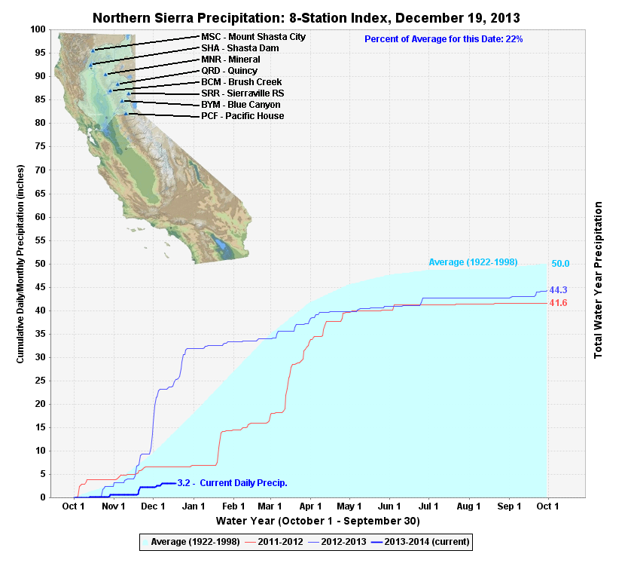
http://cdec.water.ca.gov/cdecapp/precipapp/get8SIPrecipIndex.action

Slide 4
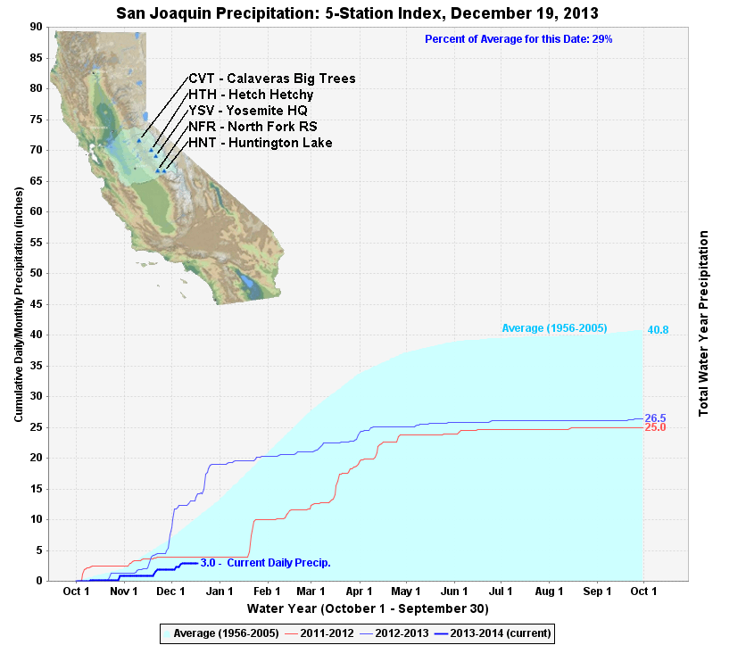
http://cdec.water.ca.gov/cdecapp/precipapp/get5SIPrecipIndex.action

Slide 5
California Climate Tracker – Calendar Year Precipitation (Jan-Nov)
Red is Record Dry
8-Station Index and 5-Station Index on track for record low totals
Sierra Region
Statewide average accumulation record low
3
3
93
11
Summer Monsoon Influence
http://www.wrcc.dri.edu/monitor/cal-mon/frames_version.html

Slide 6
Runoff – Water Year Perspective
Sacramento 4 Rivers Index Below Normal in WY 2012 and Dry in WY 2013
San Joaquin 4 Rivers Index Dry in WY 2012 and Critically Dry in WY 2013
April-July runoff below average for both basins for past 2 years

Slide 7
Sacramento WY versus Apr-July Runoff Volumes
April-July Runoff Volume (MAF)
WY 2012
Water Year Runoff Volume (MAF)
http://cdec.water.ca.gov/cgi-progs/iodir/WSIHIST

Slide 8
San Joaquin WY versus Apr-July Runoff Volumes
April-July Runoff Volume (MAF)
WY 2012
WY 2013
Water Year Runoff Volume (MAF)
http://cdec.water.ca.gov/cgi-progs/iodir/WSIHIST

Slide 9
Reservoir Storage WY 2012 - Present
http://cdec.water.ca.gov/cgi-progs/reports/STORAGEW

Slide 10
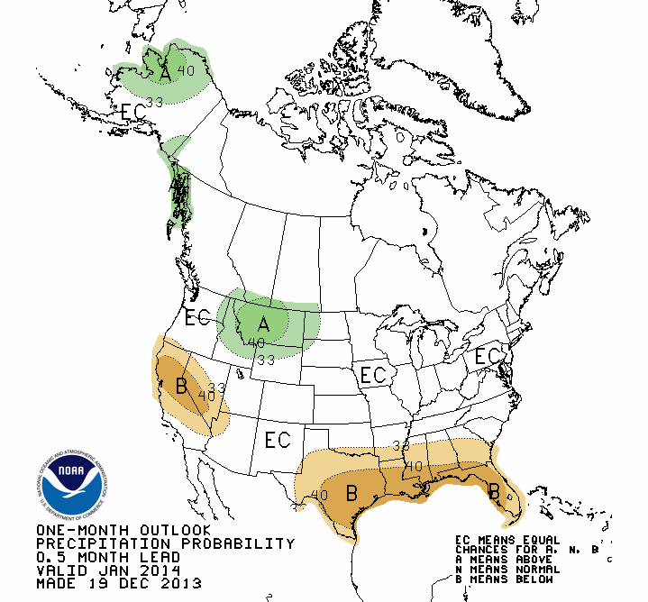
U. S. Outlook – Climate Prediction Center
January 2014

Slide 11
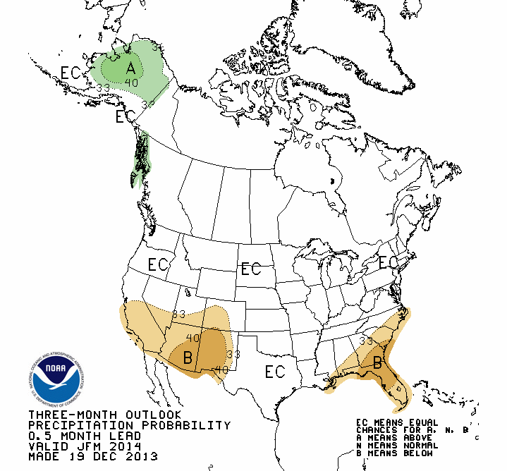
U. S. Seasonal Outlook – Climate Prediction Center January 2014 – March 2014

Slide 12
California Outlook
No clear climate signal due to neutral El Niño Southern Oscillation conditions
DWR Experimental Forecast suggests dry winter with possible Spring improvement if El Niño continues to develop
http://www.water.ca.gov/news/newsreleases/2013/112513.pdf

Slide 13
Flood Forecasting
Authority - California Water Code (Section 236)
DWR in joint collaboration with National Weather Service’s (NWS) California-Nevada River Forecast Center (CNRFC)
Provide year-round daily forecasts of reservoir inflows, river flows, and water levels throughout California
Issue river and tide Forecast for 94 locations in California, parts of Nevada
Forecasts used by the Flood Operations Center to determine the level of joint Federal-State flood response activation and operations

Slide 14
Operations Schedule
Winter Mode [~October 15th to April 15th]
Weekdays: Forecasts issued by 9:00 AM and 3:00 PM
Weekends: Forecast issued by 9:00 AM
Flooding
- Forecasts also issued at 9:00 PM & 3:00 AM
Summer Mode [~April 15th to October 15th]
Forecasts issued by 9:00 AM daily

Slide 15
http://www.cnrfc.noaa.gov/

Slide 16
Weather and Hydrology briefings
During flood season (mid-October – mid-April)
Joint effort between DWR and CNFRC
Information sharing and coordination between
State & Federal Partners

Slide 17
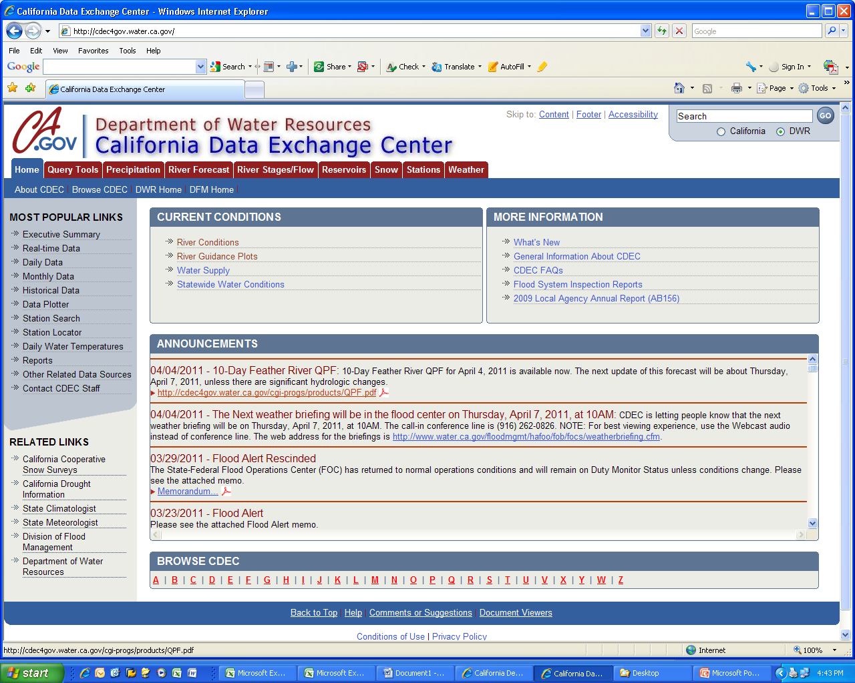
http://cdec.water.ca.gov/

Slide 18
Information and Contacts
Public California Data Exchange (CDEC access)
http://cdec.water.ca.gov
Agency access - http://cdec4gov.water.ca.gov To Apply flood.webmaster@water.ca.gov
Webcast Weather/Hydrology Briefings –
wx_webcast-request@water.ca.gov
California Nevada River Forecast Center
http://www.cnrfc.noaa.gov/

Slide 19
Questions?

Slide 20
Sudhakar Talanki, PE
Chief, River Forecasting Section
Hydrology Branch
Hydrology and Flood Operations Office
Division of Flood Management
Department of Water Resources
916 574 2617
Sudhakar.Talanki@water.ca.gov

Slide 21
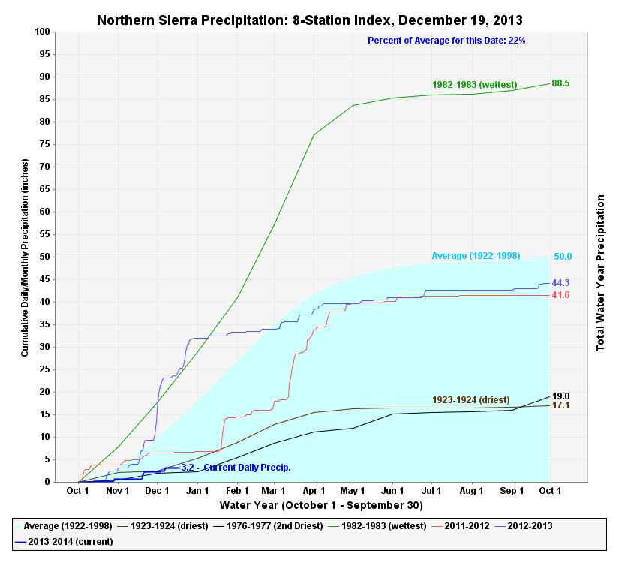

Slide 22
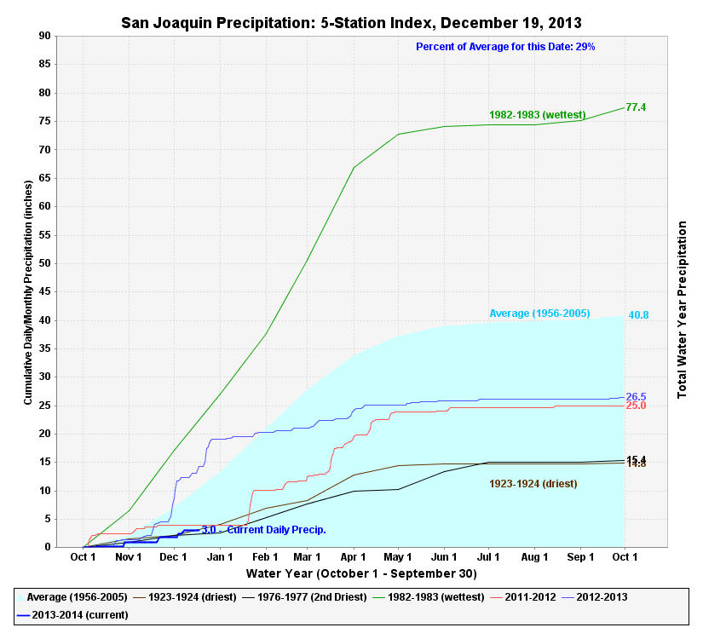

Slide 23
