Slide 1
Flood Emergency Preparedness
Preseason Briefing
Fall 2013
Darren Suen, PE, MBA, PMP
Chief, Flood Operations Center
Hydrology and Flood Operations
Division of Flood Management

Slide 2
DWR Emergency Response Priorities
Protect
Life, property, and infrastructure
Water quality and water supply
Environment

Slide 3
Preseason Meetings
Our Partners in preparedness
California-Nevada River Forecast Center (CNRFC)
National Weather Service (NWS) Weather Forecast Offices
Army Corps of Engineers
California Conservation Corps (CCC)
Cal Fire
Cal OES
County OES

Slide 4
13 Preseason meetings
Southern California Northern California
Ventura – September 16 Sacramento – September 23
San Bernardino – September 17 Fresno – September 24
Orange County – September 18 Marin – October 1
San Diego – September 19 Red Bluff (MARAC) – Oct 2
Monterey – October 3
Stockton – October 8
Yuba City – October 9
SCVWD – October 31
Eureka – November 20
Tehama – December 16

Slide 5
Preseason meeting objectives
Provide flood preparedness info
Sharing of issues, solutions, and resources within each region
Reinforce the Standardized Emergency Management System (SEMS) protocol
Ensure the dissemination of information from Operating Agencies (OA’s) to respective local maintaining agencies (LMA’s)

Slide 6
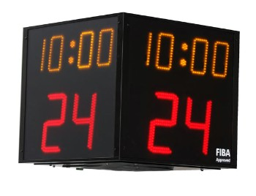
Preparedness info
NWS 2013-14 Winter Outlook
Flood System Vulnerabilities
Flood Fight Methods
Tools
Flood Emergency Management System (FEMS)
Directory of Flood Officials
Web (CDEC/CNRFC)

Slide 7
Preparedness info
Flood Emergency Response Grants Status
Delta Emergency Communications Grant
$5M in Prop 84 funds to 5 Delta counties & 1 agency
Interoperability: to improve emergency communication
Statewide Flood ER Grant
$5M in Prop 84 funds to 14 agencies
Delta Flood ER Grant
$5M in Prop 1E funds recommended to award to six Delta agencies

Slide 8
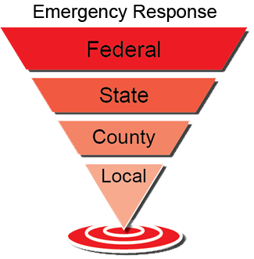
SEMS reinforcement
Starts local
Supports local agency requests for technical assistance
Supports flood fight activities
Federal assistance (PL84-99)

Slide 9
Flood Operation Center limitations…
Does NOT
Declare emergencies
Order evacuations
Repair levees
Not responsible for recovery (clean-up, shelter, etc.)

Slide 10
Flood Operations Center information
Year-round, the FOC provides a focal point for gathering, analyzing, and disseminating information to get the right information to the right people

Slide 11
Points of interest
Focus on erosion, seepage, slope stability
Information sources
Calls into FOC
Flood Project Integrity & Inspection Branch
Flood System Sustainability Branch

Slide 12
Upper Sacramento region
Oroville Dam
Sutter Buttes
Marysville
Roseville
Notes:
Critical erosion, critical seepage, critical stability

Slide 13
Lower Sacramento region
West Sac
Elk Grove
Twin Cities Road
Hwy 12
Notes:
Serious/critical seepage spots

Slide 14
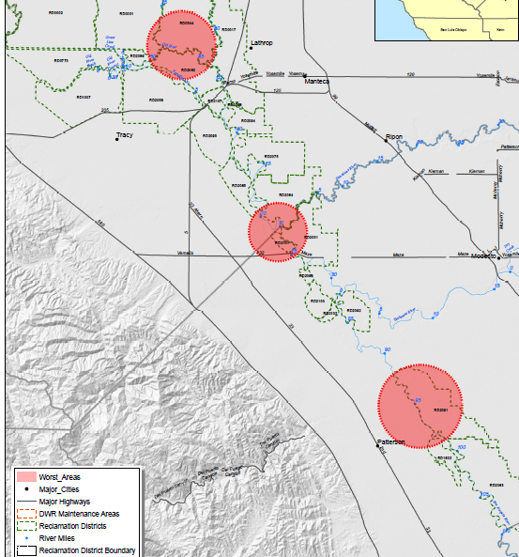
San Joaquin River Basin
Lathrop
Manteca
Tracy
Modesto
Patterson
Notes:
Mostly critical/serious seepage, some critical stability, serious erosion

Slide 15
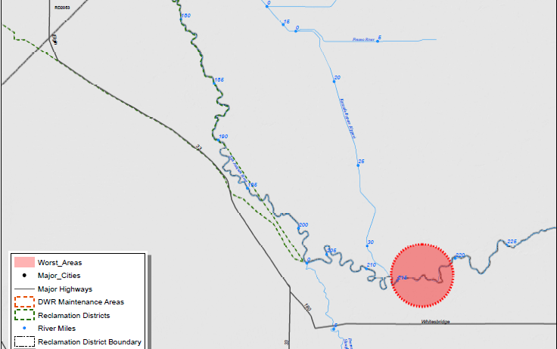
San Joaquin River Basin
Chowchilla
Notes:
Critical seepage

Slide 16
Ongoing readiness
Weather and hydrology briefings
Delta Working Group
Meet quarterly
Yolo, Sacramento, San Joaquin, Solano and Contra Costa counties
Chowchilla Working Group
Meet monthly
Fresno, Madera, and Merced counties
USACE and CAL OES Preseason meeting
Roster training

Slide 17
Flood fight material inventory (2013)
Inventory Table (Updated Annually)
Description | Specification | Quantity (approx.)
Sandbags | 18"x30" - 10oz. Burlap | 2 Million
Plastic Sheeting | 20'x100' black poly roll | 3,900 rolls
Buttons | Custom Design | 540,000 EA
Twine | 110 lb. strength/10,500 length (10lb. Box) | 2,600 cases
Geotextile Fabric | 12'x300' polypropylene (400 sq. yds) | 900 rolls
Stakes | 1"x3"x24" wood | 250,000
Muscle Wall | 2'x6' poly with accessories | 700

Slide 18
Information and contacts
Flood Center (916) 574-2619 flood_center@water.ca.gov
Recorded Conditions and Forecasts (800) 952-5530
Public CDEC access - http://cdec.water.ca.gov
Agency access - http://cdec4gov.water.ca.gov Call (916) 574-1777 to Apply
Webcast Weather/Hydrology Briefings –
wx_webcast-request@water.ca.gov
Directory of Flood Officials and Emergency Phone Cards:
Wendy Francis (916) 574-2619 or wendy.francis@water.ca.gov

