Slide 1
CVFPB Meeting December 20, 2013 USACE INSPECTION RESULTS Ryan Larson, P.E.

Slide 2
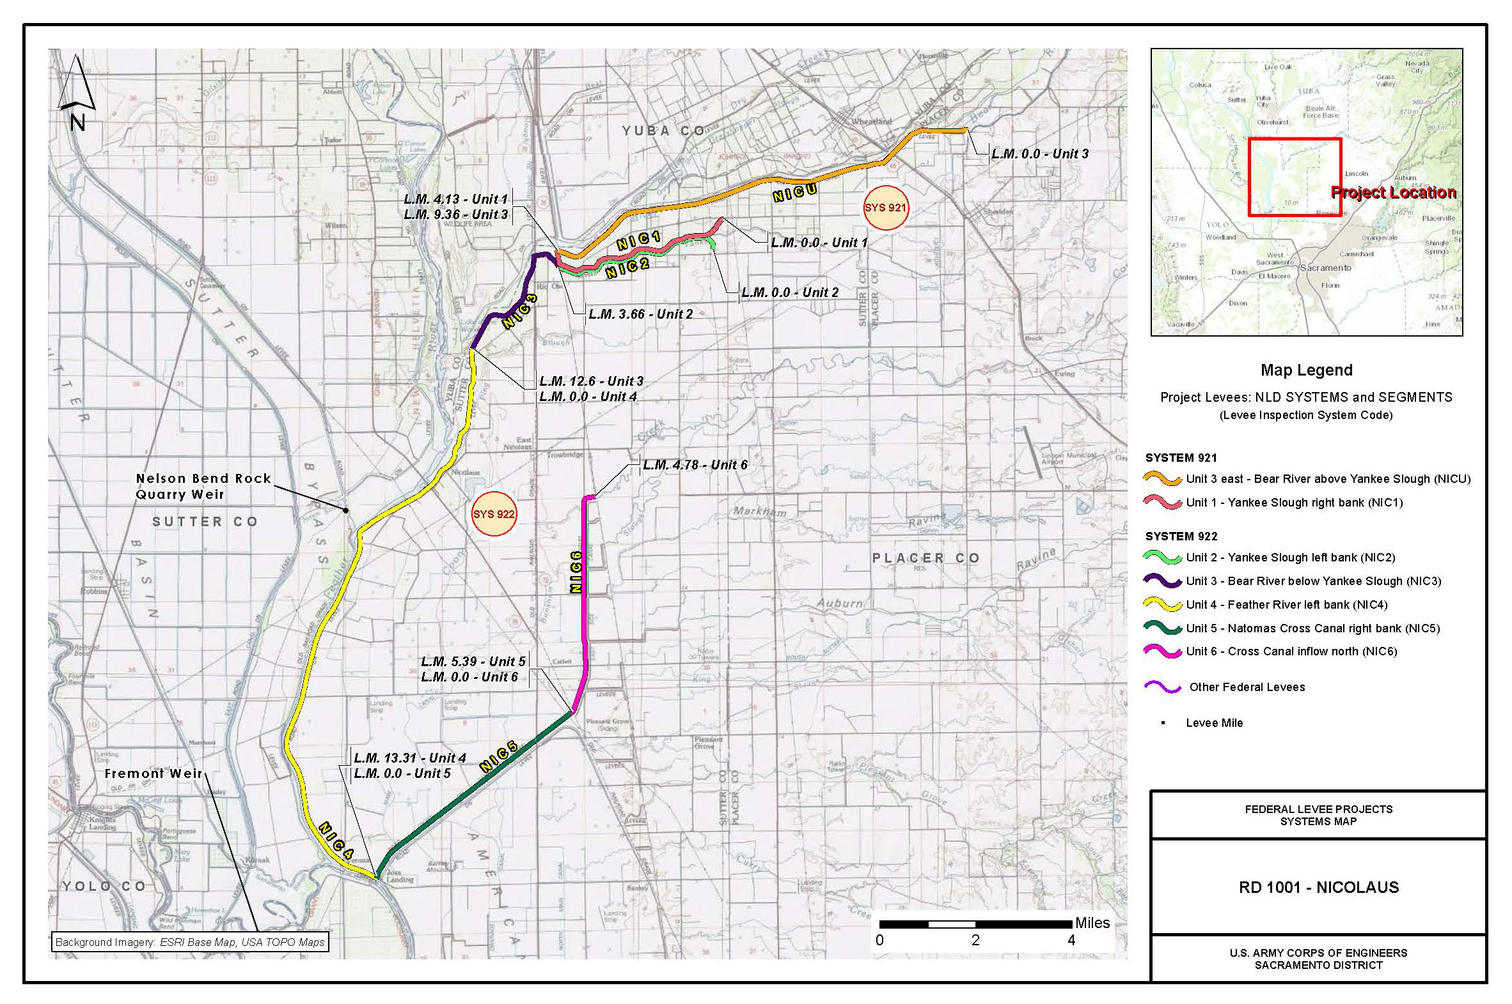
RD 1001

Slide 3
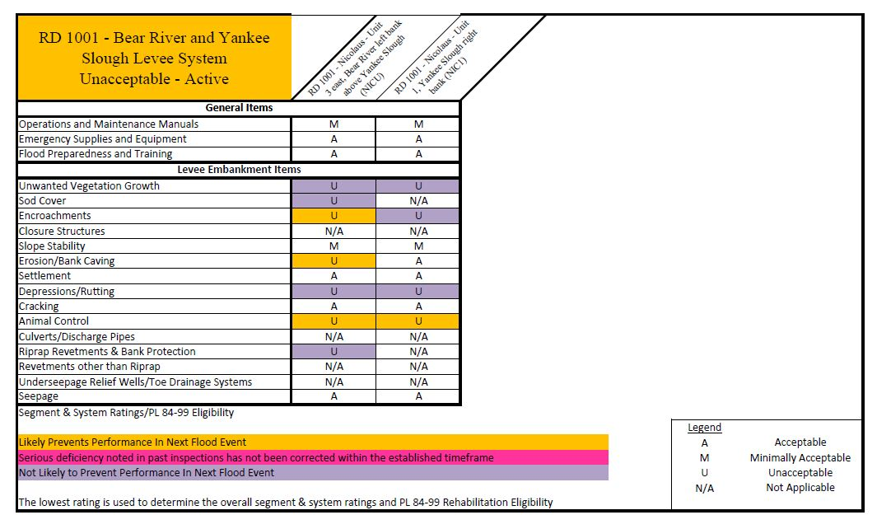

Slide 4
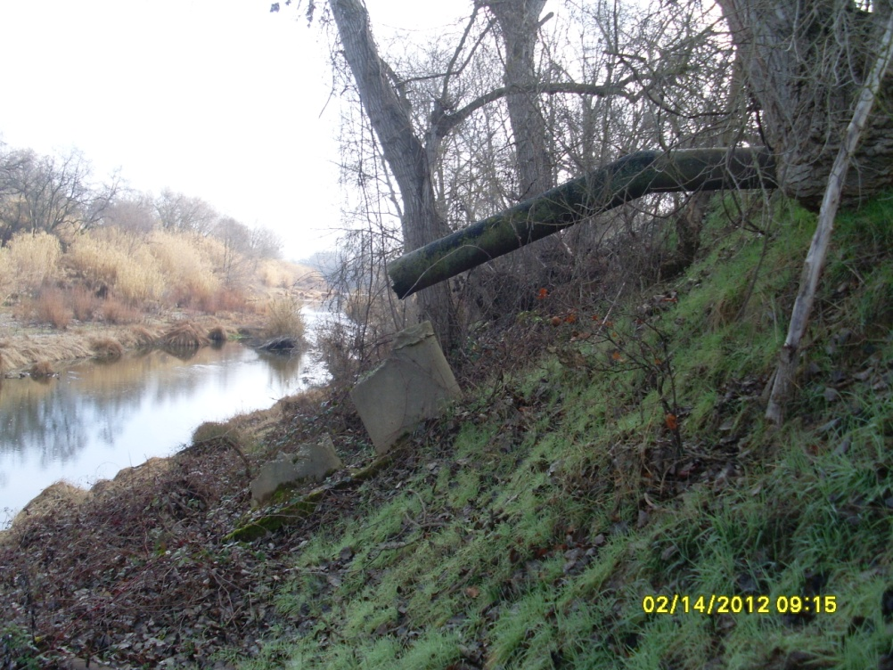
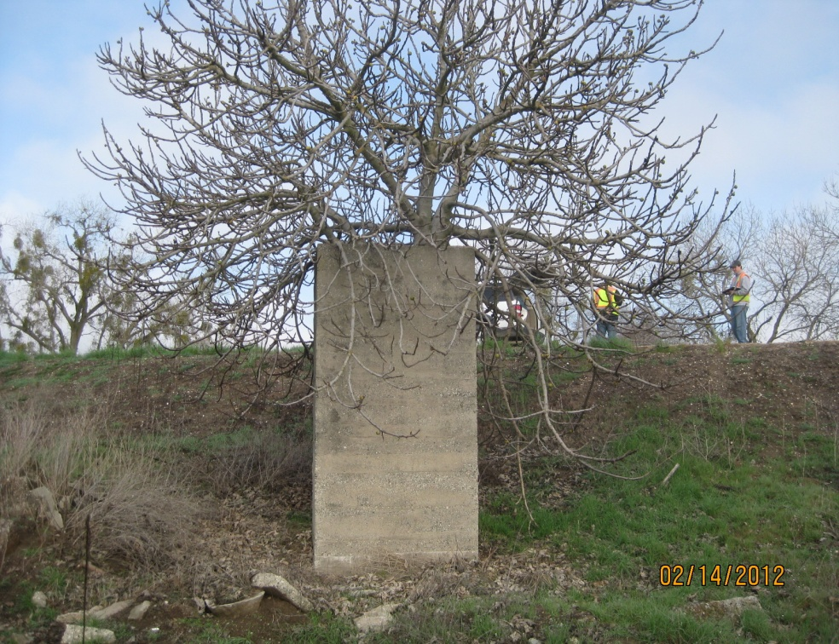
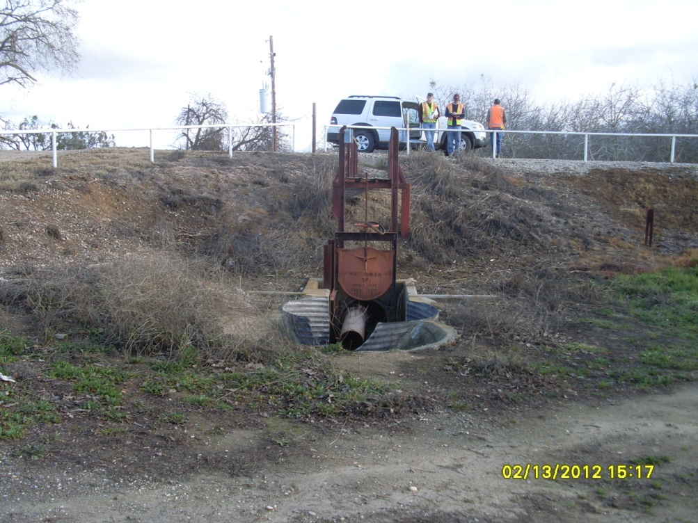
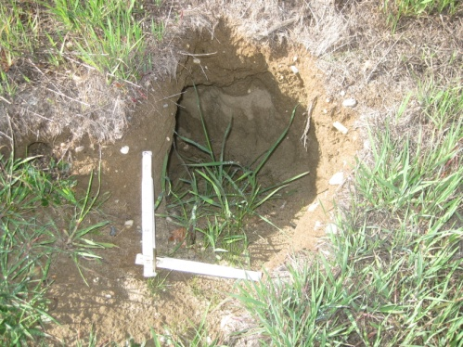
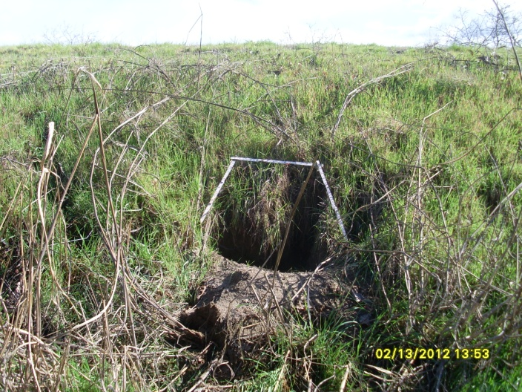
Notes:
NICU 147 ENCROACHMENT: 18 inch pipe through levee. Discharge pipe on waterside, no closure device. Concrete riser structure with tree growing out of it on landside. Inspection records not available.
NICU 108 Encroachment: 30 inch metal pipe through levee with well at waterside toe. Metal walkway from crown, and slide gate on waterside. 12 inch pipe prevents operation of slide gate.

Slide 5
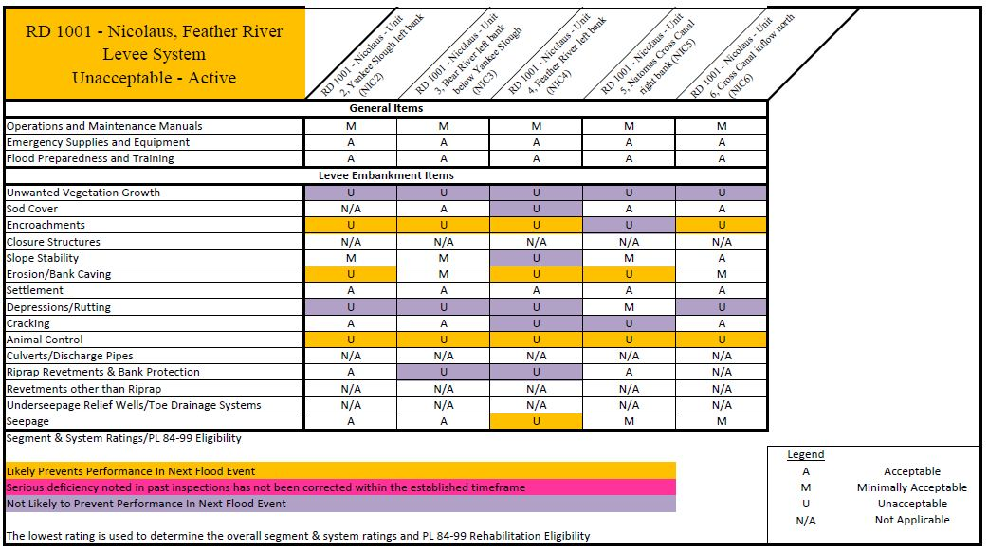

Slide 6
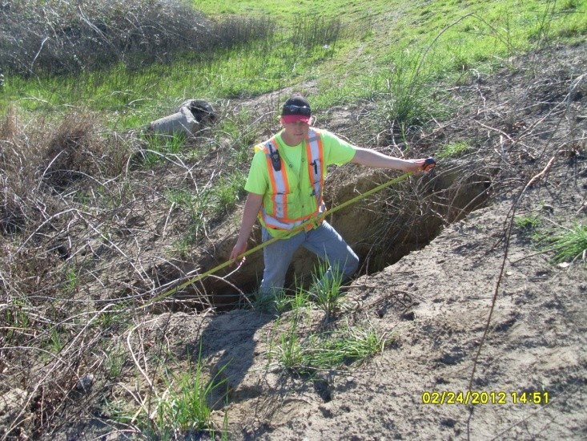
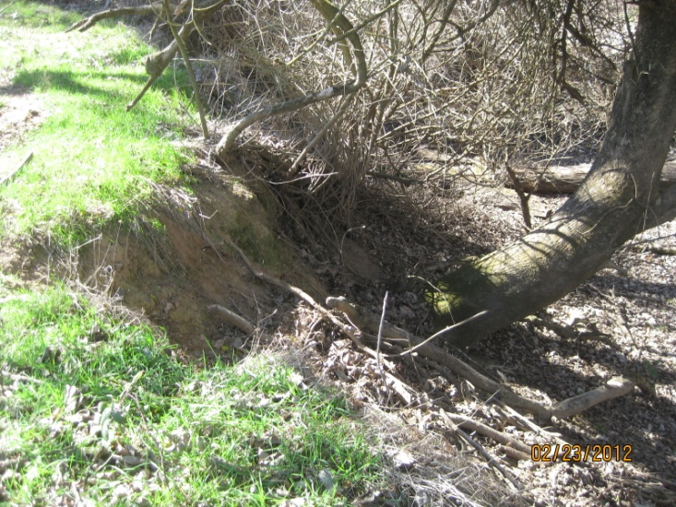
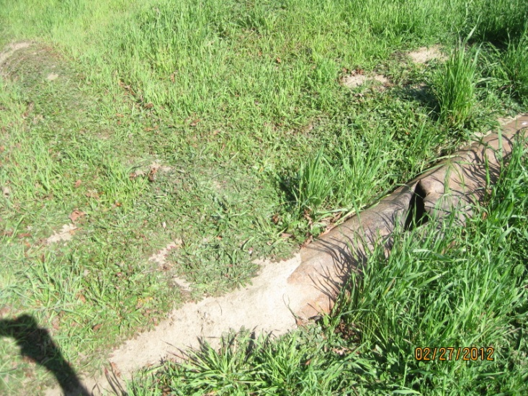
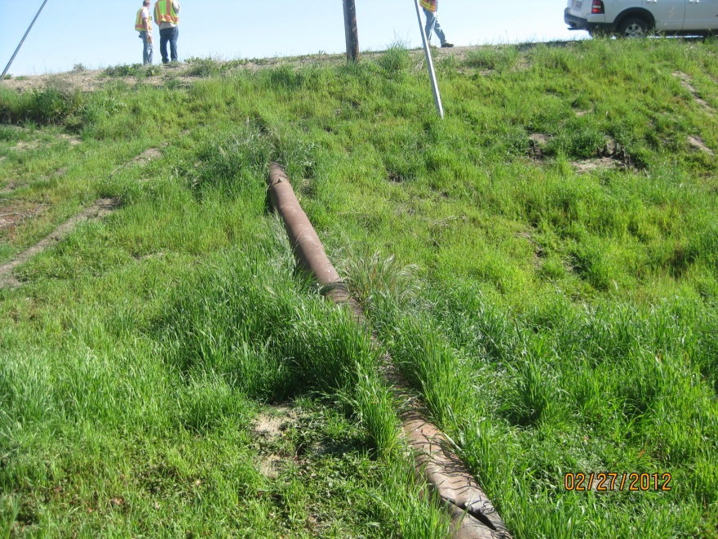
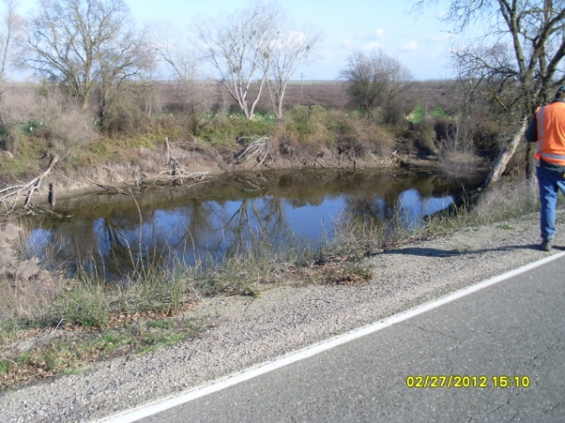
Notes:
Bottom Right: NIC4 557 SEEPAGE: Scour hole 12 to 15 feet from LS toe, likely from historical levee breach. Seepage cannot be ascertained due to water in hole at time of investigation. Water in hole appears to be roughly the same elevation as the water level of the waterside channel.
Middle: NIC4 512 ENCRO: 12 inch pipe through levee. Pipe exposed on waterside and landside with no positive closure device. Pipe on waterside is breached with holes and sand is visible within. Animals were exiting pipe at time of inspection. No inspection records available.
Top Left: NIC4 392 ENCRO: 6 foot diameter hole on lower third of landside embankment. Hole is 5 feet deep and caused by pipe through levee at this location (point 390).
Top Right: NIC4 122 EROSION: Start point. Erosion site at waterside toe. Erosion area is within the levee prism. Erosion face is 10 feet at a 1H:1V slope, with tree roots exposed. End point is 134.

Slide 7
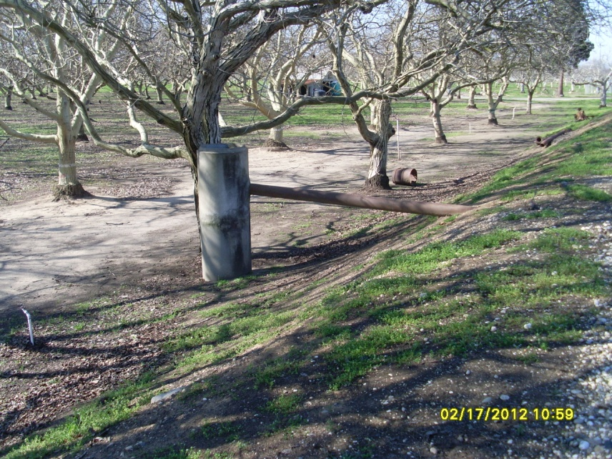
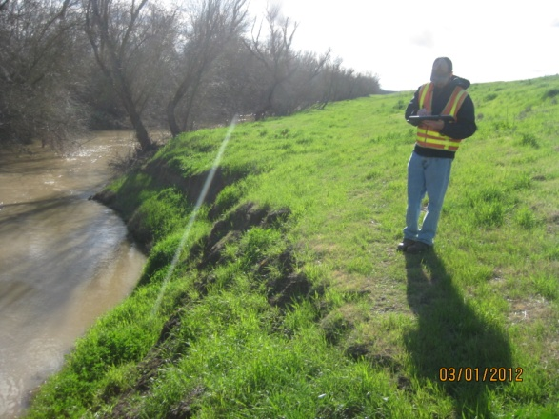
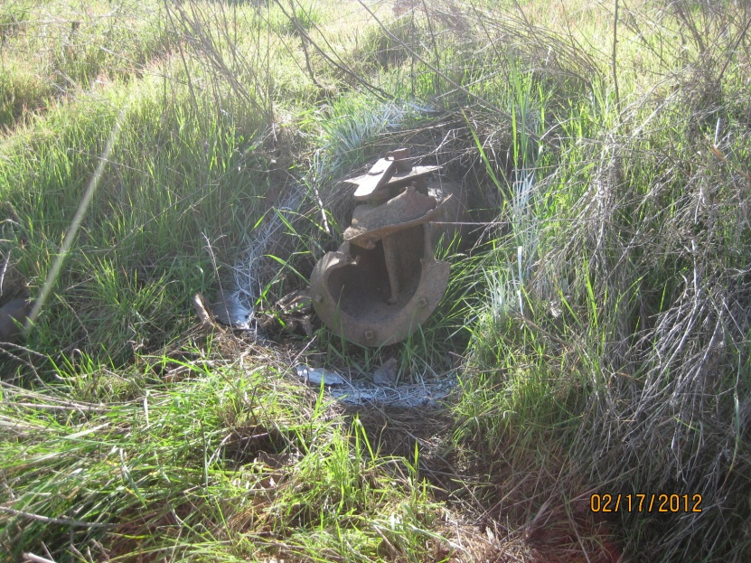
Notes:
Left: NIC2 35 ENCRO: 7 inch Pipe through the levee. Open on the waterside (broken), concrete standpipe at landside toe. (Permit No. 2281). Inspection records not available.
Right: NIC5 166 EROSION: Waterside bank eroded into levee embankment toe. Erosion 100 foot long and extends about 5 feet into embankment with a 1H:1V face of 15 feet.

Slide 8
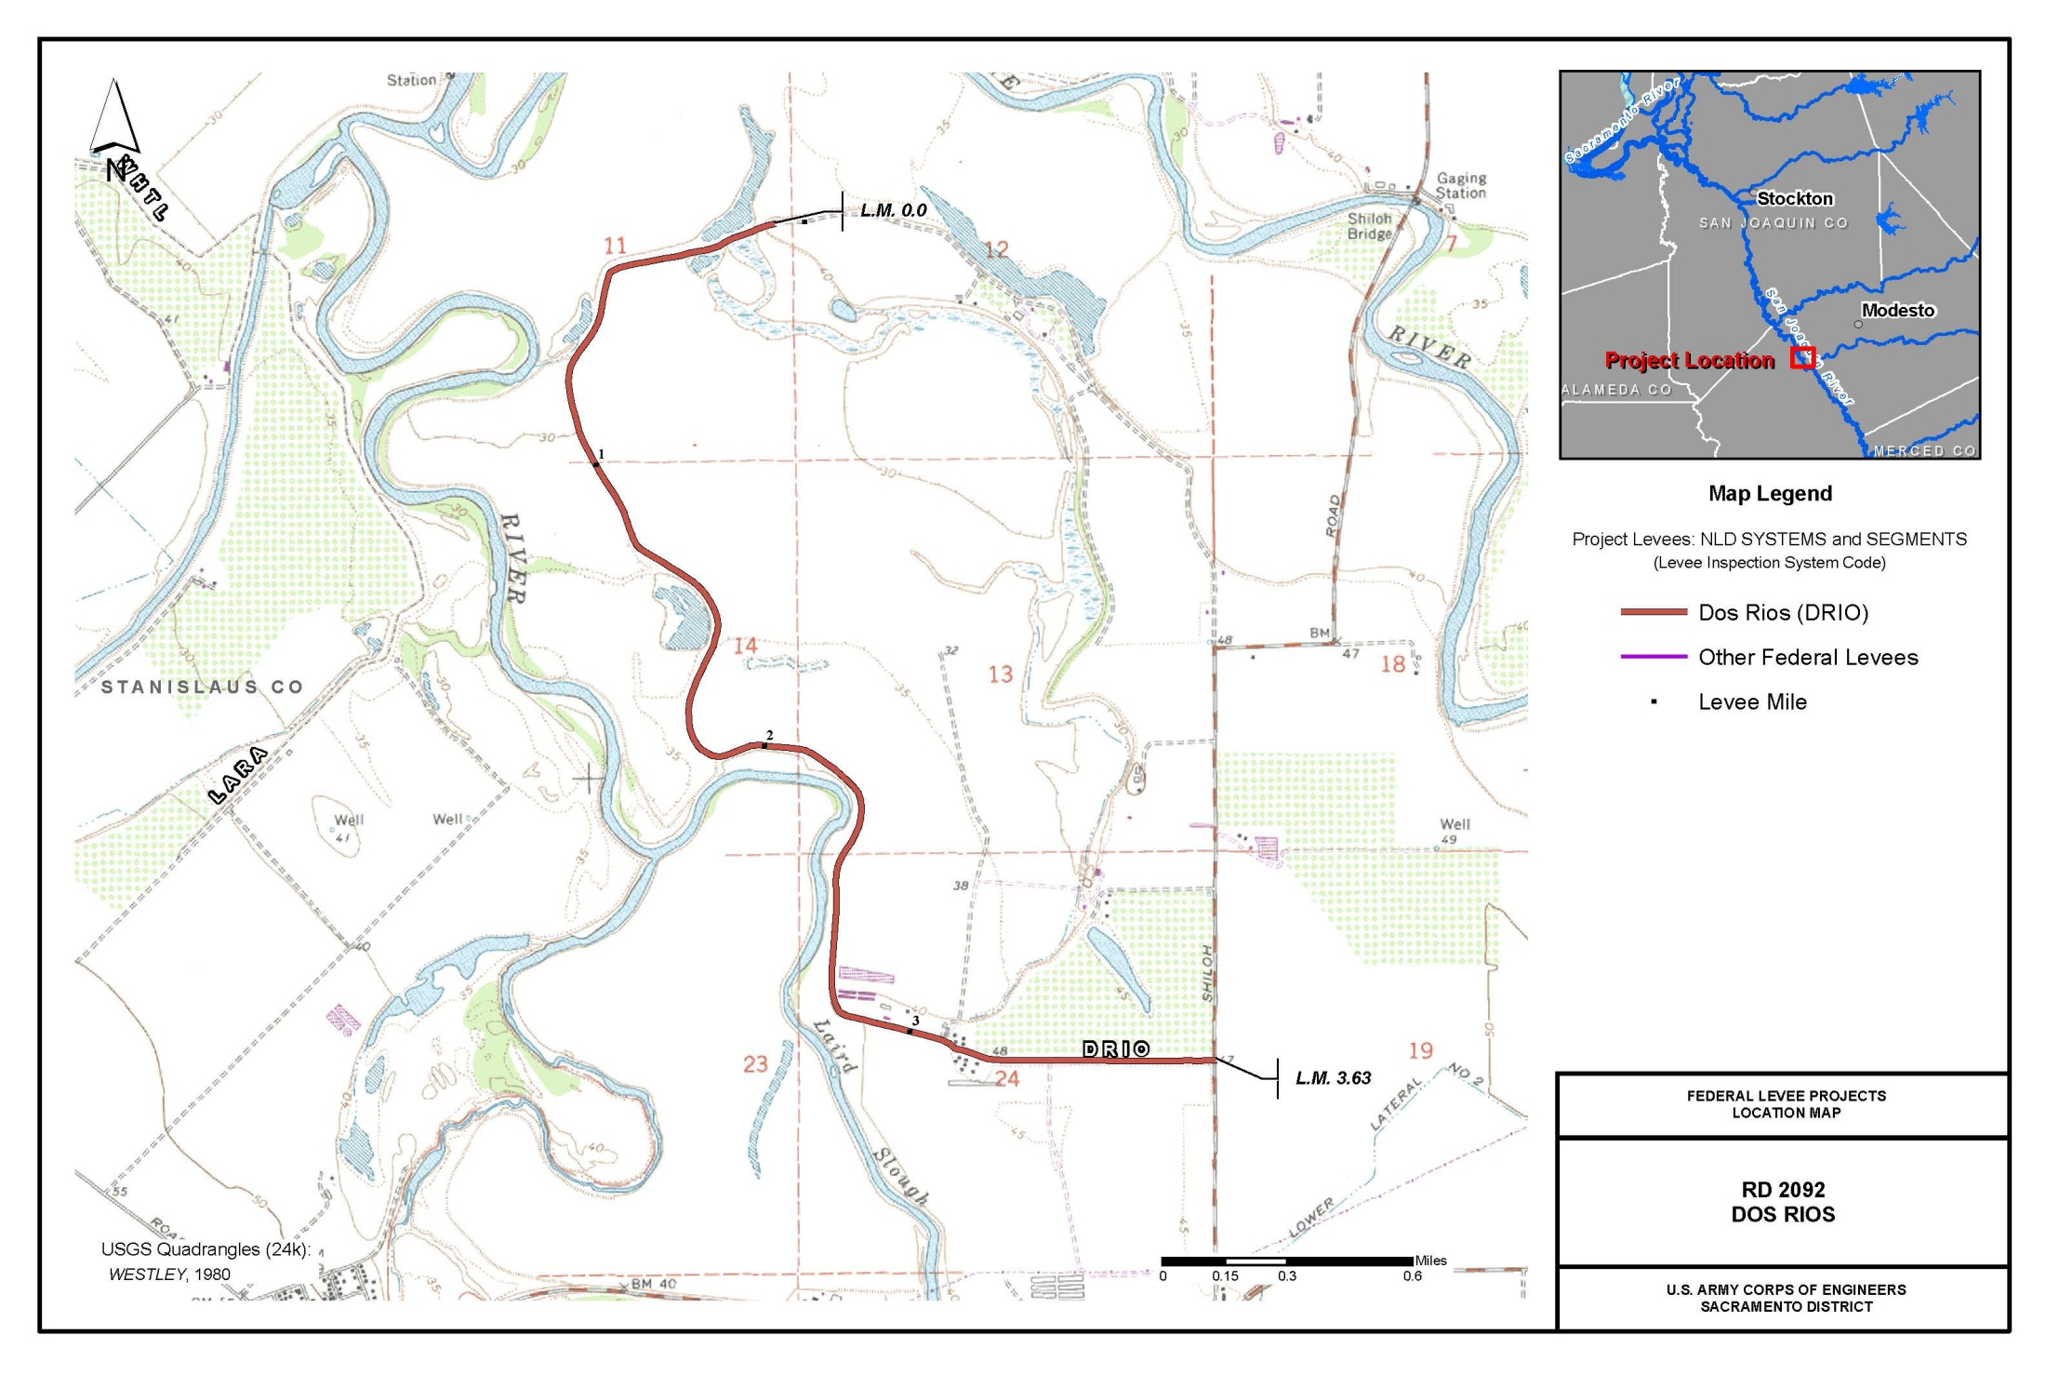
RD 2092

Slide 9
