Slide 1
AGENDA ITEM NO. 13c: knights landing Unit 2 – yolo bypass – service area 6 levee system:
Letter of intent to develop and implement a system-wide improvement framework plan
Jon P. Tice, Jr., PE
Enforcement Section decEMBER 20, 2013
Knights Landing unit 2 – yolo bypass – service area 6: letter of intent

Slide 2
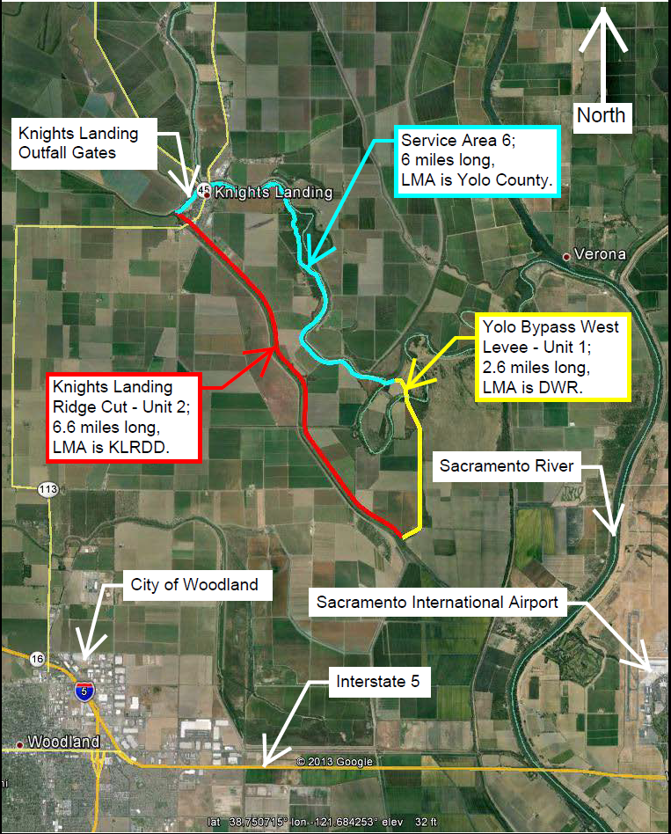
Knights Landing unit 2 – yolo bypass – service area 6: letter of intent
Location
Yolo County & Sutter County.
Includes the town of Knights Landing.
Description
One levee system, three levee segments, three LMAs.
15.2 miles of levee embankments and the Knights Landing Outfall Gates.
Protects population of approximately 1,000 people.
Local Maintaining Agencies (LMAs)
Knights Landing Ridge Drainage District (Knights Landing Ridge Cut – Unit 2)
DWR Sacramento Maintenance Yard (Yolo Bypass West Levee – Unit 1)
Yolo County (Service Area 6)

Slide 3
Knights Landing unit 2 – yolo bypass – service area 6: letter of intent
LMA Roles
  Knights Landing Ridge Drainage District (KLRDD) is leading the Letter of Intent (LOI) and System-Wide Improvement Framework (SWIF) plan efforts.
  Yolo County and DWR are the supporting partner LMAs in the levee system
USACE Periodic Inspection (PI) Report
  Issued June 2013 as “Unacceptable – Inactive” in PL 84-99 Rehabilitation & Inspections Program (RIP).
Purpose of the LOI and SWIF
  If accepted by the USACE, the LOI will allow the levee system to regain eligibility for RIP assistance for two years while LMAs develop a SWIF plan.

Slide 4
Knights Landing unit 2 – yolo bypass – service area 6: letter of intent
Staff Recommendation
  Staff has reviewed the LOI submitted by the KLRDD and finds that it adequately addresses the USACE’s six requirements for submitting a LOI for a SWIF; and therefore;
  Staff recommends that the CVFPB authorize the Executive Officer to finalize a letter of transmittal to the USACE and forward it with the signed LOI to the USACE.

Slide 5
Knights Landing unit 2 – yolo bypass – service area 6: letter of intent
LMA Representatives:
  Lewis Bair, KLRDD
  Mark List, DWR
  Regina Espinosa, Yolo County

Slide 6
Knights Landing unit 2 – yolo bypass – service area 6: letter of intent
  QUESTIONS?
  Barry O’Regan (Peterson Brustad Inc.)

Slide 7
Knights Landing unit 2 – yolo bypass – service area 6: letter of intent
USACE Policy for Development and Implementation of System-Wide Improvement Frameworks (SWIFs)
  Section 7. Requirements for Development and Submittal of a SWIF
    a. Requirements for Submitting a Letter of Intent for a SWIF. A letter of Intent must be signed by all associated levee sponsors.
      (1) Identification of levee systems to be covered as listed in the NLD;
      (2) Brief description of deficiencies or issues that will be included in the SWIF and discussion of how a system-wide approach will improve flood risk reduction;
      (3) Demonstration that significant non-federal resources have been, or will be committed;
      (4) Anticipated interim risk reduction measures that will be implemented throughout the SWIF process
      (5) Brief description of existing or planned interagency collaborative efforts;
      (6) List of anticipated state and federal permits and consultation requirements, needed to implement the SWIF.

