Slide 1
American river common features Project Agenda Item 13B RESOLUTION 2013-28 Dec 20, 2013

Slide 2
BOARD ACTION
Consider approval of Res. No. 2013-28 to:
Adopt the Mitigated Negative Declaration, Findings, and Mitigation, Monitoring and Reporting Plan for the R3A, L10, L7 and R7 Levee Improvement Projects;
Delegate authority to the Executive Officer to execute the Notice of Determinations;
Approve the R3A, L10, L7 and R7 Levee Improvement Projects

Slide 3
PROJECT INFORMATION
Project Partners
Federal – US Army Corps of Engineers
State – Central Valley Flood Protection Board
Local – Sacramento Area Flood Control Agency

Slide 4
PROJECT BENEFITS
Increasing American River’s capacity to 115,000cfs plus 3ft freeboard
Accommodates Folsom Dam Modifications Project

Slide 5
Jet Grout Methodology
All project cut-off walls will use Jet Grout method.
Jet Grout technique includes a drilling phase followed by withdrawal and rotation with simultaneous injection of fluids at high pressure to form columns.
Columns are overlapped to form a cut-off wall.

Slide 6
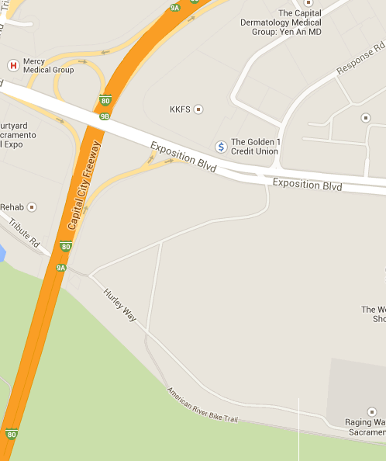
Site R3A Location
Location of R3A Project
Off of Business I-80.
Across from the California Exposition Center.

Slide 7
Site R3A Information
Description of R3A Project:
Levee improvements will be made in two locations on the American River South Levee.
Cutoff walls will be extended by approximately 75-feet on the upstream side of the Capital City Freeway and 67-feet downstream of the Freeway.

Slide 8
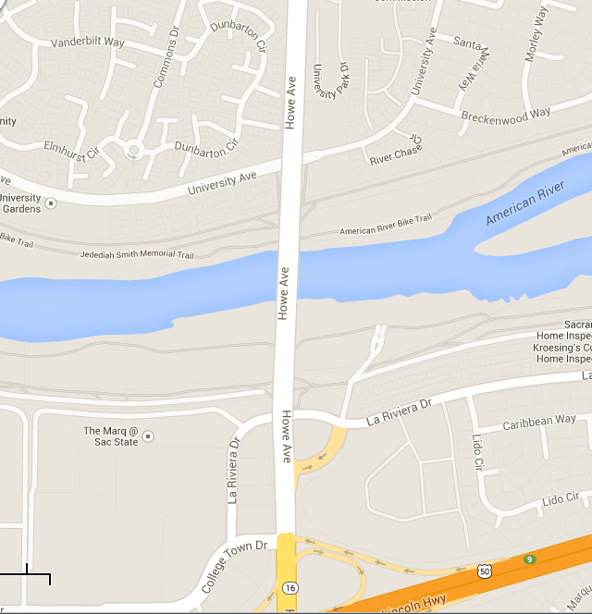
Site L10 Location
Location of L10 Project:
Along the south side of the American River.
At Howe Ave Bridge.

Slide 9
Site L10 Information
Description of L10 Project:
Levee improvements will be made on the American River levee on the south side.
A soil-cement cutoff wall will be installed under the Howe Avenue bridge.
A low permeability soil blanket will be installed connecting with the cutoff wall.

Slide 10
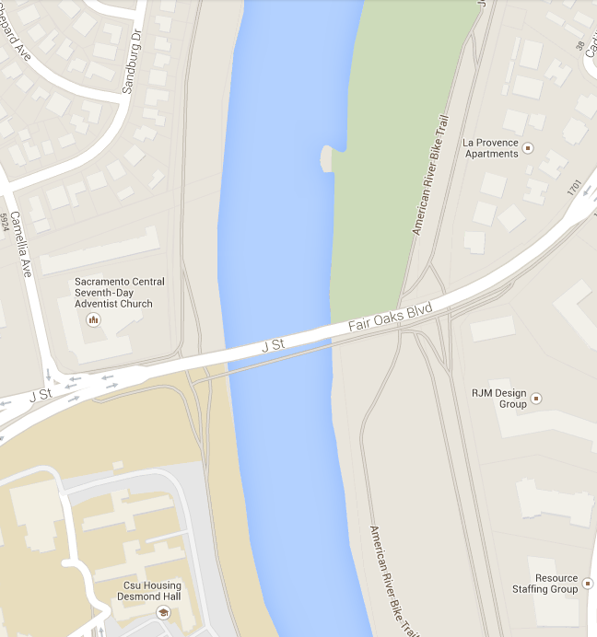
Sites R7 and L7 Location
Location of R7 and L7 Projects
Off H Street (Fair Oaks) Bridge.
Near Sacramento State University.

Slide 11
Site R7 Information
Description of R7 Project:
Existing levee approximately 11 feet height and a crown width of approximately 10 to 15 feet, with an asphalt road on the levee crown on both sides of bridge.
Dirt ramps on both sides of the bridge connect the levee crown.
The gap between these 2 ramps is 151 feet and will be used for jet grouting.

Slide 12
Site L7 Information
Description of L7 Project:
Existing levee approximately 12 feet height and a crown width of approximately 18 to 20 feet, with an asphalt road on the levee crown on both sides of the bridge.
Dirt ramps on both sides of the bridge connect the levee crown.
The gap between these 2 ramps is 325 feet and will be used for jet grouting.

Slide 13
Staff Recommendation
Board adopt Resolution No. 2013-28 which constitutes the Board’s written findings and decision in the matter. The Resolution contains the following:
Adoption of the Mitigated Negative Declarations
Adoption of the Mitigation, Monitoring and Reporting Plans
Delegate authority to the Executive Officer to execute the Notice of Determinations
Approval of the American River Common Features Sites R3A, L10, L7 and R7

Slide 14
Purposed CEQA Findings
Questions?

