Slide 1
feather river setback levee at THE star bend project to levee district No. 1, OF sutter county December 20, 2013
BOARD TRANSFER of O&M RESPONSIBILITIES

Slide 2
REQUESTED ACTION
Consider adoption of Central Valley Flood Protection Board (Board) Resolution 2013-21 which:
Accepts, from the USACE, Board responsibilities to operate and maintain the Feather River Setback Levee at Star Bend,
Receives, from the U.S. Army Corps of Engineers (USACE), the revised Supplement to Standard Operations and Maintenance Manual, Sacramento River Flood Control Project, Unit No. 144, West Levee of Feather River from North Boundary of Levee District 1 to North Boundary of Maintenance Area 3 (previously Reclamation District No. 823), USACE, Sacramento District, June 2013,
Receives, from the USACE, final project as-built drawings, originally prepared by Levee District 1,
and transfers to Levee District No. 1, Sutter (LD 1), (via draft letter), responsibilities to operate and maintain the Star Bend Setback Levee along with the above documentation.

Slide 3
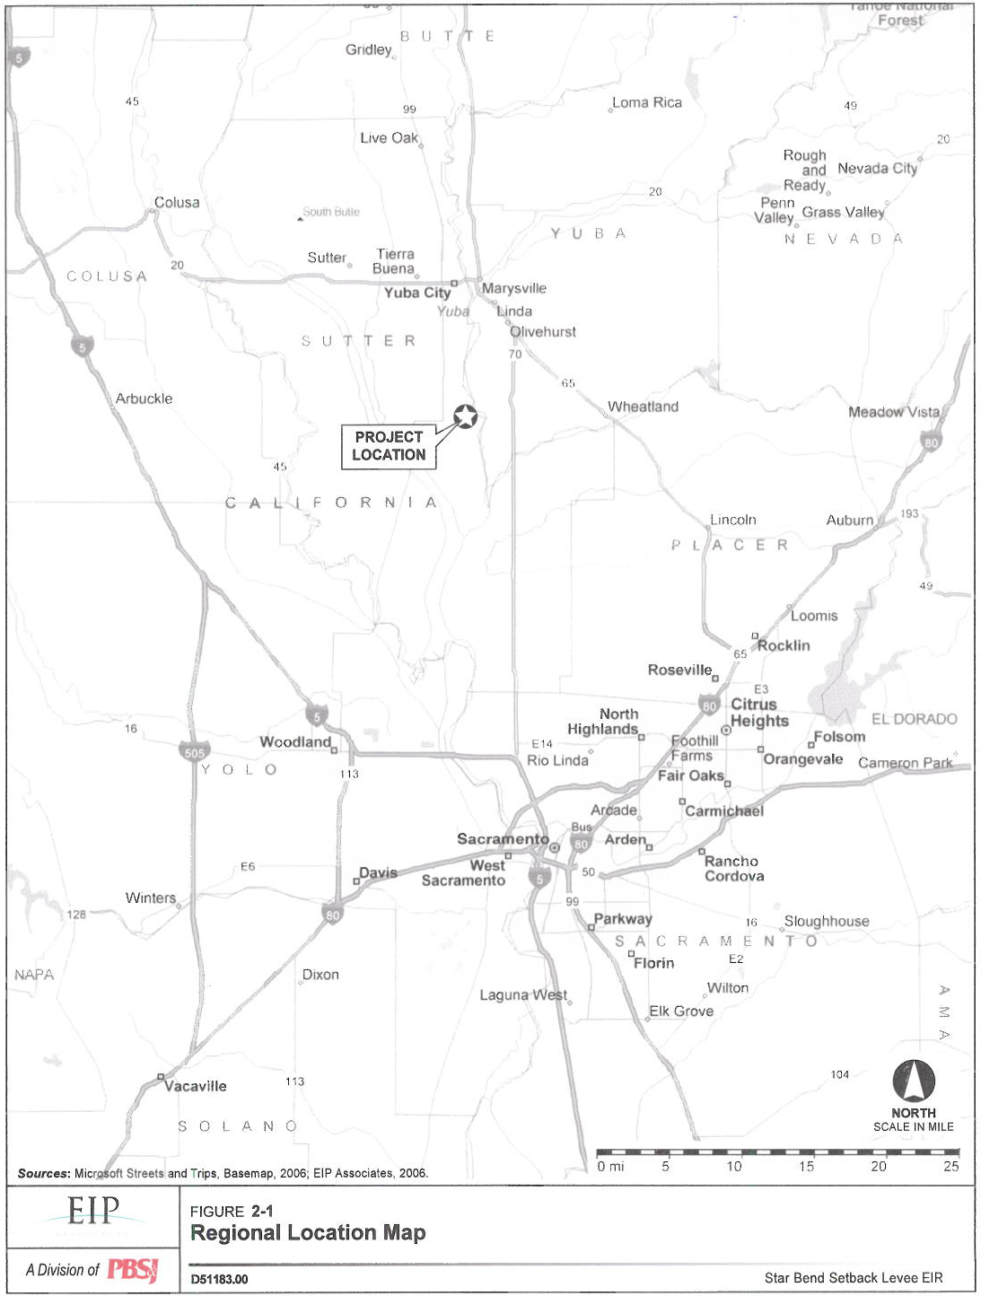
REGIONAL MAP
YUBA CITY
FEATHER RIVER
SUTTER BYPASS
PROJECT LOCATION
HWY-70
HWY-5

Slide 4
PROJECT BACKGROUND
This reach of levee was originally built by local interests to protect Yuba City and adjacent agricultural lands and later re-constructed to the adopted grade and section by the USACE.
Freeboard 3 feet or better at project design flow of 300,000 cfs
The Feather River floodplain varies between 1,200 feet and 6,000 feet in width.
The project works include the west levee and banks of the Feather River from the north boundary of Levee District No. 1 (LD 1) downstream 16.65 levee miles to the north boundary of Maintenance Area 3 (formerly Reclamation District No. 823).

Slide 5
PROJECT DESCRIPTION
The project included:
Removal of approximately 4,500 linear feet of existing project levee
Construction of 3,400 linear feet of setback levee with slurry cutoff wall
Modification of existing irrigation pipelines and facilities

Slide 6
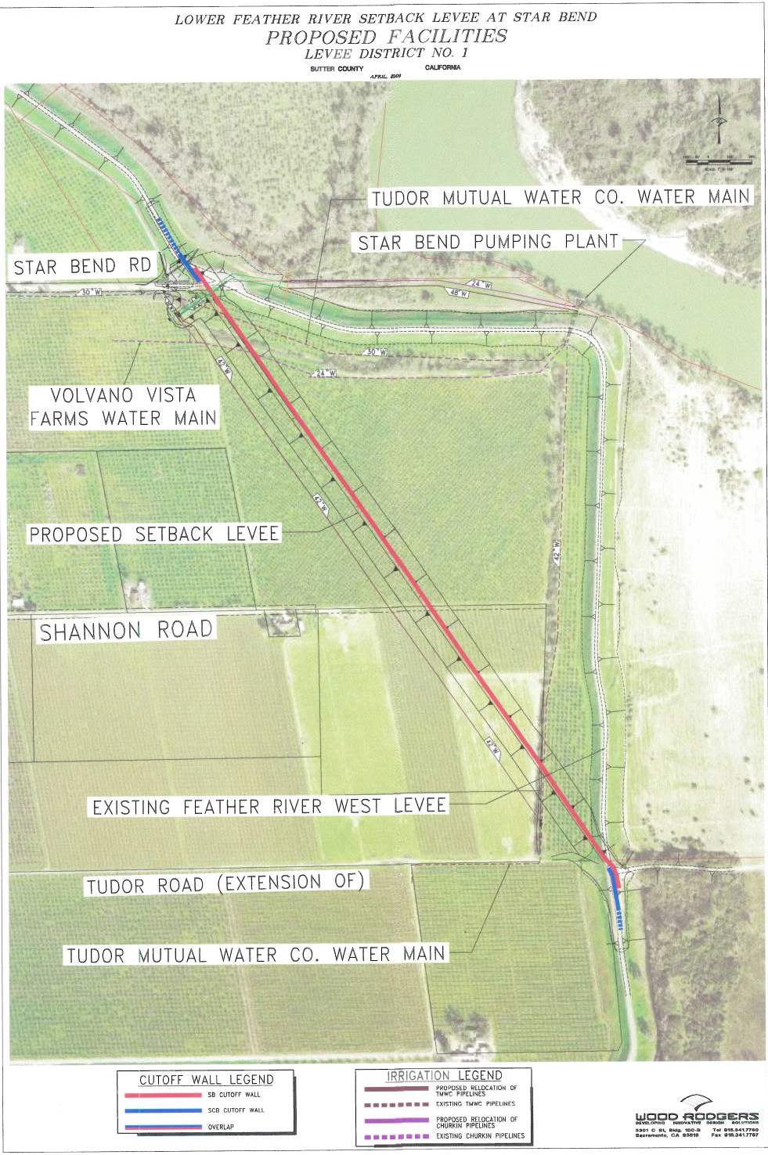
FACILITIES MAP
NEW
DEGRADED

Slide 7
AERIAL OF STAR BEND SET-BACK LEVEE

Slide 8
AUTHORITY OF THE BOARD
California Water Code, Division 5, Part 2, Chapter 3, § 8350 and § 8370
California Code of Regulations, Title 23 (CCR 23)
Rivers and Harbors Act of 1899, Title 33 United States Code, § 408 (Section 408)
Standard Operation and Maintenance Manual for the Sacramento River Flood Control Project (Revised), Sacramento District, USACE, May 1955
Supplement to Standard Operation and Maintenance Manual, Sacramento River Flood Control Project, Unit No. 144, West Levee of Feather River from North Boundary of Levee District No. 1 to North Boundary of Reclamation District No. 823, Sacramento District, Corps of Engineers, U.S. Army, August 1955.

Slide 9
PROJECT TIME LINE (1 OF 3)
Feb 2007 LD 1 Draft EIR for Star Bend Setback Levee
Jun 16, 2008 EIP Funding Agreement signed between DWR and LD 1
Nov 14, 2008 CVFPB provided assurances to USACE via 408 request letter on behalf of LD 1
Apr 17, 2009 CVFPB public hearing approving Permit No. 18191
May 11, 2009 CVFPB conditionally issued Permit No. 18191
Jun 1, 2009 USACE HQ 408 approval to CVFPB to alter a portion of the SRFCP
Jun 16, 2009 USACE Sac District Letter of Permission (transmitting June 1 HQ approval)

Slide 10
PROJECT TIME LINE (2 OF 3)
Fall 2009 Levee setback construction substantially completed
Dec 3, 2010 OMRR&R Agreement in place between Board and LD 1
July 2012 LD 1 submittal of revised Supplemental to Standard O&M Manual, as-builts, Flood Safety and Preparedness Plan, pursuant to ER 1110-2-401
Oct 23, 2012 CVFPB Staff Permit Acceptance Letter to USACE
Constructed in accordance with final plans and specifications
Met all permit conditions
Compliant with Title 23

Slide 11
PROJECT TIME LINE (3 OF 3)
Jul 18, 2013 O&M Transfer Letter from USACE to CVFPB
Improvements constructed in accordance with final plans and specifications
Accepted setback levee as part of the SRFCP
transmitted Supplement to Standard O&M Manual and as-built drawings to CVFPB
Accepted Flood Safety and Preparedness Plan
Assigned Board the responsibilities to operate and maintain the setback levee as part of the SRFCP

Slide 12
CEQA ANALYSIS
The Board, as a responsible agency previously approved construction of the project under Permit No. 18191, made appropriate CEQA findings, and filed determinations with the State Clearinghouse
Today’s action consists solely of the transfer of operations and maintenance responsibilities and corresponding documents for the completed project to LD 1
This action constitutes a ministerial approval statutorily exempt from CEQA under CEQA Guidelines section 15268

Slide 13
REAL ESTATE ACQUISITION
Permit No. 18191, Condition 18, states that a fee interest or permanent easement is required granting all flood control rights upon, over and across the property occupied by the setback levee to the Sacramento San Joaquin Drainage District (SSJDD).
LD 1 submitted all documents required by this permit condition, and final document processing is being performed by the DWR Real Estate Branch
When complete DWR will submit the documents for Board approval and signature prior to recording with the Sutter County Recorder
Staff anticipates this will occur within the next few months
This action does not impact today’s decision

Slide 14
STAFF CONCLUSIONS
Board staff concludes that the Feather River Setback Levee at Star Bend:
was constructed in accordance with the final (100 percent) plans and specifications
met all permit conditions (including incorporated USACE conditions)
is compliant with the Board’s Title 23 regulations
was properly certified by professional engineers
Staff further concludes that:
the project was properly transferred by the USACE to the Board
all necessary preparations have been made to transfer operations and maintenance responsibilities to LD 1 as the local maintaining agency

Slide 15
STAFF RECOMMENDATION
Staff therefore recommends that the Board adopt Board Resolution 2013-21 which:
Accepts responsibilities to operate and maintain the Feather River Setback Levee at Star Bend, a portion of the Sacramento River Flood Control Project as described in the USACE-accepted Supplement to Standard Operations and Maintenance Manual, Unit No. 144, West Levee of Feather River from North Boundary of Levee District No. 1 to North Boundary of Maintenance Area 3 (Previously Reclamation District No. 823), U.S. Army Corps of Engineers, Sacramento District, June 2013.
Transfers those same responsibilities (along with copies of the Supplemental to Standard O&M Manual and as-built drawings) to Levee District No. 1, Sutter Co. through approval of the draft Transfer of Operation and Maintenance Responsibilities for the Feather River Setback at Star Bend Project letter.
Determines that these transfers from the Board to LD 1 are ministerial approvals and statutorily exempt from CEQA, and directs the Executive Officer to file a Notice of Exemption with the State Clearinghouse.
Authorizes the Board’s Executive Officer to execute the Transfer Letter in substantially the form provided.

Slide 16
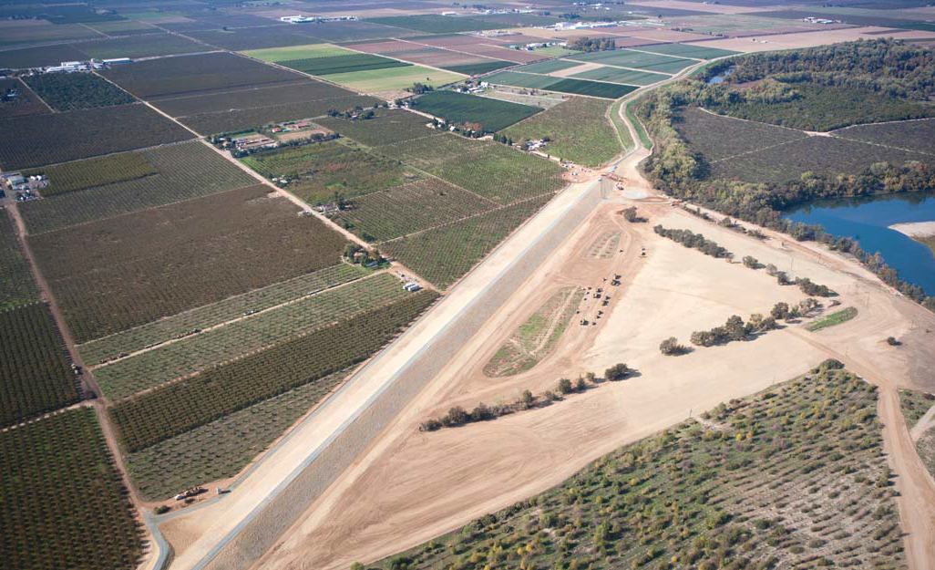
QUESTIONS
Prepared By: David R. Williams, PE
Environmental By: James Herota
Legal review By: Leslie Gallagher, Esq
Reviewed By: Eric Butler, PE
Len Marino, PE

Slide 17
BACK-UP MATERIAL
Levee District – 1, Sutter County OFFICIALS
Chairman: Francis Silva (530)632-3069 cell
General Manager/ Superintendent: Bill Hampton (530)237-7547 cell
District Office: (530) 673-2454 office
Engineer: Sean Minard, MHM Eng’s (530)682-6497 cell
Attorney: Dan Kelly, SomachSimmons&Dunn (916)469-3833 direct
dkelly@somachlaw.com (916)446-7979 office

Slide 18
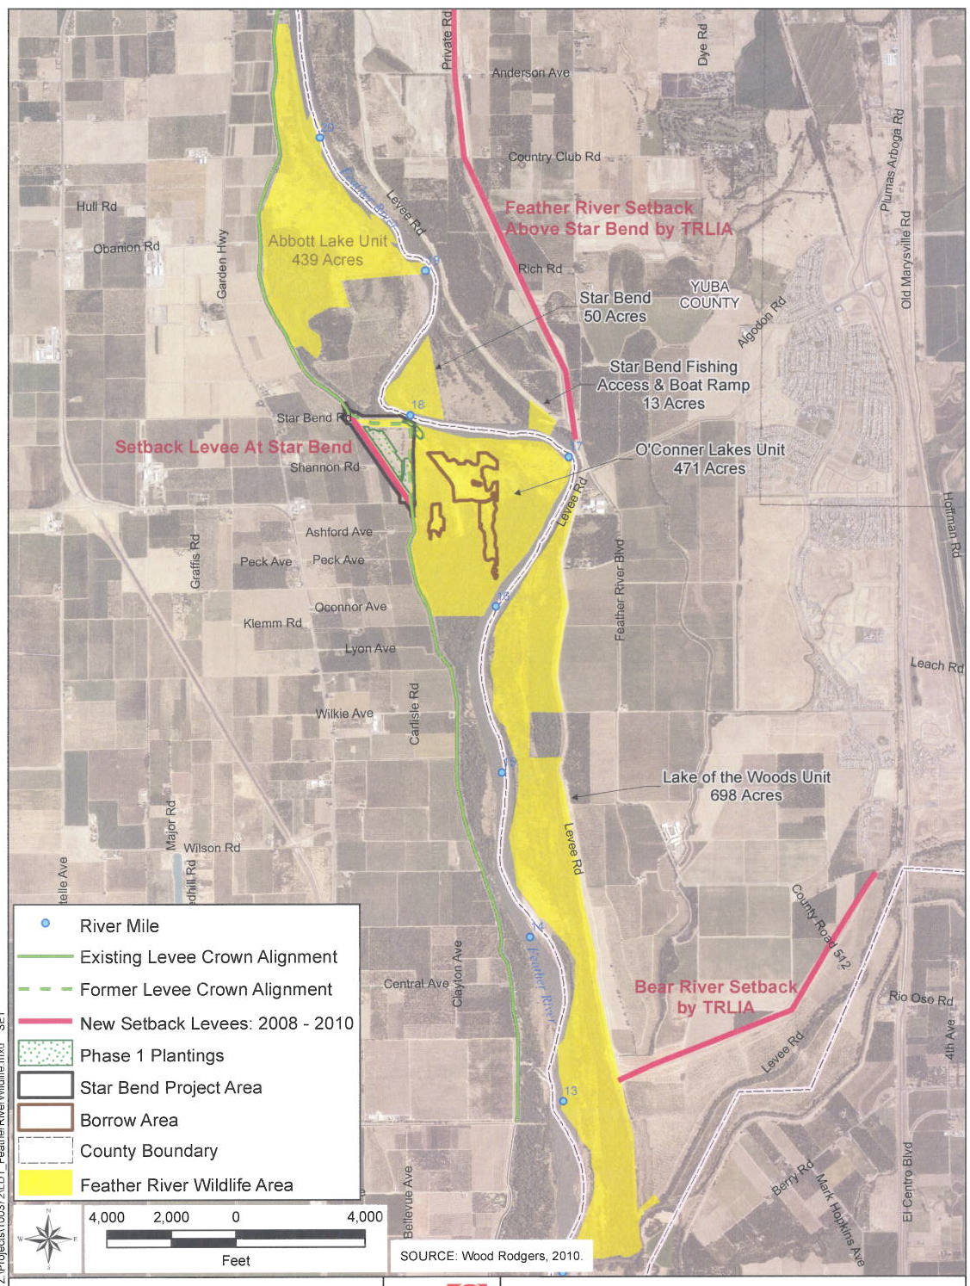
FEATHER RIVER WILDLIFE AREA

Slide 19
PROJECT PERMITS 1 of 2
LD-1 SetBack Levee is a constructed project consisting of four CVFPB permits.
The first main permit is being transferred to LD-1 for O&M responsibilities.
The remaining three permits have O&M responsibility lined out by the Board permits with over-sight by LD-1, the Board, and USACE.
Permit 18191 Levee District No.1, Sutter County, dated: May 11, 2009.
Remove ~4,500 feet of existing project levee and
Construct 3,400 feet of setback levee (LM 3.75 to 4.5) with a slurry cutoff wall Modify the existing pipelines at Star Band on the west bank of the Feather River.
Permit 18437 Tudor Mutual Water Company, dated: April 13, 2009.
Remove an existing irrigation pipe and
Install a 48-inch-diameter, 1,660-foot pipe from the existing pump station to the waterside toe of the new setback Levee
Install two 30-inch-diameter, 510-foot pipes up and over new setback levee, and place fill material on landside slope at upstream end of the setback levee.

Slide 20
PROJECT PERMITS 2 of 2
Permit 18438 Volcano Vista Farms, dated: April 13, 2009
Removed existing irrigation pipeline and
Install a 24-inch diameter, 1,660-foot pipe from the existing pump station to the waterside toe of the new setback levee
Install an 18-inch-diameter, 510-foot pipe up and over new setback levee; and place fill material on landside slope at upstream end of setback levee.
Permit 17936 Ca. Department of Fish and Game, dated: August 18, 2006
To restore 20.5 acres by planting several species of native trees and shrubs on the overflow area of the west bank of the Feather River within the Feather River Wildlife Area in Sutter County.
This was a condition of the USFWS Biological Opinion.

Slide 21
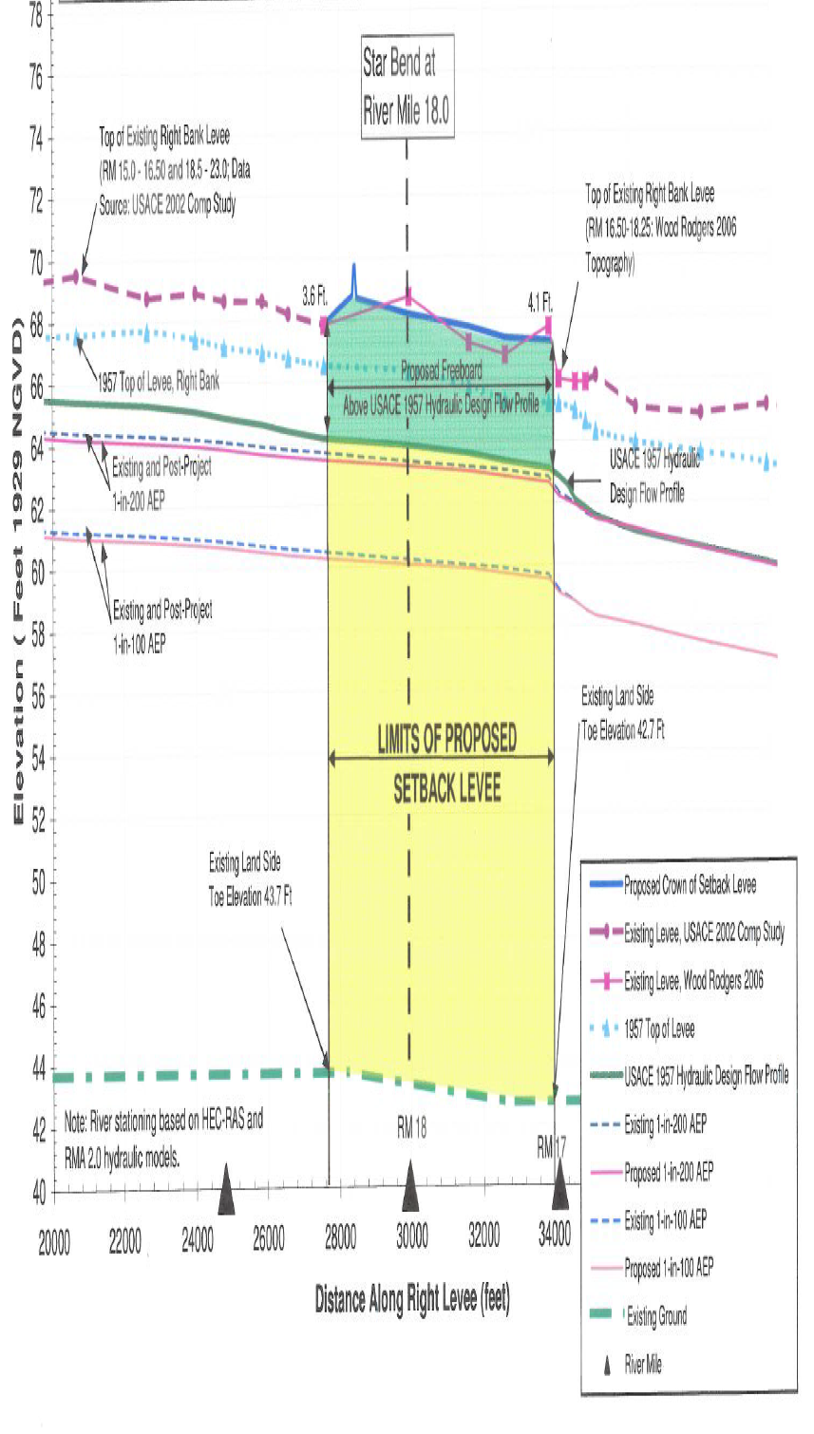
PRE AND POST WATER SURFACE PROFILE
U/S
D/S

Slide 22
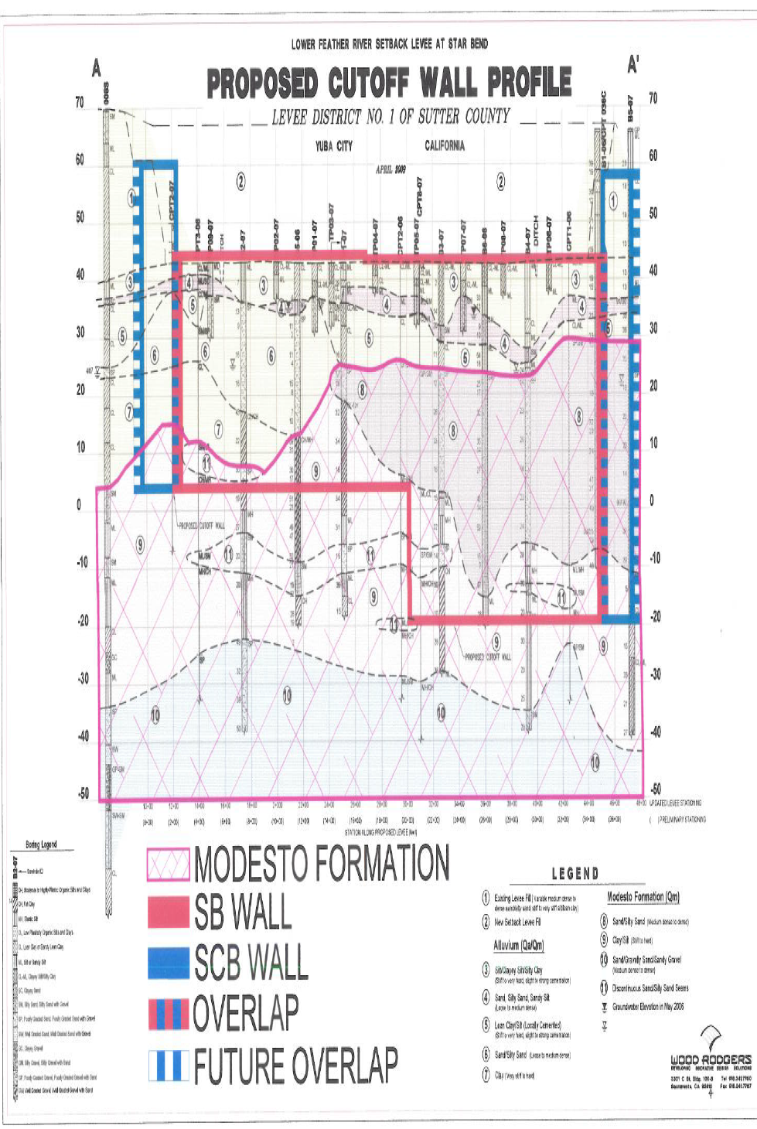
CONSTRUCTED CUTOFF WALL
U/S
D/S
FRWL Proj-C
FRWL Proj-B
D=40 ft.
D=62 ft.
L=1,750 ft.
L=1,500 ft.

Slide 23
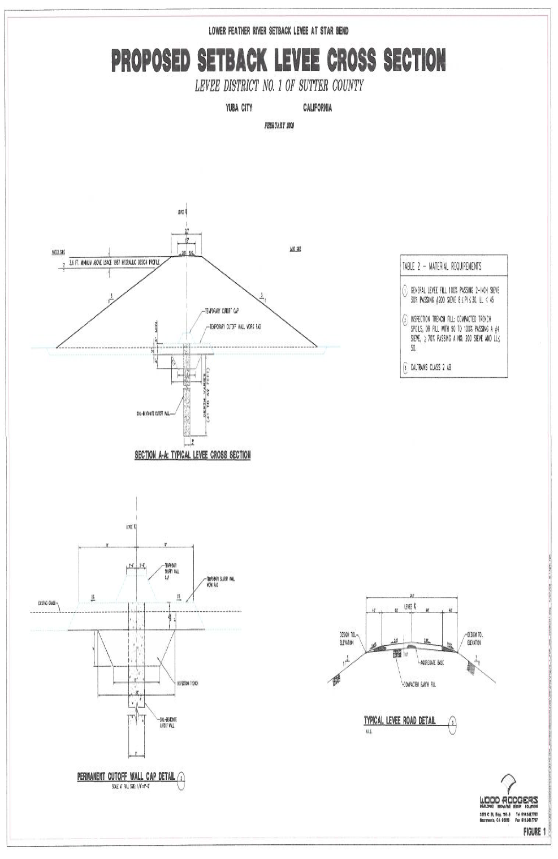
CONSTRUCTED LEVEE SECTION

Slide 24
