Slide 1
Agenda item no. 10A: Sacramento river west bank levee system Letter of intent to develop and implement a system-wide improvement framework plan Martin Janolo CVFPB Enforcement Section DECEMBER 20, 2013
Sacramento River West Bank Levee System – letter of intent

Slide 2
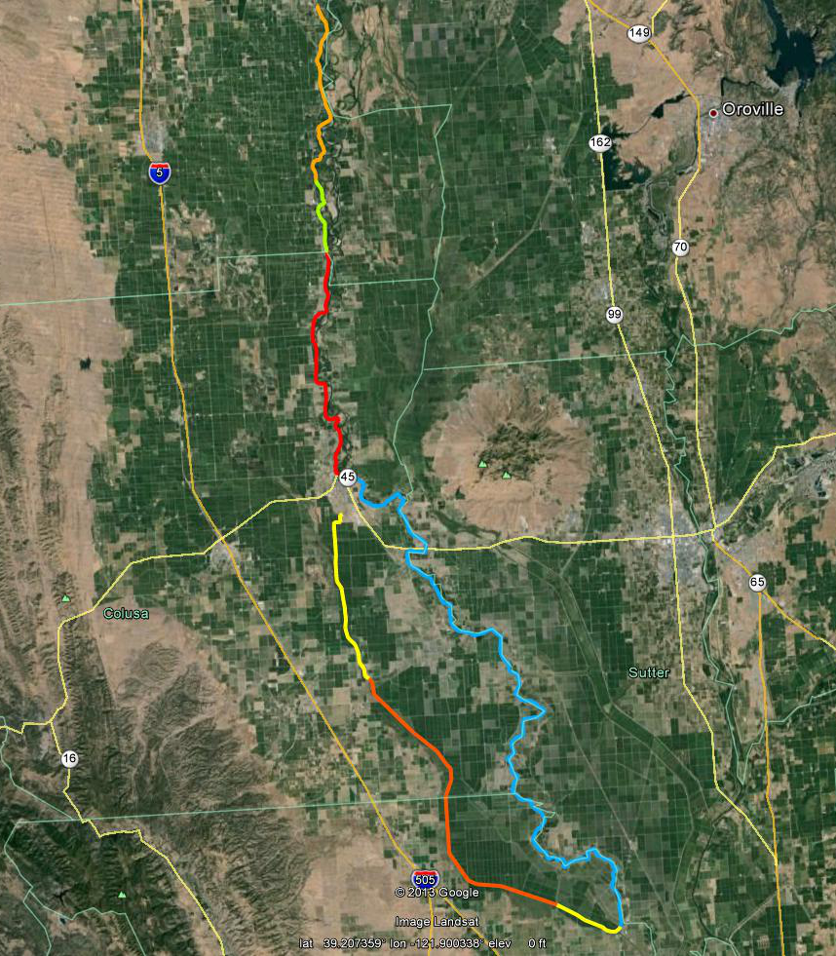
SRWB Levee System – location
Location
Butte, Sutter, Yolo, Colusa, Glenn Counties
Description
Approximately 120 miles of Project Levees protecting about 202,000 acres that include urban, rural, agricultural land, and towns including Glenn, Princeton, Colusa, and Grimes. Population protected are in excess of 7,600 people.
GLENN
Glenn
Princeton
BUTTE
Moulton Weir
Colusa Weir
Sacramento River
Colusa
COLUSA
Tisdale Weir
Colusa Drainage
Grimes
SUTTER
YOLO
Map Source: Google Earth

Slide 3
SRWB – LEVEE SEGMENTS
Levee Segments
Levee District (LD) 1 Glenn – 12 mi.
LD 2 Glenn – 4 mi.
DWR Maintenance Area (MA) 1 – 16 mi.
Sacramento River West Side Levee District (SRWLD) from Colusa Bridge to Tisdale Bypass – 23 mi.
SRWSLD below Tisdale Bypass – 26 mi.
Reclamation District (RD) 787 – 4 mi.
RD 108 – 20 mi.
DWR MA 12 – 11 mi.
LD1G
LD2G
MA1
MA12
SRWLD
Tisdale Weir
RD108
SRWLD
RD787
Notes:
SRWLD ends at River Mile 89.9, on Sycamore Slough.

Slide 4
SRWB Levee system – letter of intent
LMA Roles
RD 108 has taken the lead in coordinating with the LMAs and DWR to submit a Letter of Intent (LOI) for a System-Wide Improvement Framework (SWIF) plan
Letters of Support for the LOI for a SWIF plan were received from all affected local maintaining agencies (LMAs), including DWR
USACE Inspections
April 2013 - Final Periodic Inspection Report was released and indicated the system to be rated “Unacceptable,” resulting in an “Inactive” status in the PL84-99 Rehabilitation and Assistance Program (RIP).

Slide 5
Srwb levee system – letter of intent
Purpose of the LOI and SWIF
If accepted by the USACE, the LOI will allow the levee system to regain eligibility for RIP assistance for two years while the SRWB Levee System develop a SWIF.
Staff Recommendation
Staff has reviewed the LOI submitted by RD 108 for the SRWB Levee System and finds that it adequately addresses the USACE’s six requirements for submitting a LOI for a SWIF; therefore
Staff recommends that the CVFPB authorize the Executive Officer to finalize a letter of transmittal to the USACE and forward it with the signed LOI to the USACE

Slide 6
Srwb levee system– letter of intent
QUESTIONS?
Barry O’Regan (Peterson Brustad Inc.)

Slide 7
Srwb levee system– letter of intent
USACE Policy for Development and Implementation of System-Wide Improvement Frameworks (SWIFs)
Section 7. Requirements for Development and Submittal of a SWIF
a. Requirements for Submitting a Letter of Intent for a SWIF. A letter of Intent must be signed by all associated levee sponsors.
(1) Identification of levee systems to be covered as listed in the NLD;
(2) Brief description of deficiencies or issues that will be included in the SWIF and discussion of how a system-wide approach will improve flood risk reduction;
(3) Demonstration that significant non-federal resources have been, or will be committed;
(4) Anticipated interim risk reduction measures that will be implemented throughout the SWIF process

Slide 8
Srwb levee system– letter of intent
USACE Policy for Development and Implementation of System-Wide Improvement Frameworks (SWIFs)
Section 7. Requirements for Development and Submittal of a SWIF
a. Requirements for Submitting a Letter of Intent for a SWIF. A letter of Intent must be signed by all associated levee sponsors.
(5) Brief description of existing or planned interagency collaborative efforts;
(6) List of anticipated state and federal permits and consultation requirements, needed to implement the SWIF.

Slide 9
Srwb levee system– letter of intent
USACE Continuing Eligibility Inspection (CEI)
Visual inspection that verifies proper levee system operation and maintenance, and conducted annually on 10% of the project levees
USACE Periodic Inspection (PI)
Provides a more rigorous level of assessment than the annual Routine Inspection and are conducted every five years
Both Inspections will result in a rating that determines if a levee system is active in the USACE Levee Safety Program
Notes:
3 key steps: collection of existing and available data on O&M, previous inspection and engineering reports, EAP’s, and flood-fighting records; field inspection performed by multidisciplinary team; inspection report
More information found at USACE Sacramento District website FAQ sheet - http://www.spk.usace.army.mil/Missions/CivilWorks/LeveeSafetyProgram/LeveeSafetyFAQs.aspx

