Slide 1
CVFPB MEETING – October 25, 2013
AGENDA ITEM
Hearing for Permit No. 18845
Applicant: Westervelt Ecological Services
Project: To develop a Giant Garter Snake Mitigation Bank in the Colusa Drain Designated Floodway.

Slide 2
CVFPB MEETING – October 25, 2013
Agenda Amendment:
Item 9A of the October 25, 2013 Agenda refers to Resolution No 2013-24 that was initially required for the Board’s consideration due to the applicants request to modify several permit conditions. Staff continued to work with the applicant and an agreement was achieved after the Agenda was made final. Therefore Resolution No. 2013-24 was not included with the Staff Report.

Slide 3
BOARD ACTION
Consider approval of Permit No. 18845 to:
Develop a wetland and giant garter snake preserve;
De-level portions of the site to create a managed-marsh complex;
Create interior berms 3-feet above existing grade;
Utilize existing and new water control structures to efficiently direct water.

Slide 4
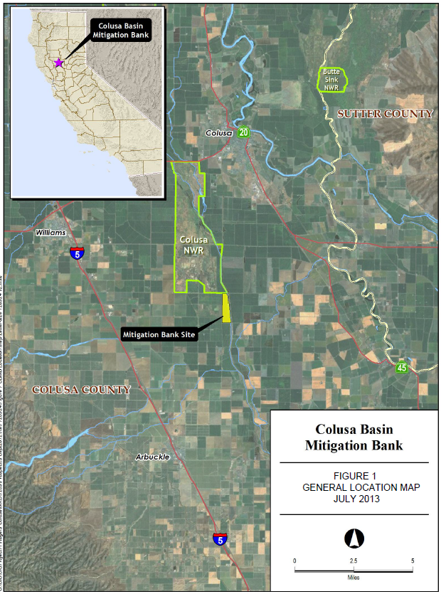
PROJECT LOCATION MAPS
The project is located on the right overflow bank of the Colusa Drain.
Partially located inside of the Colusa Drain Designated Floodway ( ̴41%).
Colusa County

Slide 5
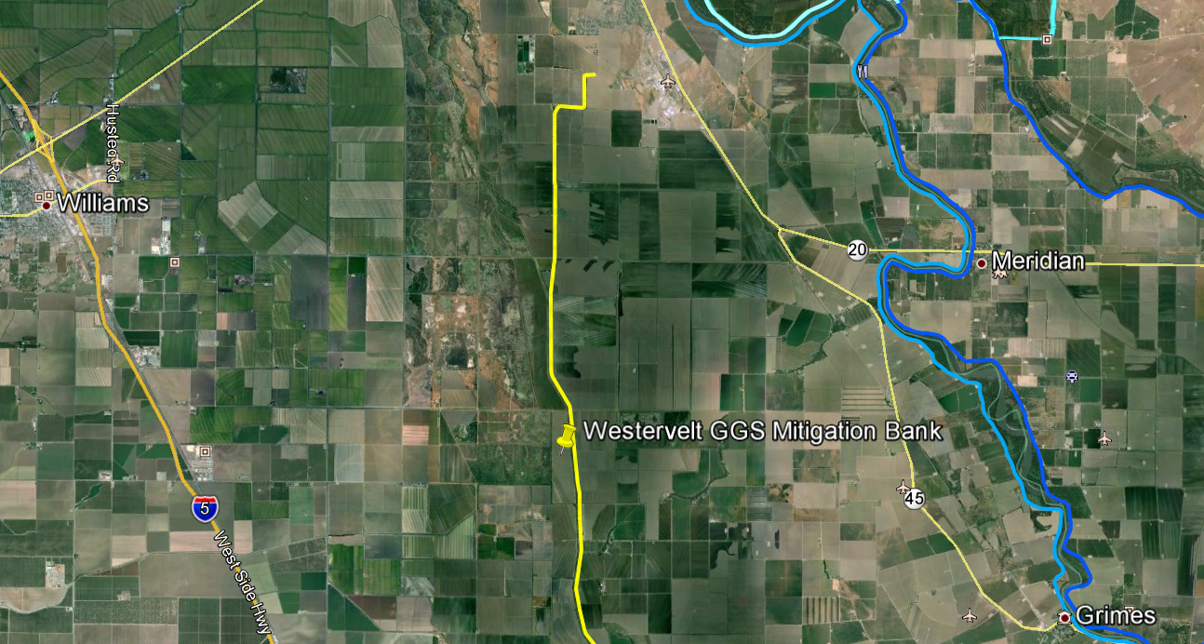
AERIAL VIEW
RD-108 Back Levee
N

Slide 6
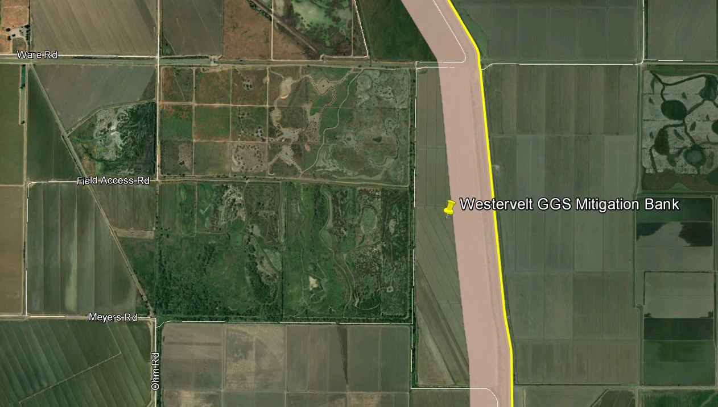
AERIAL VIEW
Designated Floodway
Property Boundary
N
plan
x-sec

Slide 7
PROJECT ANALYSIS
After review, staff has concluded that the proposed Giant Garter Snake Mitigation Bank project is compatible with Title 23 Article 5 Designated Floodways Section 107 (a) and (i) as allowable encroachments.
The project site is in agricultural use as rice fields and can be easily converted to the proposed project parameters as submitted.
The portion of the project (habitat) that is within the Colusa Drain Designated Floodway is 89 acres, which is approximately 41% of the 215 acre property.
The proposed project is designed to be a balanced cut and fill operation so there will be no adverse impacts to the existing Colusa Drain Designated Floodway.

Slide 8
HYDRAULIC ANALYSIS
A hydraulic analysis was performed using a one dimensional steady state model of the project site and vicinity and was developed using the US Army Corps of Engineers (USACE) HEC-RAS model.
Two scenarios were evaluated – existing conditions and full project conditions. The impact of the project on flood conveyance was characterized in terms of potential rise in water surface elevation for the design hydrology (100-year event).
The results of the hydraulic analysis showed zero rise to a 0.01 foot decrease in water surface elevations under 100- and 50-year flows respectively.
Based on the results of the hydraulic analysis, it can be concluded that the project will not unduly impede the free flow of water in the Colusa Drain Designated Floodway.

Slide 9
LONG TERM MANAGEMENT
The annual report for this project, as required by the Colusa Basin Mitigation Bank Long Term Management Plan, will identify all required maintenance activities that are to be performed to meet compliance with the Plan such as removal of woody vegetation, sediment removal and bank erosion control and any other identified adverse condition.
No trees or woody vegetation will be planted.
Management of vegetation will include grazing, disking, and mowing.
Invasive non-native plants will be controlled by hand removal, mechanical equipment, biological controls, or herbicides.
Maintenance funding, in perpetuity, shall come from the Colusa Basin Mitigation Bank Long Term Management Plan Endowment Fund.

Slide 10
AGENCY COMMENTS/ENDORSEMENTS
The maintaining agency for this project is DWR’s Sutter Maintenance Yard which has endorsed this application with no conditions.
The U.S. Army Corps of Engineers 208.10 comment letter has been received for this application. The USACE District Engineer has no objection to the project, subject to conditions. The letter is incorporated into the permit as Exhibit A.

Slide 11
CEQA CONCLUSIONS
The Board, as a responsible agency under CEQA, has reviewed the Initial Study/Mitigated Negative Declaration (IS/MND) (SCH Number: 2013012062, January 2013) and Mitigation Measures for the Colusa Basin Mitigation Bank Project prepared by the lead agency, Colusa County.
Colusa County determined that the project would not have a significant effect on the environment on March 4, 2013 and filed a Notice of Determination on March 7, 2013 with the Colusa County Clerk.
The project proponent has incorporated mandatory mitigation measures into the project plans to avoid identified impacts or to mitigate such impacts to a point where no significant impacts will occur.

Slide 12
8610.5 CONSIDERATIONS
The Board will make its decision based on the evidence in the permit application and attachments, this staff report, and any other evidence presented by any individual or group.
The accepted industry standards for the work proposed under this permit as regulated by Title 23 have been applied to the review of this permit.
This project has no adverse effects on facilities of the State Plan of Flood Control and is consistent with the Central Valley Flood Protection Plan.
There will be no effects to the proposed project from reasonable projected future events.

Slide 13
STAFF RECOMMENDATION
Staff recommends that the Board adopt:
CEQA Findings
Findings of Fact
Approve Permit No. 18845
Direct the Executive Officer to take necessary actions to prepare and execute the permit and related documents and to File a Notice of Determination with the State Clearinghouse.

Slide 14
QUESTIONS
Presented by: Charles (Steve) Dawson
CVFPB, Staff

