Slide 1
DWR Maintenance Area Response to USACE Periodic Inspections
Presented by:
Noel Lerner, Chief, Flood Maintenance Office
Mark List, Chief, Maintenance Support Branch

Slide 2
Total Budget 2007 – 2017
MA Routine Maintenance
DWR Channels Structures Levees
Channels
Structures
& Facilities
SPFC Levee Remediation
Notes:
General Funds:
MA Routine Maintenance (MA Budget for 12/13 used as an estimate for all years)
DWR (8361) Channels Structures and Levees ()
Bond Funds:
All data from FMO Fund Centers

Slide 3
Annual Routine Maintenance Breakdown by Activity (FY12/13 Budget for DWR 8361 and MAs)
8361 Levees
(DWR)
MA Levees
Channels (DWR)
Structures
(DWR)
Notes:
Budget:
DWR 8361 Levees, Channels, Structures $4.5M (Includes Equipment and Overhead)
MA $2.7
TOTAL $7.2M

Slide 4
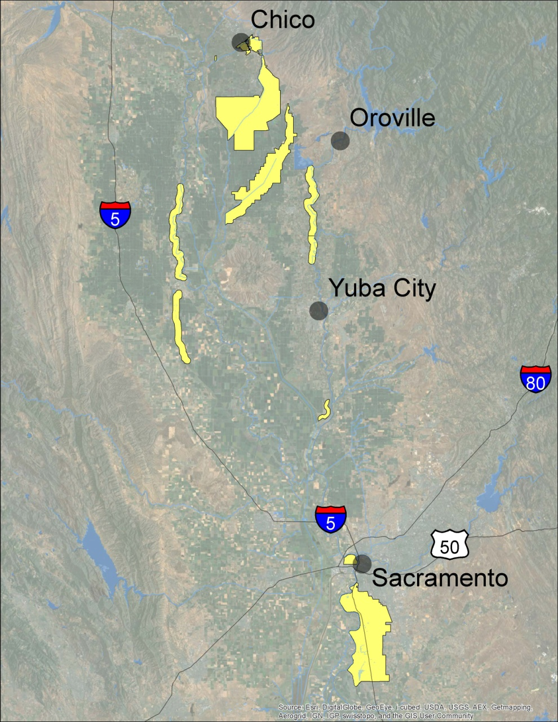
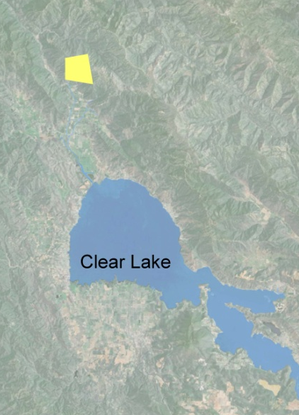
MA5
MA17
MA13
MA7
MA16
MA1
MA12
MA3
Sacramento and Sutter Yard Maintenance Areas
MA4
(NOT TO SCALE)
MA9
Notes:
SUTTER MA’s
MA 17 Lake County near Clear Lake (Middle Creek Pumping Plant)
MA 16 Feather River south of Horncutt Creek in Butte County
MA 13 Cherokee Canal in Butte County
MA 12 Nothern half of the Colusa Basin Drain
MA 7 Feather River north of Horncutt Creek in Butte County
MA 5 Butte Creek
MA 3 Feather River just upstream of Sutter Bypass
MA 1 Sacramento River from Colusa Bridge to Glenn County Line
SACTO MA’s
MA 4 Sacramento River at West Sacramento
MA 9 Sacramento River from Sacramento to Freeport

Slide 5
DWR 8361 and MA Levee Maintenance FY 12/13 Budgeted Expenses per Mile (Thousands)
Notes:
Median Budget per levee mile is $10K.
Some levees have more expenses associated with them.
Examples of these expenses could be:
Levee Size (MA 13 levees are undersized, so they cost less to maintain.)
Vegetation
# of Encroachments (MA 9 involves more encroachments)
Flood Season (a levee which experiences a high water event will need more repairs and clean up)
MA 9 had some one time expenses including surveying and rock, so this does not show a typical average (which would be more like $32K per mile).
MA 9 Budget Breakdown:
$300K encroachment removal (and surveying)
$425K Restoration/Repair ($220K of it for rock)
$125K Equipment
$184K Vegetation Control
Remainder for Overhead & Materials, Minor Structures, Crown Roads, Inspection, Mowing, Patrolling, Rodent Control, etc.

Slide 6
Maintenance Areas Budget FY 12/13 ($2,700,000)
Notes:
SUTTER MA’s
MA 17 Lake County near Clear Lake (Middle Creek Pumping Plant)
MA 16 Feather River south of Horncutt Creek in Butte County
MA 13 Cherokee Canal in Butte County
MA 12 Nothern half of the Colusa Basin Drain
MA 7 Feather River north of Horncutt Creek in Butte County
MA 5 Butte Creek
MA 3 Feather River just upstream of Sutter Bypass
MA 1 Sacramento River from Colusa Bridge to Glenn County Line
SACTO MA’s
MA 4 Sacramento River at West Sacramento
MA 9 Sacramento River from Sacramento to Freeport

Slide 7
USACE Periodic Inspections and Continuing Eligibility Inspections Summary (red and yellow items) | MA5, 1, 12, 9, 13, 3, 7, 16 145 Levee Miles
Vegetation Growth | u | u | u | u | u | u | u | u | u | u | u | u | u | u | u | u | u | u | u
Encroachments | u | u | u | u | u | u | u | u | u | u | u | u | u | u | u | u | u | u | u
Animal Control | u | u | u | u | u | u | u | u | u | u | u | u | u
Depressions/Rutting | u | u | u | u | u | u | u | u | u | u | u | u
Riprap Revetments & Bank Protection | u | u | u | u | u | u | u | u | u | u
Erosion/Bank Caving | u | u | u | u | u | u | u | u | u | u
Slope Stability | u | u | u | u | u | u | u | u | u
Sod Cover | u | u | u | u | u | u
Cracking | u
Underseepage Relief Wells/Toe Drainage Systems | u
Closure Structures
Settlement
Culverts/Discharge Pipes
Seepage
Operations and Maintenance Manuals
Emergency Supplies and Equipment
Flood Preparedness and Training
Many unresolved issues were categorized as erosion, depressions, etc. by the USACE but are caused by encroachments.
Notes:
Annual Budget % Increase:
MA5 MA1 MA12 MA9 MA13 MA3 MA7 MA16
Restoration and Repair 50 9 75 0 25 44 100 150
(Erosion, Depressions, Etc)
Encroachment Removal 30 150 83 0 38 100 21 29
Equipment 75 42 27 0 125 0 55 60

Slide 8
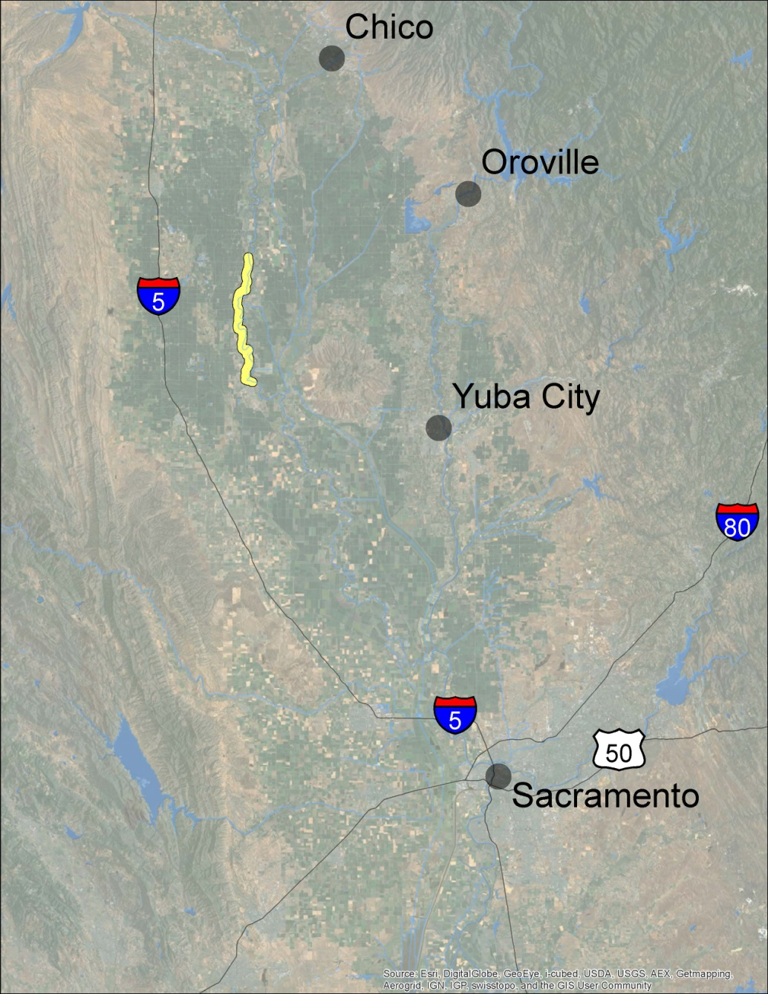
MA 1
West Levee of
Sacramento River
Near Colusa
FY13/14 - $284.5K
17 Levee Miles

Slide 9
MA 1 17 Levee Miles JOB CATEGORY | 2012-2013 | 2013-2014
 | APPROVED | PROPOSED | % Change
 | BUDGET | BUDGET | BUDGET
Vegetation Control | $ 48,000 | $ 48,000 | -
Burning | $ 22,000 | $ 22,000 | -
Rodent Control | $ 38,000 | $ 38,000 | -
Patrolling | $ 35,000 | $ 38,000 | 9%
Mowing | $ 10,000 | $ 10,000 | -
Inspection | $ 4,000 | $ 4,000 | -
Encroachment Removal | $ 12,000 | $ 30,000 | 150%
Restoration/Repair | $ 23,000 | $ 25,000 | 9%
Crown Roadways | $ 20,000 | $ 20,000 | -
Minor Structures | $ 9,500 | $ 9,500 | -
Dragging | $ 15,000 | $ 15,000 | -
MEO Equipment Costs | $ 12,000 | $ 17,000 | 42%
Maintenance Yard Overhead | $ 6,000 | $ 8,000 | 33%
Telemetry Maintenance | $ - | $ - | -
TOTAL BUDGET | $ 254,500 | $ 284,500 | 12%

Slide 10
MA 3
West Levee
Feather River near
Sutter Bypass
FY13/14 - $67K
5 Levee Miles

Slide 11
MA 3 5 Levee Miles JOB CATEGORY | 2012-2013 | 2013-2014
 | APPROVED | PROPOSED | % Change
 | BUDGET | BUDGET | BUDGET
Vegetation Control | $ 10,000 | $ 10,000 | -
Burning | $ 10,000 | $ 10,000 | -
Rodent Control | $ 7,500 | $ 7,500 | -
Patrolling | $ 1,500 | $ 1,500 | -
Mowing | $ 12,500 | $ 12,500 | -
Inspection | $ 1,000 | $ 1,000 | -
Encroachment Removal | $ 1,500 | $ 3,000 | 100%
Restoration/Repair | $ 4,500 | $ 6,500 | 44%
Crown Roadways | $ 3,500 | $ 3,500 | -
Minor Structures | $ 2,500 | $ 2,500 | -
Dragging | $ 4,000 | $ 4,000 | -
MEO Equipment Costs | $ 3,000 | $ 3,000 | -
Maintenance Yard Overhead | $ 2,000 | $ 2,000 | -
Telemetry Maintenance | $ - | $ - | -
TOTAL BUDGET | $ 63,500 | $ 67,000 | 6%

Slide 12
MA 4
Sacramento River Levee in
West Sacramento
FY13/14 - $87K
3 Levee Miles

Slide 13
MA 4 3 Levee Miles JOB CATEGORY | 2012-2013 | 2013-2014
 | APPROVED | PROPOSED | % Change
 | BUDGET | BUDGET | BUDGET
Vegetation Control | $ 28,000 | $ 28,000 | -
Burning | $ - | $ - | -
Rodent Control | $ 3,000 | $ 3,000 | -
Patrolling | $ - | $ - | -
Mowing | $ 9,000 | $ 9,000 | -
Inspection | $ 2,000 | $ 2,000 | -
Encroachment Removal | $ 2,000 | $ 2,000 | -
Restoration/Repair | $ 15,000 | $ 15,000 | -
Crown Roadways | $ 3,000 | $ 3,000 | -
Minor Structures | $ 4,000 | $ 4,000 | -
Dragging | $ - | $ - | -
MEO Equipment Costs | $ 17,000 | $ 17,000 | -
Yard Overhead & Materials | $ 4,000 | $ 4,000 | -
Telemetry Maintenance | $ - | $ - | -
TOTAL BUDGET | $ 87,000 | $ 87,000 | 0%

Slide 14
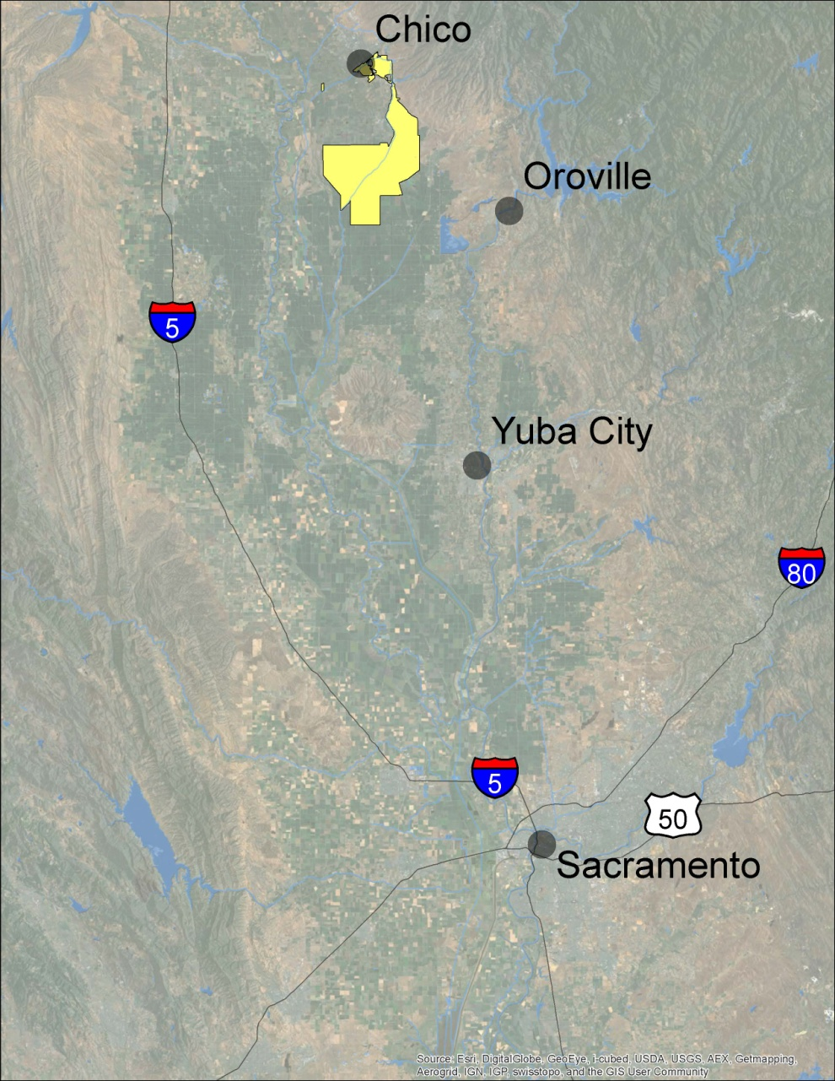
MA 5
Butte Creek Levees and
Little Chico
Creek Channel
FY13/14 - $408.5K
33 Levee Miles

Slide 15
MA 5 33 Levee Miles JOB CATEGORY | 2012-2013 | 2013-2014
 | APPROVED | PROPOSED | % Change
 | BUDGET | BUDGET | BUDGET
Vegetation Control | $ 76,000 | $ 76,000 | -
Burning | $ 25,000 | $ 25,000 | -
Rodent Control | $ 34,000 | $ 34,000 | -
Patrolling | $ 4,000 | $ 4,000 | -
Mowing | $ 16,000 | $ 16,000 | -
Inspection | $ 5,500 | $ 6,000 | 9%
Encroachment Removal | $ 48,000 | $ 65,000 | 35%
Restoration/Repair | $ 20,000 | $ 30,000 | 50%
Crown Roadways | $ 30,000 | $ 30,000 | -
Minor Structures | $ 23,000 | $ 23,000 | -
Dragging | $ 14,500 | $ 14,500 | -
Little Chico Diversion Struct. | $ 20,000 | $ 20,000 | -
Sediment Removal | $ - | $ - | -
Vegetation Control Channel | $ 20,000 | $ 20,000 | -
MEO Equipment Costs | $ 20,000 | $ 35,000 | 75%
Maintenance Yard Overhead | $ 9,500 | $ 10,000 | 5%
Telemetry Maintenance | $ - | $ - | -
TOTAL BUDGET | $ 365,500 | $ 408,500 | 12%

Slide 16
MA 7
West Levee
Feather River below Oroville
FY13/14 - $124.3K
12 Levee Miles

Slide 17
MA 7 12 Levee Miles JOB CATEGORY | 2012-2013 | 2013-2014
 | APPROVED | PROPOSED | % Change
 | BUDGET | BUDGET | BUDGET
Vegetation Control | $ 19,000 | $ 17,000 | -11%
Burning | $ 1,500 | $ 1,500 | -
Rodent Control | $ 29,000 | $ 29,000 | -
Patrolling | $ 2,000 | $ 2,000 | -
Mowing | $ 20,500 | $ 20,500 | -
Inspection | $ 2,000 | $ 2,000 | -
Encroachment Removal | $ 14,000 | $ 17,000 | 21%
Restoration/Repair | $ 3,000 | $ 6,000 | 100%
Crown Roadways | $ 7,500 | $ 7,500 | -
Minor Structures | $ 7,000 | $ 7,000 | -
Dragging | $ 2,500 | $ 2,500 | -
MEO Equipment Costs | $ 5,500 | $ 8,500 | 55%
Maintenance Yard Overhead | $ 3,800 | $ 3,800 | -
TOTAL BUDGET | $117,300 | $124,300 | 6%

Slide 18
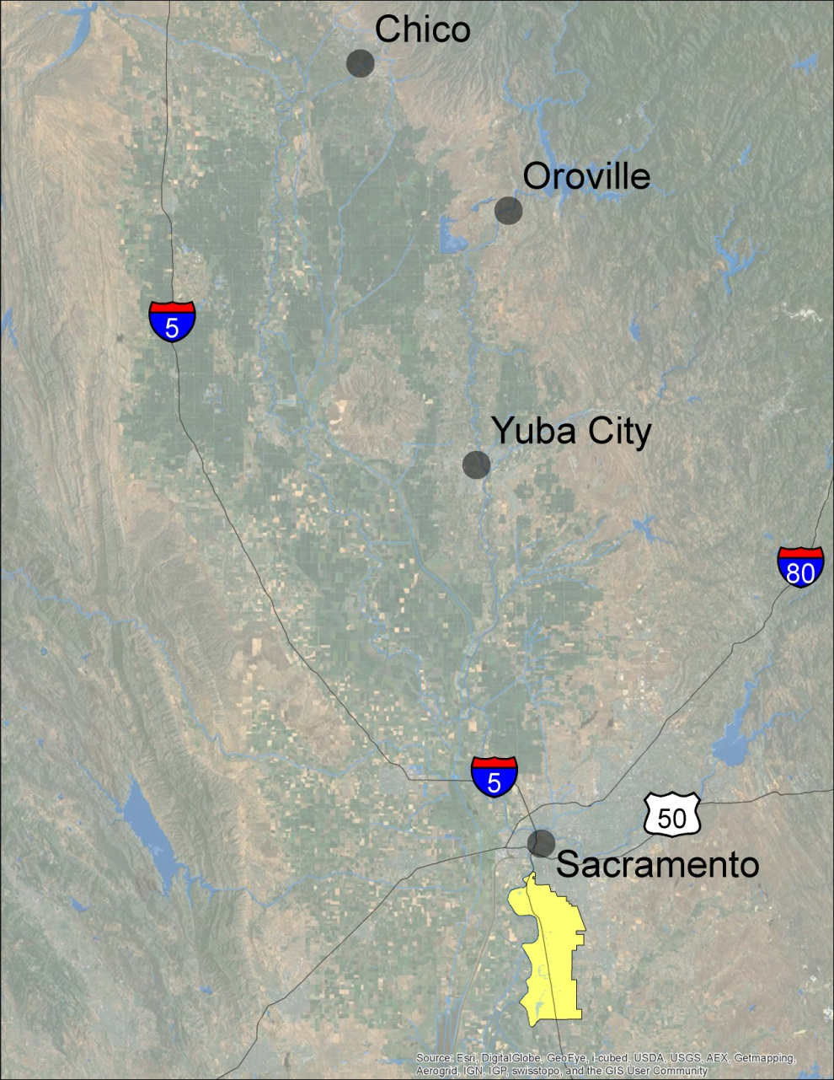
MA 9
East Levee of
Sacramento River
in Sacramento
FY13/14 - $1.34M
20 Levee Miles

Slide 19
MA 9 20 Levee Miles JOB CATEGORY | 2012-2013 | 2013-2014
 | APPROVED | PROPOSED | % Change
 | BUDGET | BUDGET | BUDGET
Vegetation Control | $ 184,000 | $ 184,000 | -
Burning | $ - | $ - | -
Rodent Control | $ 60,000 | $ 60,000 | -
Patrolling | $ 35,000 | $ 35,000 | -
Mowing | $ 85,000 | $ 85,000 | -
Inspection | $ 7,000 | $ 7,000 | -
Encroachment Removal | $ 300,000 | $ 300,000 | -
Restoration/Repair | $ 425,000 | $ 425,000 | -
Crown Roadways | $ 32,000 | $ 32,000 | -
Minor Structures | $ 32,000 | $ 32,000 | -
Dragging | $ - | $ - | -
MEO Equipment Costs | $ 125,000 | $ 125,000 | -
Yard Overhead & Materials | $ 54,000 | $ 54,000 | -
Telemetry Maintenance | $ - | $ - | -
TOTAL BUDGET | $ 1,339,000 | $1,339,000 | 0%
Notes:
Budget was increased up previous years to address encroachments.

Slide 20
MA 12
Colusa Drain Levee
FY13/14 - $98.5K
11 Levee Miles

Slide 21
MA 12 11 Levee Miles JOB CATEGORY | 2012-2013 | 2013-2014
 | APPROVED | PROPOSED | % Change
 | BUDGET | BUDGET | BUDGET
Vegetation Control | $ 17,000 | $ 17,000 | -
Burning | $ 7,500 | $ 7,500 | -
Rodent Control | $ 6,000 | $ 6,000 | -
Patrolling | $ 6,000 | $ 6,000 | -
Mowing | $ 5,500 | $ 5,500 | -
Inspection | $ 3,000 | $ 3,000 | -
Encroachment Removal | $ 3,000 | $ 5,500 | 83%
Restoration/Repair | $ 2,000 | $ 3,500 | 75%
Crown Roadways | $ 22,000 | $ 22,000 | -
Minor Structures | $ 4,500 | $ 4,000 | -11%
Dragging | $ 8,000 | $ 8,500 | 6%
MEO Equipment Costs | $ 5,500 | $ 7,000 | 27%
Maintenance Yard Overhead | $ 3,000 | $ 3,000 | -
Telemetry Maintenance | $ - | $ - | -
TOTAL BUDGET | $ 93,000 | $ 98,500 | 6%

Slide 22
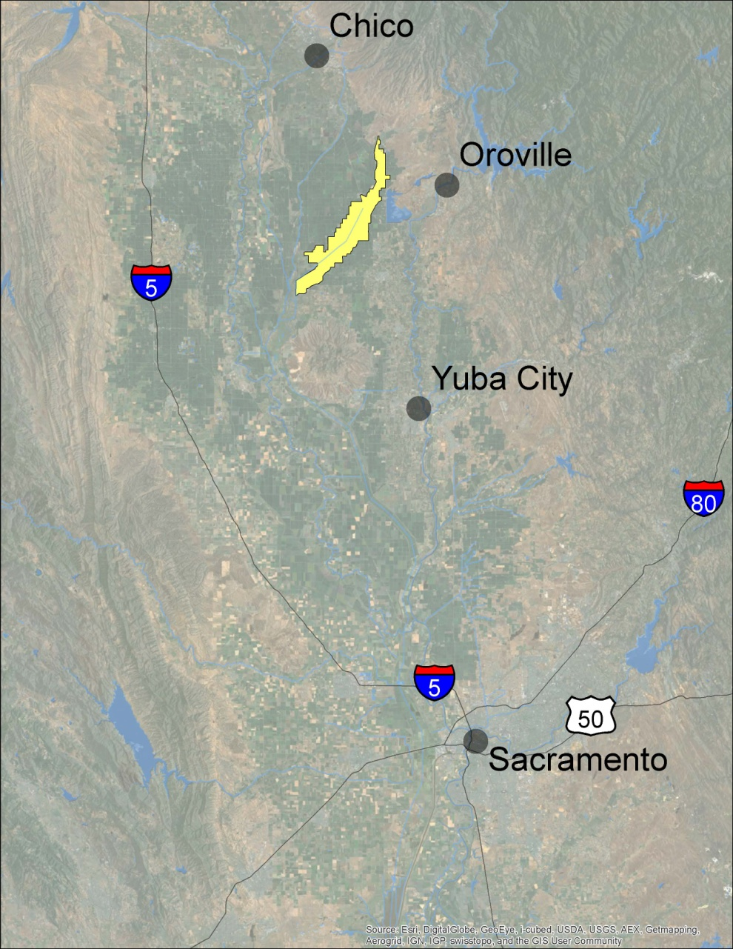
MA 13
Cherokee Canal Levees
FY13/14 - $240K
41 Levee Miles

Slide 23
MA 13 41 Levee Miles JOB CATEGORY | 2012-2013 | 2013-2014
 | APPROVED | PROPOSED | % Change
 | BUDGET | BUDGET | BUDGET
Vegetation Control | $ 45,000 | $ 45,000 | -
Burning | $ 23,000 | $ 23,000 | -
Rodent Control | $ 17,000 | $ 17,000 | -
Patrolling | $ 8,500 | $ 8,500 | -
Mowing | $ 25,000 | $ 25,000 | -
Inspection | $ 3,000 | $ 3,000 | -
Encroachment Removal | $ 14,500 | $ 20,000 | 38%
Restoration/Repair | $ 16,000 | $ 20,000 | 25%
Crown Roadways | $ 24,000 | $ 24,000 | -
Minor Structures | $ 12,000 | $ 12,500 | 4%
Dragging | $ 10,000 | $ 10,000 | -
MEO Equipment Costs | $ 12,000 | $ 27,000 | 125%
Maintenance Yard Overhead | $ 5,000 | $ 5,000 | -
Telemetry Maintenance |  |  | -
TOTAL BUDGET | $ 215,000 | $ 240,000 | 12%

Slide 24
MA 16
West Levee
Feather River near Live Oak
FY13/14 - $74K
6 Levee Miles

Slide 25
MA 16 6 Levee Miles JOB CATEGORY | 2012-2013 | 2013-2014
 | APPROVED | PROPOSED | % Change
 | BUDGET | BUDGET | BUDGET
Vegetation Control | $ 10,000 | $ 10,000 | -
Burning | $ 1,000 | $ 1,000 | -
Rodent Control | $ 11,500 | $ 11,500 | -
Patrolling | $ - | $ - | -
Mowing | $ 16,000 | $ 16,000 | -
Inspection | $ 1,000 | $ 1,000 | -
Encroachment Removal | $ 14,000 | $ 18,000 | 29%
Restoration/Repair | $ 2,000 | $ 5,000 | 150%
Crown Roadways | $ 3,000 | $ 3,000 | -
Minor Structures | $ 2,500 | $ 2,500 | -
Dragging | $ 1,000 | $ 1,000 | -
MEO Equipment Costs | $ 2,500 | $ 4,000 | 60%
Maintenance Yard Overhead | $ 1,000 | $ 1,000 | -
Telemetry Maintenance | $ - | $ - | -
TOTAL BUDGET | $ 65,500 | $ 74,000 | 13%

Slide 26
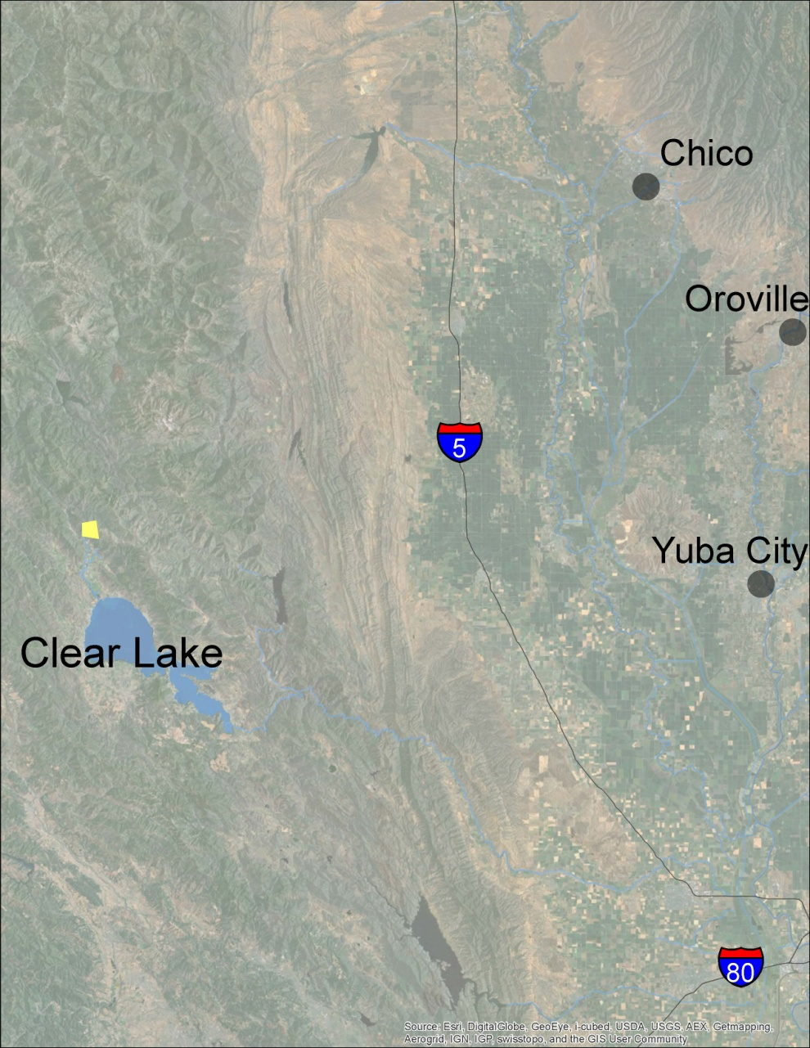
MA 17
Middle Creek at
Clear Lake
FY13/14 - $99.2K
4 Levee Miles

Slide 27
MA 17 4 Levee Miles JOB CATEGORY | 2012-2013 | 2013-2014
 | APPROVED | PROPOSED | % Change
 | BUDGET | BUDGET | BUDGET
Vegetation Control | $ 5,700 | $ 5,700 | -
Burning | $ - | $ - | -
Rodent Control | $ 1,000 | $ 1,000 | -
Patrolling | $ 10,000 | $ 10,000 | -
Mowing | $ 13,000 | $ 13,000 | -
Inspection | $ 3,000 | $ 3,000 | -
Encroachment Removal | $ 2,000 | $ 5,000 | 150%
Restoration/Repair | $ 30,000 | $ 30,000 | -
Crown Roadways | $ 2,500 | $ 2,500 | -
Minor Structures | $ 3,500 | $ 3,500 | -
Dragging | $ - | $ - | -
Plant Maintenance & Repairs | $ 7,500 | $ 7,500 | -
Plant Operations | $ 9,000 | $ 12,000 | 33%
MEO Equipment Costs | $ 3,000 | $ 5,000 | 67%
Maintenance Yard Overhead | $ 1,000 | $ 1,000 | -
Telemetry Maintenance | $ - | $ - | -
TOTAL BUDGET | $ 91,200 | $ 99,200 | 9%

Slide 28
FY13/14
Average
Maintenance Area Costs
152 Levee Miles

Slide 29
USACE Periodic Inspections and Continuing Eligibility Inspections Summary (red and yellow items) | MA5, 1, 12, 9, 13, 3, 7, 16 145 Levee Miles
Vegetation Growth | u | u | u | u | u | u | u | u | u | u | u | u | u | u | u | u | u | u | u
Encroachments | u | u | u | u | u | u | u | u | u | u | u | u | u | u | u | u | u | u | u
Animal Control | u | u | u | u | u | u | u | u | u | u | u | u | u
Depressions/Rutting | u | u | u | u | u | u | u | u | u | u | u | u
Riprap Revetments & Bank Protection | u | u | u | u | u | u | u | u | u | u
Erosion/Bank Caving | u | u | u | u | u | u | u | u | u | u
Slope Stability | u | u | u | u | u | u | u | u | u
Sod Cover | u | u | u | u | u | u
Cracking | u
Underseepage Relief Wells/Toe Drainage Systems | u
Closure Structures
Settlement
Culverts/Discharge Pipes
Seepage
Operations and Maintenance Manuals
Emergency Supplies and Equipment
Flood Preparedness and Training
Many unresolved issues were categorized as erosion, depressions, etc. by the USACE but are caused by encroachments.
Notes:
Annual Budget % Increase:
MA5 MA1 MA12 MA9 MA13 MA3 MA7 MA16
Restoration and Repair 50 9 75 0 25 44 100 150
(Erosion, Depressions, Etc)
Encroachment Removal 30 150 83 0 38 100 21 29
Equipment 75 42 27 0 125 0 55 60

Slide 30
Potential Path to PL 84-99 compliance
Address ALL U-rated deficiencies, and request USACE Re-Inspection
Develop NOI and SWIF with partner LMAs
SBFCA Example (LD-1, LD-9, MA-3, MA-7, MA-16, and DWR levees)
All Paths to PL 84-99 Should:
Address Worst-First Issues (Highest Risk Items)
Coordinate Legacy Design and Construction Issues with Regional Planning Effort (Ex: Under Seepage Remediation)
Address Easement Issues, Encroachment, and Enforcement
Pipe Penetrations (legacy, permitted, unpermitted)
Plan for Vegetation Management using Life-Cycle Management
Remove true threats to levee integrity
Notes:
Annual Budget % Increase:
MA5 MA1 MA12 MA9 MA13 MA3 MA7 MA16
Restoration and Repair 50 9 75 0 25 44 100 150
(Erosion, Depressions, Etc)
Encroachment Removal 30 150 83 0 38 100 21 29
Equipment 75 42 27 0 125 0 55 60

Slide 31
USACE Periodic Inspections and Continuing Eligibility Inspections Summary | All DWR Maintained Areas 241 Levee Miles
Vegetation Growth | u | u | u | u | u | u | u | u | u | u | u | u | u | u | u | u | u | u | u | u | u | u | u | u | u | u | u | u | u | u | u | u | u | u | u | u | u | u
Encroachments | u | u | u | u | u | u | u | u | u | u | u | u | u | u | u | u | u | u | u | u | u | u | u | u | u | u | u | u | u | u | u | u | u | u | u | u | u
Depressions/Rutting | u | u | u | u | u | u | u | u | u | u | u | u | u | u | u | u | u | u | u | u | u | u | u | u | u | u
Animal Control | u | u | u | u | u | u | u | u | u | u | u | u | u | u | u | u | u | u | u | u | u | u | u | u | u
Erosion/Bank Caving | u | u | u | u | u | u | u | u | u | u | u | u | u | u | u | u | u | u | u | u | u | u | u
Riprap Revetments & Bank Protection | u | u | u | u | u | u | u | u | u | u | u | u | u | u | u | u | u | u | u | u
Sod Cover | u | u | u | u | u | u | u | u | u | u | u | u | u | u | u | u
Slope Stability | u | u | u | u | u | u | u | u | u | u | u | u
Cracking | u | u | u | u | u | u | u | u | u | u | u
Underseepage Relief Wells/Toe Drainage Systems | u | u
Culverts/Discharge Pipes | u
Settlement | u
Closure Structures
Seepage
Operations and Maintenance Manuals
Emergency Supplies and Equipment
Flood Preparedness and Training
Many unresolved issues were categorized as erosion, depressions, etc. by the USACE but are caused by encroachments.
Notes:
The table includes all unacceptable items (red yellow purple pink orange etc)

