Slide 1
Status of State-Led Basin-Wide Feasibility Studies
Briefing to the Central Valley Flood Protection Board
June 28, 2013

Slide 2
Today’s Briefing
Purpose and Scope of Basin-Wide Feasibility Studies
Planning Approach to BWFS
Activities to Date
Board Briefing Schedule …“some ideas”

Slide 3
Purpose and Scope of Basin-Wide Feasibility Studies

Slide 4
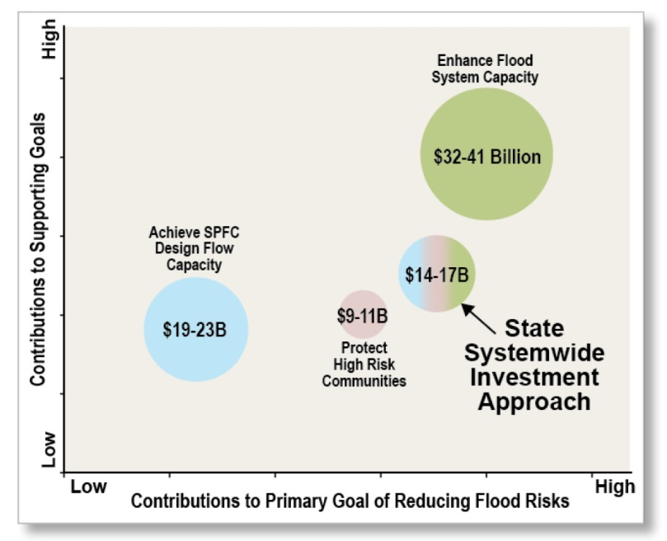
State Systemwide Investment Approach
Relative Comparison of Preliminary Approaches to State Systemwide Investment Approach (from 2012 CVFPP)

Slide 5
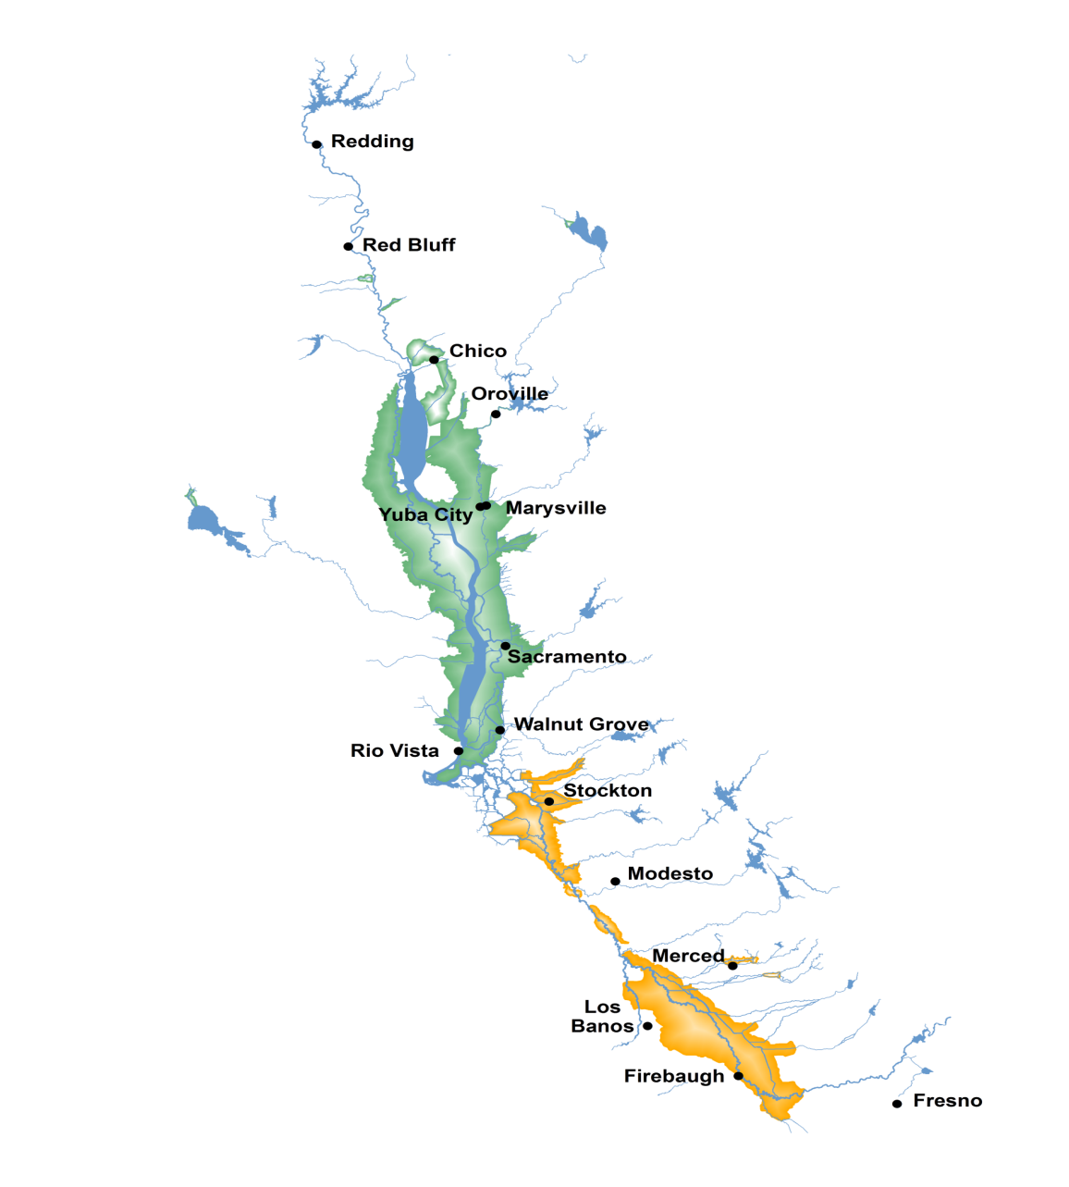
Geographic Scope of Studies
DWR has launched two Basin-Wide Feasibility Studies (BWFS) to refine the physical improvements broadly described in the 2012 CVFPP
Sacramento River Basin
San Joaquin River Basin

Slide 6
Purpose of BWFS…
… is to evaluate the feasibility of different alternatives for improving the flood management system, consistent with the SSIA, including
Improving flood management system flexibility and resiliency through expansion and extension of the flood bypass system and other system improvements
Integrating ecosystem enhancements and other multi-objective projects with systemwide flood management improvements
Combining regional improvements with system improvements to identify the State’s systemwide investment package.

Slide 7
Scope of BWFS
Refine SSIA System Improvements
Weir and bypass system expansion
New bypasses
Flood system structure modifications
Conjunctive use and groundwater recharge
System operational changes through coordinated reservoir operations
Mitigation features (for potential flood stage increases of other improvements)
Focus of Activities to Date

Slide 8
Planning Approach to BWFS

Slide 9
Planning Approach
Specify problems and opportunities
Inventory and forecast conditions
Formulate alternative plans
Evaluate effects/screen alternative plans
Compare alternative plans
Select recommended plan

Slide 10
BWFS Development Milestones
Continuous integration with Conservation Strategy development
Phase 1
Phase 2
Study Initiation
M1 - Identify Basin Problems, Objectives & System Improvement Features
M2 - Formulate Alternative Options
M3 - Identify Preferred Option
M4 - Public Draft BWFS Report
M6 - Final BWFS Report
M5 - Public Comments and Revisions
2012
2013
2014
2015
2016
Integration with Regional Flood Management Plans

Slide 11
Technical Analysis Process
Phase 1
Phase 2
Step
1
Step
2
Step
3
Step
4
Identify & evaluate potential bypass improvement features
Formulate bypass system options (Combination of Features)
Compare preliminary plans & explore trade-offs
Refine & confirm recommended basin-wide plan
Option 1
Compare benefits & costs systemwide, & evaluate tradeoffs
Evaluate & compare individually
Evaluate & compare combinations
Preferred Option
Option 2
Option 3

Slide 12
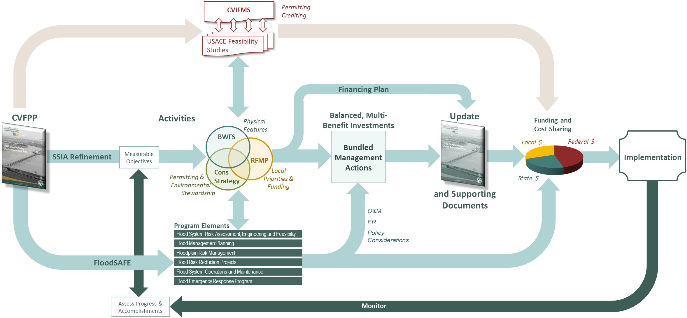
One Process, Many Activities

Slide 13
Scope of CVFPP Implementation Planning Efforts
State-Led
Central Valley Flood System Conservation Strategy
Basin-Wide Feasibility Studies
State Interest
Local/Regional Priorities
Locally-led Regional Flood Management Planning

Slide 14
Opportunities for Alignment
Representative Regional Flood Management Planning (RFMP) Activities
Review Regional Atlas
Collect Data
ID Regional Problems & Priorities
Initial List of Regional Solutions
Screening Criteria
Evaluate and Compare
Prioritized Project List
ID Financing Strategies
Finance Plan
Draft and Final RFM Plan
Feather
Upper/Mid Sac
Lower Sac
Lower San Joaquin
Mid San Joaquin
Upper San Joaquin
Individual RFMPs
Timeframe
Q1 | Q2 | Q3 | Q4
2013
Q1 | Q2 | Q3 | Q4
2014

Slide 15
Communications and Engagement
Management Actions
Objectives
Problems
Information
Sharing
Collaboration
Informal Communication
Projects
Implementation
Land Use
Operations & Maintenance
Regulatory

Slide 16
Activities to Date

Slide 17
Activities to Date…and continuing
Problem Identification
Objectives
Technical data and analyses

Slide 18
Problem Identification & Objectives
Problems
What do we want to achieve?
What do we measure?
How much is needed to achieve the results?
Objectives
Management Actions
SSIA Refinement: What actions best achieve the objectives?
Implementation
Monitoring
Are we making progress?
Do we need to adjust our actions?

Slide 19
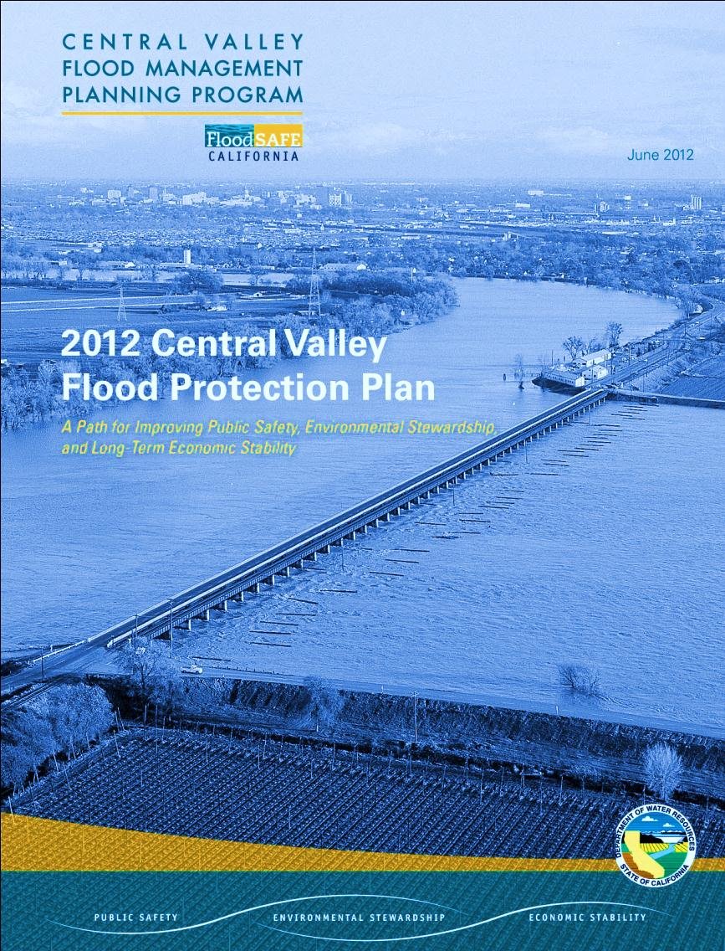
Draft Objective Topics
2012 CVFPP Goals
Basin-Wide Feasibility Study Objective Topics
CVFPP Primary Goal:
Improve Flood Risk Management
CVFPP Supporting Goals:
Promote Ecosystem Functions
Improve Operations and Maintenance
Improve Institutional Support
Promote Multi-Benefit Projects
People and property at risk
Flood system flexibility
Flood system resiliency
Floodplain management
Ecosystem Processes
Habitats
Species
Stressors
Long-Term Cost of O&M
Consistent and Efficient O&M Practices
Collaboration
Sustainable Funding
Information and Tools
Project Approvals
Integrated Water Management

Slide 20
Measureable Objectives Development
Pubic Workshop held on May 2nd
Next steps
Review of comments received
Technical analyses to inform refinement of objectives
Consideration of level of detail of objectives to be displayed in BWFS and 2017 update to CVFPP
2nd Technical workshop in Fall 2013

Slide 21
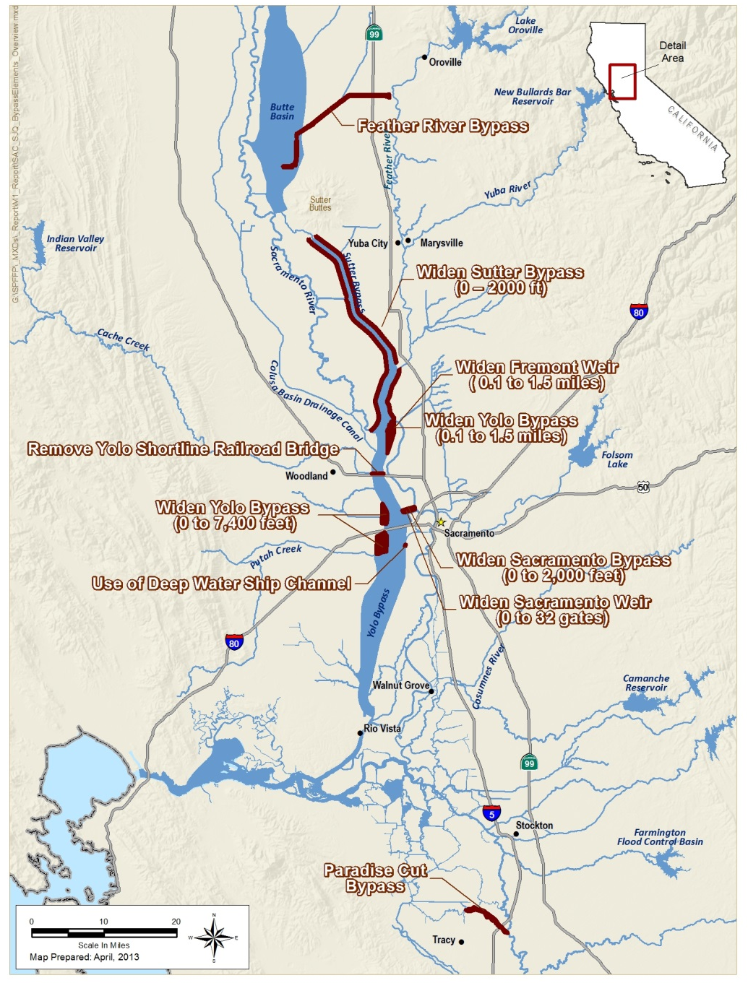
Technical Analysis Highlights
Refinement of Bypass System Improvements
Supporting Evaluations
Climate change approach
Updated hydrology
Two-dimensional model development in bypasses
Economic benefit and cost analyses

Slide 22
Board Briefing Schedule …“some ideas”

Slide 23
Potential BWFS Briefing Topics
Timeframe | Potential Topics
2nd Quarter 2013 | BWFS Progress Update (Today’s Briefing)
3rd Quarter 2013 | Climate Change Approach Technical Tools and Analysis Update
4th Quarter 2013 | Technical Workshop #2 Summary Initial Results of Technical Analyses Permitting Approaches Public Draft Conservation Strategy
1st Quarter 2014 | BWFS Progress Update Other Future Topics To be Determined

Slide 24
Questions or Comments?

