Slide 1
Open Water Workgroup Methylmercury Open Water Control Study Workplan March 22, 2013
Methylmercury Open Water Workplan

Slide 2
BOARD ACTION
Consider approval to delegate the Executive Officer authority to:
Sign a letter to the Central Valley Regional Water Quality Control Board (RWQCB)
Expressing the Board’s support of the Methylmercury Control Study Workplan
NOTE:
Methylmercury issues are bigger than just the open-water workgroup,
however staff is proposing that for this Board meeting we focus on open-water
staff will organize an informational briefing with the appropriate technical and Regional Water Quality Control Board (RWQCB) staff to explain how all the issues tie together and what is required of the Board.

Slide 3
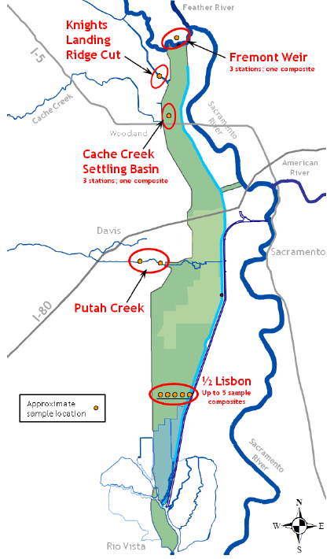
PROJECT LOCATION
Open-water habitat within channels and floodways
in the Delta
and Yolo Bypass

Slide 4
WORKPLAN
Description:
Sacramento-San Joaquin River Delta Total Maximum Daily Load (TMDL) established a Delta Mercury Control Program (DMCP) due to RWQCB’s Basin Plan Amendment (BPA)
The DMCP divides the Sacramento-San Joaquin Delta (Delta) and Yolo Bypass into seven subareas, each of which is then assigned an “open water” methylmercury load allocation in the Basin Plan.
Open water allocations encompass three activities:
water conveyance operations that may impact Delta in-channel production;
flood management operations that may impact MeHg production in the Yolo Bypass; and
regulatory or management oversight of activities proposed within open water areas.
Submittal of this Workplan complies with the DMCP April 20, 2013 due date
Board Requirements:
Board named as a responsible entity due to property, easements, and regulatory authority for the purpose of regulating floodwaters and flood control features.
Board staff has participated in this collaborative effort to meet the DMCP requirements

Slide 5
BACKGROUND
The series of events shown below led to the production of this Workplan:
Staff participated in a stakeholder process from 2008 – 2011
Consistent issues raised by Board staff:
Upstream and historical issues led to current conditions and downstream mitigation alone won’t solve the problem
Flood control is a matter of public safety, so restricting operations, maintenance, and regulatory compliance in the floodplain is a larger scale issue
BPA was effective as of October 20, 2011 (Board named as a responsible agency)
RWQCB established the following deadlines:
April 20, 2012 – letter stating the Board’s collaboration (submitted April 10, 2012)
August 17, 2012 – Workgroup Concept Proposal (submitted August 17, 2012)
April 20, 2013 – Open Water Control Study Workplan (action requested today)
August 20, 2013 – initiate Control Study
October 20, 2015 – submit Control Study Progress Report
October 20, 2018 – submit Control Study Final Report

Slide 6
WORKPLAN ANALYSIS
Objectives and Structure:
The objective is to provide two working models,
one for the open waters of the Delta
and one for the Yolo Bypass,
to examine the impact on methylmercury supply of proposed operational changes in water management and flood conveyance (field data/mechanistic modeling)
Funding Obligations:
There are no obligations outlined in this Workplan (further work is subject to funding)
The Workplan is a framework for Phase 1 and 2 of the Control Studies
CVFPP Interaction with Water Quality:
Flood protection is clearly paramount – “…in order to model mercury cycling, changes to the way that flood events are managed are unlikely to provide a feasible means of addressing elevated mercury levels because flood control is a public safety action that takes precedence over water quality.”
Cache Creek Settling Basin (CCSB):
CCSB is subject to its own TMDL and is separate from this Workplan

Slide 7
STAFF ANALYSIS
Staff is in agreement with the modeling effort proposed in the Workplan to better understand the mercury issues in the Delta and Yolo Bypass for the reasons below:
There are no specifics known or feasible alternatives at this point to reduce methylmercury in open water that will not affect flood control → the most practical direction from staff’s perspective is to produce a model and collect data
This method will not impact flood control and staff is in support of an alternative that will meet our requirements of the DMCP and will not adversely impact the system

Slide 8
AGENCY COLLABORATION
Cooperating Agencies:
California Central Valley Flood Protection Board (Board)
California Department of Water Resources (DWR)
California State Lands Commission (CSLC)
U.S. Army Corps of Engineers (USACE)
U.S. Bureau of Reclamation (USBR)
Collaboration:
Management of the agencies listed above are concurrently reviewing the Draft Final Workplan to obtain respective approvals to send letters in support of the Workplan.
agency staff collaboration throughout the process it is anticipated that the five cooperating agencies will meet the April 20, 2013 deadline to the RWQCB.
staff is prepared to continue its involvement throughout the process.

Slide 9
STAFF RECOMMENDATION
Board Staff recommends that the Board:
Delegate authority to sign a letter to the RWQCB expressing the Board’s support of the Workplan in substantially the form provided.

Slide 10
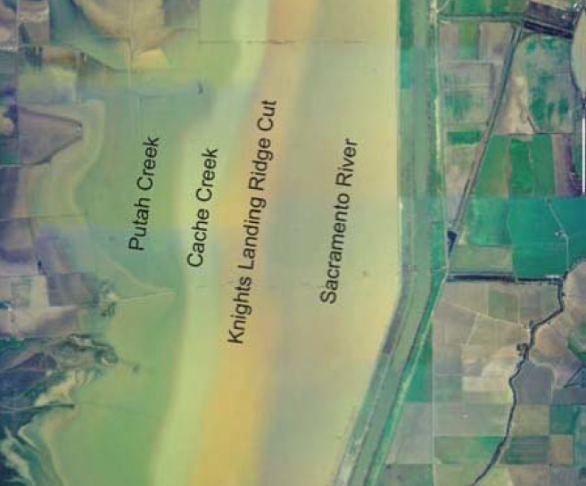
QUESTIONS
Presented: Nancy C. Moricz, P.E.

