Slide 1
Folsom Dam Modification Project Approach Channel Agenda Item 7C : Resolution 2013-04 March 22, 2013

Slide 2
BOARD ACTION
Consider approval of Resolution No. 2013-04 to:
Certify the Supplemental Environmental Impact Statement & Environmental Impact Report
Adopt the Findings
Adopt the Mitigation Monitoring Plan
Approve project design refinements
Delegate authority to Executive Officer to execute Notice of Determination

Slide 3
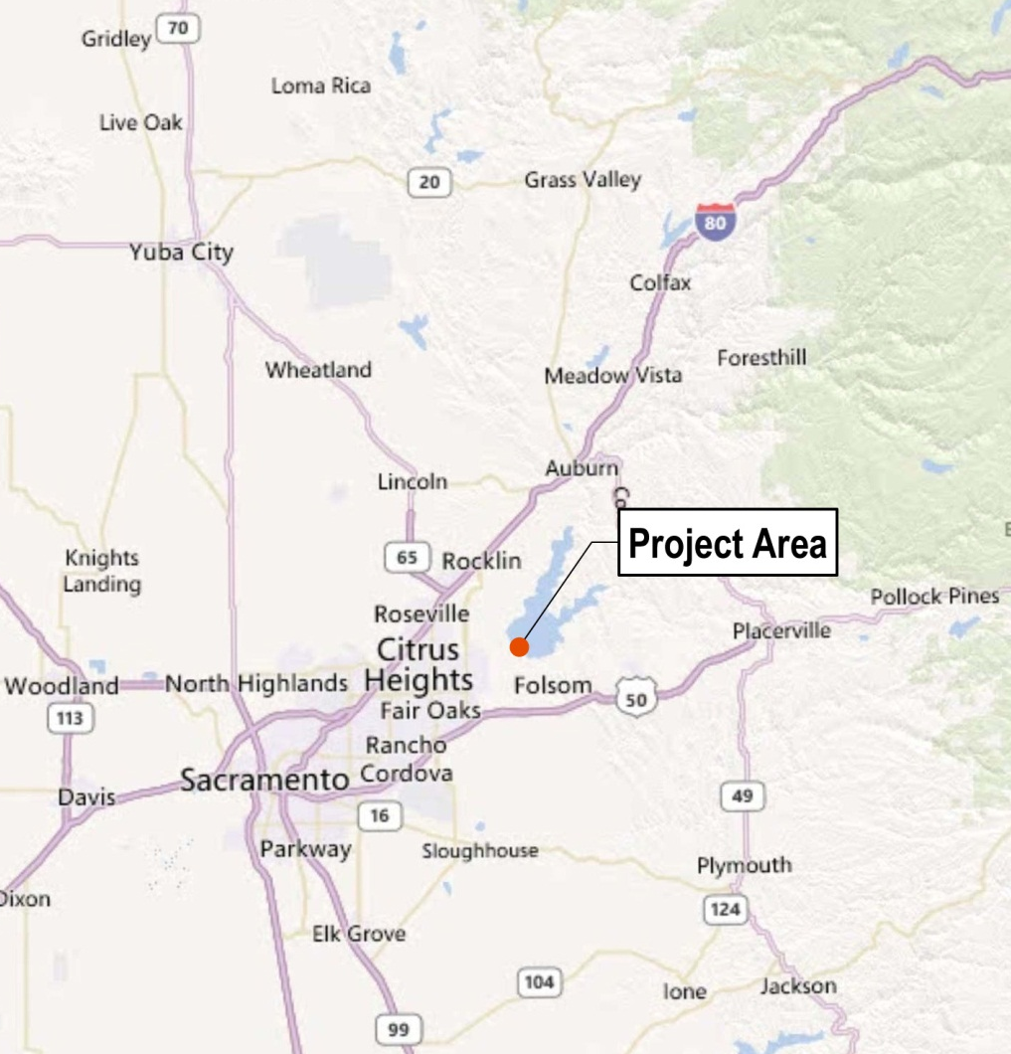
PROJECT LOCATION
Folsom Dam & Reservoir:
Within the city of Folsom
20 miles northeast of the city of Sacramento

Slide 4
FUTURE PROJECT RENDERING

Slide 5
PROJECT BACKGROUND
The Joint Federal Project was authorized congressionally by the Water Resources Development Act of 1999 (JFP) and by State Water Code Section 12670.14
The Final Folsom Dam Safety and Flood Damage Reduction Environmental Impact Statement/ Environmental Impact Report (FEIS/EIR) was approved and certified by the Board in July 2007 (Reclamation/CVFPB 2007)

Slide 6
PROJECT BACKGROUND
This Supplemental Environmental Impact Statement/ Environmental Impact Report SEIS/EIR (State Clearing House No. 2012072039) was circulated for 45-day public and agency review from July 25 to September 10, 2012
During public review:
SEIS/EIR was posted on the Board and USACE websites
Agency and Public comments were solicited
Two public workshops were held on August 23, 2012
Responses and comments received and incorporated into this Final SEIS/EIR

Slide 7
PROJECT BACKGROUND
Refinements to project design and operations have necessitated further environmental analysis and documentation. These refinements consist of:
Temporary Cutoff Wall or Cofferdam
Haul Road Embankment
Approach Channel Excavation
Approach Channel Concrete Slab and Walls
Hydraulic Spur Dike Construction
Material Stockpiling and Disposal
Temporary Trans-load Facility
Temporary Staging Areas
Temporary Concrete Batch Plant
Temporary Rock Crusher

Slide 8
PROJECT MAP

Slide 9
STAFF RECOMMENDATION
Approving Resolution No. 2013-04
Certifying the Supplemental Environmental Impact Statement & Environmental Impact Report
Adopting the Findings
Adopting the Mitigation Monitoring Plan
Approving project design refinements
Delegating authority to Executive Officer to execute Notice of Determination

Slide 10
QUESTIONS?

Slide 11
QUESTIONS?

