Slide 1
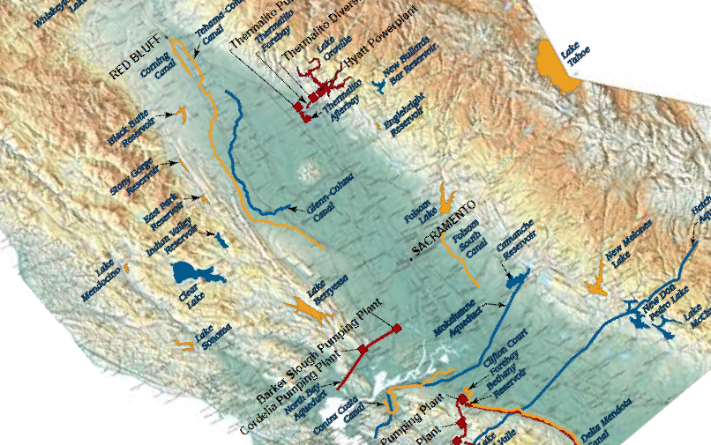

Department of Water Resources 2013-14 Legislative Update
Central Valley Flood Protection Board
May 10, 2013

Slide 2
2013-14 Legislative Calendar
January 7 – Legislature reconvened
January 10 – Budget submitted by Governor Brown
February 22 – Last day to introduce bills
May 3 / May 10 – Policy committee deadline (fiscal/non-fiscal bills)
May 24 – Fiscal committee deadline
May 31 – Deadline to pass bills out of the house of origin
July 12 / August 16 – Second house policy deadline (Assembly/Senate)
August 30 – Second house fiscal deadline
September 13 – Last day to pass bills for 2013

Slide 3
Pending Legislation
CEQA
AB 37 (Perea) – Preparation of Record of Proceedings
SB 731 (Steinberg) – Renewable Energy
AB 543 (Campos) – CEQA: Translation
AB 953 (Ammiano) – Human Impacts
SB 436 Jackson) – Scoping Meetings
SB 633 (Pavley) – EIR Update
SB 617 (Evans) – CEQA Notices and Records
SB 754 (Evans) – EIR: Lead Agency Preparation
AB 51 (Gatto) – CEQA: Impacts on Native American Sacred Sites

Slide 4
Pending Legislation
Flood Protection / Infrastructure
SB 753 (Steinberg) – Central Valley Flood Protection Board: encroachments
AB 1259 (Olsen) – Sacramento-San Joaquin Valley: urban level of protection
AB 242 (Dickinson) – Infrastructure Financing Districts
AB 229 (Perez) - Infrastructure and Revitalization Financing Districts
SB 33 (Wolk) - Infrastructure Financing Districts: voter approval

Slide 5
Pending Legislation
2014 Water Bond
AB 142 (Cmte. on Water, Parks & Wildlife) – Water Resources: infrastructure
AB 295 (Cmte. on Water, Parks & Wildlife) – Water Supply: infrastructure
AB 1331 (Cmte. on Water, Parks & Wildlife) – Water: Delta Sustainability

Slide 6
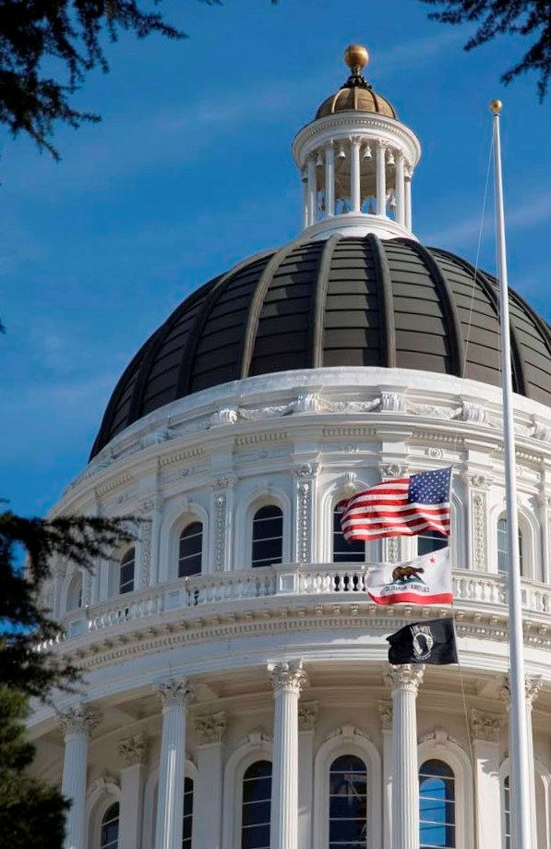
Department of Water Resources Office of Legislative Affairs
Kasey Schimke, Assistant Director
CA Department of Water Resources
(916) 653-0488
Kasey.Schimke@water.ca.gov

