Slide 1
Sutter Butte Flood Control Agency (SBFCA) Feather River West Levee Project (FRWLP) Project Area C, Sutter County September 27, 2013
APPLICATION NO. 18793-1

Slide 2
BOARD ACTION
Consider approval:
amendment to Board Permit No. 18793-1
which includes three variances to Board standards
send a letter to the U.S. Army Corps of Engineers, Sacramento District
requesting a Project Design Change
pursuant to requirements of USACE Letter of Permission, page 3, paragraph c, item 2 (September 19, 2013) which states:
“Should field conditions or future investigations require a deviation from the Final Plans, this deviation must be approved by this office though a request from the CVFPB”

Slide 3
AUTHORITY OF THE BOARD
California Code of Regulations, Title 23, Division 1 (CCR 23) § 11 – Variances
CCR 23 § 120(a)(13),(15),(18) – Levees
CCR 23 § 121 – Erosion Control
Rivers and Harbors Act of 1899, Title 33 United States Code, Section 408, hereafter referred to as Section 408

Slide 4
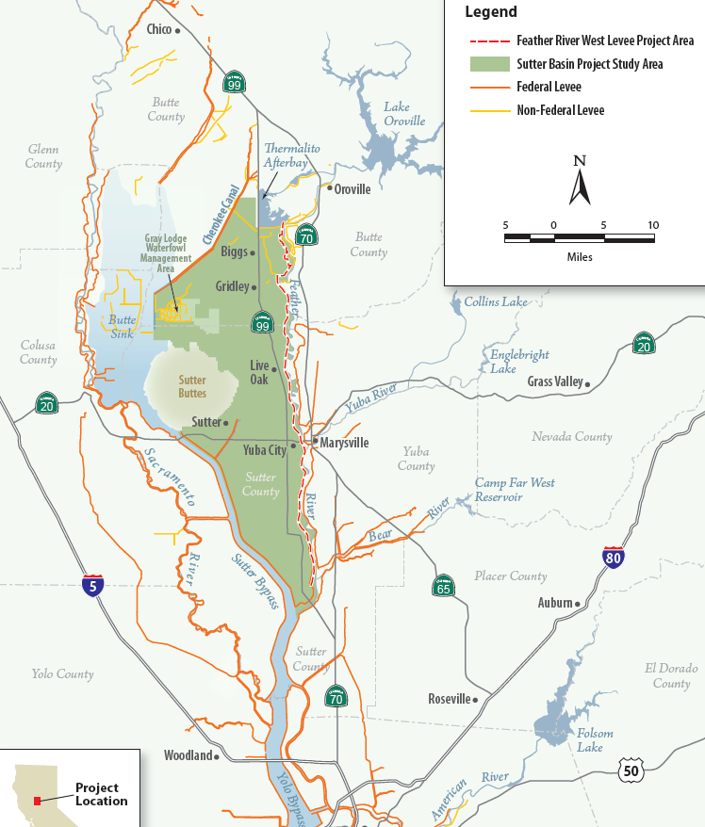
REGIONAL LOCATION

Slide 5
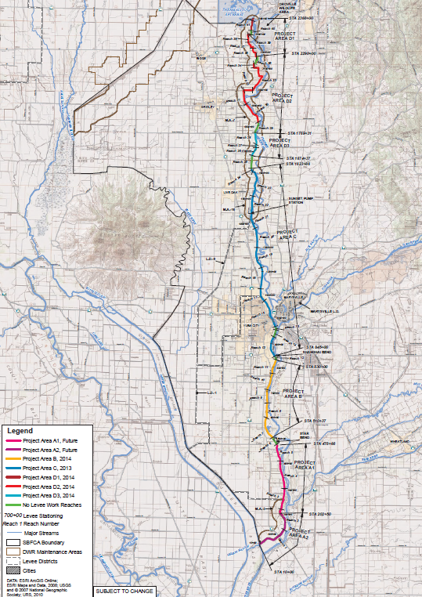
FRWLP AREAS / REACHES

Slide 6
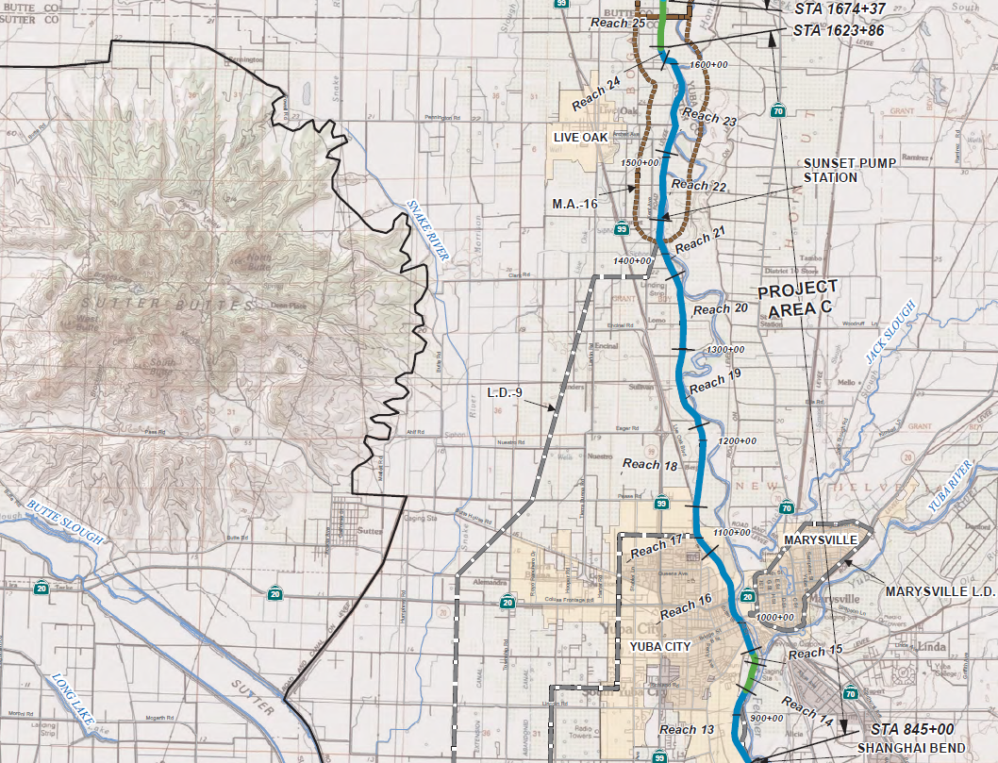
PROJECT AREA C
Sutter Buttes
Project Area C:
(Reaches 13-25)
Marysville
Yuba City

Slide 7
USACE APPROVALS
The following USACE approvals have been received:
Expedited USACE Section 408 Record of Decision and Letter of Permission issued July 2013 for Reach 13 of Project Area C to allow construction of critical public safety improvements before the upcoming flood season
USACE Section 408 Record of Decision (Headquarters) issued September 13, 2013 – Programmatic Section 408 approval for Reaches 2 through 41 (the entire Feather River West Levee Project)
USACE Section 408 Letter of Permission (Sacramento District) issued September 19, 2013 – Permission to construct all of Project Area C
Future Letters of Permission would be issued by the USACE Sacramento District to approve construction (via future Board permits) of FRWL Project Areas A, B, and D
Notes:
What is the incremental reduction in WSE with the exception of the bump?

Slide 8
PROPOSED VARIANCES
Board staff recommends the following variances to Board CCR 23 Standards:
Method Specification – a detailed instruction specifying machine type, lift depth, number of passes, machine speed, and moisture content.
End-result Specification – ASTM outlines test methods to be used and desired results
Standard
Proposed Variance
§120(a)(13)
Use a method specification to achieve desired relative density
of levee backfill in lieu of end-result ASTM test-based specification
§120(a)(15)
Increase maximum allowable particle size from three (3) to
eight (8) inches
§120(a)(18)
Increase maximum fill material lift thickness from six (6) to twelve (12) inches

Slide 9
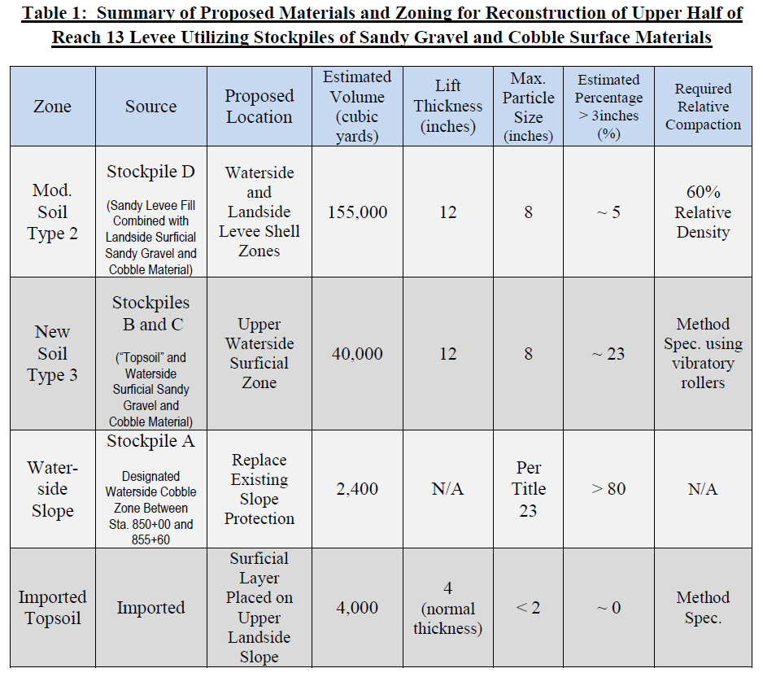
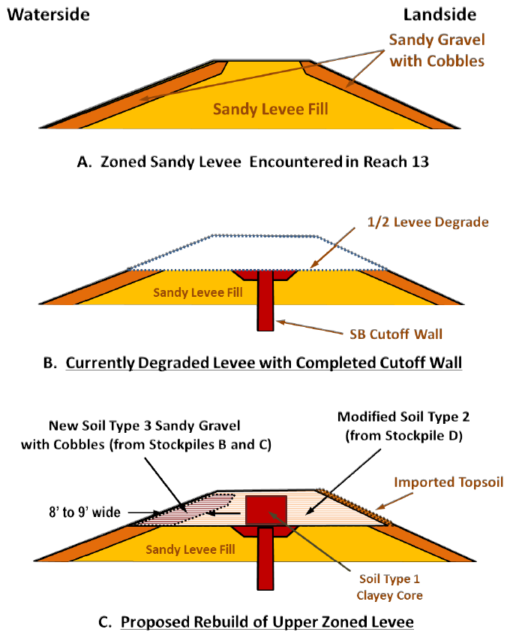
SBFCA PROPOSAL
Area C construction features installation of a soil-bentonite cutoff wall, which requires a temporary degrade of the levee to about half its height during construction
During levee degrade unanticipated quantities of 3- to 8-inch cobble were found in the degraded material, and SBFCA is proposing to reuse this material when reconstructing the upper levee section and slopes

Slide 10
SBFCA PROPOSAL – STAFF REVIEW
Attachment D (SBFCA Executive Summary) provides a detailed description of conditions encountered in the field, proposed design changes, and justification for the amending the permit:
Board staff met with representatives from SBFCA, USACE, the DWR, and the FRWLP Independent Panel of Experts on September 23, 2013
The meeting concluded with Board staff and all parties in agreement that the proposed design changes are acceptable, and that amending the permit is justified
If approved the proposed design changes will:
allow intelligent and efficient reuse of the onsite materials
provide an improved design
result in a safer levee improvement project

Slide 11
STAFF CONCLUSIONS
Board staff concurs:
with SBFCA’s proposal and justification
with the need for the requested variances
Board staff concludes that the proposed design changes:
will result in an overall betterment to the Sacramento River Flood Control Project (SRFCP) and State Plan of Flood Control
are consistent with the adopted 2012 Central Valley Flood Protection Plan
will not be injurious to the public interest
will not impair the usefulness of the SRFCP
Notes:
What is the incremental reduction in WSE with the exception of the bump?

Slide 12
PROPOSED CEQA FINDINGS
The Board finds that its prior CEQA findings made on May 24, 2013 regarding the FRWL project are still valid.
The Board finds that the proposed project design change constitutes a subsequent activity to the previously adopted EIR.
The Board finds that the proposed permit modifications are within the scope of the previously adopted EIR, and that no new environmental effects could occur and no new mitigation measures are required as a result of the modifications.
Therefore , no new environmental documents are required pursuant to CEQA Guidelines section 15162.
Notes:
What is the incremental reduction in WSE with the exception of the bump?

Slide 13
STAFF RECOMMENDATIONS
Board staff therefore recommends that the Board:
adopt Resolution 2013-23 (including CEQA findings)
approve sending a letter, in substantially the form provided, to USACE requesting a Project Design Change pursuant to requirements of their Letter of Permission and Record of Decision
delegate authority to the Executive Officer to sign the letter on behalf of the Board
approve construction variances to Board standards pursuant to CCR 23, §11 and §120(a)(13),(15) and (18)
approve, subject to USACE approval, amending Permit No. 18793-1 to include the Board-approved variances, and to incorporate any additional conditions of the USACE subsequent to the Record of Decision and Letter of Permission received in September
direct the Executive Officer to take the necessary actions to issue the amended permit, and to file a Notice of Determination with the State Clearinghouse
Notes:
What is the incremental reduction in WSE with the exception of the bump?

Slide 14
QUESTIONS
Presented by: Eric R. Butler, P.E.
Chief, Projects and Environmental Branch

