Slide 1
Sutter butte flood control agency (sbfca) FEATHER RIVER WEST LEVEE PROJECT project area c sutter county May 24, 2013
APPLICATION NO. 18793-1

Slide 2
2012 PROJECT 408 REQUEST
On October 26, 2012 the Board:
approved a letter to the U.S. Army Corps of Engineers (USACE) requesting Section 408 approval to alter approximately 41 miles of federal flood control project levee on the west side (right bank) of the Feather River in Butte and Sutter Counties,
directed the Executive Officer to send the letter and Project Summary Report to the USACE Sacramento District Engineer, and
agreed that subject to USACE Section 408 approval the Sutter Butte Flood Control Agency (SBFCA) will submit individual construction permit applications to seek Board approval for each phase of project construction planned over the next 3 years
a Record of Decision from USACE headquarters and a Letter of Permission from USACE Sacramento District are anticipated this July

Slide 3
BOARD ACTION
Today’s Board action is to consider approval of Permit No. 18793-1 to:
Alter approximately 15 miles (Project Area C, Reaches 13 - 24) of federal flood control project levee on the right (west) bank of the Feather River in Sutter County
Install seepage cutoff wall 35 to 120 feet in depth
partially degrade and reconstruct approximately 13 miles
fully degrade and reconstruction approximately 600 feet
Remove and reconstruct various utilities and drainage structures
Today’s action also includes requests to approve several variances to Board Standards pursuant to California Code of Regulations, Title 23 (CCR 23) § 11(a) and (b) to construct various project features

Slide 4
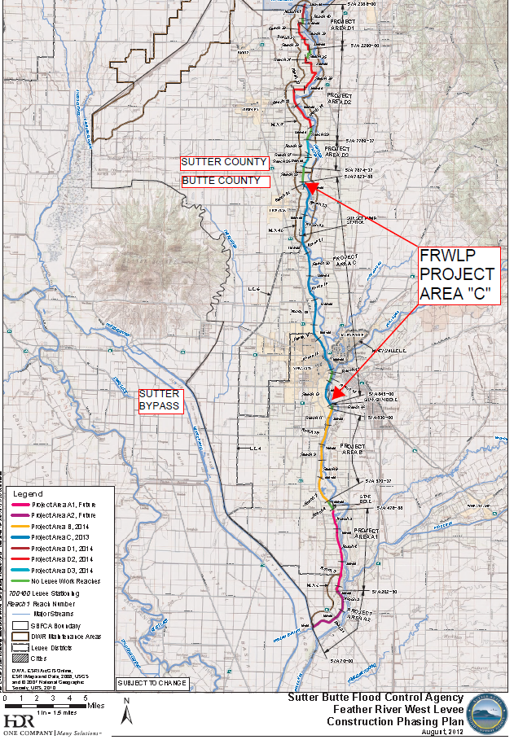
LOCATION MAP
FEATHER RIVER
MARYSVILLE
YUBA CITY

Slide 5
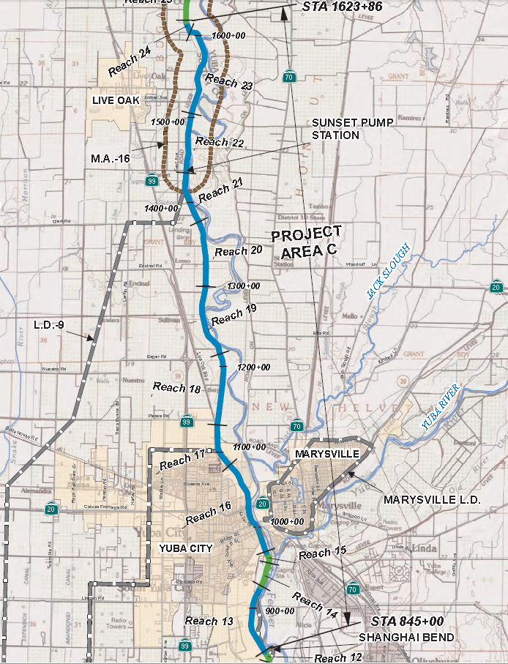
FRWLP - VICINITY MAP

Slide 6
AUTHORITY OF THE BOARD
CCR 23, § 106, Existing Encroachments within an Adopted Plan of Flood Control
CCR 23, § 112, Streams Regulated and Nonpermissible Work Periods
CCR 23, § 116, Borrow and Excavation Activities – Land and Channel
CCR 23, § 120, Levees
CCR 23, § 121, Erosion Control
CCR 23, § 123, Pipelines, Conduits and Utility Lines
CCR 23, § 124, Abandonment of Pipelines
Rivers and Harbors Act of 1899, Title 33 United States Code, Section 408, hereafter referred to as Section 408

Slide 7
DESIGN REVIEW
The following documents have been reviewed by Board staff:
65%, 90%, 100%, and 100% “Issued for Bid” Plans and Specifications
Design Documentation Report
Geotechnical Data Report
Geotechnical Design Recommendations Report
Hydrology/Hydraulic Analysis
Draft and Final Environmental Impact Report
Addenda Nos. 1 and 2

Slide 8
DESIGN FEATURES (1 of 2)
Reaches 13 thru 17 (Shanghai Bend to UPRR Crossing)
Approximately 5.4 miles
Conventional cutoff walls with 50% levee degrade & rebuild
Reach 13 – investigation of existing relief wells
Reaches 14 and 15 – no work due to existing cutoff wall
Reach 16 – closure of gap in cutoff wall at Yuba City 10th Street (SR 20) Bridge
Two features within Project Area C will be constructed in future work:
Reach 16 – closure of gap in cutoff wall at Yuba City 5th St. Bridge
Reach 19 – closure structure at UPRR crossing

Slide 9
DESIGN FEATURES (2 of 2)
Reaches 18 thru 24 (UPRR Crossing to Northern Live Oak)
Approximately 9.3 miles
Conventional cutoff walls with 50% levee degrade & rebuild
Reach 22 – approximately 600 feet of full levee degrade and reconstruction to eliminate severe animal burrowing
Variances for work during the flood season (currently estimated to be scheduled between February 1 and March 20) are needed to reconstruct Sunset Pump Station pipelines and Campbell Road Storm Drain

Slide 10
PROJECT BENEFITS
Address major geotechnical concerns of through- and under-seepage and related slope stability, and condition and impact of existing encroachments
Reduce the risk of flooding for existing urban areas, agricultural commodities, infrastructure, and other properties.
Increase the level of flood protection to a targeted 200-year level for Yuba City and Live Oak consistent with the adopted CVFPP and Senate Bill 5 (Statutes of 2008) to provide 200-year flood protection for urban and urbanizing areas.
Preserves riparian and other native habitats.
Bring encroachments surveyed by SBFCA into CCR 23 compliance while addressing 100 percent of encroachment issues categorized by the USACE in their 2010 periodic inspections as “Unacceptable – likely to prevent performance in the next flood event.”

Slide 11
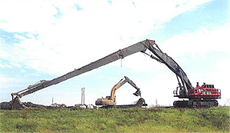
A TYPICAL CUTOFF WALL METHOD

Slide 12
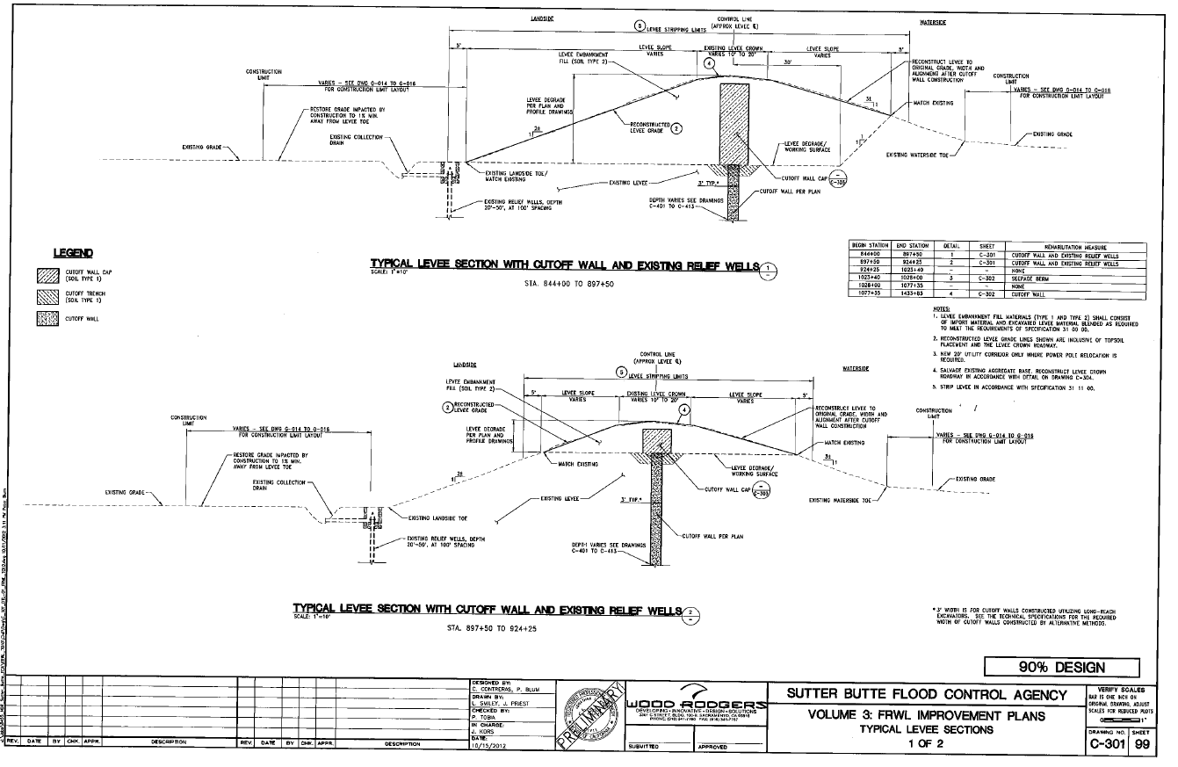
TYPICAL CROSS SECTIONS (1 of 2)
Landside
Waterside
Reach 13 D/S - Deep levee degrade
Reach 13 U/S - Shallow levee degrade

Slide 13
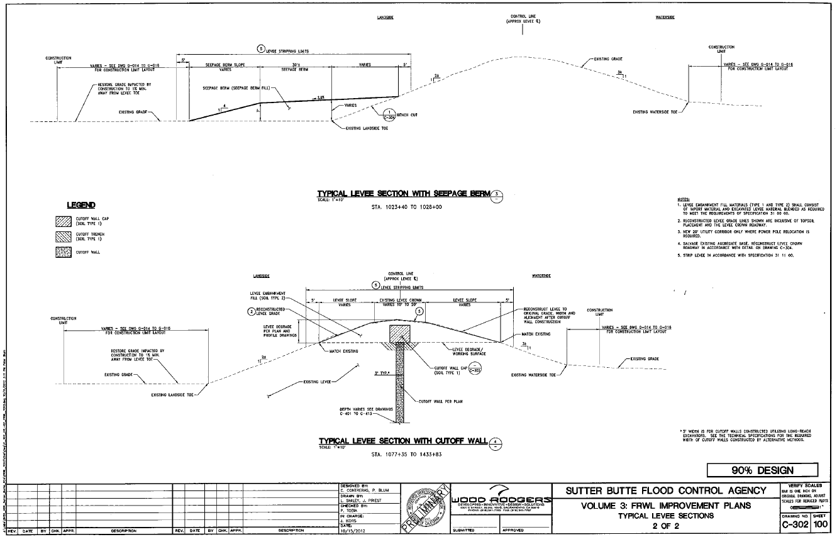
TYPICAL CROSS SECTIONS (2 of 2)
Landside
Waterside
Landside Seepage Berm - Reach 16
Cutoff Wall with Minimal Degrade

Slide 14
SOIL BENTONITE CUTOFF WALLS
The contractor has four choices to install Soil Bentonite Slurry Cutoff Walls: Project depth range = 35 feet to 120 feet deep.
Conventional; Open Trench Method (max. depth of 80 feet)
Cutter Soil Mixed (CSM); Non-conventional (up to 180 feet)
Deep Mix Method (DMM); Non-conventional (can exceed 120 feet)
Trench Remixing Deep (TRD); Non-conventional (50 to 80 feet)

Slide 15
CCR Title 23 Variances
Staff Report Section 8.5 – Variances from CCR 23, Section 11(a) & (b)
“(a) An applicant for an encroachment permit for a use that is not consistent with the board’s standards as outlined in Article 8 of CCR 23 requires a variance approved by the board.
(b) When approval of an encroachment requires a variance, the applicant must clearly state in the application why compliance with the board’s standards is infeasible or not appropriate.”
Variances to the following sections of Board Standards (CCR 23, Article 8) are required for construction:
CCR 23, § 112, Streams Regulated and Nonpermissible Work Periods
CCR 23, § 120; Levees
CCR 23, § 123; Pipelines, Conduits, and Utility Lines
CCR 23, § 124; Abandoned Pipelines and Conduits

Slide 16
CCR 23 Variances (Category 1)
8.5.1 - Variance Category 1 - Issues raised by Board staff in our October 2012 Section 408 Request Staff Report (see Attachment – J)
The October 2012 Section 408 request Staff Report listed 17 items that were to be resolved between Board and SBFCA staffs. Attachment – J states Board staff’s original concerns, SBFCA responses, and Board staff’s final response.
Nine items (B, C, D, G, H, J, K, O, and P) have been resolved by Board and SBFCA staff collaboration.
Three items are addressed by draft permit conditions SEVENTY TWO (A, CVFED data), SEVENTY THREE (F, Seismic Assessment) and EIGHTY TWO (I, DWR / Sutter Butte Canal Maintenance Agreement) in the draft permit (Attachment – B).

Slide 17
CCR 23 Variances (Category 1)
Five items (E, L, M, N, and Q) are addressed through proposed variances to Board standards as follows:
Item E, Levee slopes, CCR 23, § 120(a)(12)
Item L, Reuse of degrade materials, CCR 23, § 120(a)(12)
Item M, Sunset Pump Station pipelines, CCR 23, § 123(d)(7), (d)(9), (d)(11), and (d)(20)
Item N, Levee slopes at Yuba City 5th and 10th Street Bridges, CCR 23, § 120(a)(24)
Item Q, Existing Pipelines (included in Variance Category 2, Attachment K)

Slide 18
CCR 23 Variances (Category 2)
8.5.2 - Variance Category 2; - Pipeline crossings deviating from CCR 23: (see Attachment – K)
SBFCA is requesting construction variances to CCR 23 § 123 -Pipelines, Conduits, and Utility Lines to remove and replace twenty-two existing pipeline crossings

Slide 19
CCR 23 Variances (Category 3)
8.5.3 - Variance Category 3; Time Variance Requests: (See Attachment K)
Four variances to CCR 23, § 112, Streams Regulated and Nonpermissible Work Periods are needed to work during the flood season (November 1 through April 15) at the following pipeline crossings:
Sunset Pump Station 36”, 60”, 60” low pressure water lines
Campbell Road Storm Drain 36” gravity line
The canal can only be shut down from February 1 through March 20 to complete this work.
These crossings are critical to staying on the construction schedule and require draining the Sutter Butte Main Canal to remove and replace the lines
Board staff has the authority to stop work due to inclement weather.

Slide 20
CCR 23 Variances (Category 4)
8.5.4 – Variance Category 4; Levee Earthwork Variances: deviating from CCR 23, § 120 Levees (see Attachment L)
Detailed descriptions of the following three earthwork variances are provided in Staff Report Attachment L:
EW-1: Use of Non-Impervious Soil in Outer Shells for Reconstructed Zoned Levee
EW-2: Compaction Requirements for Cohesionless Fill
EW-3: Moisture Content for Cohesive Fill

Slide 21
Existing Pipelines
8.5.5 – Pipe Owner Permits; (excluding PG&E and AT&T)
38 pipeline encroachments within Area C - SBFCA proposes to:
remove or replace 22 pipelines (Variance Category 2)
remove and dispose 15 pipelines
abandon in place 1 pipeline
Crossings fall into the following categories:
Owner has an existing Board permit
Owner does not have an existing Board permit
The pre-existing pipeline was incorporated into the USACE O&M Manual
Permit status or owner has not been confirmed
Board and SBFCA staffs will work together to:
Update existing permits so they conform to current CCR 23 regulations and USACE policies, or
Process applications for previously unpermitted encroachments so that all regulatory parties can effectively track and inspect future operations and maintenance of these encroachments

Slide 22
CEQA FINDINGS & WC 8610.5 CONSIDERATIONS
Responsible Agency CEQA Findings are provided in Staff Report Section 9.0 and included in Resolution 2013-07
Water Code Section 8610.5 Considerations are provided in Staff Report Section 10.0 and included in Resolution 2013-07

Slide 23
STAFF CONCLUSIONS
Staff concludes that the proposed Area C construction phase of the FRWLP, to be constructed as described in SBFCA’s 100 percent “Issued For Bid Set”, dated March 13, 2013, and in Addenda Nos. 1 and 2, will result in an overall betterment to the Sacramento River Flood Control Project and State Plan of Flood Control, and will be consistent with the adopted 2012 Central Valley Flood Protection Plan.
Staff further concludes that the proposed project alterations can be constructed in a manner not injurious to the public interest and that will not impair the usefulness of the SRFCP.

Slide 24
STAFF RECOMMENDATIONS (1 of 2)
Staff recommends that the Board:
approve Draft Permit No. 18793-1, conditioned upon receipt of Section 408 Record of Decision and Letter of Permission from the USACE when received,
approve, pursuant to CCR 23, §§ 11(a) and (b), with regard to Variances to Board Standards, the requested construction variances summarized in Staff Report Section 8.5 and further detailed in Attachments – J, – K, and – L,
delegate authority to the Executive Officer to make non-substantive changes to the draft permit as needed to incorporate additional design changes submitted by SBFCA prior to receipt of the USACE Record of Decision and Letter Of Permission. If substantive changes to the draft permit are required, the Board staff will bring the permit back to the Board at a future meeting to seek approval for substantive changes,

Slide 25
STAFF RECOMMENDATION (2 of 2)
Staff recommends that the Board:
adopt the CEQA findings and Resolution 2013-07 (Attachment C), and direct staff to file a Notice of Determination with the State Clearinghouse.
direct the Executive Officer to process applications to amend existing or issue new encroachment permits to owners of pipeline crossings within Project Area C that will be reconstructed as part of the Area C project, and as detailed in Section 8.5.5 herein,
direct the Executive Officer that if, during construction, additional non-conforming encroachments or constructability issues are discovered by any party, SBFCA will consider whether or not they can be brought into compliance during construction. Board staff will evaluate the proposal(s) for Board approval to be made either by direct Board action or by delegation to the Executive Officer as appropriate.

Slide 26
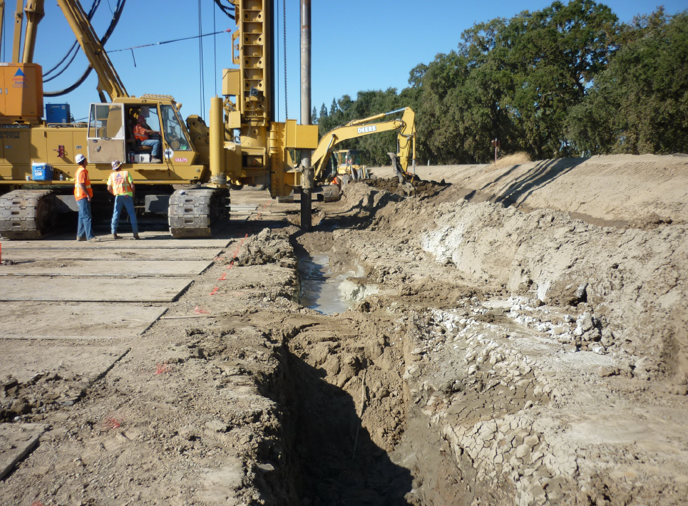
QUESTIONS
Presented & Prepared by:
David R. Williams, P.E.
Debabrata Biswas, P.E.
Reviewed by: Eric Butler, P.E.
Reviewed by: Len Marino, P.E.

