Slide 1
AGENDA ITEM NO. 7A: Letter of intent to develop and implement a system-wide improvement framework plan for the MA-09 – City of Sacramento, American River left bank levee system ALISON TANG Enforcement Section SEPTEMBER 27, 2013
MA09 - City of Sac, ARCFCD: letter of intent

Slide 2
MA09 - City of Sac, ARFCD: letter of intent
Location
Sacramento County
Partially in City of Sacramento
Mix of urban and non-urban areas
Description
One levee system, 5 levee segments, three LMAs
34 miles of levee embankments, ½-mile of floodwall
Protects population of 450k and $70 billion in property
Local Maintaining Agencies (LMA)
City of Sacramento Department of Utilities
American River Flood Control District (ARFCD)
DWR State Maintenance Area 09 (MA 09)
N
HWY 80
Sac County
City of Sacramento
HWY 99
HWY 5
Map Source: Google Earth

Slide 3
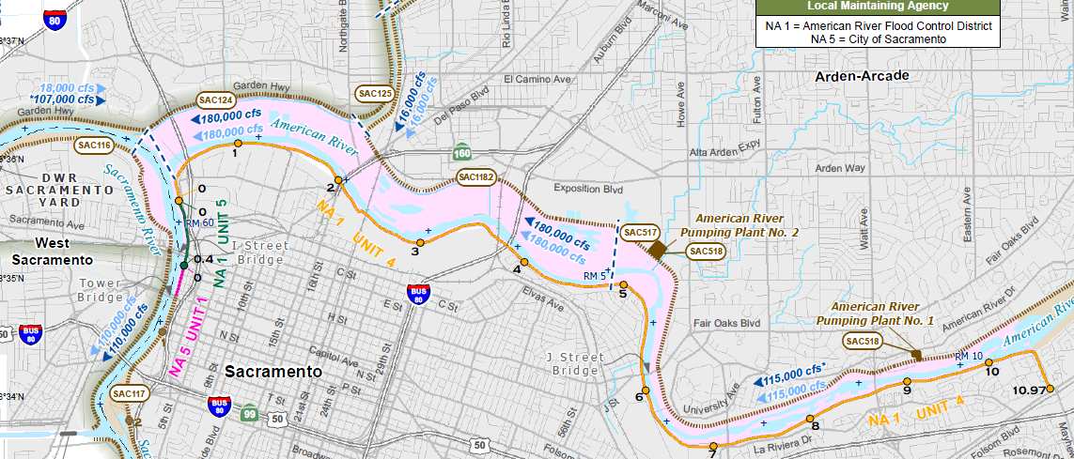
MA09 - City of Sac, ARFCD: letter of intent
Levee Segments
Unit 4, American River left bank (ARFCD) – 10.7 mi
Unit 5, Sacramento River (ARFCD) – 0.4 mi
CONFLUENCE OF SACRAMENTO & AMERICAN RIVERS
N
AMERICAN RIVER
SACRAMENTO RIVER
Map Source: FloodSAFE (2012)

Slide 4
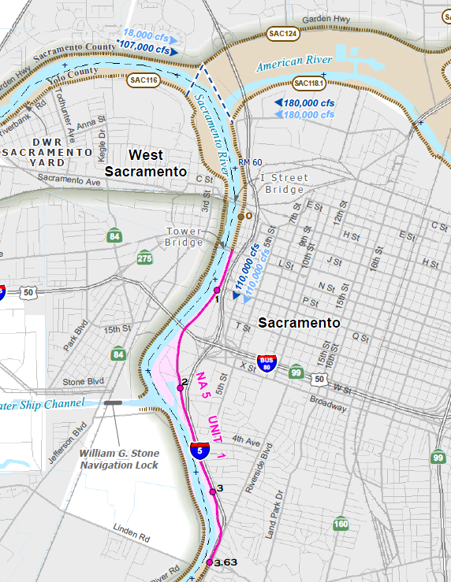
MA09 - City of Sac, ARFCD: letter of intent
Levee Segments
Sacramento River left bank (City of Sacramento) – 3.7 mi
N
AMERICAN RIVER
SACRAMENTO RIVER
Map Source:
FloodSAFE (2012)

Slide 5
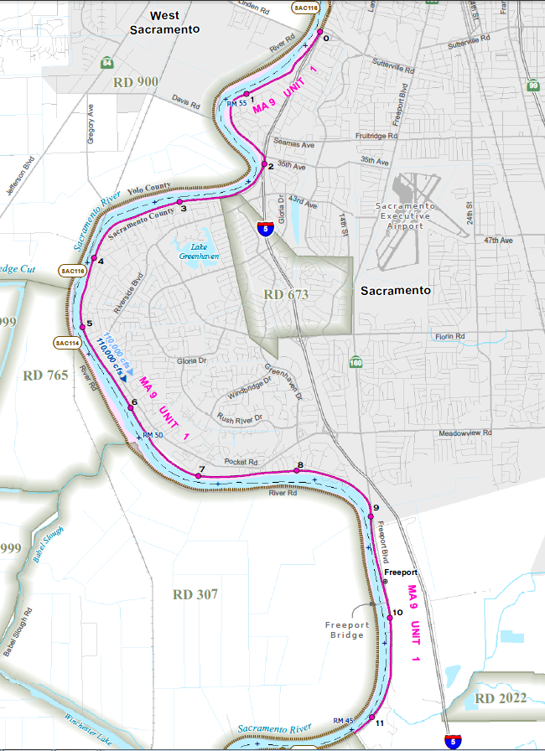
MA09 - City of Sac, ARFCD: letter of intent
Levee Segments
Sutterville Road to Freeport (MA 09) – 11.2 mi
N
SACRAMENTO RIVER
Map Source:
FloodSAFE (2012)

Slide 6
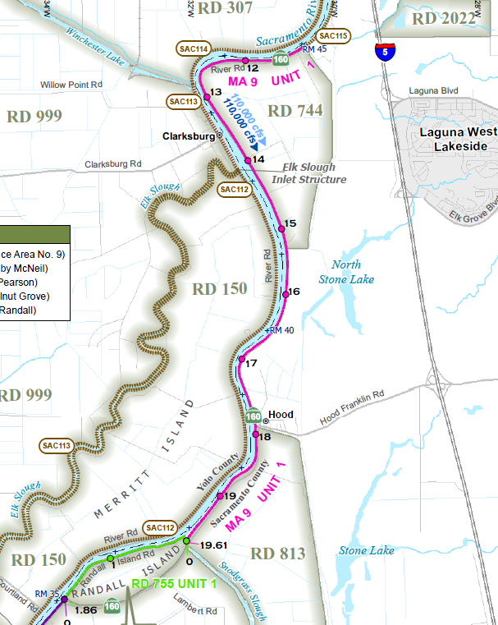
MA09 - City of Sac, ARFCD: letter of intent
Levee Segments
Freeport to Snodgrass Slough (MA 09) – 8.4 mi
N
SACRAMENTO RIVER
Map Source:
FloodSAFE (2012)

Slide 7
MA09 - City of Sac, ARFCD: letter of intent
LMA Roles
City of Sacramento Department of Utilities is leading the Letter of Intent (LOI) and System-Wide Improvement Framework (SWIF) plan efforts.
ARFCD and MA 09 are the supporting partner LMAs in the levee system
USACE Periodic Inspection (PI) Report
Issued September 2010 as “Unacceptable – Active” in PL 84-99 Rehabilitation & Inspections Program (RIP) because of the California’s Central Valley Flood System Improvement Framework (Framework).
Upon expiration of the Framework in July 2012, system became “Unacceptable – Inactive” in RIP.
Purpose of the LOI and SWIF
If accepted by the USACE, the LOI will allow the levee system to regain eligibility for RIP assistance for two years while LMAs develop a SWIF plan.

Slide 8
MA09 - City of Sac, ARFCD: letter of intent
Staff Recommendation
Staff has reviewed the LOI submitted by the City of Sacramento Utilities Department and finds that it adequately addresses the USACE’s six requirements for submitting a LOI for a SWIF; therefore
Staff recommends that the CVFPB authorize the Executive Officer to finalize a letter of transmittal to the USACE and forward it with the signed LOI to the USACE
September 9, 2013 – City of Sacramento Utilities Department submitted signed LOI to CVFPB for transmittal to USACE.
September 13, 2013 – American River Flood Control District submitted a letter of support for the LOI for a SWIF plan.
September 18, 2013 – DWR Flood Maintenance Office submitted a letter of support for the LOI for a SWIF plan.

Slide 9
MA09 - City of Sac, ARFCD: letter of intent
LMAs
Bill Busath, City of Sacramento
Tim Kerr, ARFCD
Mark List, MA 09
Brigid Briskin, USACE

Slide 10
MA09 - City of Sac, ARFCD: letter of intent
USACE Policy for Development and Implementation of System-Wide Improvement Frameworks (SWIFs)
Section 7. Requirements for Development and Submittal of a SWIF
a. Requirements for Submitting a Letter of Intent for a SWIF. A letter of Intent must be signed by all associated levee sponsors.
(1) Identification of levee systems to be covered as listed in the NLD;
(2) Brief description of deficiencies or issues that will be included in the SWIF and discussion of how a system-wide approach will improve flood risk reduction;
(3) Demonstration that significant non-federal resources have been, or will be committed;
(4) Anticipated interim risk reduction measures that will be implemented throughout the SWIF process
(5) Brief description of existing or planned interagency collaborative efforts;
(6) List of anticipated state and federal permits and consultation requirements, needed to implement the SWIF.

