Slide 1
FloodSAFE California: A Strategic Approach to Reducing Flood Risk
Central Valley Flood Protection Board
October 25, 2013
Presented by:
Michael Mierzwa, P.E. Chief of the FloodSAFE Program Management Office California Department of Water Resources

Slide 2
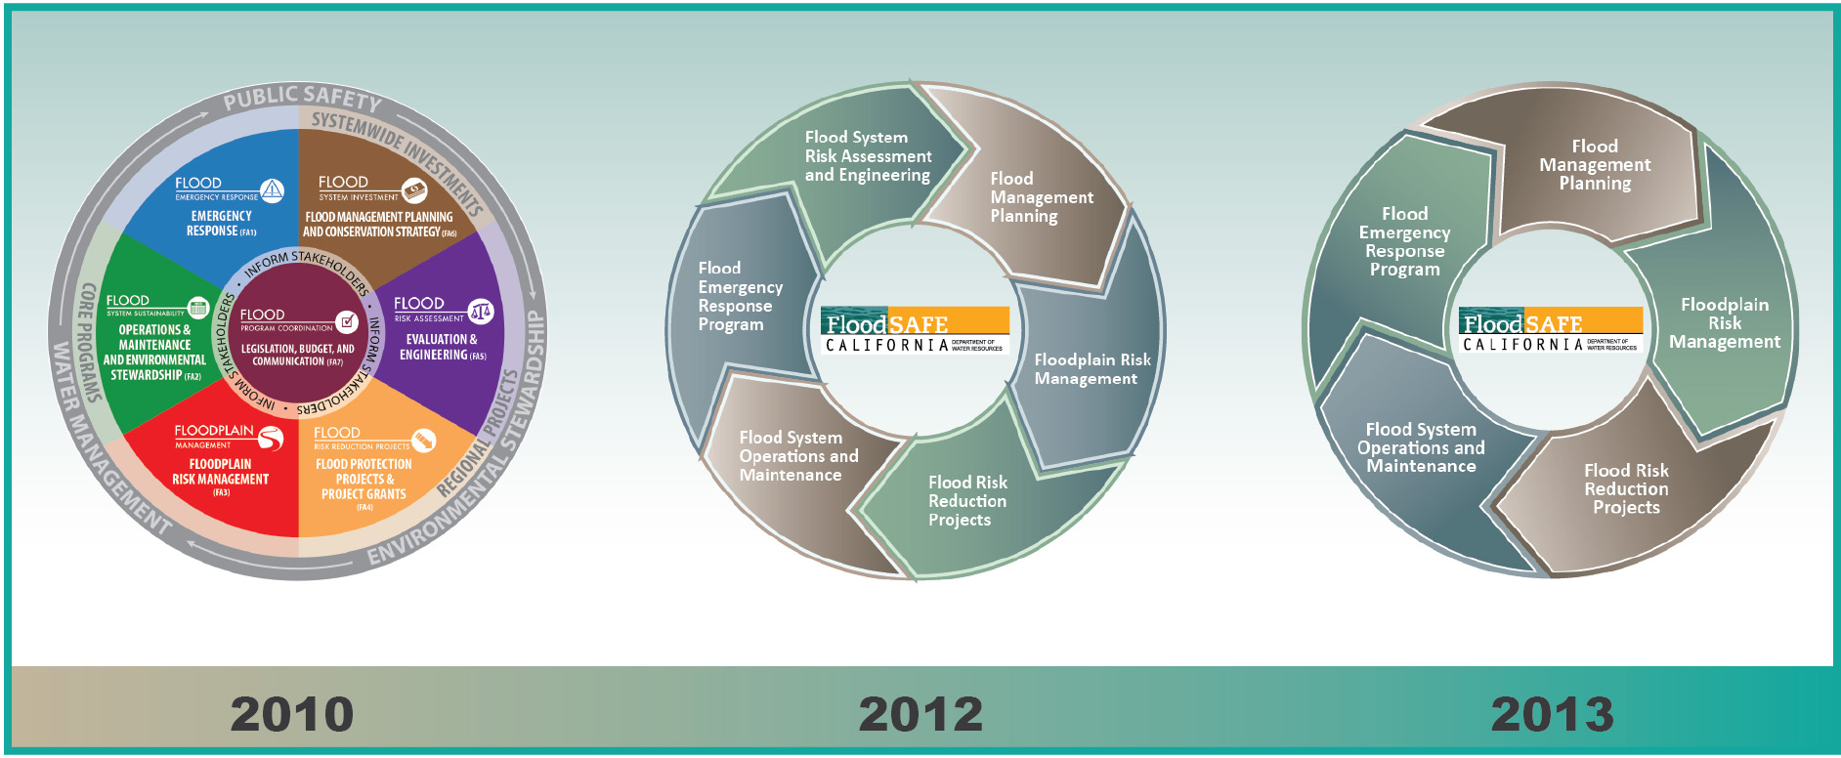
Organizing the Work
Strategic planning documents have moved from describing
“Functional Areas” in 2010 to “Mega Programs” in 2013 and beyond.

Slide 3
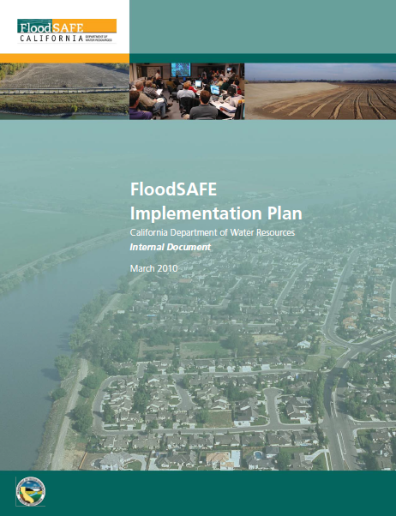
2010 Internal Implementation Plan
Goals & Principals
Internal Coordination (Establishment of Functional Areas & Functional Area Cross Coordination Teams – FAXCTs)
Deliverables
Reporting & Tracking
Investment Strategy
Governance / Roles & Responsibilities

Slide 4
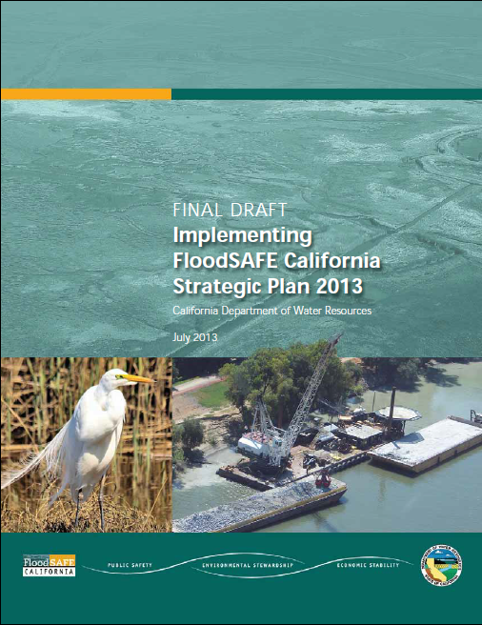
2013 Strategic Plan
Defines FloodSAFE’s vision, goals, and strategic approach to implementing an integrated flood management program to reduce flood risk statewide.
5-Yr focus
Establishes high level performance measures
Describes recent general fund & bond expenditures and planned expenditures by common services

Slide 5
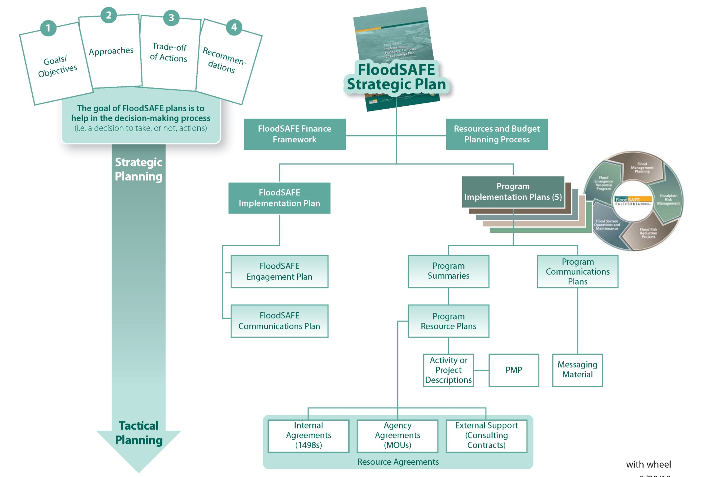
Strategic to Tactical FloodSAFE Plans

Slide 6
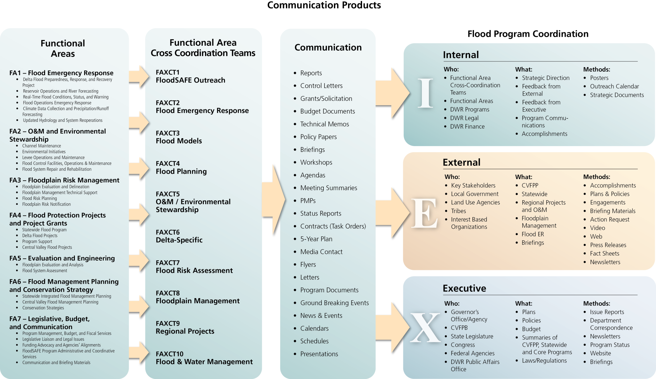
Communication Products

Slide 7
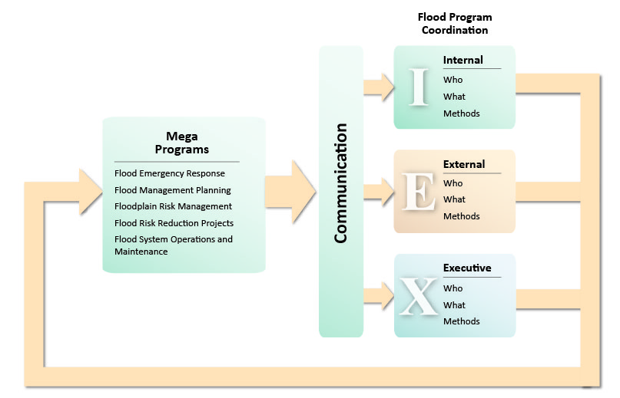
Engagement Planning

Slide 8
California Flood Preparedness Week
November 4-9, 2013
Goal:
Inform the public about flood risks,
Get the public to take action to reduce their flood risk
Objective:
To encourage federal, state and local agencies to actively reach out to the public about flood preparedness
Participants:
20 counties
5 cities
10 federal, state, and local agencies
Be Aware, Be Prepared, and Take Action!
Flood Preparedness Website:
www.water.ca.gov/ca-flood-preparedness
Notes:
Core team: 7-10 individuals from DWR and USACE
Larger Interested Agency Call: Over 75 contacts added to the list for a monthly call (see list below)
Events and activities during 2013 CFPW
Public:
Booths at preparedness fairs and a hazard expo; also how to put together a disaster kit
Sand bag and flood fight training (San Joaquin County, RD 2085)
“Flood Retrospective” event in Yuba City with speakers, displays, and videos. SBFCA and Trilia participating (Cait’s going up)
High Water Mark Initiative event at Garcia Bend Park (Pocket): Darryl Fong (host), FEMA, USACE, DWR, City of Roseville and Sacramento
Press conferences/media events
Social media campaign (Facebook, Twitter, Instagram) and NOAA weather radio
Education programs at schools in Washington Unified School District (West Sacramento), K-12
Mailings to Delta residents (Delta Protection Commission) and website
California Flood Preparedness Week website: hosted by DWR, updated for the week, information left up year-round
Internal
Functional exercises (internal): Sacramento County + DWR; Yolo Co. + City of West Sacramento;
“Storm Day” across all divisions in Ventura County government
Webinars on “Communicating Flood Risk” for elected officials (put on by FEMA Region IX/FloodSMART)
Before CFPW
Internal:
Exercise on failure of New Exchequer Dam (Merced County)
Sandbag and flood fight training (both public and for government agencies)
Counties
Alameda
Colusa
Contra Costa
Del Norte
Fresno
Humboldt
Mendocino
Merced
Napa
Nevada
Orange
Sacramento
San Diego
San Joaquin
San Mateo
Sutter
Tehama
Ventura
Yolo
Yuba
Cities:
Atherton
Chico
Roseville (HWMI)
Sacramento
West Sacramento
Government agencies
Alameda County Flood Control and Water Conservation District, Zone 7
California Department of Water Resources
Delta Protection Commission
Federal Emergency Management Agency, Region IX
National Weather Service
United States Army Corps of Engineers
West Sac Flood Protect (aka. West Sacramento Area Flood Control Agency)
Other:
FloodSMART (through FEMA Region IX)

Slide 9
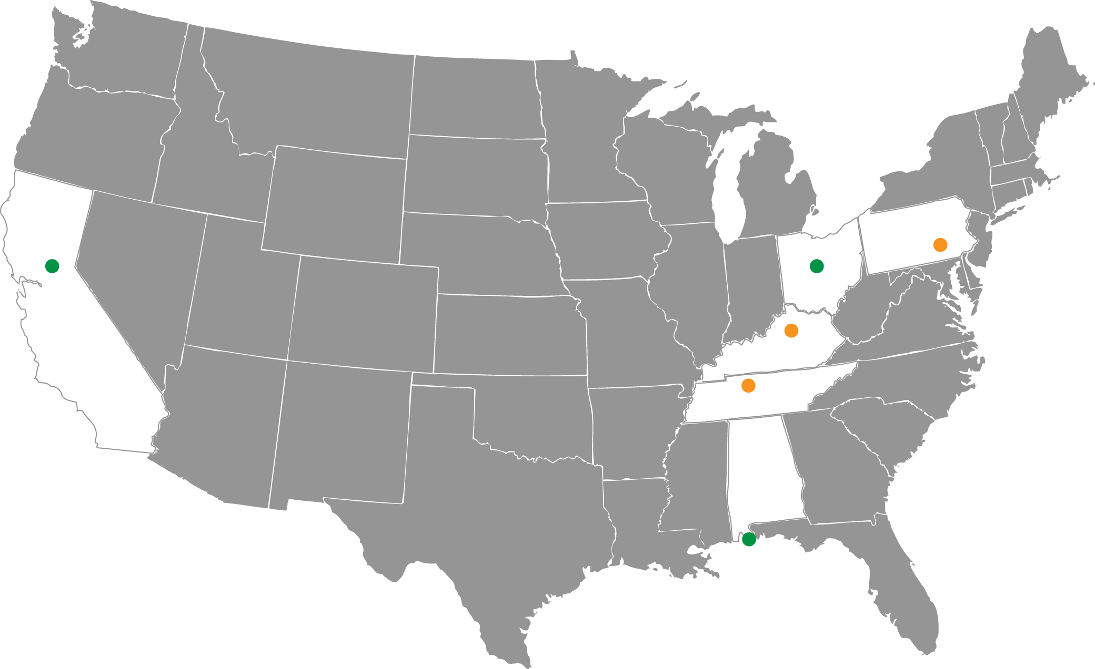
High Water Mark Initiative
“Know Your Line: Be Flood Aware” initiative developed to:
Improve the public’s awareness of flood risk
Encourage them to take action to reduce it.
Roseville
Sacramento
Participating Federal Agencies
FEMA | U.S. Department of Agriculture, Natural Resources Conservation Service
National Oceanic and Atmospheric Administration | U.S. Department of Housing and Urban Development
National Park Service | U.S. Geological Survey
U.S. Army Corps of Engineers | U.S. Small Business Administration
Notes:
Orange dots=existing projects; green=future rollout
To date, three pilot projects have been launched in Frankfort and Franklin County, KY, Harrisburg, PA,
and Nashville, TN, with two additional pilots planned for Orange Beach, AL and Columbus, OH.
A national rollout of the initiative is planned for fall 2013, which will open enrollment to all interested communities
nationwide.
(source: Silver Jackets newsletter, July 2013, pg. 3
From FEMA website:
FEMA and seven other federal agencies developed the “Know Your Line: Be Flood Aware” initiative to improve the public’s awareness of flood risk and encourage them to take action to reduce it. The initiative helps communities showcase their local flooding history and motivate their residents to take action by posting high water mark signs in prominent places to show how high flood waters have risen in the past.
Communities are encouraged to hold a high profile event to announce the initiative, followed by supporting outreach to remind residents of their flood risk over time and prompt them to take steps to reduce it.
Flexible Tools and Materials
FEMA and its partners developed tools, templates, and other materials that communities can customize to launch their own Know Your Line initiative. This flexibility allows communities to choose materials and outreach tactics that work best for them.
Benefits of Community Participation
Communities that launch their own Know Your Line initiative:
Underscore their commitment to the well-being of residents and the local business community
Galvanize their community to take steps now to reduce the often devastating impact of floods
Can receive Community Rating System Rating (CRS) points to reduce the cost of flood insurance
Can put existing applicable Federal and state mitigation assistance funds to work
Participating Federal Agencies
FEMA
National Oceanic and Atmospheric Administration
National Park Service
U.S. Army Corps of Engineers
U.S. Department of Agriculture, Natural Resources Conservation Service
U.S. Department of Housing and Urban Development
U.S. Geological Survey
U.S. Small Business Administration
Last Updated: 07/12/2013 - 12:14

Slide 10
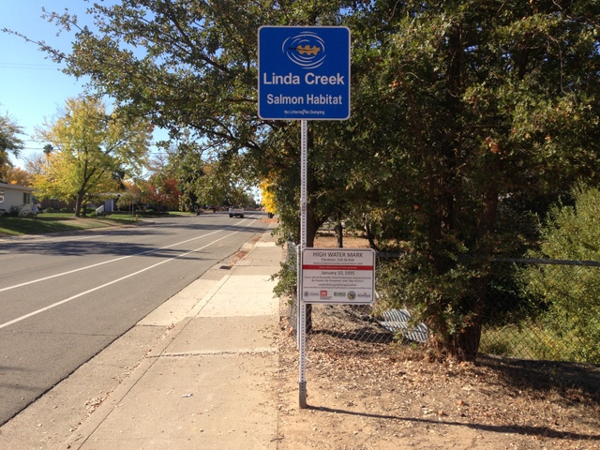
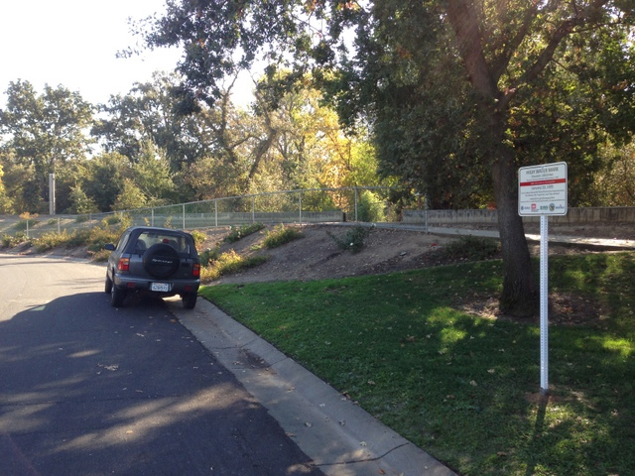
High Water Mark Initiative Event
Event: Friday, November 8, 2013
Location: Garcia Bend Park, Pocket Area 7654 Pocket Road, Sacramento
Time: 11:00 am – 1:00 pm
Host: Darrell Fong, Sacramento City Councilmember
Speakers:
City of Roseville
City of Sacramento
DWR
FEMA
U.S. Army Corps of Engineers
Central Valley Flood Protection Board (invited)
Top: High water mark sign by Linda Creek in Roseville. Bottom: Sign on Tina Way in Roseville.
Notes:
11 signs total: 4 in Roseville, 7 in Sacramento
2013 is pilot year for High Water Mark Initiative. California was specifically asked to participate by FEMA Headquarters.
Sacramento is using the 1986 event to determine its high water mark. Roseville used the January 1995 event for its high water marks.
Press information for Sacramento event:
The "Know Your Line: Be Flood Aware" High Water Mark initiative, created by FEMA and seven other Federal agencies, helps communities remind residents of major local floods and encourage residents to prepare for the next one. Participating communities post high water mark signs in prominent places, hold a high profile launch event to unveil the signs, and conduct ongoing education to build local awareness of flood risk and motivate people to take action.
Benefits of Community Participation
Communities that launch their own Know Your Line initiative:
* Underscore their commitment to the well-being of residents and the local business community
* Galvanize their community to take steps now to reduce the often devastating impact of floods
* Can receive Community Rating System Rating (CRS) <http://www.fema.gov/national-flood-insurance-program/community-rating-system> points to reduce the cost of flood insurance
* Can put existing applicable Federal and state mitigation assistance funds to work

Slide 11
Questions: Michael.Mierzwa@water.ca.gov

