Slide 1
CVFPB Meeting October 25, 2013 USACE INSPECTION RESULTS Ryan Larson, P.E.

Slide 2
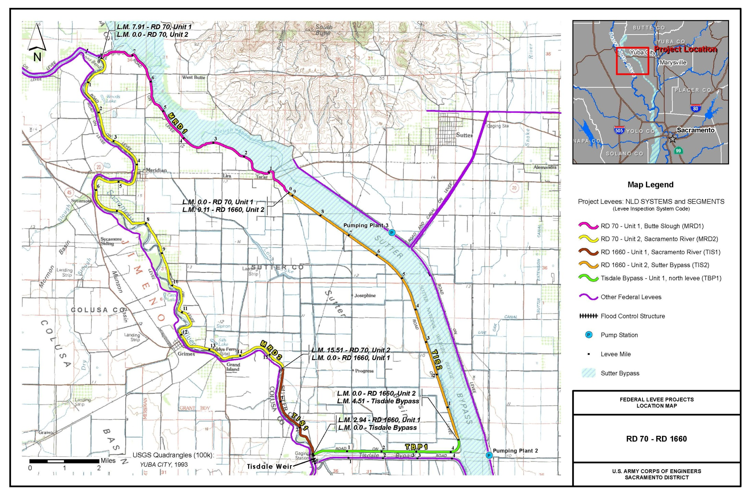
RD 0070 & RD 1660 – Sutter Basin North (Sutter County)

Slide 3
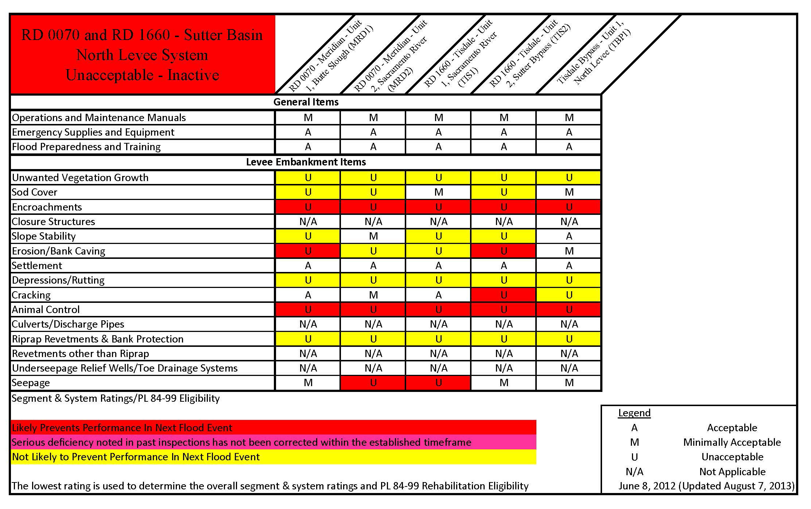
RD 0070 & RD 1660 – Sutter Basin North (Sutter County)

Slide 4
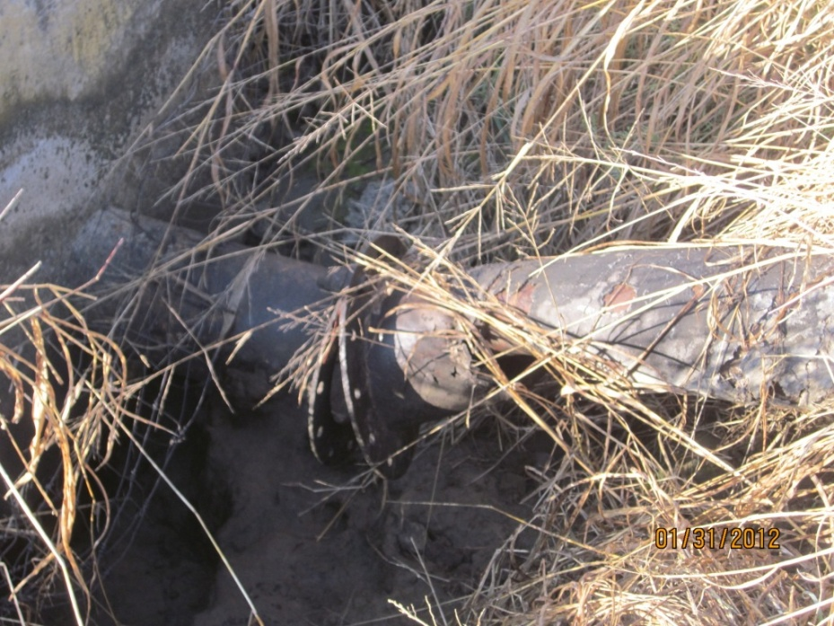
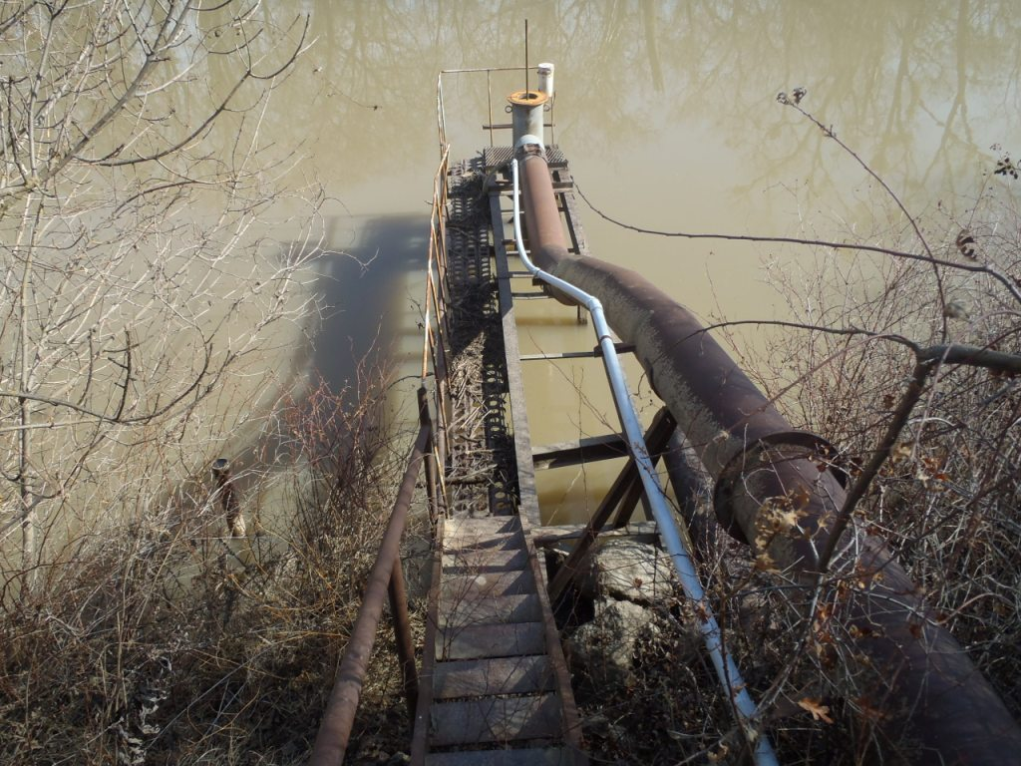
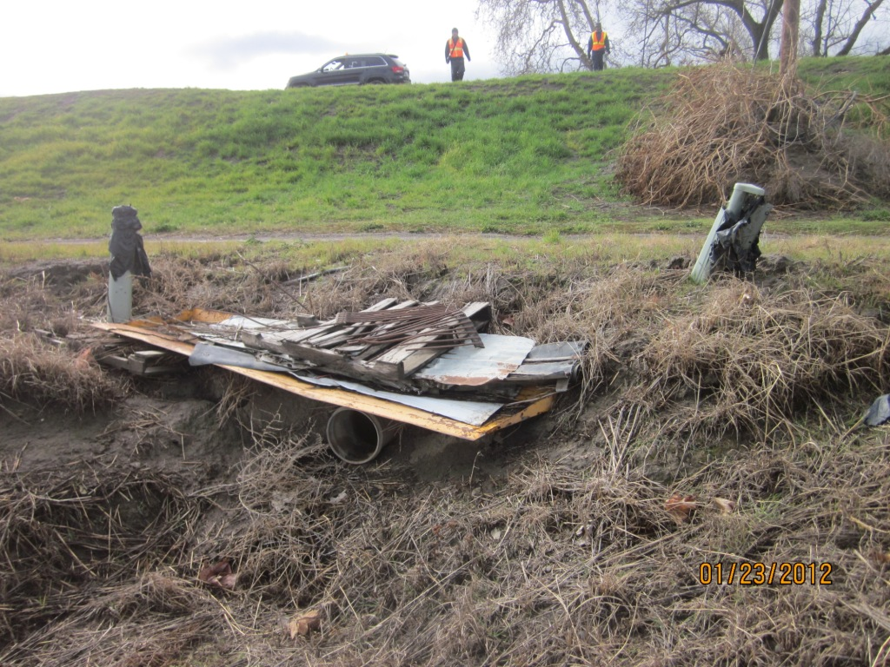
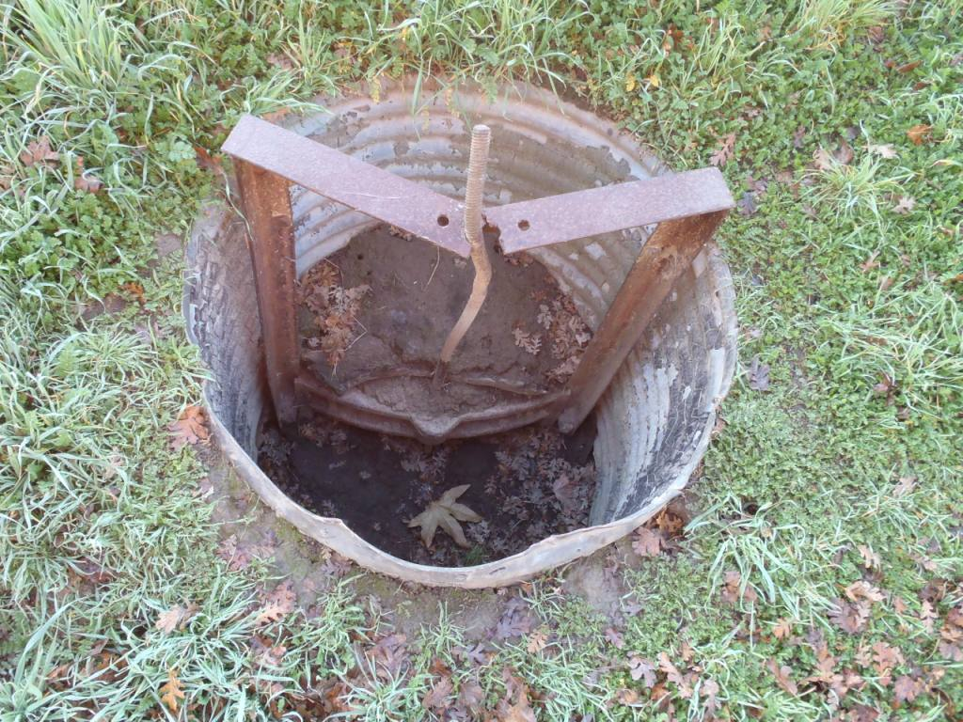
Notes:
Top Left: point 30 Mrd1 encro: irrigation structure at LS toe, 12 inch pipe going through leee. Pipe is damaged. No flap gate or sluice gate. Pump station at WS bank, 2 pipes run under the levee, valves visible, no flap gates visible.
Top Right: point 110 MRD1 encro: on LS concrete vault with 10 inch pipe through levee. On WS walkway and culvert outlet at bank, gates not visible, 12 inch culvert through levee, pipe visible at WS toe.
Bottom Left: TIS1: point 79 encro: 12 inch culvert runs under levee, no flap or slide gate on WS. Metal debris covering pipe on LS no permit or inspection records available.
Bottom Right: point65 MRD2 encro: Concrete retaining wall, 6 feet tall, 18 inch pipe (not visible) retaining WS slope.

Slide 5
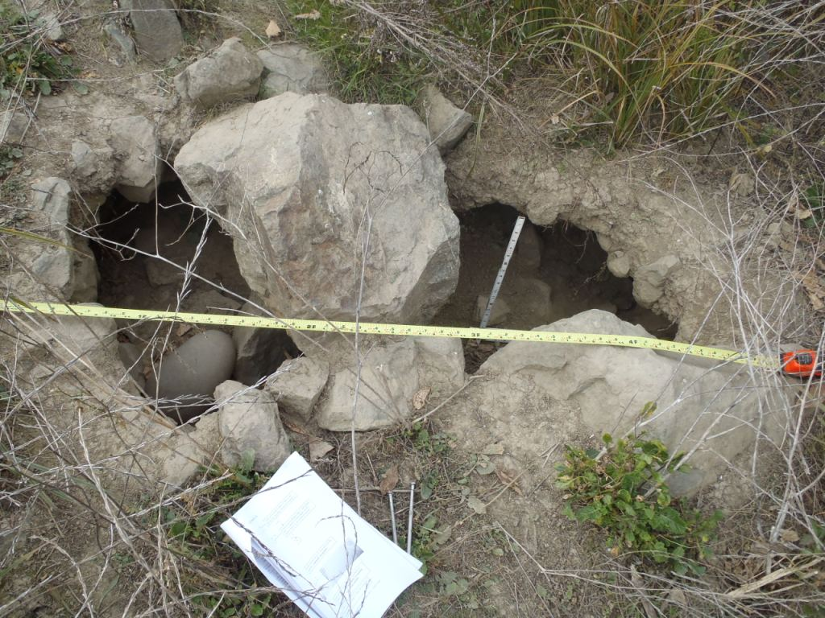
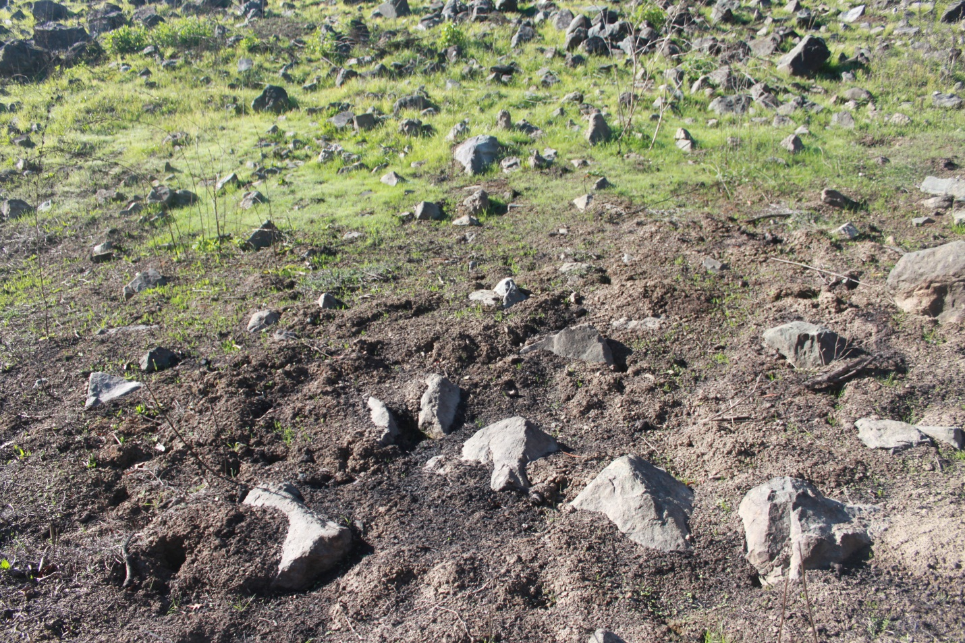
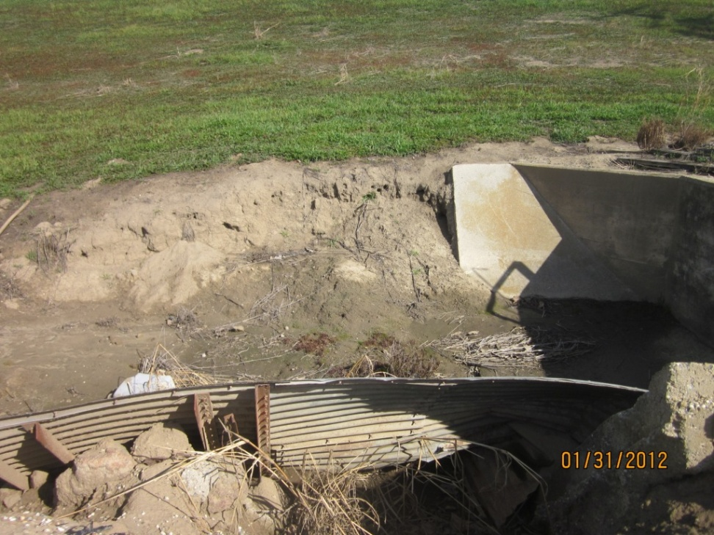
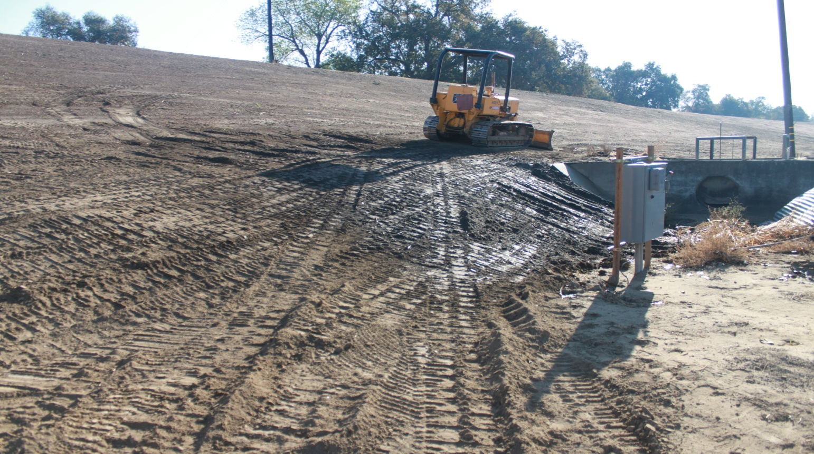
Notes:
Top : TIS2: point 142 erosion/bank caving: Erosion WS toe in levee prism, up to 10 feet deep and 5 feet wide.
Bottom: point 126 erosion MRD1: over steepend slope on the LS slope, slough seen at bottom of slope, head scarp about 4-5 feet tall in levee prism.

Slide 6
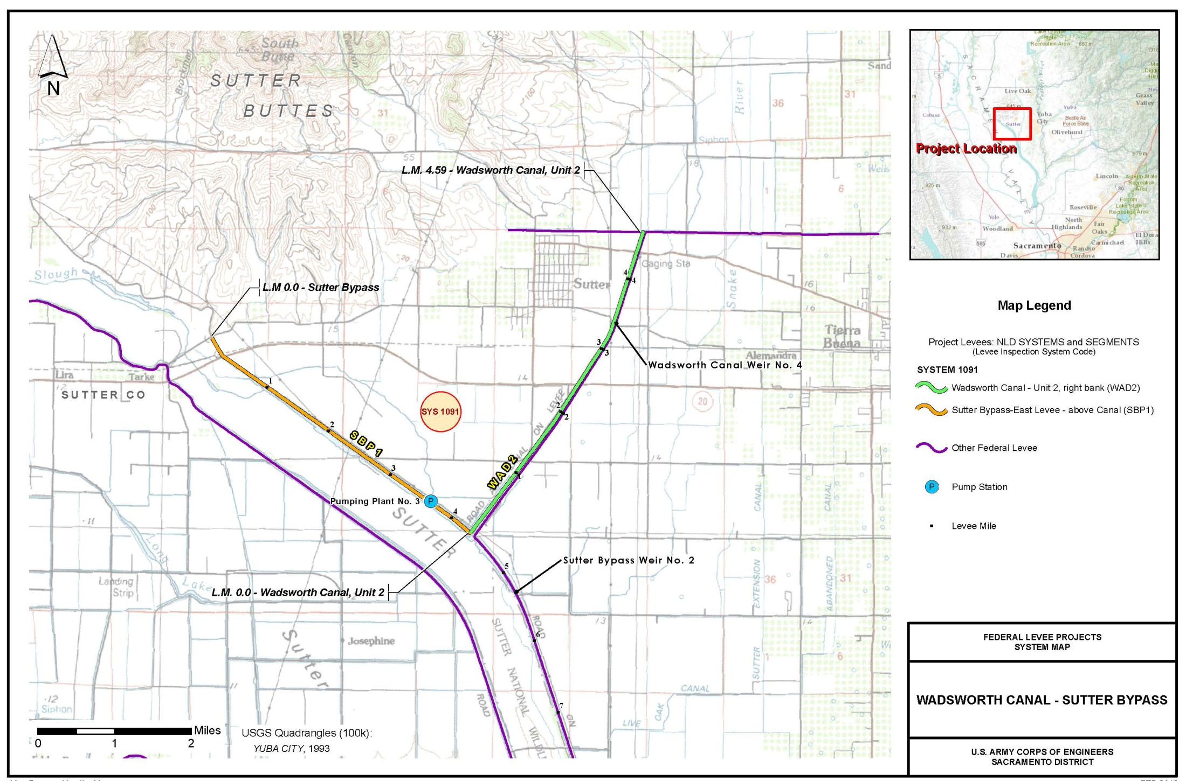
Wadsworth Canal Right Bank – Sutter Bypass East (Sutter County)

Slide 7
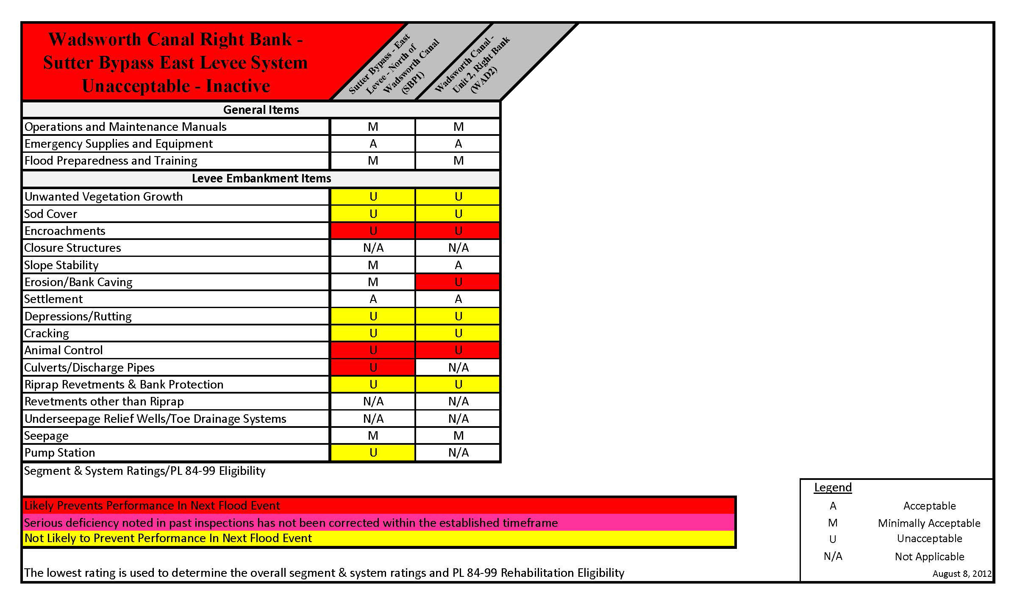
Wadsworth Canal Right Bank – Sutter Bypass East (Sutter County)

Slide 8
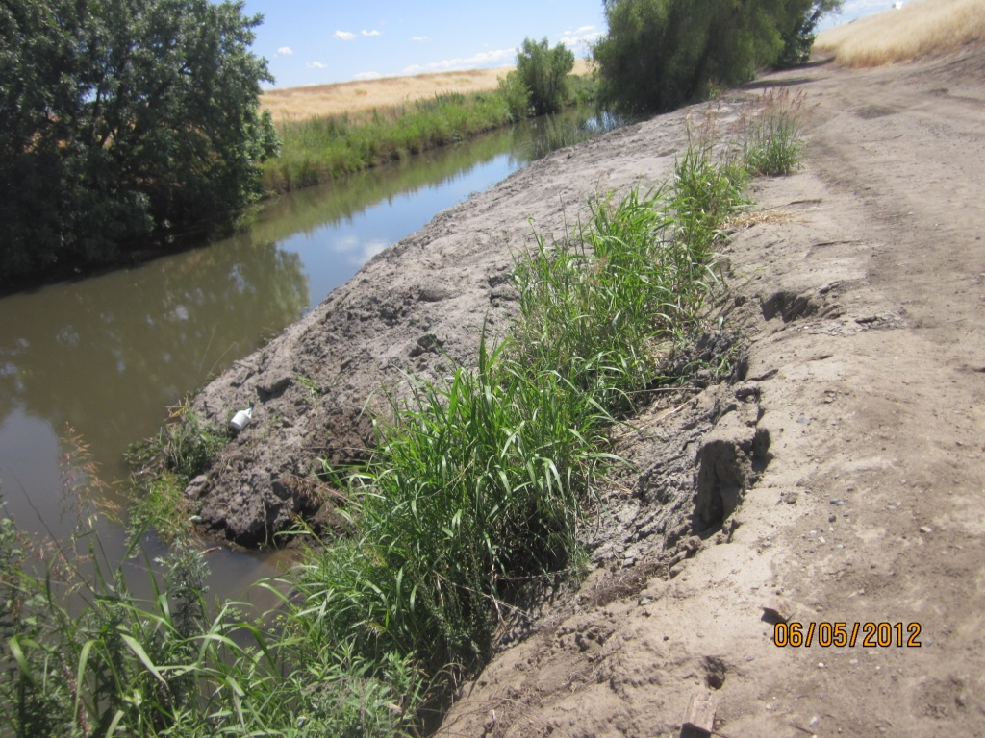
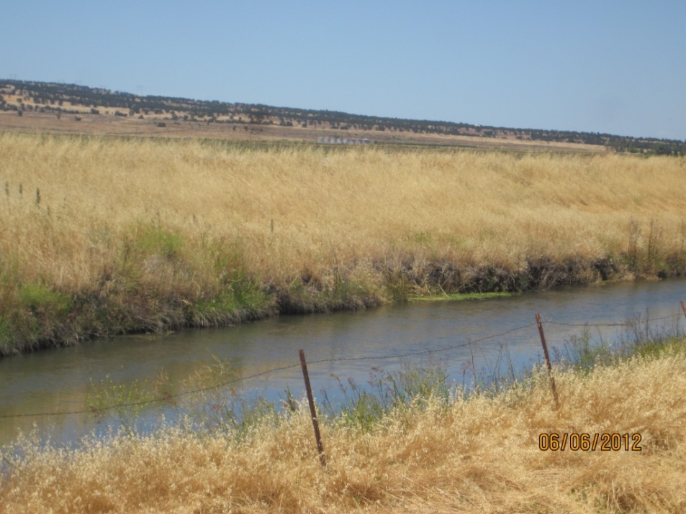
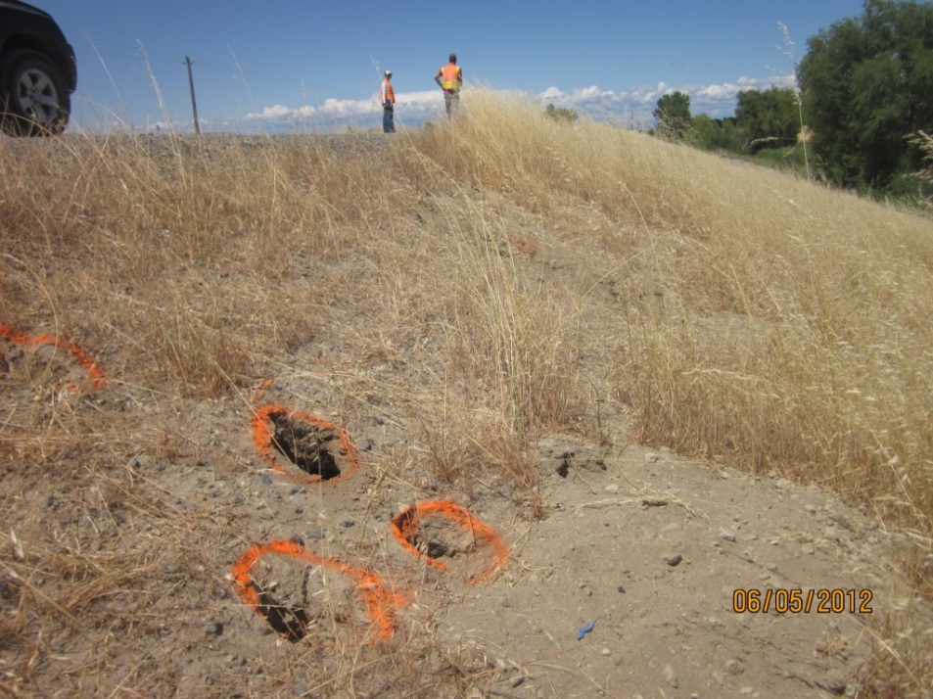
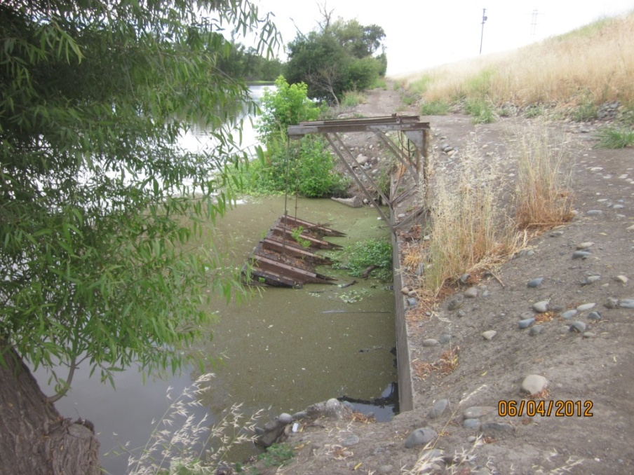
Notes:
Top Left: WAD2 erosion pt 40: Erosion with 10 to 12 feet vertical face 5 feet from toe cutting into levee prism and exposing pump structure footing. Located near pump. Erosion area upstream and downstream of the pump has been backfilled with loose sand.
Top right: WAD2 erosion pt119: Erosion cutting a vertical face on waterside toe, 100 feet long, more than 2 feet deep. Difficult to inspect the extent and depth of erosion due to grass and the canal water level, however the erosion appears to cut into the projected levee prism.
Bottom left: About 5 animal burrows in a 20 foot stretch on the waterside slope, 6 inches wide, 6 inches deep, with one spoil pile exceeding 2 cubic feet. Vegetation impairs inspector's visibility of animal burrows on landside.:
Bottom right: 50 foot diameter hole on landside toe from abandoned pump station filled with water still has piles from original building foundation.

Slide 9
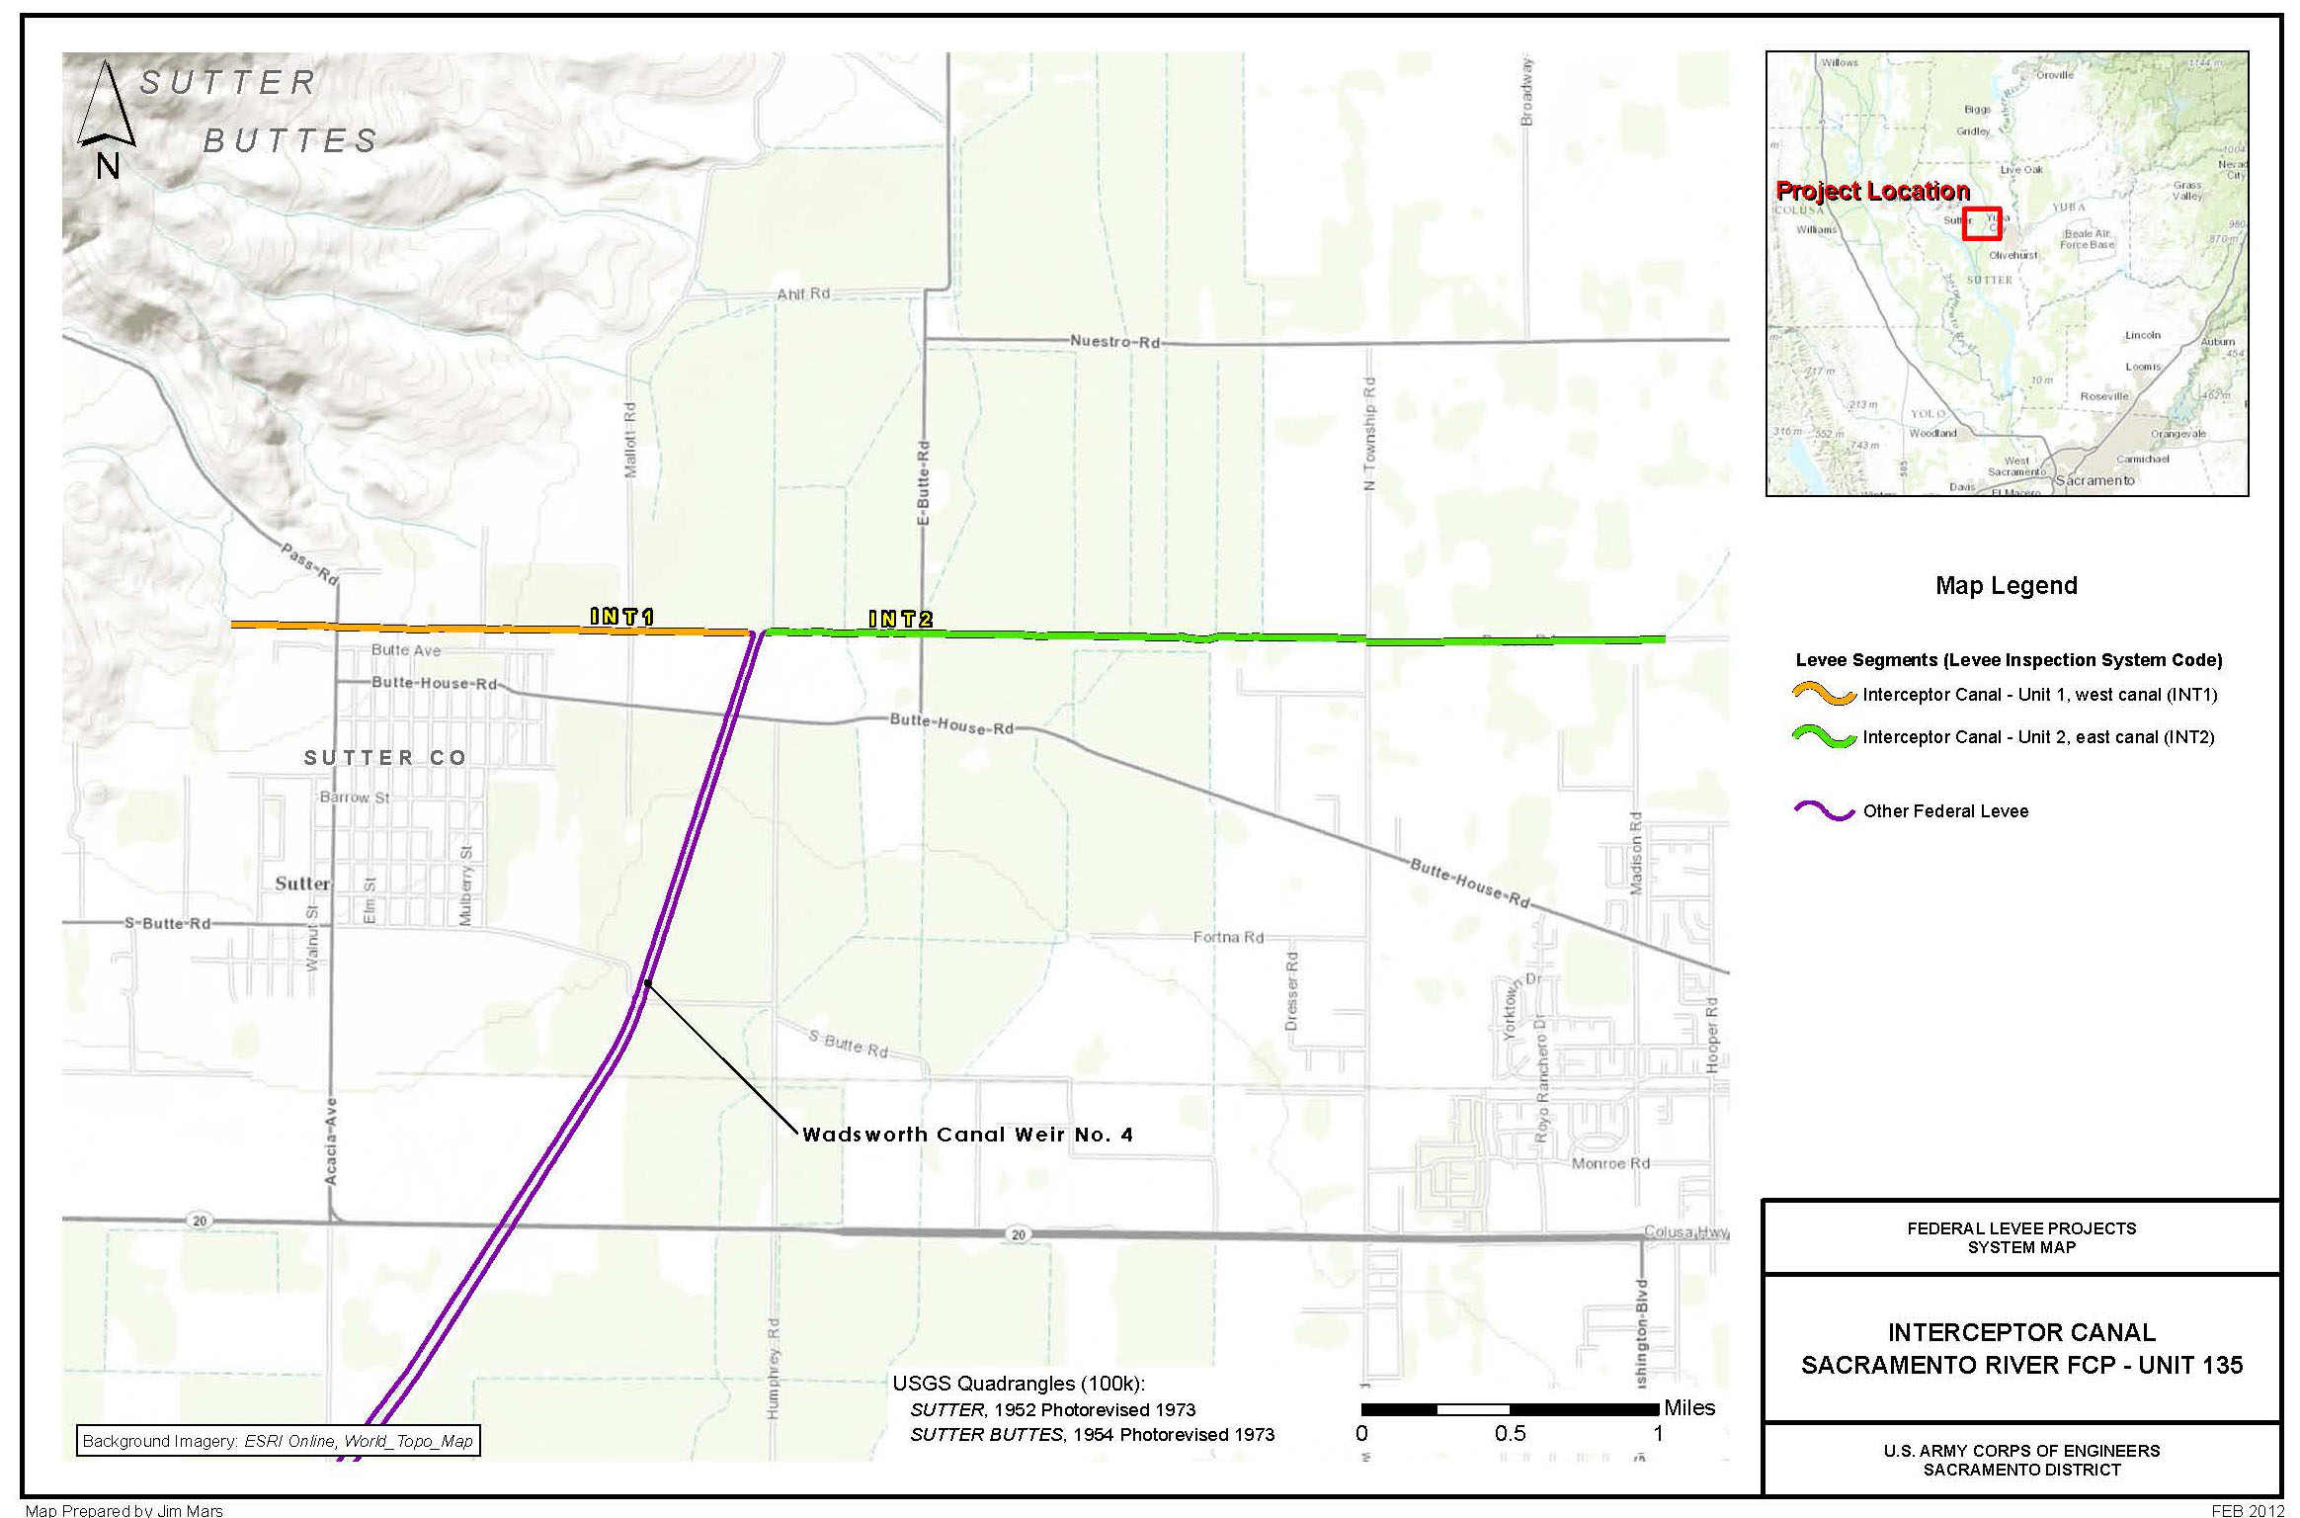
Interceptor Canal – West (Sutter County)

Slide 10
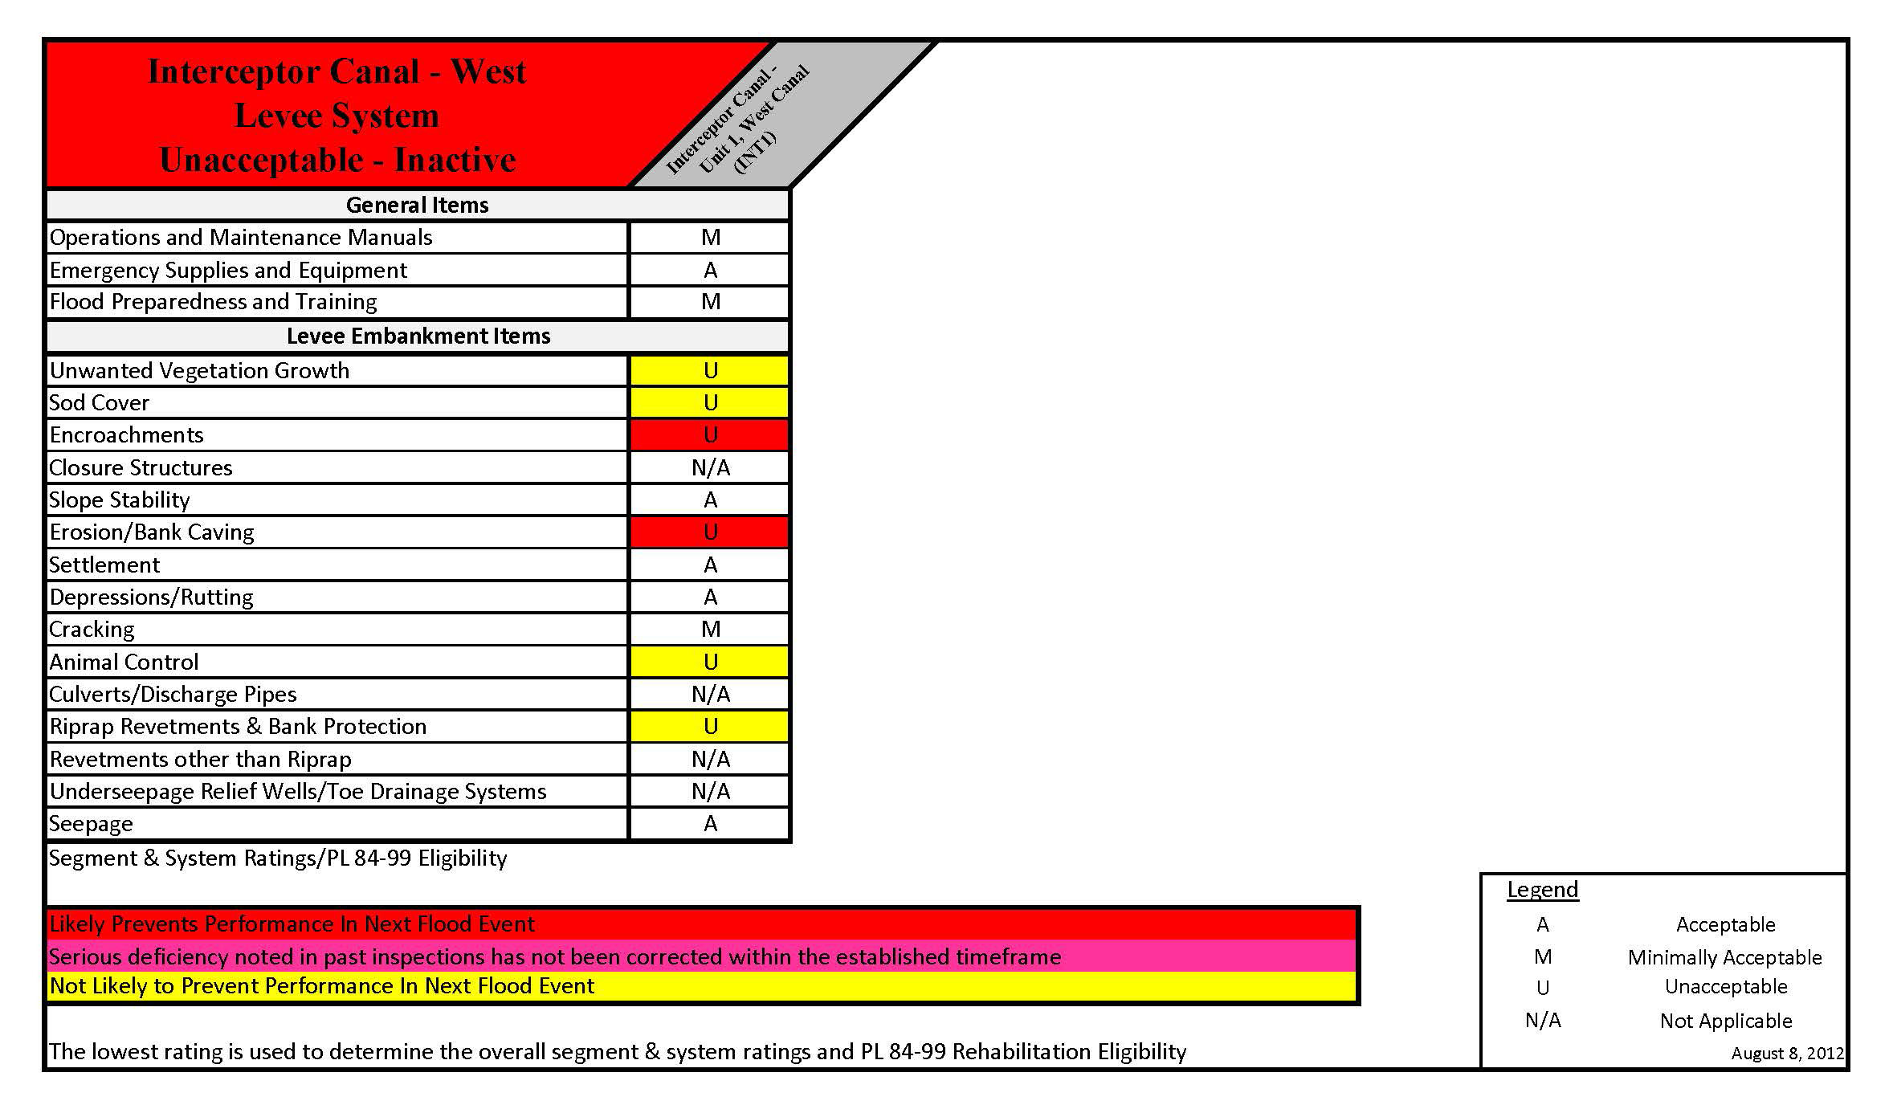
Interceptor Canal – West (Sutter County)

Slide 11
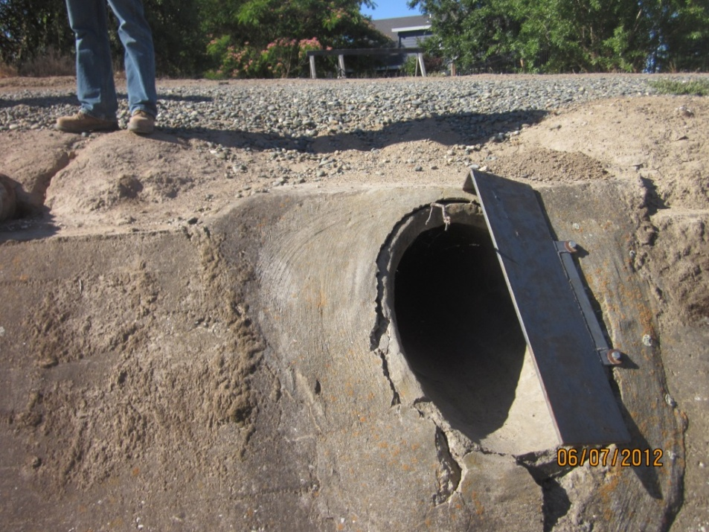
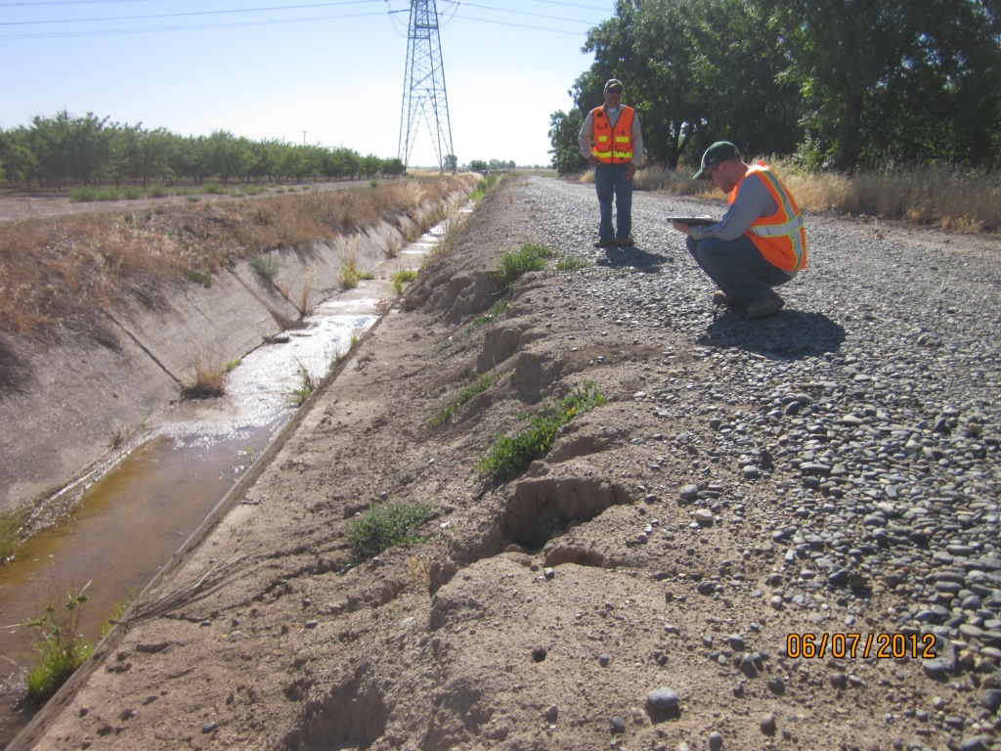
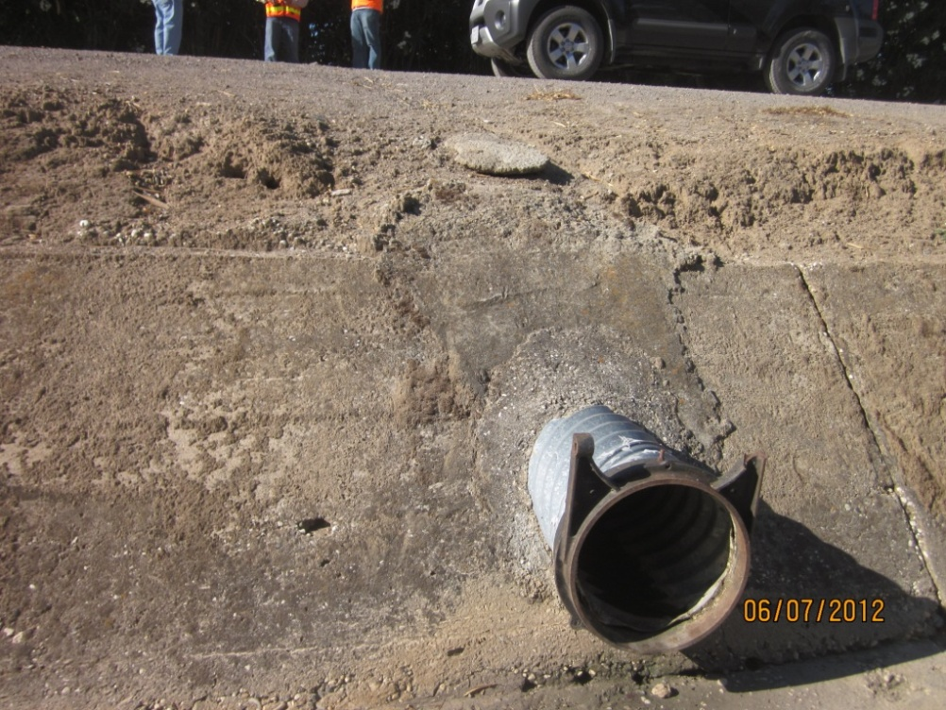
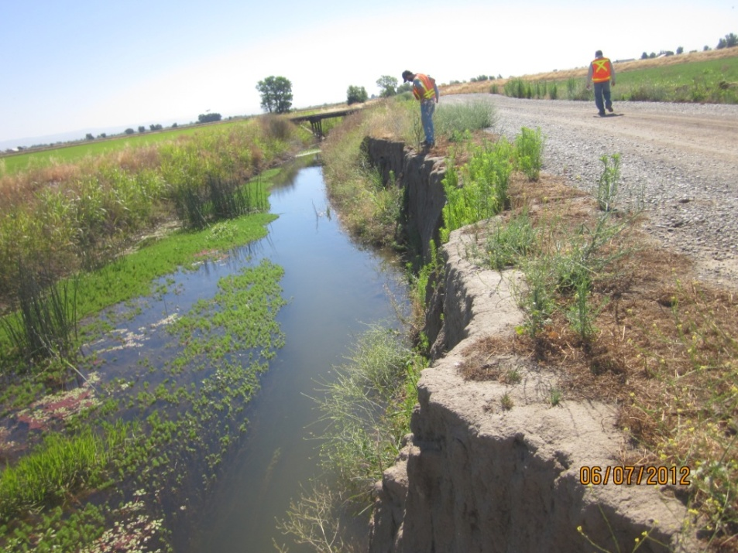
Notes:
Top Left: Encro Int1 pt 58: approximate 24 inch diameter concrete culvert drains into channel. No flap gate present. Inspection records not available.
Bottom Left: 59: 8 inch diameter CMP culvert runs about 1 foot under crown and drains into channel. No flap gate. Inspection records not available.
Top Right: Erosion pt 63: Erosion on the waterside slope above the canal lining with a 24 inch vertical face, extending 2 feet into the slope, for 50 feet. Erosion is within the projected prism.
Bottom Right: Erosion Int1 pt 83: Erosion on waterside slope with a 6 foot long vertical face. Extends 3 to 4 feet into the slope. Erosion is within the projected levee prism.

