Slide 1
CVFPB Meeting June 28, 2013 USACE INSPECTION RESULTS Ryan Larson

Slide 2
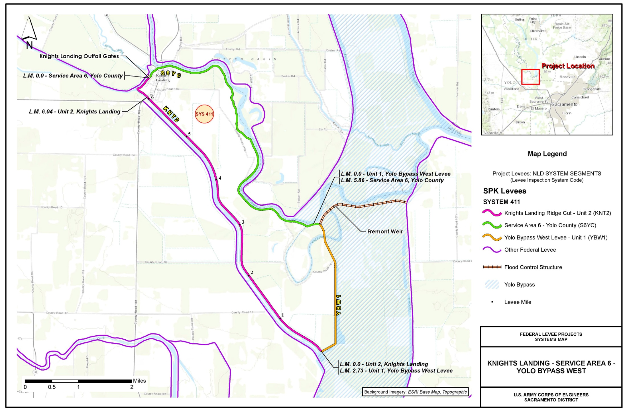
Knights Landing – Service Area 6 - Yolo Bypass West
Notes:
System Length in L.M.: 14.63

Slide 3
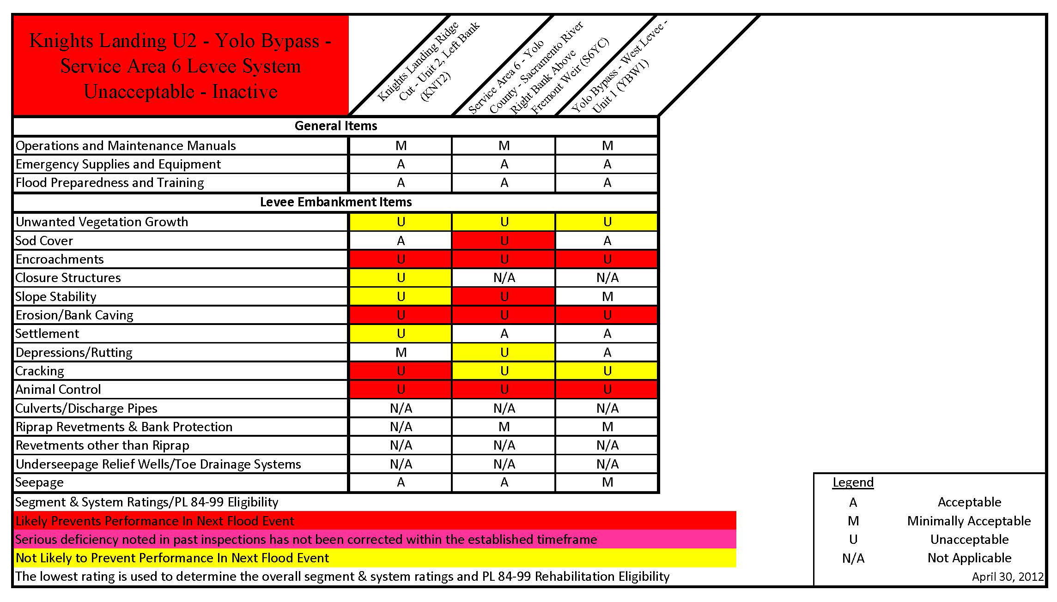

Slide 5
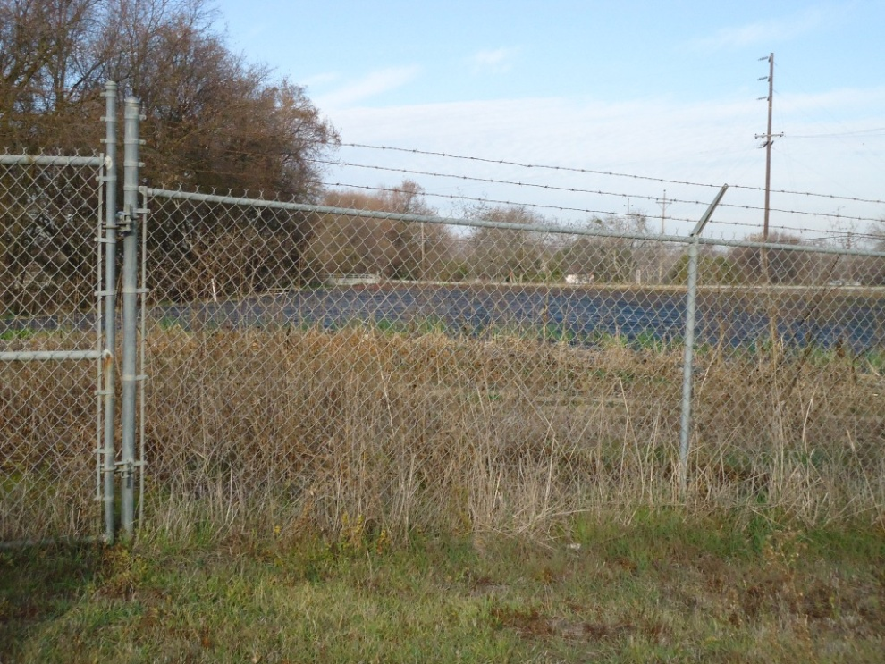
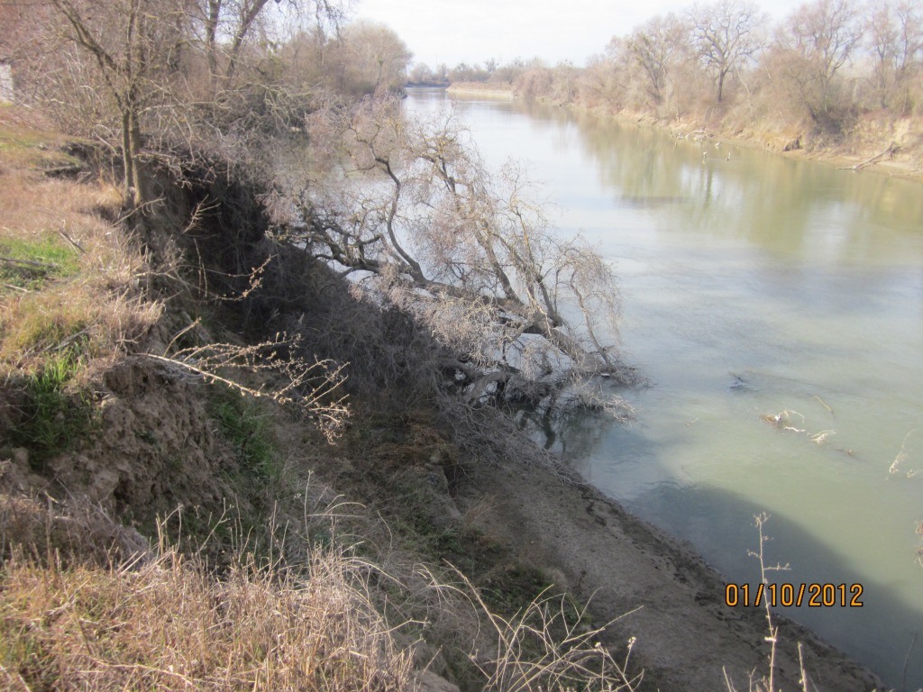
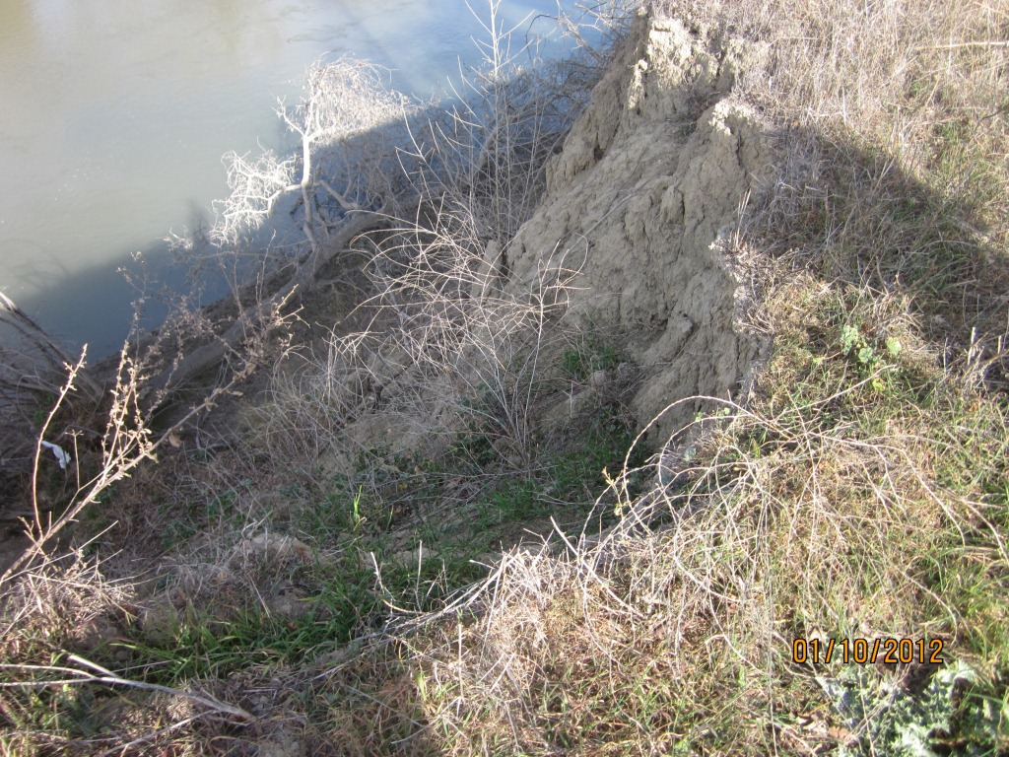
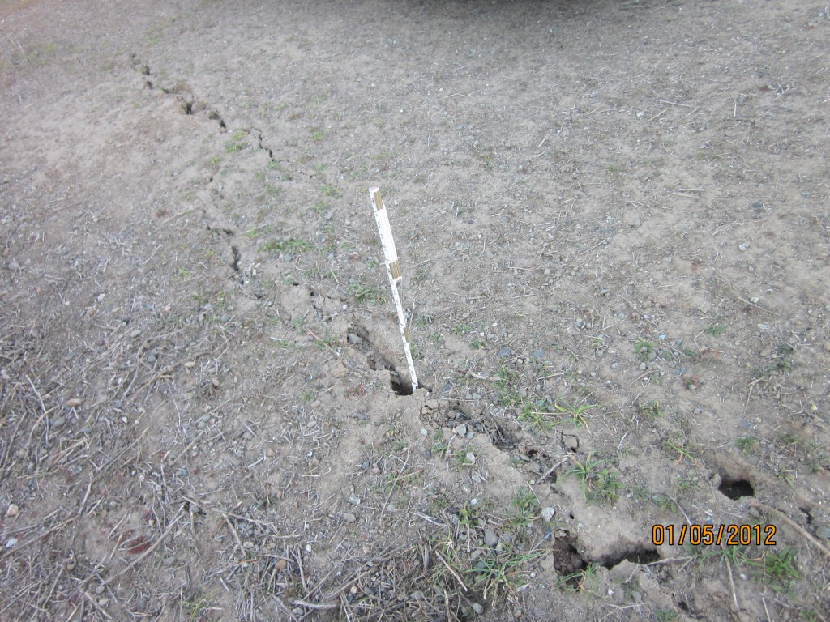
Notes:
Top Left: Strawberry field with irrigation system and barbed wire fence across the crown, and the waterside and landside embankments. (KNT2 219)
Top Right: Erosion on the waterside embankment for 200 foot stretch. Vertical face 15 to 20 feet high cutting into levee prism. (S6YC 345)
Bottom Left: Waterside embankment is over-steepened with 15 to 20 feet high vertical face cutting into levee prism. Multiple cracks 5 to 10 feet long with displacement. Slope is actively failing. (S6YC 346)
Bottom Right: Longitudinal tension crack on the waterside embankment, up to 26 inches wide, and 40 feet long. No displacement along the crack. The crack length exceeds the levee height. (KNT2 82)

Slide 6
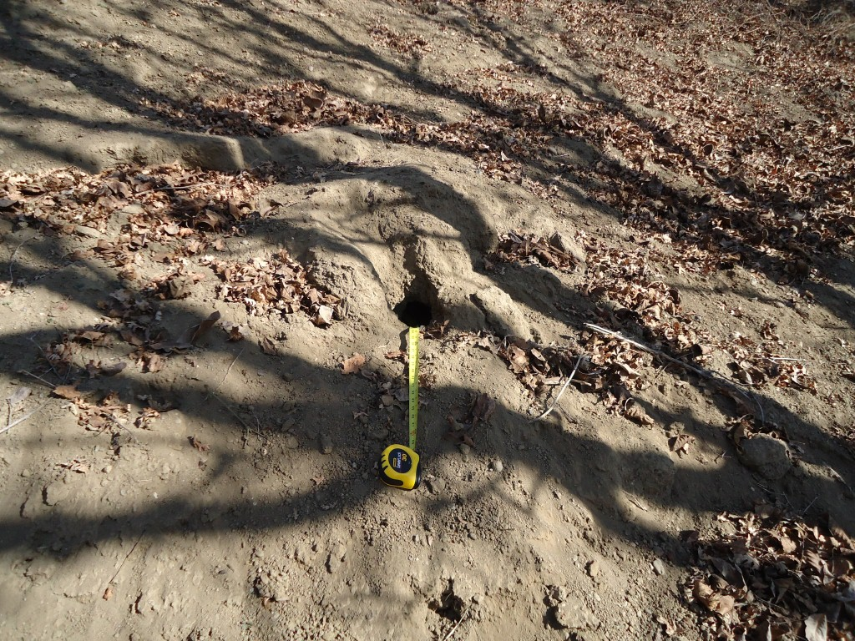
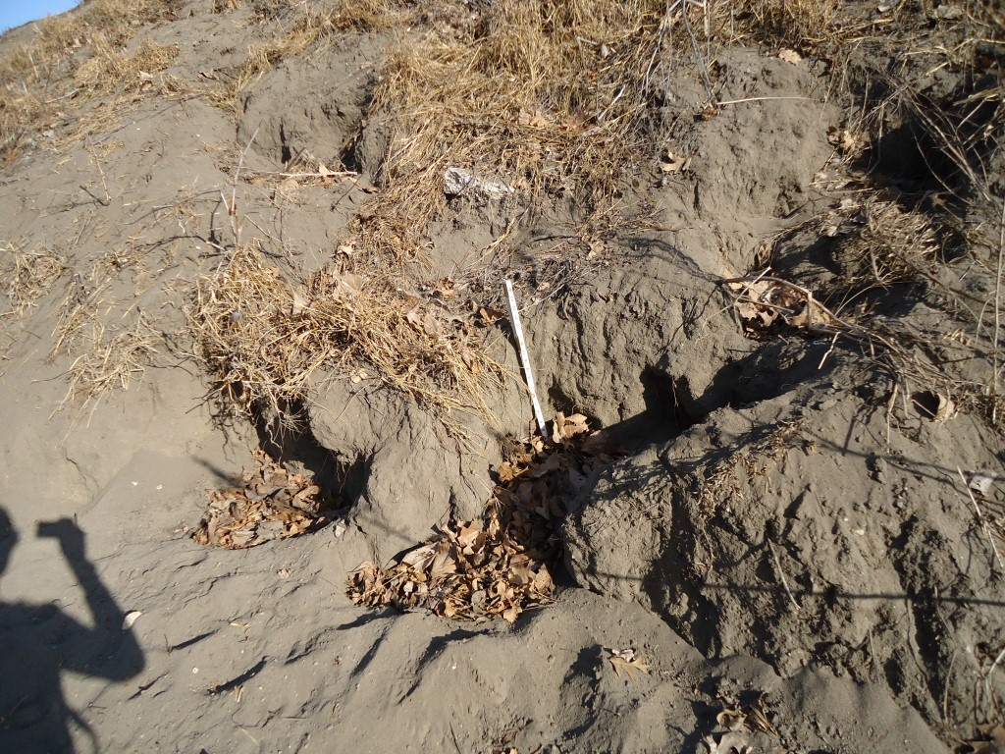
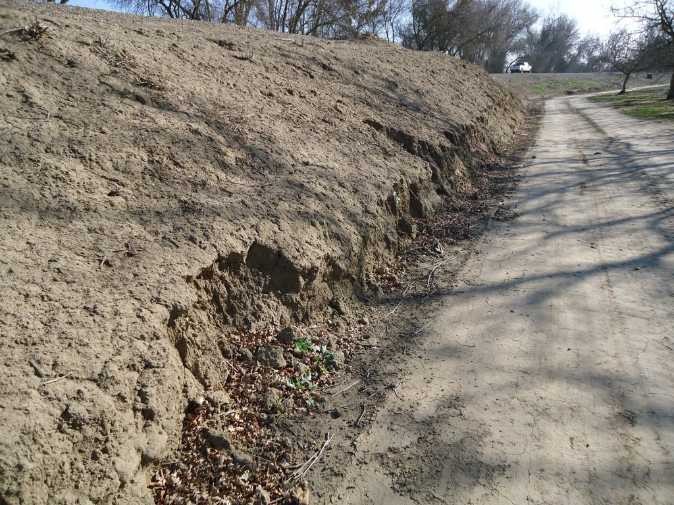
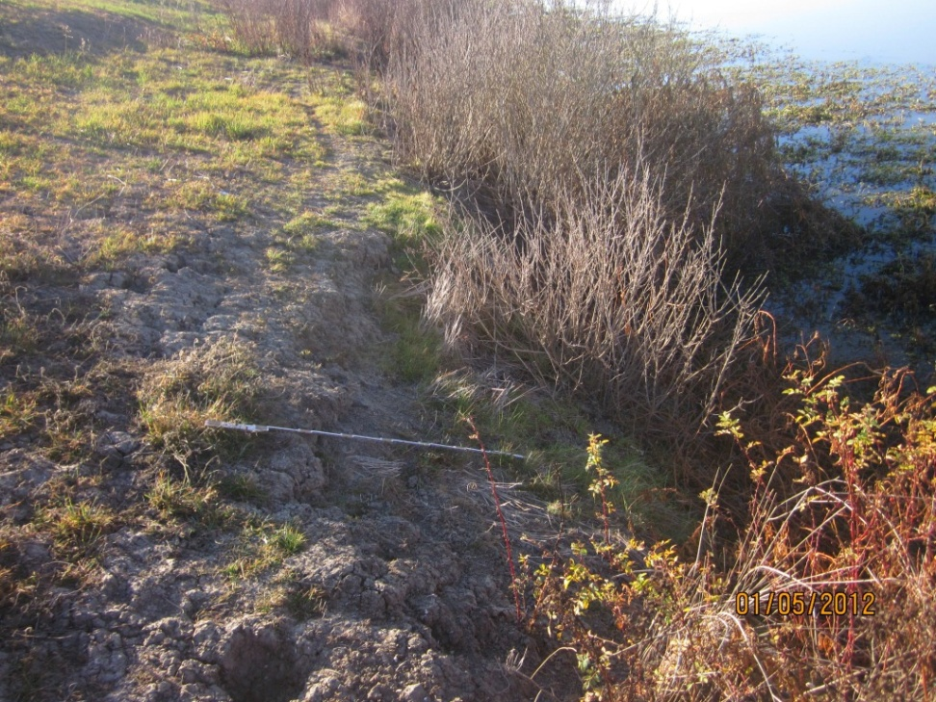
Notes:
Top Left: Animal burrows (10 burrows per 20 feet) on the land and waterside embankments, up to 6 inch diameter, up to 3 feet deep with spoil piles larger than 2 cubic feet. No evidence of animal control program. (S6YC 320)
Top Right: Surface runoff erosion on the landside embankment, 5 feet wide, and up to 24 inches deep. (S6YC 176)
Bottom Left: Landside toe cut up to 30 inches tall. (S6YC 165)
Bottom Right: Erosion of the waterside bank within 35 feet from the waterside levee toe and at the toe, 1 to 4 feet deep. Vegetation obscured the bank in many areas. (KNT2 45)

