Slide 1
HIRING PROCESS FOR THE BOARD ATTORNEY June 14, 2013

Slide 2
Positions That Report to the Board
Executive Officer (CEA position)
Attorney (Civil Service position)

Slide 3
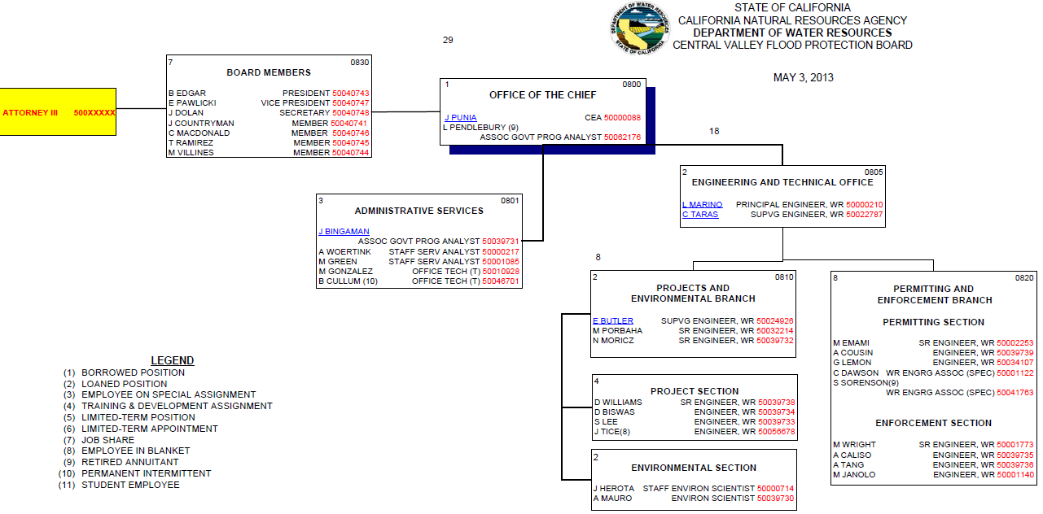
Proposed CVFPB Organization Chart

Slide 4
Attorney Position
Attorney III position will be hired
Since the Attorney III position is a Civil Service position, it needs to follow the State’s rules for hiring
Salary is $7,682 to a maximum of $9,478
Probation period is one year (probation report every 4 months)
Attorney’s time needs to be approved by someone with approval authority.
Board can delegate to the Executive Officer to approve the attorney’s time

Slide 5
Proposed Hiring Process
Upon completion of the Job Duty Statement and advertisement notice, position will be posted on the State’s vacant position website, DWR’s website, and the Board’s website
Recommended to post the position for at least a two-week period
Board should set up a small panel of attorneys (Emma, Nicole, and Robin, for example) to screen/narrow the applications pool to 3 qualified candidates
If more than 3 are recommended for interviewing, a second panel made up of the Executive Committee would conduct the interviews and narrow it down to the top 2 or 3 candidates
The interviews would be conducted during a Closed Session by the full Board
There may be a second interview requested
References will be checked
Tentative offer made to the top candidate, but person being hired is dependent upon a signed budget

Slide 6
QUESTIONS

