Slide 1
CVFPB Meeting May 10, 2013 USACE INSPECTION RESULTS Meegan G Nagy, PE Levee Safety Program Manager
Notes:
MA13 Unit 1, Unit 2 North, Unit 2 South: inactive

Slide 2
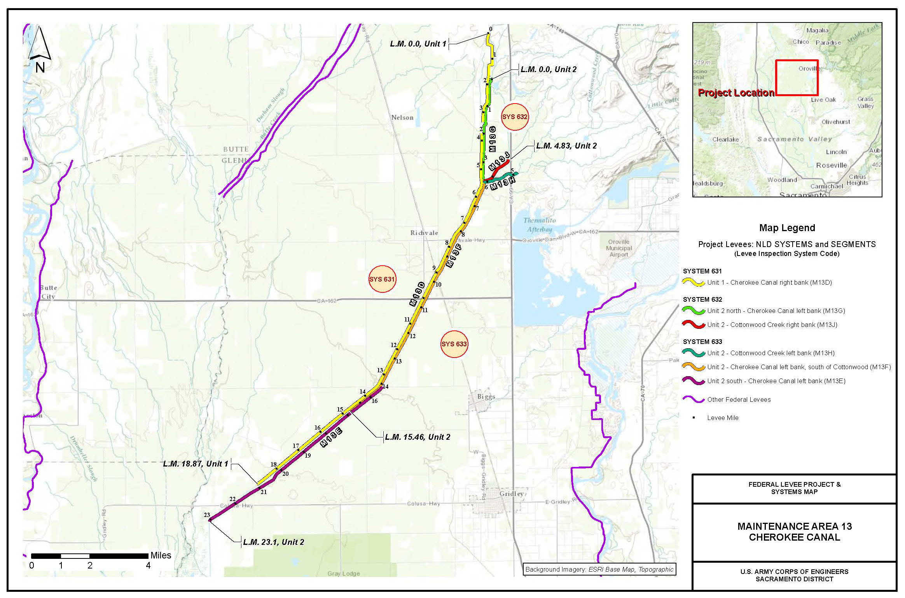
Maintenance Area 13 - Cherokee Canal

Slide 3
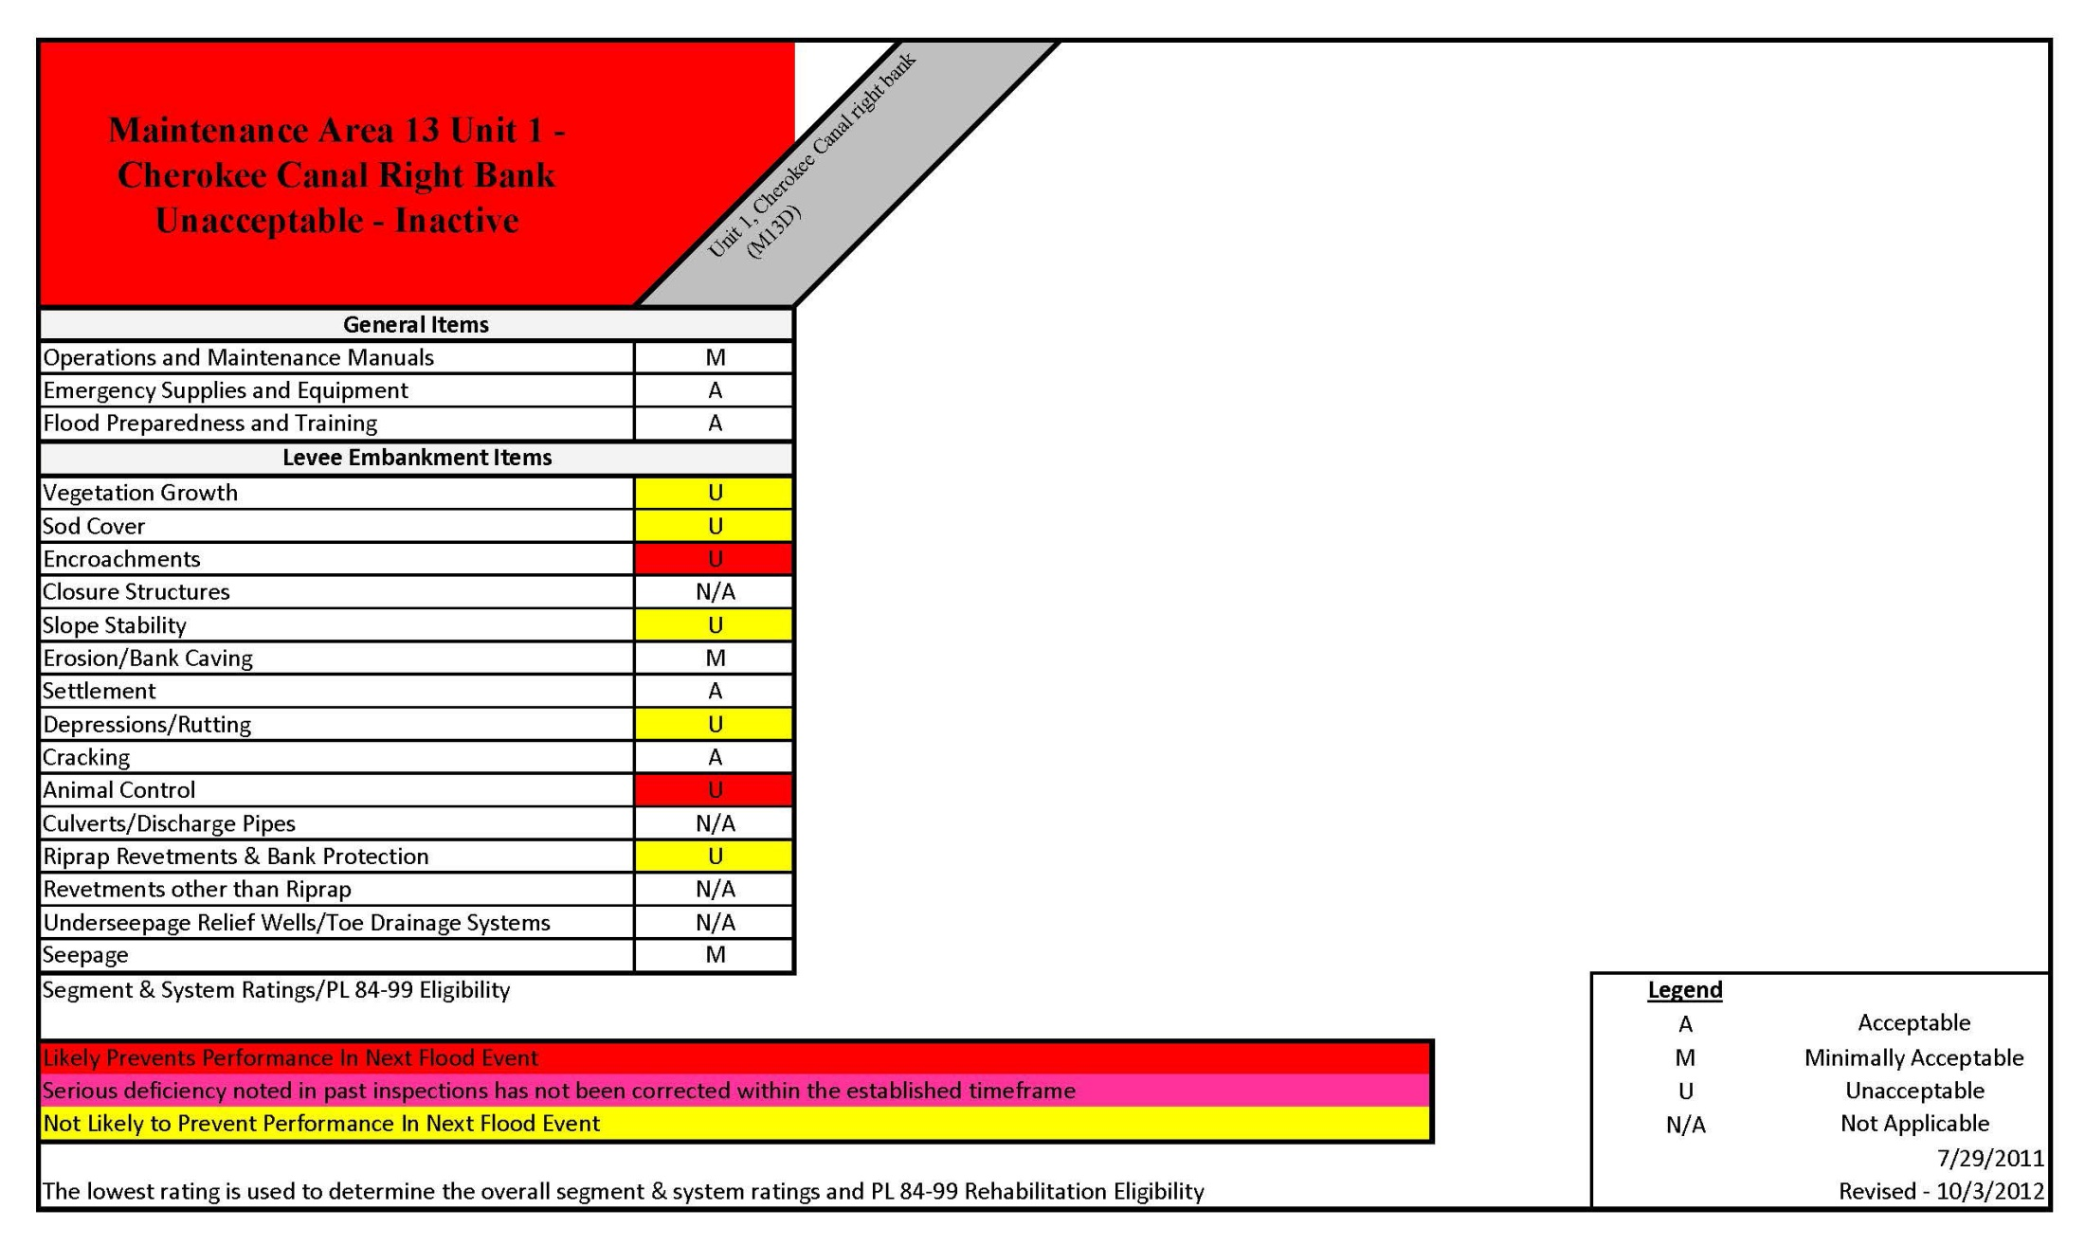
Maintenance Area 13 Unit 1
Notes:
Unit 1 System length: 18.87 L.M.

Slide 4
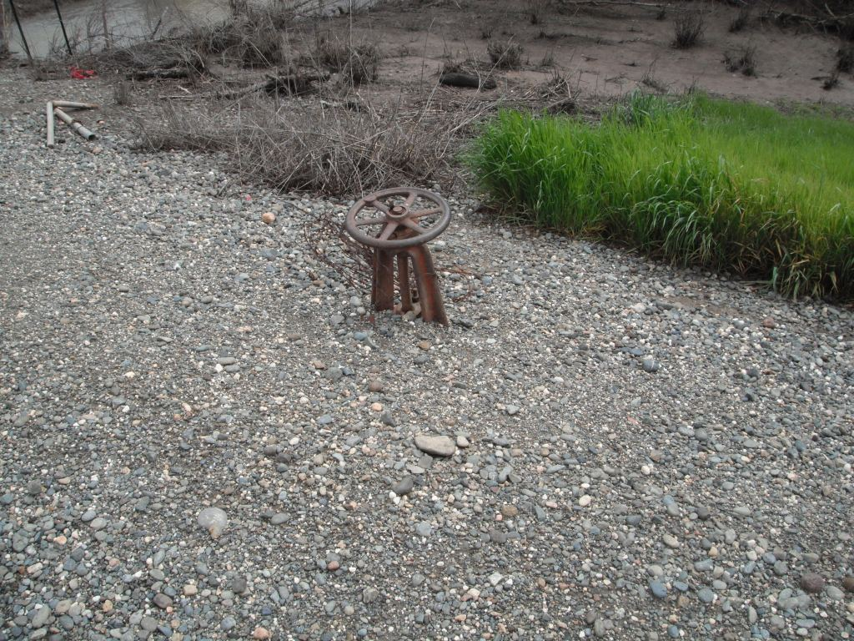
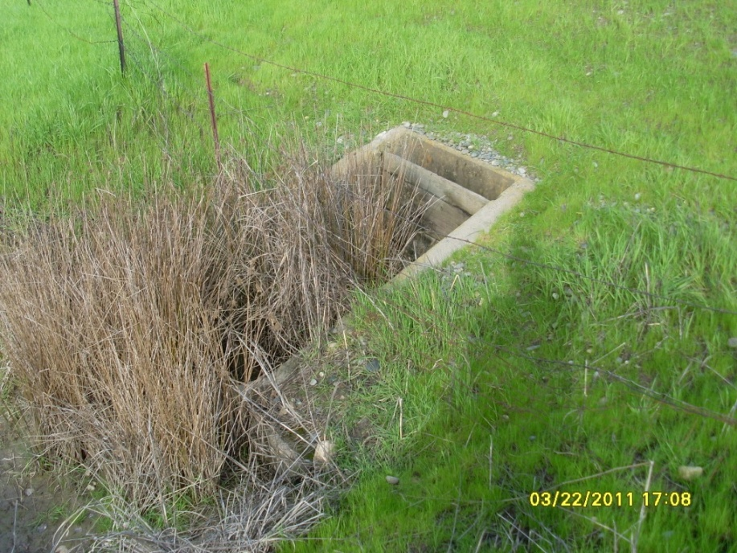
Notes:
Left: abandoned gate valve on waterside slope.
Right: 36 inch CMP through levee, flashboards on landside, waterside outlet sedimentation, overgrown with vegetation, concrete head/wing walls, sediment and tall reeds/grass at landside inlet. Inspection records not available.

Slide 5
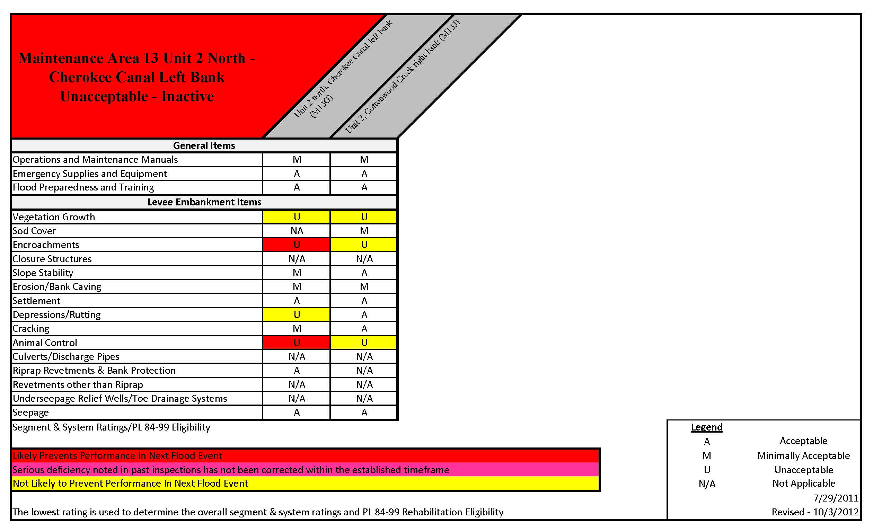
Maintenance Area 13 Unit 2 North
Notes:
Unit 2 North System length: 4.83 L.M.

Slide 6
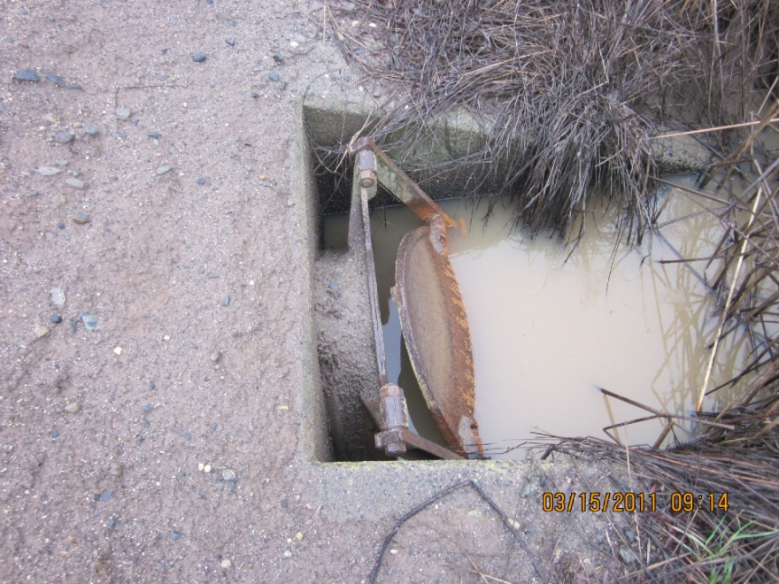
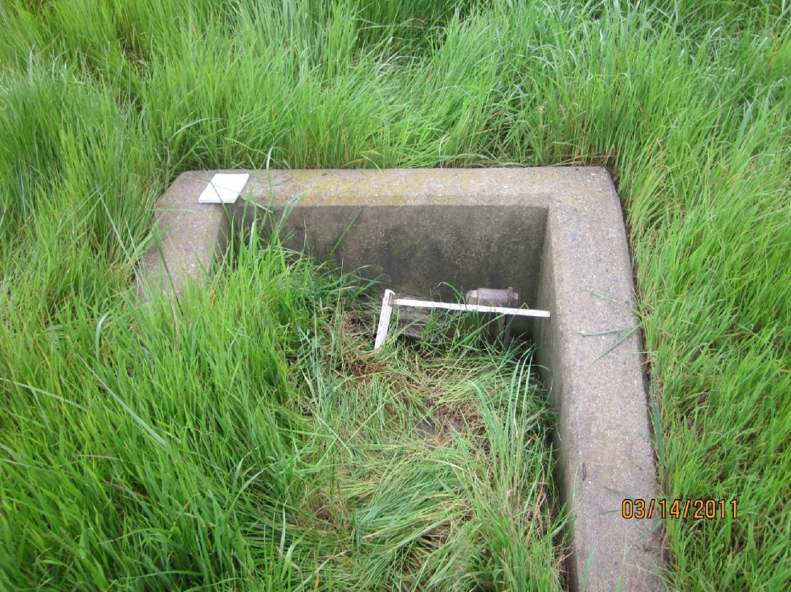
Notes:
Left: 24 inch diameter culvert through levee 6 ft below crown. Landside slide gate obstructed by veg. waterside flap gate is present but not functioning as propped open
Right: 24 inch diameter culvert through levee 6ft below crown. Waterside flap gate is filled with soil. Landside slide gate is not functioning properly for overgrown vegetation.

Slide 7
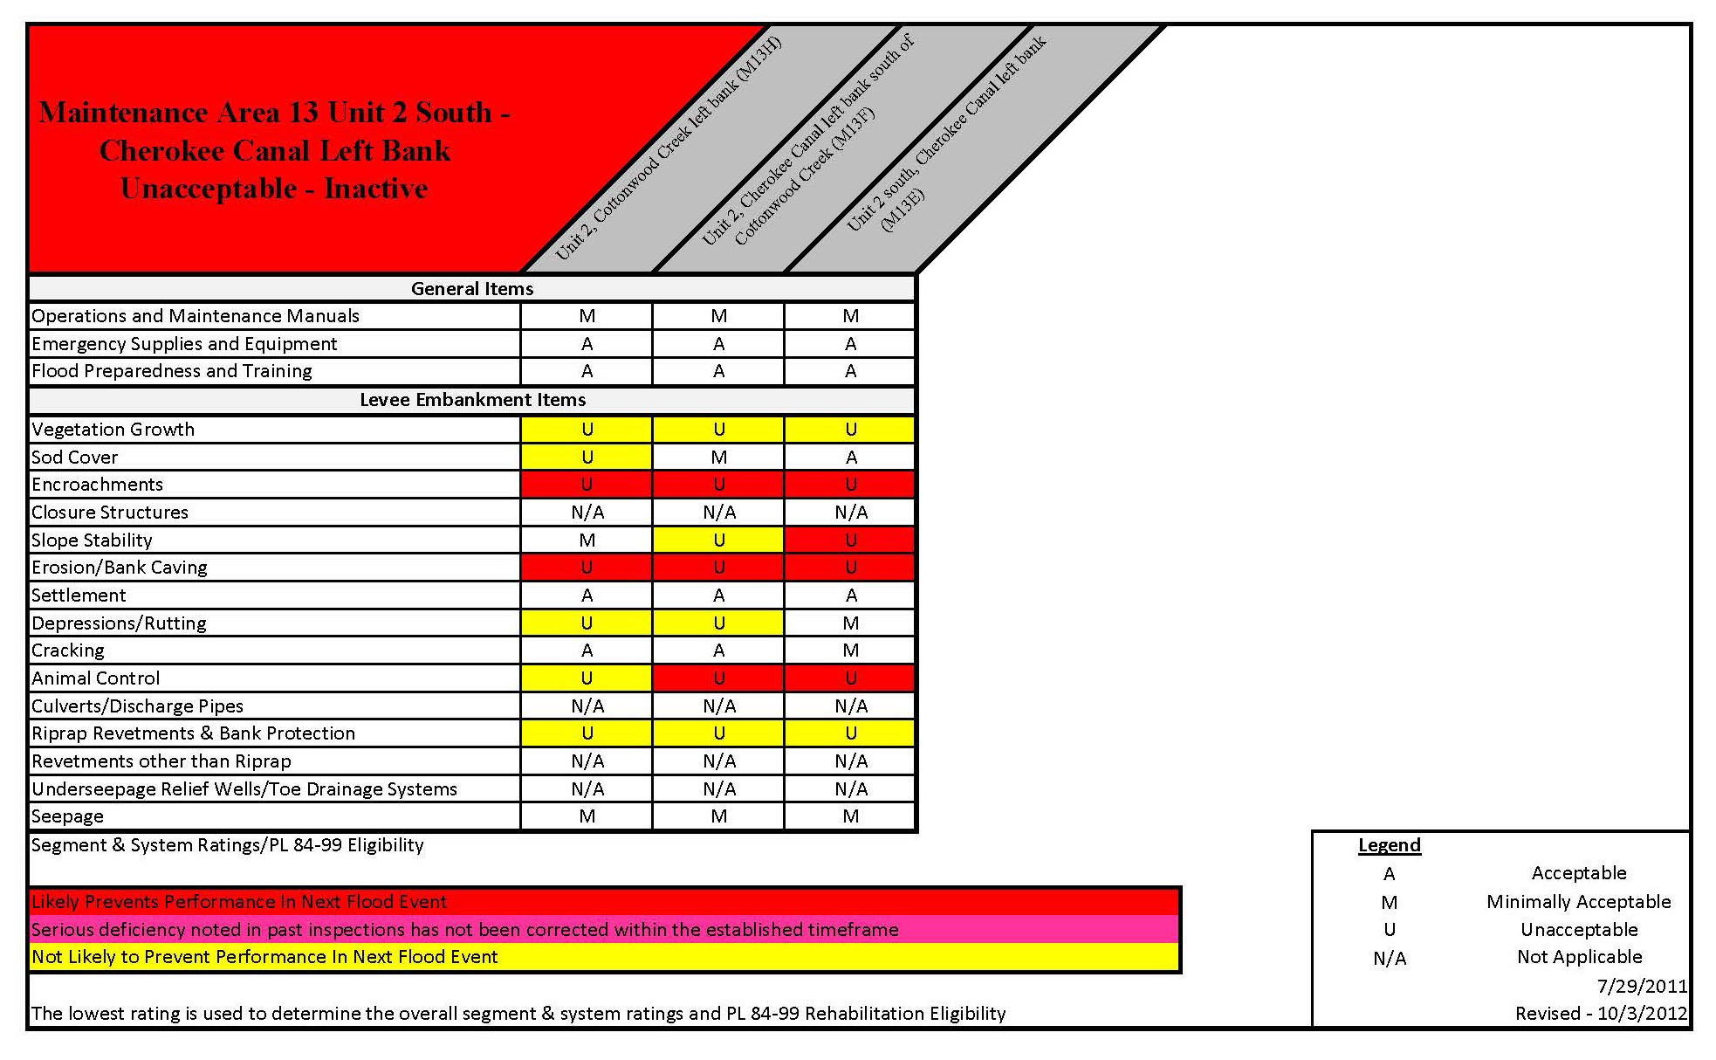
Maintenance Area 13 Unit 2 South
Notes:
Unit 2 South System length: 23.1 L.M.

Slide 8
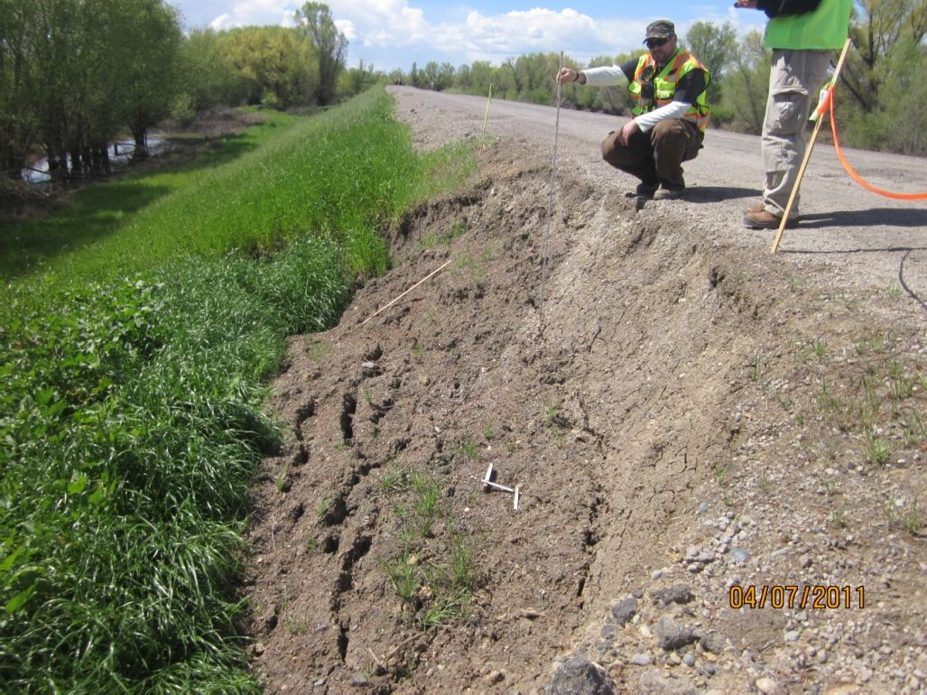
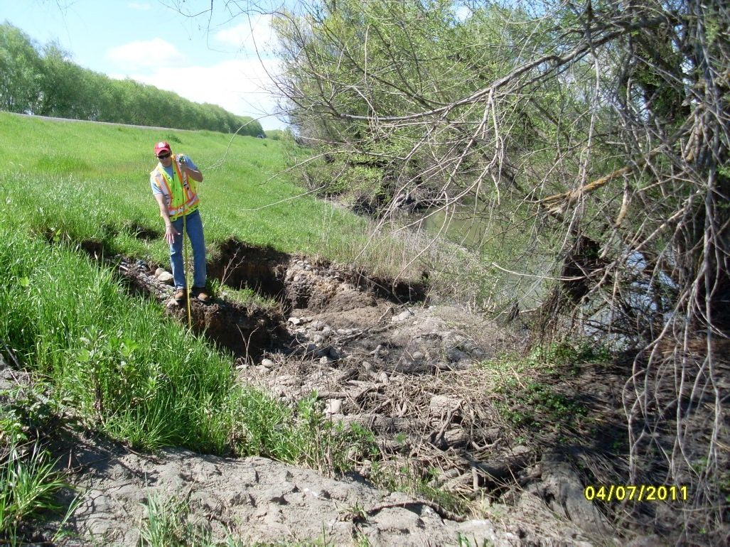
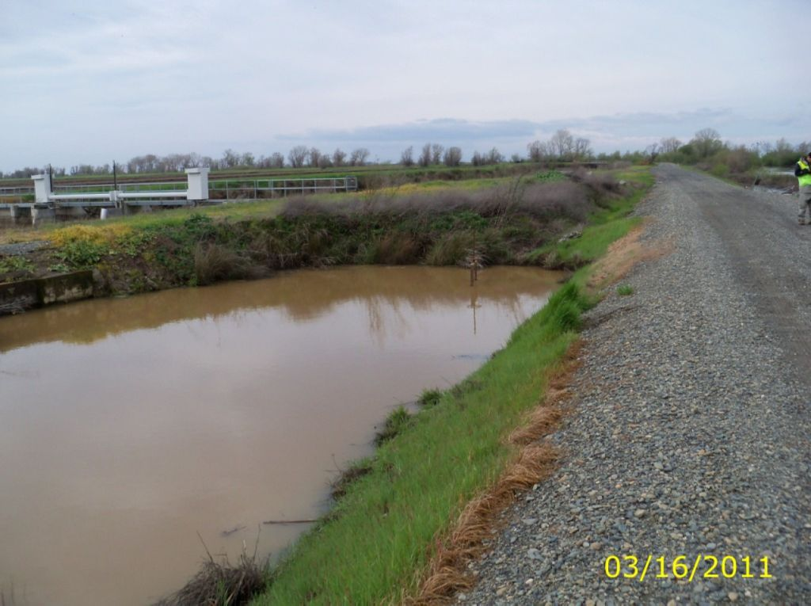
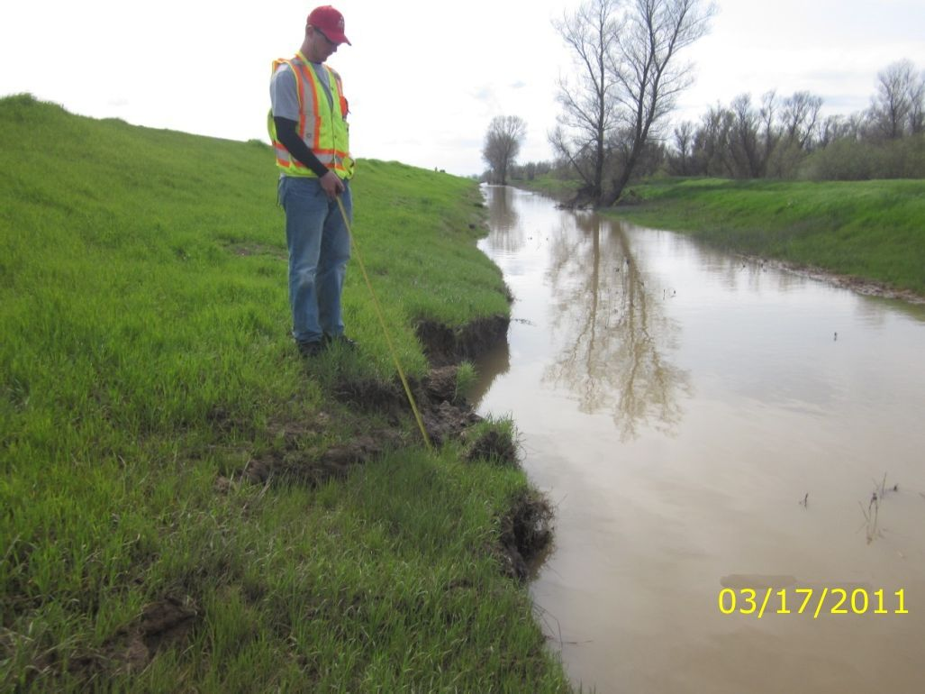
Notes:
Top Left: Slope failure on the landside hinge with a vertical face up to 3.5 feet for a 25 foot reach.
Top Right: Bank caving 4 to 5 feet deep located 6 to 8 feet from the waterside toe. The erosion was into the projected levee prism.
Bottom Left: Pond at landside toe. Pond is 100 feet by 30 feet and has a depth at landside toe of 2.5 feet.
Bottom Right: Erosion at the waterside toe that is up to 24 inches deep. The erosion does cut into the levee prism.

Slide 9
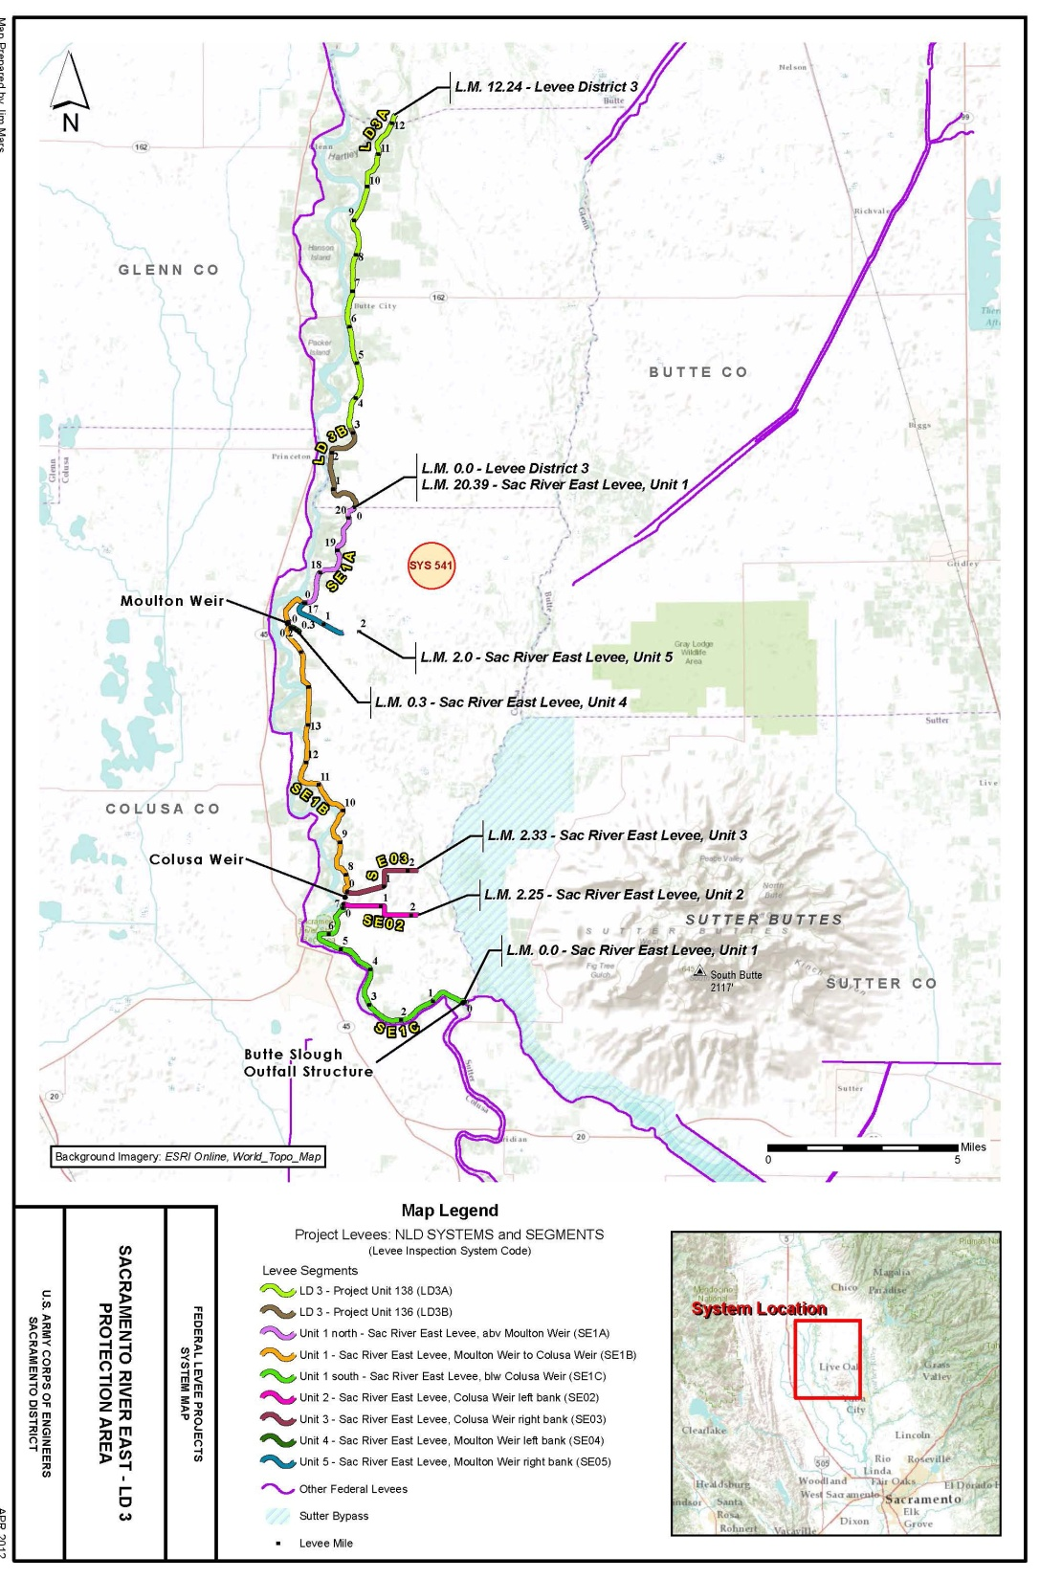
Sacramento River East Levee – LD 3 Glenn County
Notes:
LMA’s: Levee District 3, Glenn County, Sutter Yard

Slide 10
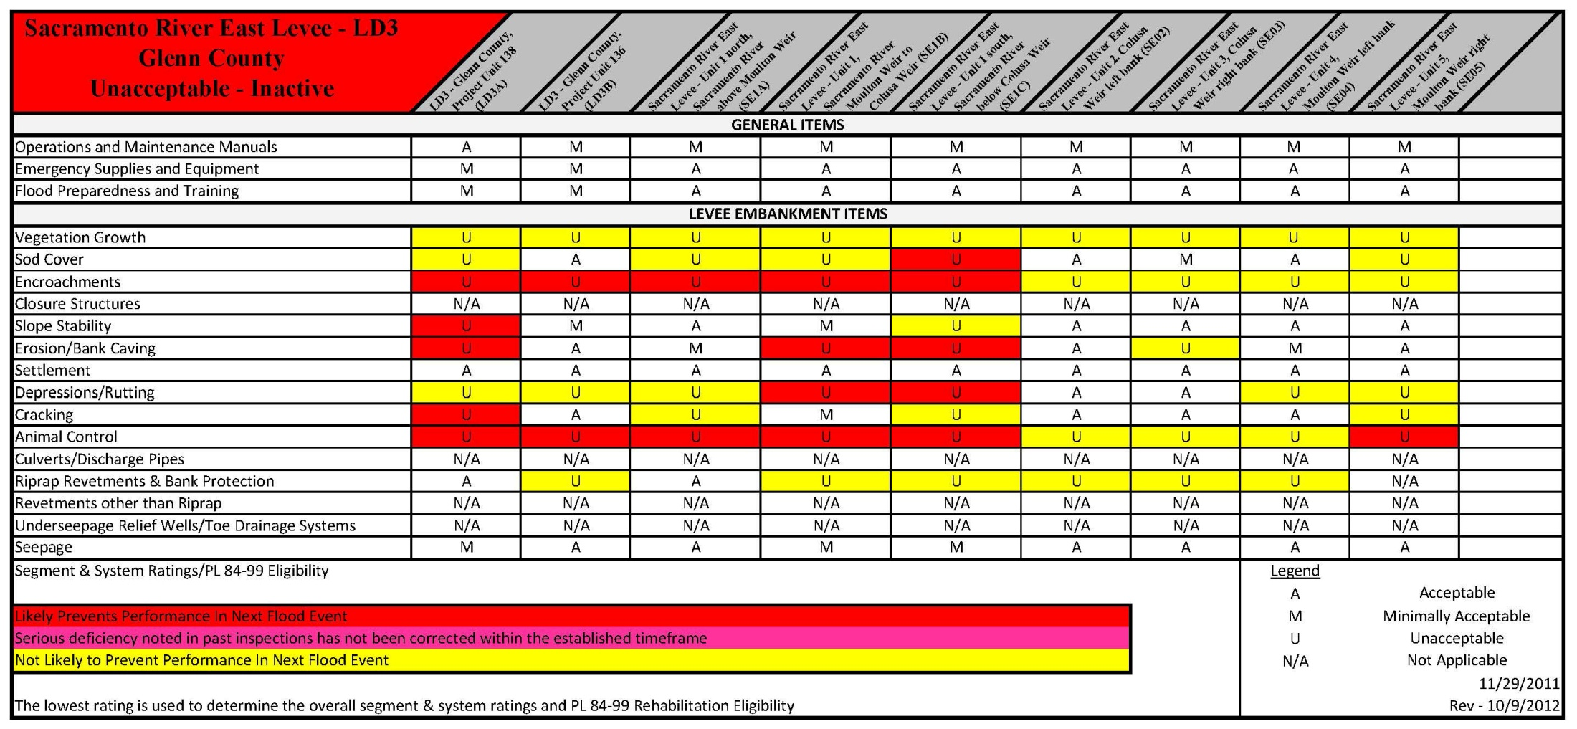
Sacramento River East Levee – LD 3 Glenn County
Notes:
System length: 39.51 L.M.

Slide 11
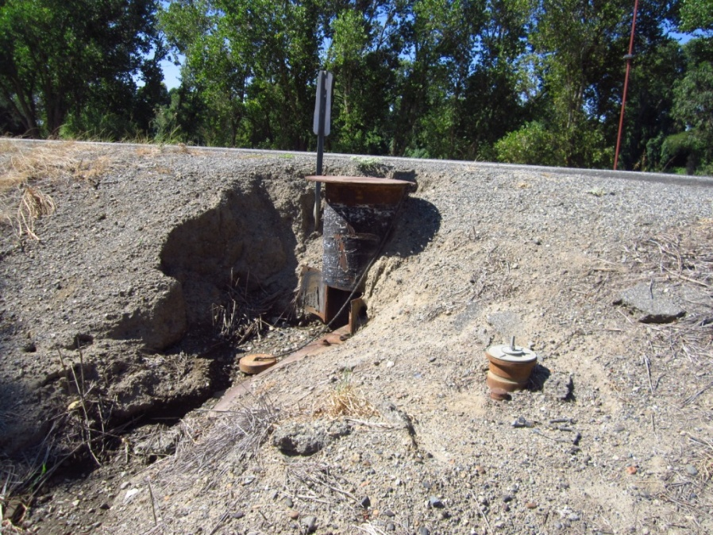
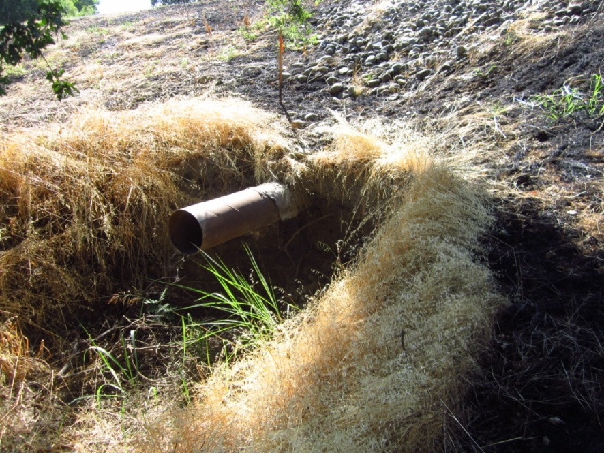
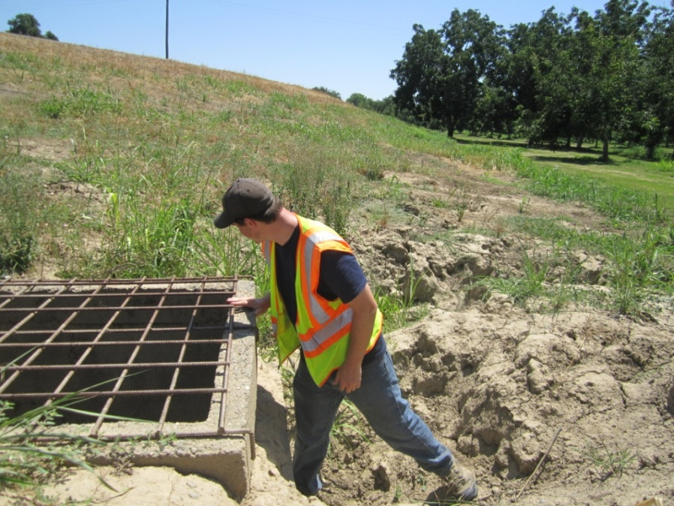
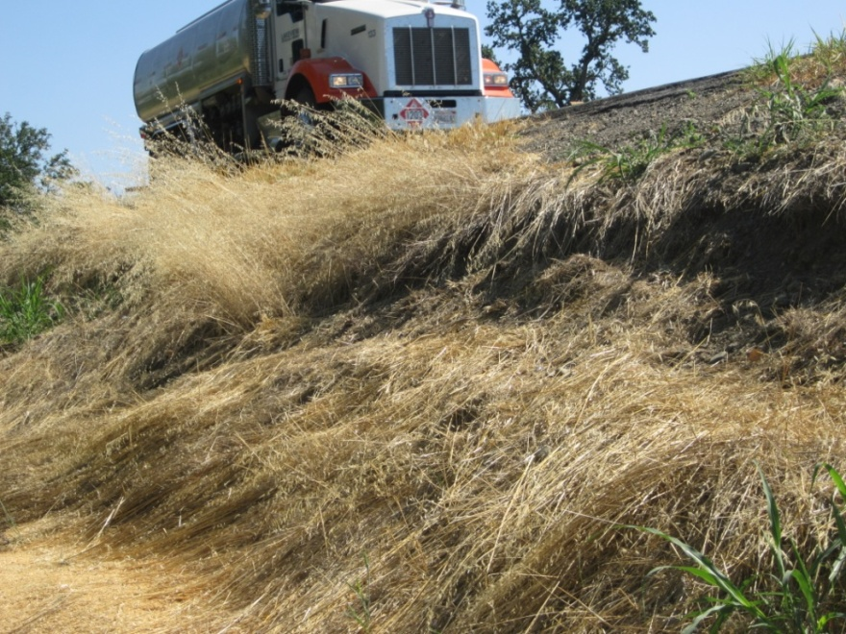
Notes:
Top Left: 24 inch and 30 inch pipe through levee. Two pumps on waterside bank. 30 inch standpipe on landside hinge. One pipe may be leaking.
Top Right: Pipe outlet has eroded landside embankment. About 8 foot deep and 20 feet into the embankment.
Bottom Left: Depression next to waterside concrete distribution box, 5 foot deep, 10 feet long.
Bottom Right: Erosion site mid slope on waterside embankment. Erosion is 1-2 feet deep.

