Slide 1
Urban Level of Flood Protection Criteria
Briefing to the Central Valley Flood Protection Board
Michele Ng
Central Valley Flood Planning Office
Department of Water Resources

Slide 2
Timeline of ULOP Requirements
2007
2008
2009
2010
2011
2012
2013
2014
2015
2016
SB 5 – Urban Level of Flood Protection requirements
AB 1665 – Not penalized by delayed state fund
SB 1070 – Excluding Fresno area
ULOP Criteria WG
Draft ULOP Criteria
CVFPP Adoption
SB 1278, AB1965 –
Reset trigger time to map availability;
Exempt shallow flooding and local drainage
ULOP Criteria Refinement WG
SB 1278 map released
ULOP Criteria
GP update
< 24 M
Zoning Ord.
< 12 M

Slide 3
Urban Level of Flood Protection
“Urban level of flood protection” means the level of protection that is necessary to withstand flooding that has a 1-in-200 chance of occurring in any given year using criteria consistent with, or developed by, the Department of Water Resources.
“Urban level of flood protection” shall not mean shallow flooding or flooding from local drainage that meets the criteria of the national Federal Emergency Management Agency standard of flood protection.

Slide 4
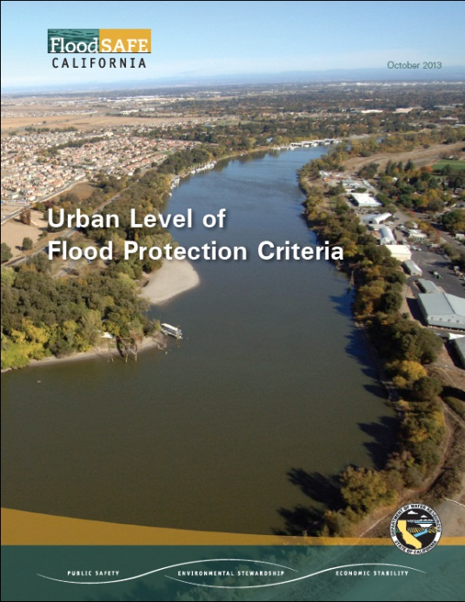
ULOP Criteria
Document Contents
Introduction
Criteria
Other Considerations
DWR’s Principles for Criteria Development
Satisfy legislative requirements without interfering with local land use authority
Provide reasonable details and flexibility
Promote prudent floodplain management

Slide 5
ULOP Criteria Uses
Cities and counties can use either these criteria or other consistent criteria
DWR does not have enforcement authority
DWR may include the ULOP Criteria in future requirements for State funding eligibility, where appropriate
DWR currently does not have plans to convert the ULOP Criteria into regulations

Slide 6
Road Map for ULOP Criteria
The California Department of Water Resources developed the Urban Level of Flood Protection Criteria (Criteria). For affected land use decisions, cities and counties in specific locations within the Sacramento and San Joaquin river basins need to make a finding related to an urban level of flood protection based on substantial evidence in the record. Cities and counties may use criteria consistent with this Criteria or apply this Criteria directly.
See DCN Provisions in the Criteria
See LOC Provisions in the Criteria
See FND Provisions in the Criteria
See EVD Provisions in the Criteria

Slide 7
ULOP Criteria
Applicable Location
Urban/urbanizing area
Within FEMA FIRM
Within Sacramento-San Joaquin Valley
Within area with potential flood depth greater than 3 feet
Within watershed with a contributing area of more than 10 square miles

Slide 8
ULOP Criteria
Findings
Currently have 200-year flood protection
Imposed conditions
Making adequate progress
Within an undetermined risk area
Substantial Evidence
Depends on type of finding (could include CE report, review from Independent Panel of Experts)
A previous finding can be used to support a new finding, when applicable

Slide 9
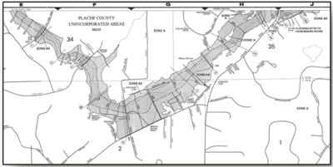
Related DWR Assistance
Developing A Guidance Document for General Plan Amendments
All cities and counties within the Sacramento-San Joaquin Valley must update their General Plans by July 2015

Slide 10
More Information
http://www.water.ca.gov/floodsafe/urbancriteria/
Michele Ng
Central Valley Flood Planning Office
Department of Water Resources
michele.ng@water.ca.gov

