Slide 1
Flood System Repair Project (FSRP) Program Status Briefing
September 18, 2013
Dave Wheeldon, Chief
Flood System Sustainability Branch
FMO, Division of Flood Management

Slide 2
Introductions and Meeting Purpose
FSRP Progress to date
Current FSRP Activities
Next Steps
FSRP Summary
Prop. 1E funded, DWR-led project to provide funding and technical assistance to LMAs for critical repairs consistent with the CVFPP

Slide 3
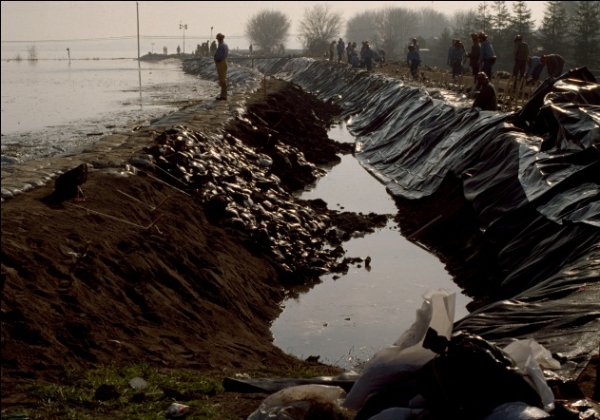
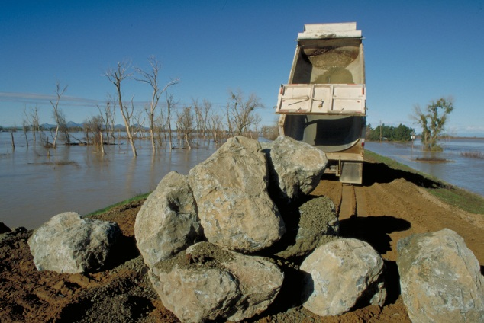
FSRP Summary - Goals and Objectives
FSRP will cost share with LMAs to:
Repair documented critical problems:
Repair deteriorated levee patrol roads to ensure effective flood fighting capability
Conduct proactive repair of minor levee problems, such as erosion sites shorter than 50 feet
Erosion, boils, slumps, hydraulic control structures, and channels

Slide 4
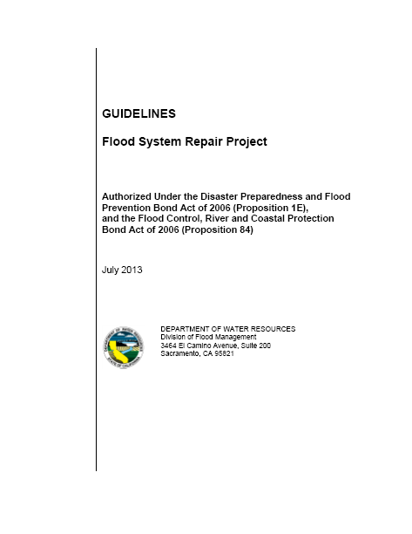
FSRP Progress to Date
FSRP Guidelines
Final Guidelines posted September 4 (http://www.water.ca.gov/floodmgmt/fmo/fsrp/guidelines.cfm)
Leveed areas defined and ranked based on relative flood risk (Tiers 1/2/3)
Critical sites identified and vetted with LMAs
Site Selection
Notices of Eligibility
Project Agreements
Planning, Design
and Permitting
Final Design & Construction

Slide 5
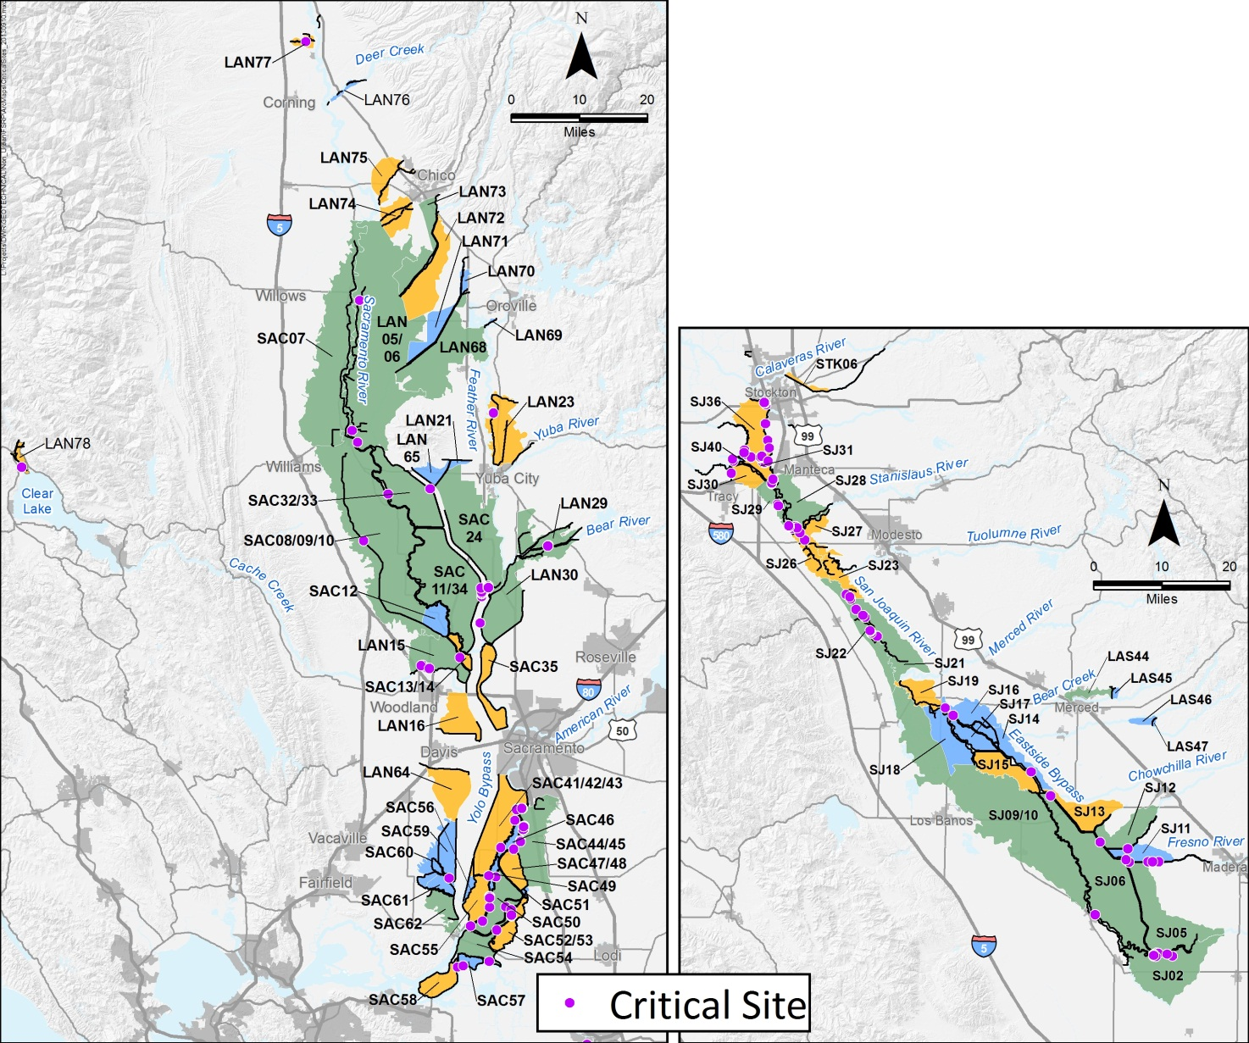
Critical Site Selection
Sacramento
Valley
LMA collaboration throughout process
Current funding sufficient all critical repairs
FSRP Guidelines
Site Selection
San Joaquin Valley
Notices of Eligibility
Project Agreements
 | # | $
Tier 1 | 66 | $74.25M
Tier 2 | 28 | $31.78M
Tier 3 | 15 | $16.91M
Total | 109 | $122.94M
Planning, Design
and Permitting
Final Design & Construction
Notes:
Jackie, can you have map(s) prepared showing the locations of the 108 critical sites if Ran wants to use that graphic?
Please use on slide for Sac System and second for

Slide 6
Repair Types and Remedies
FSRP Guidelines
Site Selection
Notices of Eligibility
Project Agreements
Planning, Design
and Permitting
Final Design & Construction
Notes:
Ran, This and the next slide have the same text but provide examples of graphical representations of the Critical Site data in the table you provided. I wanted to give you some options on presenting repair types, remedies, critical site locations, and total costs by tier. My intent would be for you to identify to us which data you would like presented and than consolidate it into a single slide. Loren or Jackie can make these changes in my absence.

Slide 7
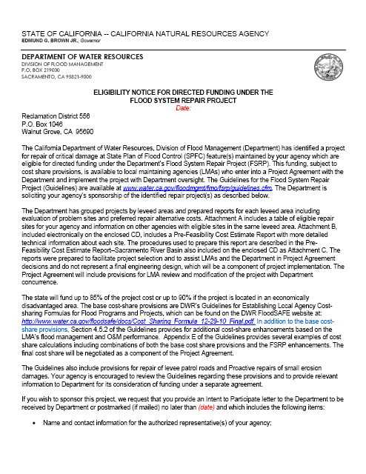
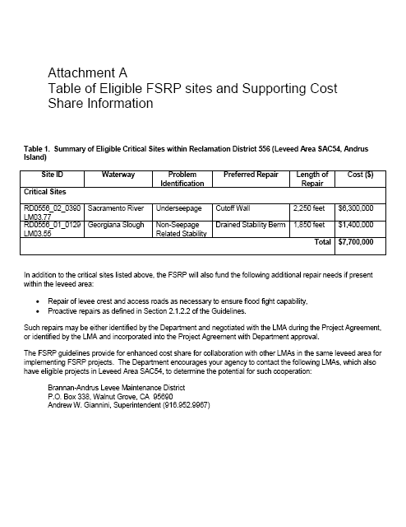
FSRP Current Activities
FSRP Guidelines
Site Selection
Planning for 66 Tier 1 Critical sites
Sacramento–31 sites ($47.55M)
San Joaquin–35 sites ($26.70M)
Notices of Eligibility to be presented at off-site briefings with LMAs
LMAs are preparing estimates of crown/access road repair needs
Notices of Eligibility
Project Agreements
Planning, Design
and Permitting
Final Design & Construction

Slide 8
FSRP Next Steps
FSRP Guidelines
Negotiate Project Agreements for Tier 1 repairs with willing LMAs
Critical repair sites
Crest/access road repairs
Assist/oversee LMA planning efforts for Tier 1 repairs
Final design
Environmental permitting
Property acquisition
Assist/oversee project implementation for Tier 1 repairs
Initiate process for Tier 2/3 critical sites
Site Selection
Notices of Eligibility
Project Agreements
Planning, Design
and Permitting
Final Design & Construction

Slide 9
FSRP Next Steps – Project Implementation
Project Implementation Schedule
2014:
Target 10-15 Project Agreements
Tier 1 Rural LMAs
Levee Repair, Patrol Road Gravelling, Structure Rehabilitation
2015 and Beyond:
Increased Number of Project Agreements
Reaching into Tier 2 and 3 Repairs
Continue Reconnaissance and Outreach efforts

Slide 10
FSRP Briefing Recap and Q&A
FSRP will cost share with LMAs to:
Conduct proactive repair of minor levee problems
Repair deteriorated levee patrol roads
Repair documented critical problems
with a goal of:
Strong coordination with LMAs to promote LMA leadership of projects
Providing effective technical support to ensure LMA’s project success
Minimizing DWR resource demands
Notes:
Ran, This largely recreates the initial slide of goals and objectives, but also adds the LMA coordinate focus and goal of fostering LMA leadership of projects to reduce strain on DWR resources. The intent of this slide is to have a final slide for Q&A that recognizes that focus and goal as we discussed today.

Slide 11
Flood System Repair Project (FSRP)
Dave Wheeldon, Chief
Flood System Sustainability Branch
FMO, Division of Flood Management

Slide 12
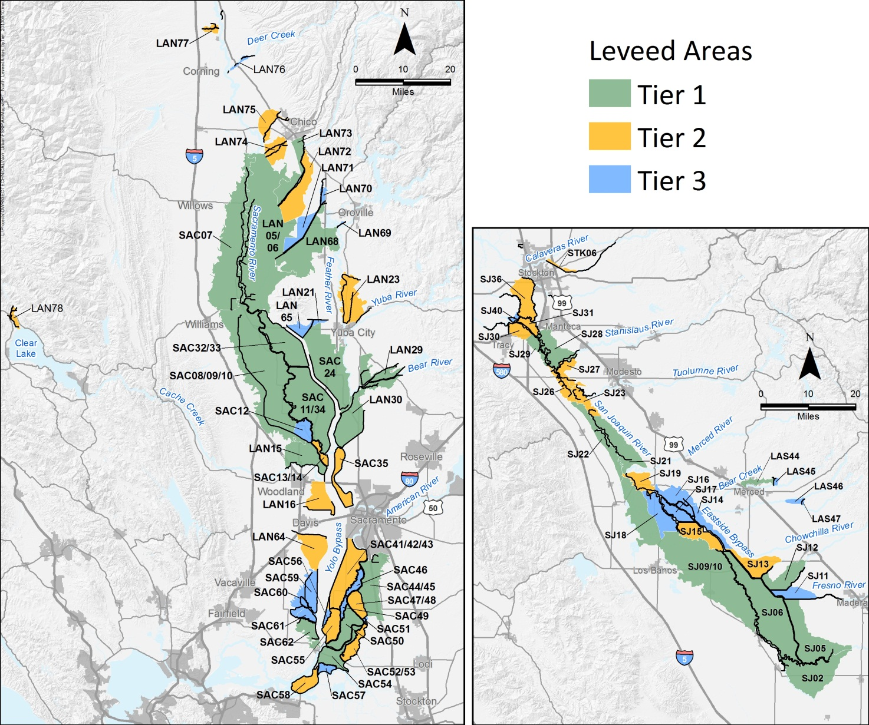
Leveed Area Definition
Sacramento
Valley
FSRP Guidelines
Site Selection
San Joaquin Valley
Notices of Eligibility
Project Agreements
Planning, Design
and Permitting
Final Design & Construction

