Slide 1
Colors

Slide 2
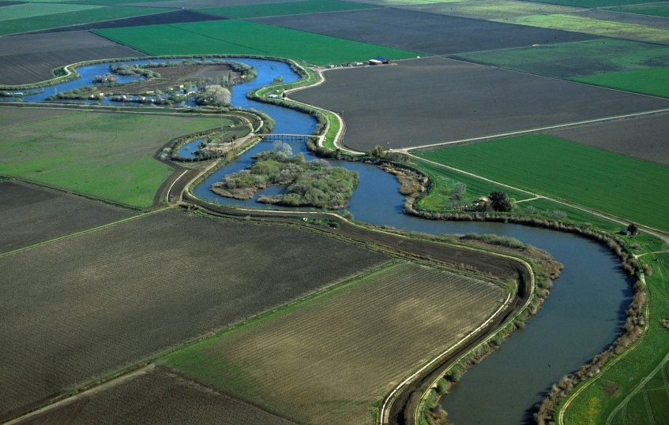
BRIEFING DELTA LEVEES MAINTENANCE SUBVENTIONS PROGRAM ABILITIY TO PAY
Sandra Maxwell, P.E.
Presented to the
Central Valley Flood Protection Board
Sacramento, California
November 22, 2013

Slide 3
Subventions Program
Helping the Delta

Slide 4
Subventions Program
1996 AB360 amended California Water Code
Section 12986

Slide 5
Subventions Program
California Water Code Section 12986
(a)(3)(A) …
the department shall require the local agency or
an independent financial consultant to provide information regarding the agency’s ability to pay for the cost of levee maintenance or improvement. Based on that information, the department may require the local agency or an independent financial consultant to prepare a comprehensive study on the agency’s ability to pay.

Slide 6
Subventions Program
1996 AB360 amended California Water Code Section 12986
1997-98 Subventions Program required
financial information from all applicants

Slide 7
Subventions Program
1996 AB360 amended California Water Code Section 12986
1997-98 Subventions Program required
financial information from all applicants
2007 Subventions Program re-examined the ability to pay for agricultural and urban districts

Slide 8
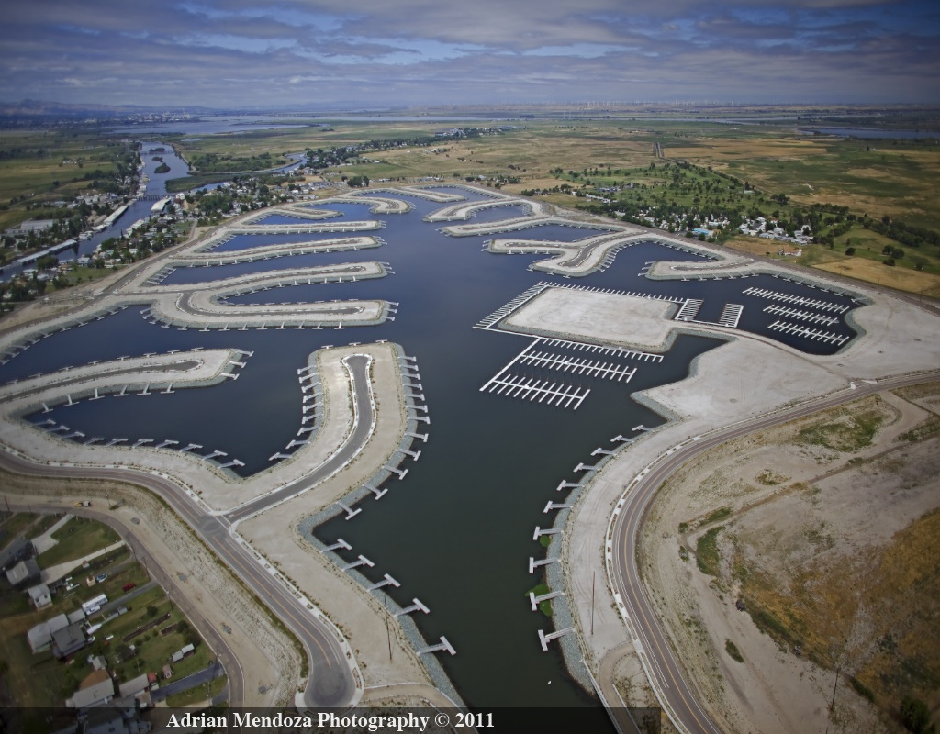
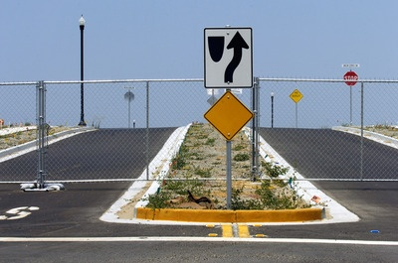
Subventions Program
Economic conditions
SUSPENDED
Delta Coves - 2008
Construction suspended due to the economy.

Slide 9
Subventions Program
1996 AB360 amended California Water Code Section 12986
1997-98 Subventions Program required financial information from all
applicants
2007 Subventions Program re-examined the ability to pay for agricultural and urban districts
2013 No significant changes of land use or
economic conditions

Slide 10
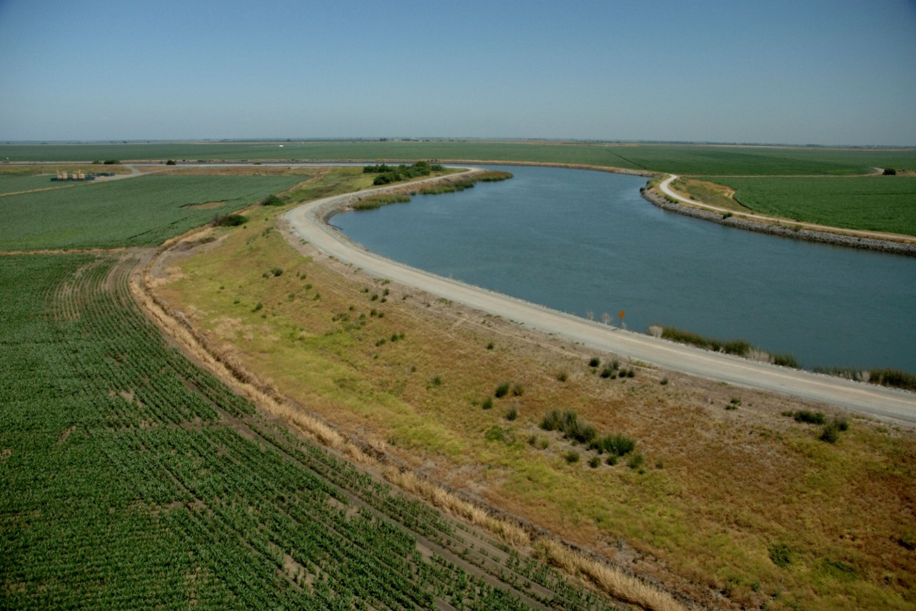
QUESTIONS?

