Slide 1
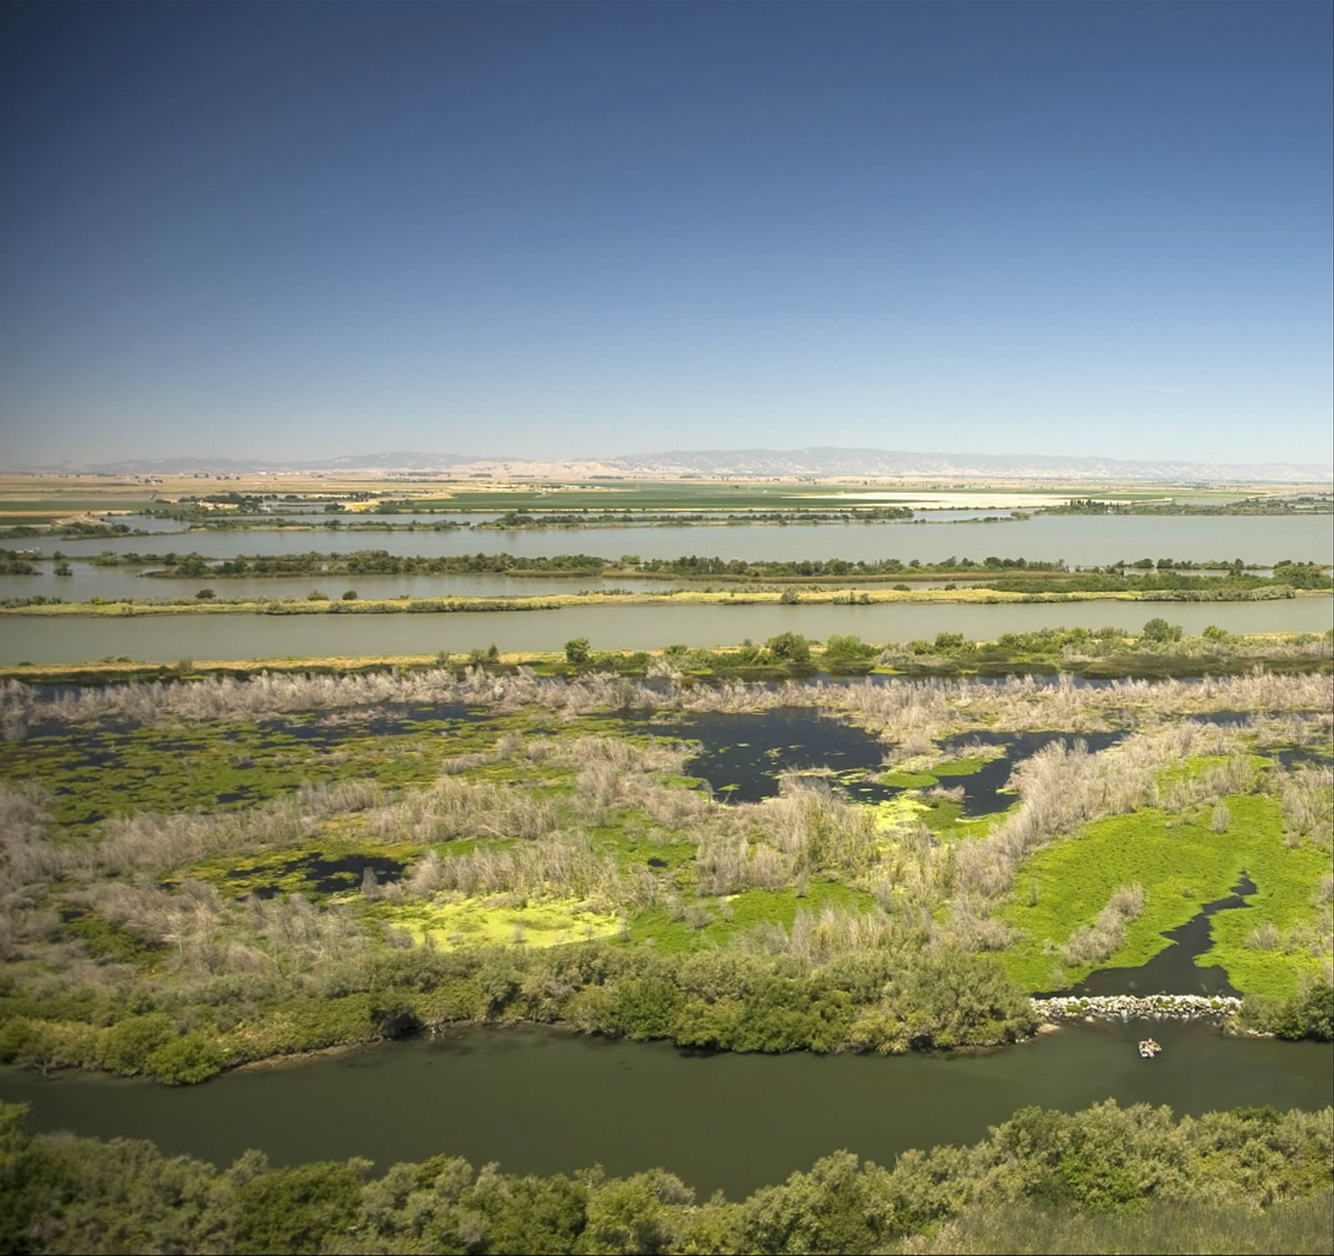
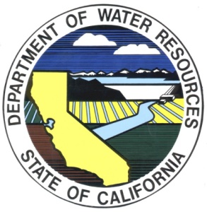
PROSPECT ISLAND
RESTORATION
&
THE FISH RESTORATION
PROGRAM AGREEMENT
Dan Riordan
Department of Water Resources
Notes:
Introduce self and talk
Joint DWR and DFW program

Slide 2
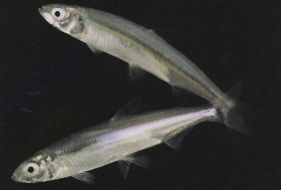
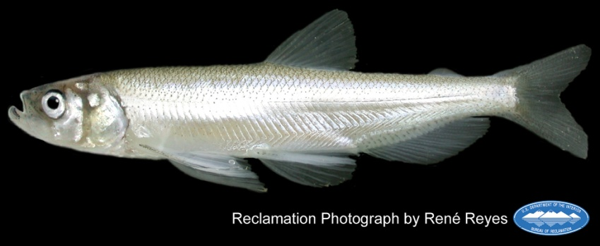
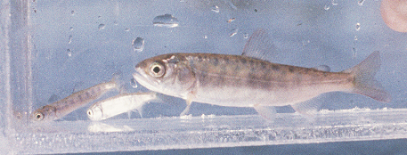
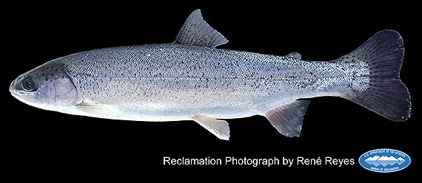
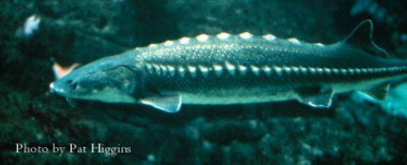
Listed Fish Species
Source: FWS
Source: DWR Aquatic Ecology
Source: FWS
Source: NOAA
Notes:
USFWS Delta Smelt BiOp, RPA 4
“DWR shall implement a program to create or restore a minimum of 8,000 acres of intertidal and associated subtidal habitat in the Delta and Suisun Marsh”
NMFS Salmonid BiOp, Action 1.6.1
“…DWR shall … provide significantly increased acreage of seasonal floodplain rearing habitat … in the lower Sacramento River basin… If these 8,000 acres [of tidal habitat created pursuant to the USFWS Biop] also provide suitable rearing habitat for salmonids, they may be used in partial satisfaction of the objective of this action.”
Action 1.6.2: Near-term actions at Liberty Island/lower cache slough and lower Yolo bypass
Longfin Smelt ITP: “[DWR] shall fund the acquisition, restoration, long-term management and long-term monitoring of 800 acres of tidal habitat in the mesohaline zone of the Delta [Suisun Bay or Marsh]“
DWR Environmental Stewardship Policy:
- DWR has a role and responsibility to protect and restore the environment, as reflected in it’s mission statement (“…protect, restore and enhance the natural and human environments”)
- Implement projects that contribute to the recovery of listed species

Slide 3
DWR Habitat Restoration Requirements
USFWS Delta Smelt Biological Opinion:
  Restore 8,000 acres of intertidal and associated subtidal habitat
NMFS Salmonid/Sturgeon Biological Opinion:
  Restore salmonid rearing habitat
  Enhance existing habitat in Liberty Island and lower Cache Slough
CDFW Longfin Smelt Incidental Take Permit:
  Restore 800 acres of brackish tidal habitat
DWR Environmental Stewardship Policy:
  Contribute to the recovery of listed species
Notes:
USFWS Delta Smelt BiOp, RPA 4
“DWR shall implement a program to create or restore a minimum of 8,000 acres of intertidal and associated subtidal habitat in the Delta and Suisun Marsh”
NMFS Salmonid BiOp, Action 1.6.1
“…DWR shall … provide significantly increased acreage of seasonal floodplain rearing habitat … in the lower Sacramento River basin… If these 8,000 acres [of tidal habitat created pursuant to the USFWS Biop] also provide suitable rearing habitat for salmonids, they may be used in partial satisfaction of the objective of this action.”
Action 1.6.2: Near-term actions at Liberty Island/lower cache slough and lower Yolo bypass
Longfin Smelt ITP: “[DWR] shall fund the acquisition, restoration, long-term management and long-term monitoring of 800 acres of tidal habitat in the mesohaline zone of the Delta [Suisun Bay or Marsh]“
DWR Environmental Stewardship Policy:
- DWR has a role and responsibility to protect and restore the environment, as reflected in it’s mission statement (“…protect, restore and enhance the natural and human environments”)
- Implement projects that contribute to the recovery of listed species

Slide 4
Fish Restoration Program Agreement (FRPA)
Executed October 2010
Joint DWR and DFW program
Fulfill habitat restoration obligations
Establishes framework for selecting, funding, implementing and managing restoration projects
Notes:
A major program recently executed by DFG and DWR is the FRPA.
“DWR and DFG intend through this Agreement to develop a fish restoration program by establishing the framework for selecting, funding, and implementing specific restoration projects, and management and funding plans for those same restoration projects.”
Establishes the framework by with DFG and DWR will work together to fulfill the habitat restoration requirements of the BIOPs and ITP,

Slide 5
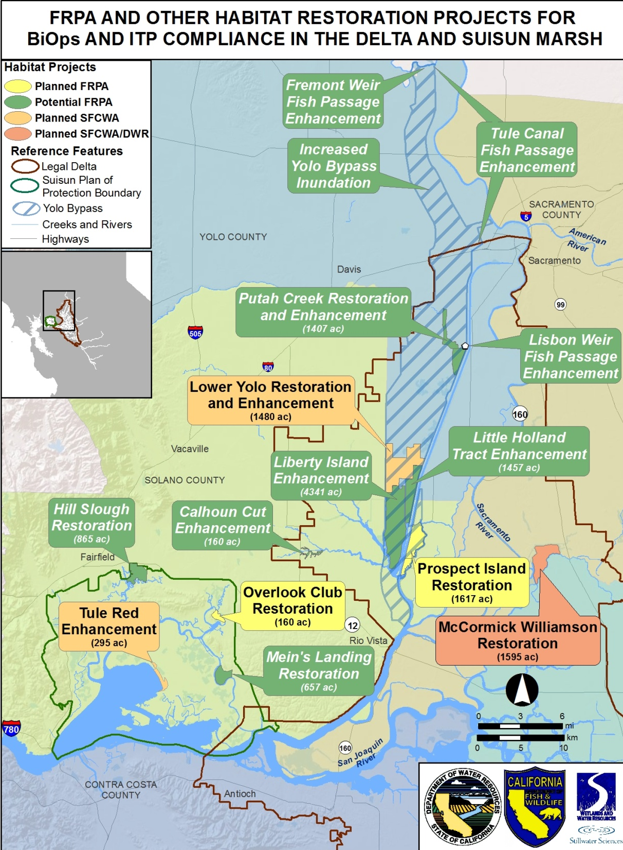
Near-term Actions
Planned and potential projects
Three geographic regions
FRPA will support other programs where possible
Notes:
The FRPA projects (planned and potential) (but all are Near-Term) are shown here.
Show three regions: Yolo Bypass, Suisun Marsh, and CSC.

Slide 6
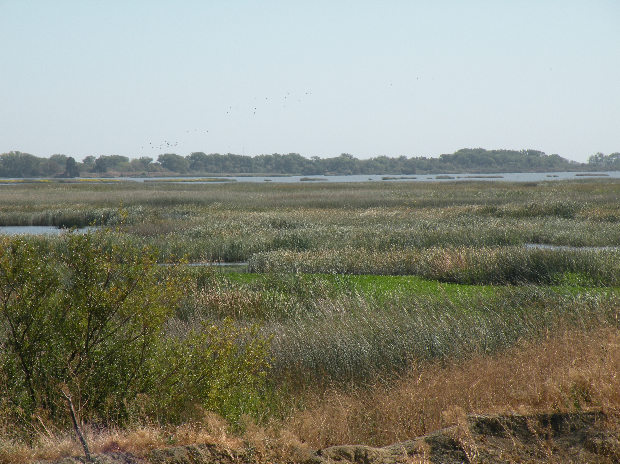
Cache Slough Complex
Existing tidal marsh habitat
Connected to Yolo Bypass floodplain
Elevations are conducive to tidal habitat restoration
Dead-end channels and shallow open water
High turbidity
High primary and secondary productivity
Delta smelt and other native fishes
Land in public ownership
Notes:
CSC is ideal for habitat restoration because
Elevations: Intertidal range: 0 ft to 6 ft above sea-level for tule marsh establishment.

Slide 7
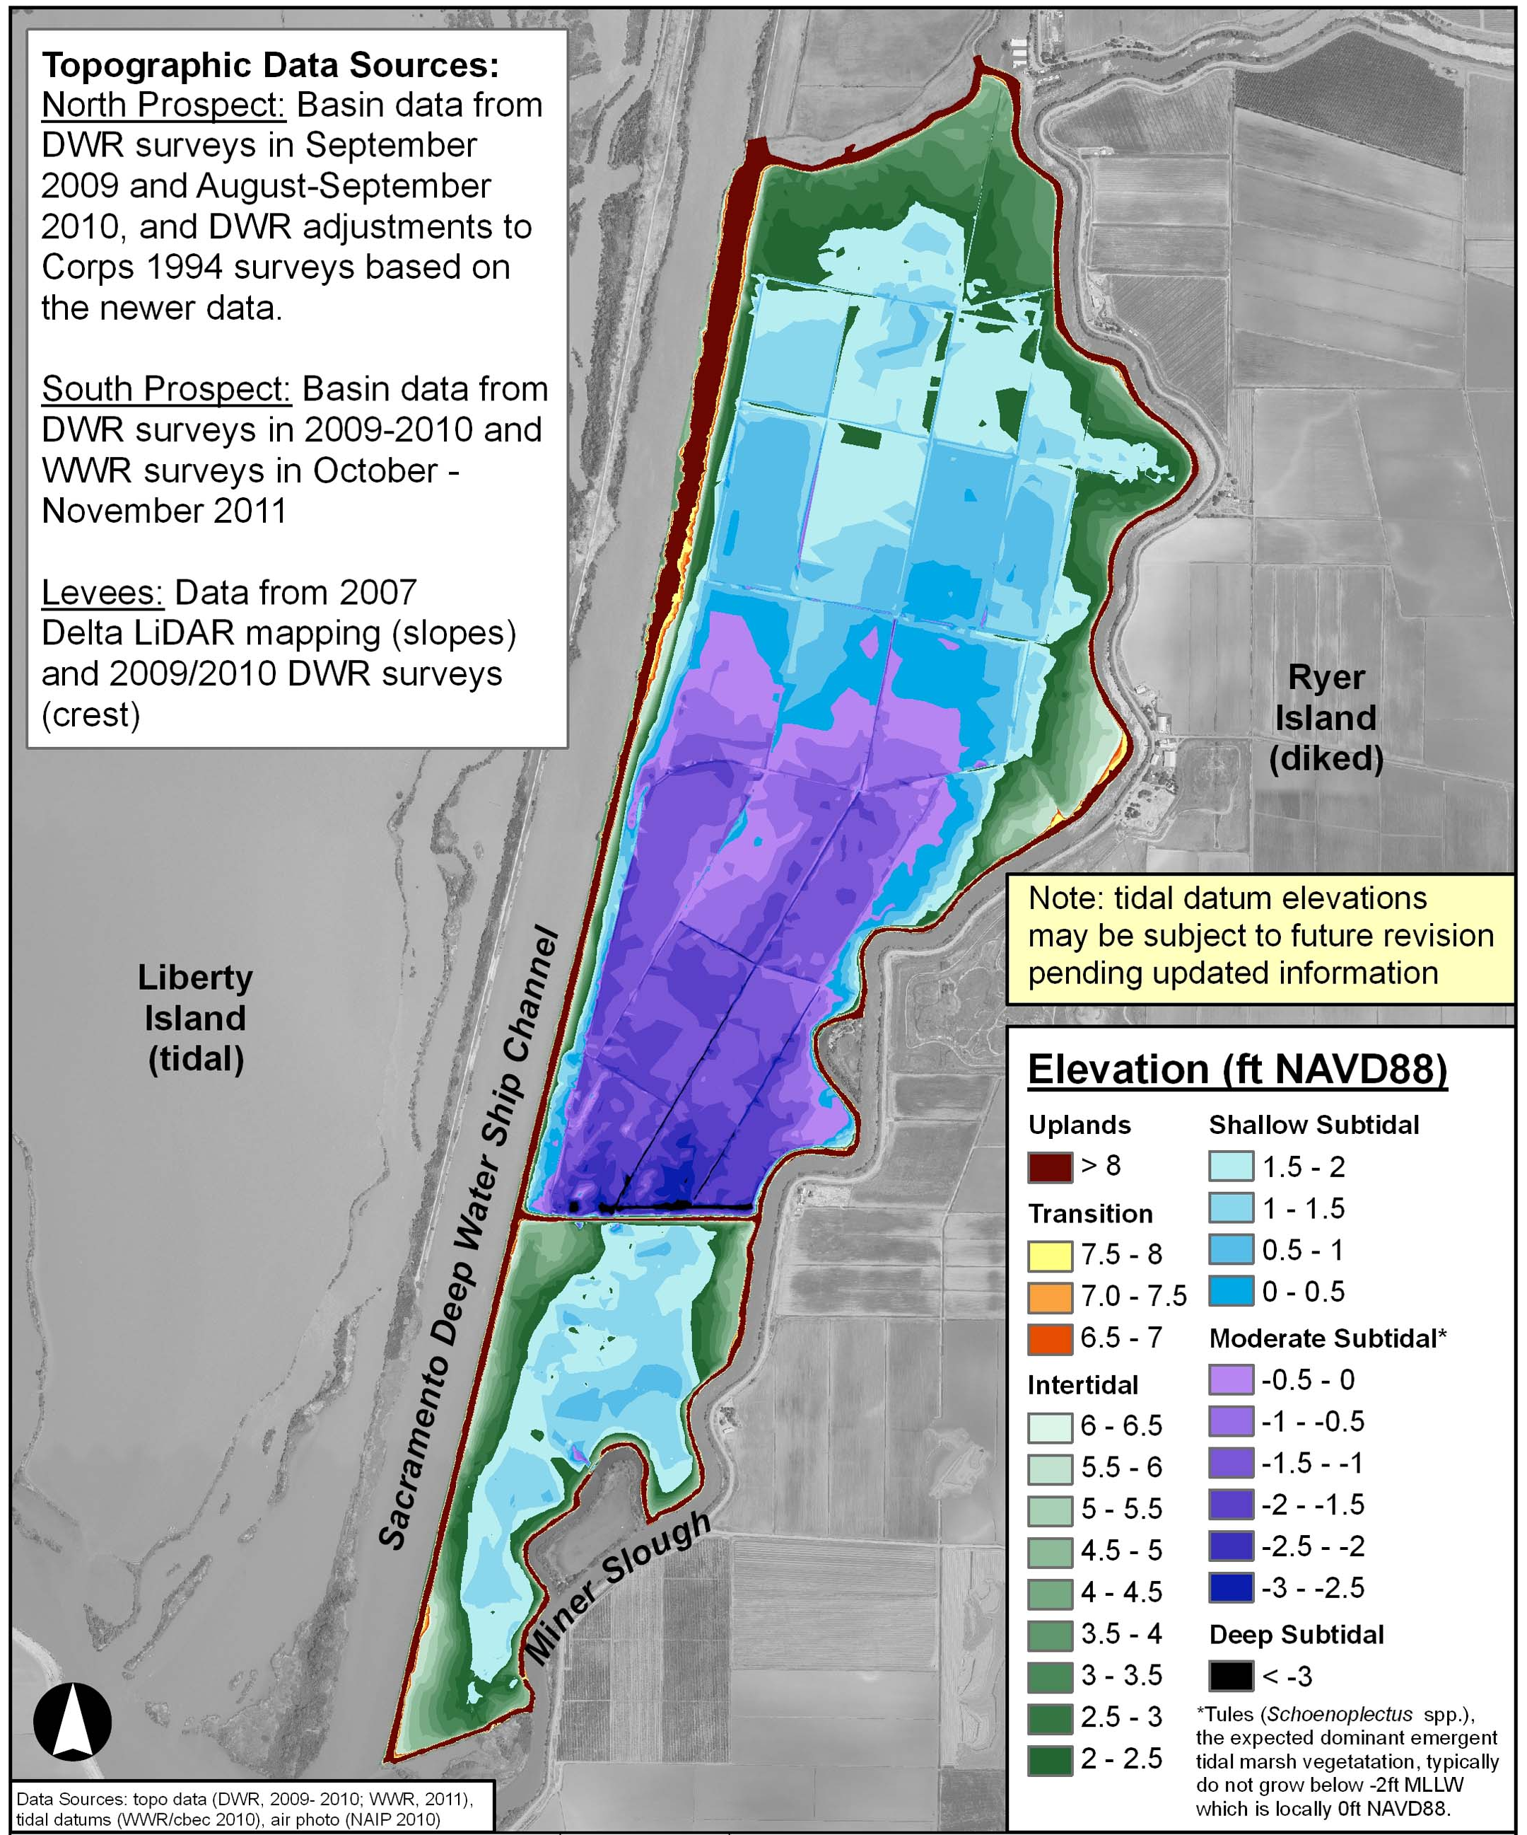
Why Prospect?
Publicly owned
Suitable elevations for tidal marsh and aquatic habitat restoration
Desirable location for target fish species

Slide 8
Prospect Planning Process
Screening Criteria and Thresholds
(completed)
Screening-Level Modeling
(completed)
DRERIP Evaluation
(completed)
Feasibility Reviews
(completed)
Broad Suite of Initial Restoration Alternatives
(completed)
Select Alternatives to Advance
(in progress)
Phase 2 Screening Criteria and Thresholds
(in progress)
Restoration objectives
Site conditions and setting
Opportunities and constraints
Outcomes hypotheses
Supporting future restorations
Phase 2 Modeling
(in progress)
EIR
Permits
Construction
Management
(future)
Draft Restoration Plan
(in progress)

Slide 9
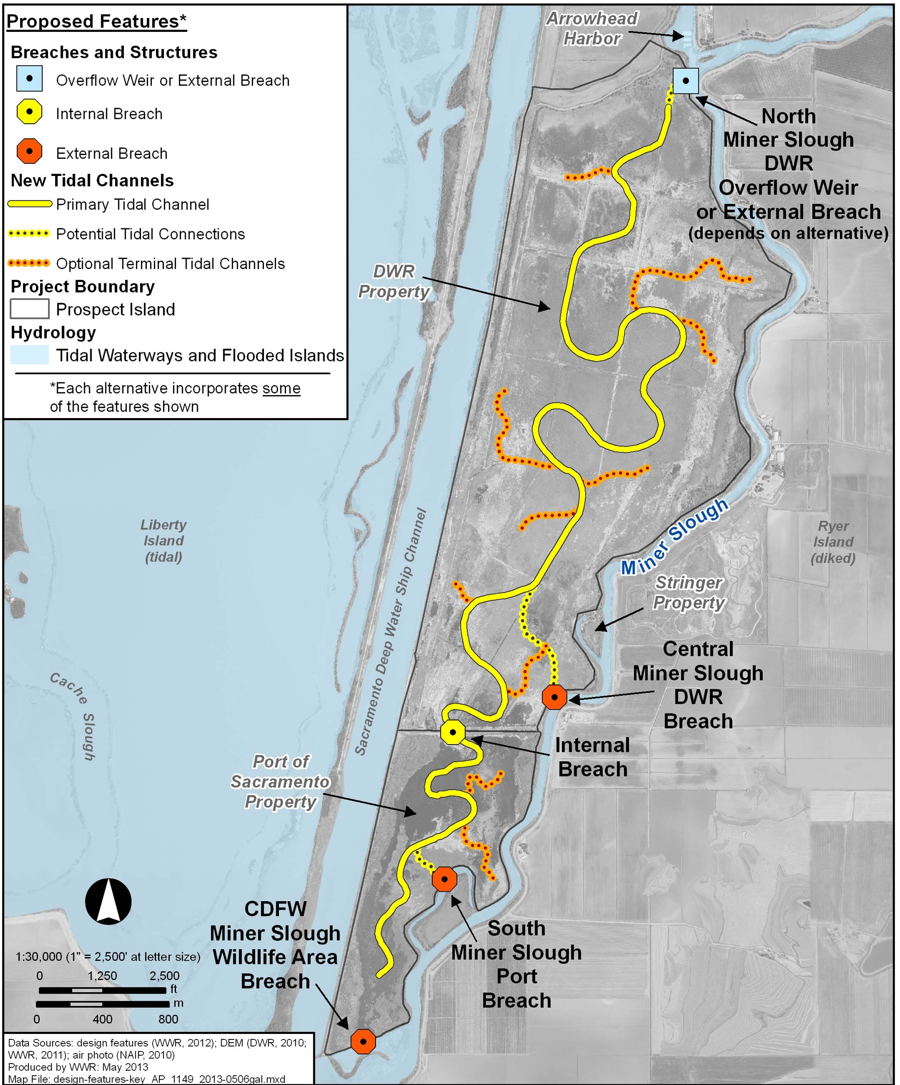
Design Features
Key
Breaches
Overflow weir
Primary channels
Secondary branch channels
Connecting channels to selected breaches
DWR and Port properties
Adjacent property access
Alternatives to be developed that mix and match these components

Slide 10
Potential
CEQA Project Actions
Breach levees
Install weir(s)
Excavate channels within Prospect Island
Place excavated soils within Prospect Island
Import clean, suitable sediment from off-site sources
Address adjacent property access
Control invasive species
Reinforce levees
Notes:
Richard OR Dan Riordan and if so moved to his presentation

Slide 11
Some Expected Permits
404, Section 10 – USACE
401, Porter-Cologne, 303(d) CWA for MeHg TMDL – CVRWQCB
Title 23 CCR – CVFPB
1602 – CDFW
Delta Reform Act – DSC

Slide 12
Outreach
FRPA/Prospect Island Restoration outreach
FRPA/Prospect Restoration OUTREACH - completed
Implementation Strategy (w/ public review)
Stakeholder Assessment – 27 interviewees
Delta Restoration public mntg in Courtland
Cache Slough Complex Tech Team mtngs
Delta Independent Science Board presentation
Delta Science Conference presentation
SWRCB Workshop presentation
DRERIP evaluation
Delta Conservancy Board mtng
Delta Regional Forum
US Army Corps of Engineers /Port of West Sac pre-NOP briefing
Solano County pre-NOP briefing
Solano County Water Agency pre-NOP briefing
S.F Bar Pilots/Port of West Sac pre-NOP briefing
Arrowhead Marina pre-NOP briefing

Slide 13
Outreach (cont.)
RD 2068 and NDWA pre-NOP briefing
Delta Protection Commission pre-scoping briefing
Mr. and Mrs. Stringer
Ryer Island RD pre-scoping briefing
Yolo Bypass Work Group briefing
Delta Stewardship Council pre-scoping briefing – June 2013
NDWA board pre-scoping briefing
CEQA Prospect Scoping session – June 10
FRPA/Prospect Restoration OUTREACH – scheduled:
Central Valley Flood Protection Board – July 12
State water contractors briefing – July 31/August 1
Completed:
Communication and Engagement Plan - FRPA
Communication and Engagement Plan – Prospect Island
Stakeholder Assessment Final Report
FRPA and Prospect web pages (DWR and DFG)

Slide 14
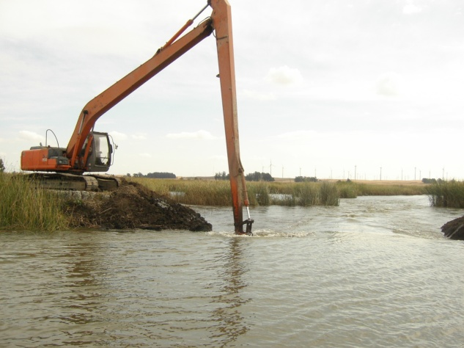
Prospect Island Restoration
Schedule
START FINISH
Jul 2010 Oct 2013
Jun 2011 Feb 2015
May 2013 Jun 2014
Jan 2013 Feb 2015
2010 2016
2016
1. OBTAIN BASELINE INFO:
2. DESIGN:
3. CEQA:
4. PERMITS:
5. INTERIM MGMT:
6. CONSTRUCTION:
Blacklock Levee Breach, Oct 2006
Photo: S. Siegel

