Slide 1
Central Valley Integrated Flood Management Study
Briefing to the
Central Valley Flood Protection Board on
Status of the FCSA
July 12, 2013
Notes:
Handouts provided yesterday:
Summary brochure describing the role and scope of BWFS
11x17 – One Process, Many Activities
11x17 – Coordination with Regional Plans

Slide 2
Today’s Briefing
Why the CVIFMS is important
Background and History
Plan Moving Forward
Next Steps
Notes:
Focus today is on the BWFS

Slide 3
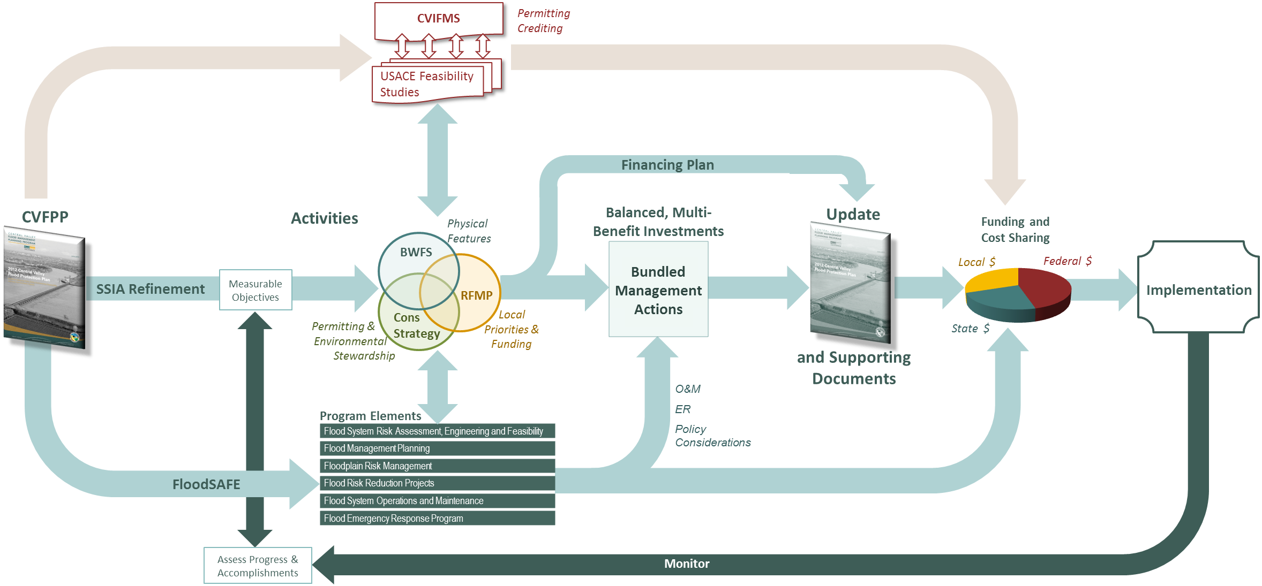

One Process, Many Activities

Slide 4
Relationship to CVFPP Planning Efforts
State-Led
Basin-Wide Feasibility Studies
Central Valley Flood System Conservation Strategy
State Interest
CVIFMS and Other
Federal cost-share
feasibility studies will help identify areas of Federal interest in CVFPP implementation
Local/Regional Priorities
Locally-led Regional Flood Management Planning

Slide 5
Timeline
FCSA for Sacramento & San Joaquin River Basins Comprehensive Study
October 2011 Amendment to FCSA approved by Board
(not executed by USACE)
July 21, 2010 Board Approves FCSA for CVIFMS
1995
2005
2010
CA Flood Legislation Passed (2006, 2007)
August 28, 2009 Board & DWR Memorandum of Understanding
for CVIFMS
2011 USACE Planning Modernization
Notes:
The Sacramento and San Joaquin River Basins Comprehensive Study (Comprehensive Study) was initiated in February 1996 with the signing of an initial FCSA between the USACE and Reclamation Board (now Central Valley Flood Protection Board). The February 1996 FCSA expired on February 2009. The Central Valley Integrated Flood Management Study (CVIFMS) is being carried out under the same authority of the Comprehensive Study.

Slide 6
2010 FCSA
Sponsors
  Federal: U.S. Army Corps of Engineers, Sacramento District
  State: The Central Valley Flood Protection Board
  Local: Department of Water Resources
Total cost $1,720,000
  Cost-shared equally with State
  Up to 100% through in-kind services
Federal authority provided under the Flood Control Act of 1962 (Public Law 87-874) and May 8, 1964 resolution of the House Committee on Public Works

Slide 7
2010 FCSA (cont)
Called for development of a Project Management Plan for CVIFMS
  Scope a more detailed, five-year feasibility study
Future funding for the feasibility study was to be provided through a subsequent FCSA or amendment
USACE completed a draft PMP for CVIFMS in 2011
  Amendment to FCSA was prepared consistent with the PMP, and signed by the Board in October 2011
  USACE did not execute the amendment due to Subsequent USACE Planning Modernization guidance

Slide 8
USACE Planning Modernization
Guidance released in early 2012
Streamlines Federal feasibility studies for greater efficiency and timeliness
  3 years
  $3 million
  Increased vertical alignment within USACE
Provides opportunities for greater collaboration with local sponsors, including use of locally-generated data
All Federal feasibility studies underwent scope review and prioritization following release of the guidance

Slide 9

Late 2012 CVIFMS Re-Scoping Efforts
One watershed study concurrent with State’s BWFS
  Federal interest in cross-regional, system improvements identified in the CVFPP
  Institutional and governance concerns associated with long-term implementation of the CVFPP
  Establish need for follow-on feasibility studies
Consistent with USACE Planning Modernization and the 5-year update schedule for the CVFPP
Revised PMP prepared in June 2013
  Significant collaboration among study partners

Slide 10
Benefits of CVIFMS Watershed Plan
Focus on system-based water resources problems
Assess technical work already completed by the State for its suitability in assessing Federal interest
Participate in State’s BWFS and Central Valley Flood System Conservation Strategy
Evaluate resource conditions related to flood risks and ecosystem conditions
Identify implementation challenges in policy, permitting, and crediting
Make recommendations for future actions, including potential feasibility studies

Slide 11
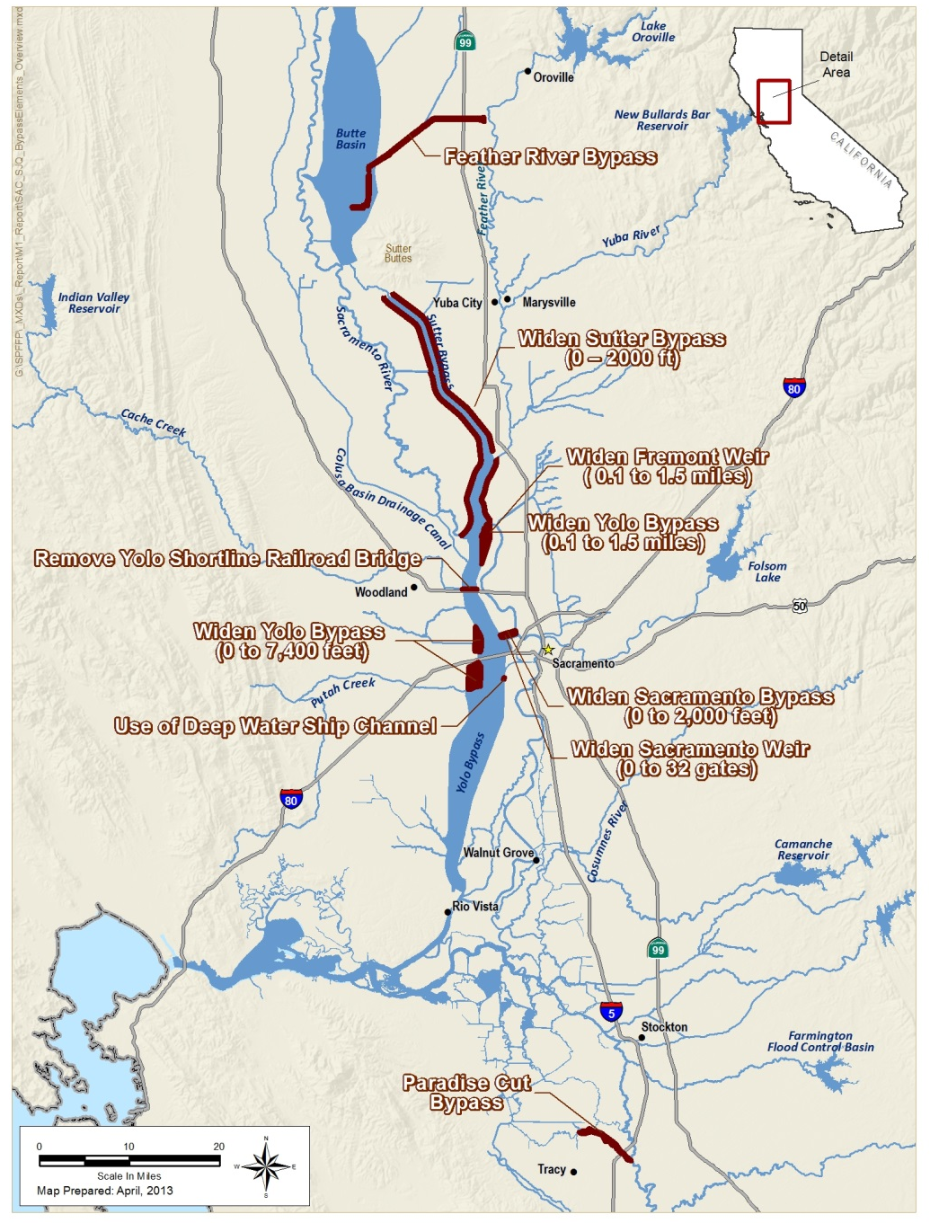
Focus on System Improvements
Potential Federal interest in CVFPP System Improvements in Sacramento River Basin
Consideration of system improvements in San Joaquin River Basin via Lower San Joaquin Feasibility Study
Notes:
Bypass system improvements:

Slide 12
Major Activities In CVIFMS PMP
Task 1: Technical data and tools gap analysis
Task 2: Without-project condition(s)
Task 3: Participation in, review and summarizing of CVFPP implementation planning efforts (BWFS, regional planning, Conservation Strategy)
Task 4: Federal interest in CVFPP implementation
Task 5: Policy and guidance recommendations (crediting, permitting, governance)
Task 6: Watershed Plan preparation
Task 7: Coordination and support

Slide 13
CVIFMS Schedule
Task Description | Schedule (Days after FCSA Amendment Execution)
1. Gap Analysis | 90 days
2. Forecast Without Project Conditions | 120 days
3. Participate, Review, Summarize | 180 days
4. Assessment of Federal Interest | 350 days
5. Policy and Guidance Recommendations | 350 days
* Decision Point Meeting | 365 days
6a. DRAFT Watershed Plan | 450 days
6b. FINAL Watershed Plan | 540 days
7. Coordination and Support | 540 days

Slide 14
Amendment 1 to FCSA
Total Watershed Study cost: $5,000,000
  Non-federal in-kind contributions $2,417,000
  Credit to the non-Federal in-kind $2,417,000
  Non-federal proportionate share about 48%

Slide 15
Next Steps
Briefing on CVIFMS July 12th
Motion to Approve Amendment 1 July 26th
USACE Approval of Amendment 1 August 2013
CVIFMS Implementation 2013 -2016
Notes:
Technical Workshop #2 would cover:
Application of tools (H&H, Cl. Change, economic?, life safety?, Cons Strategy tools?)
Initial Results of Technical Analyses to evaluate performance of system elements

Slide 16
Contact Information
DWR: Christopher Williams, Project Manager
(916) 574-2375
christopher.williams@water.ca.gov
CVFPB: Bob Scarborough, Project Manager
(916) 574-1422
robert.scarborough@water.ca.gov
USACE: Glen Reed, Project Manager – Civil Works
(916) 557-7630
Anthony.G.Reed@usace.army.mil
Notes:
Technical Workshop #2 would cover:
Application of tools (H&H, Cl. Change, economic?, life safety?, Cons Strategy tools?)
Initial Results of Technical Analyses to evaluate performance of system elements

Slide 17
Questions or Comments?

