Slide 1
Climate Change Considerations in the CVFPP
CVFPB Information Briefing
Joe Bartlett
July 12, 2013

Slide 2
Introduction
SB 5 (2007) requires climate change considerations incorporated in the CVFPP
DWR has completed 2012 CVFPP with considerations of climate change, but more to be done
Briefing focus:
  The main threat in the context of flood management
  Overview of the CVFPP approach to incorporate climate change
  Future briefings for updates and details
Notes:
SB 5 required DWR to consider climate change in CVFPP development.
Climate change impacts for extreme events, such as flooding and droughts, will result not from changes in averages, but from changes in local extremes. Available climate change information does not present probabilistic characteristics for extreme events.

Slide 3
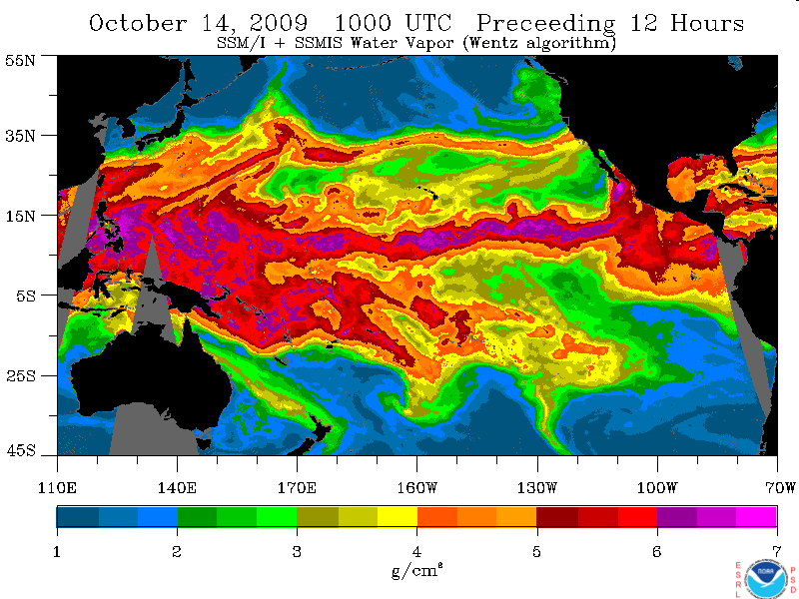
Atmospheric Rivers and Central Valley Flooding
Central CA
>15 inches
rain
Atmospheric River
45ºN
35ºN
25ºN
140ºE
170ºE
160ºW
130ºW
100ºW
1
2
3
4
5
6
7
Notes:
Michael Anderson:
The climate change effects on extreme events are of the most uncertain issues under the current understanding
The extreme events affected more by local conditions
The atmospheric rivers are very indicative for central valley flooding (based on review of historical events)
The research on atmospheric rivers is ongoing, improving the understanding of the phenomenon and information available for planning purposes
DWR has assisted in developing the body of knowledge, including UCD and USGS research.

Slide 4
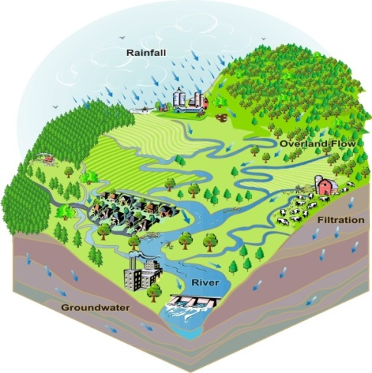
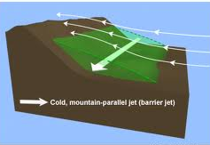

Long-term Vision for Climate Change Considerations
Atmospheric River Event
Watershed
Features
Flood Hydrograph
Sierra Barrier Jet Characteristics
Design Rainfall Event
Flood Risk Evaluation and
Flood Management Planning
Notes:
Atmospheric River Event
- moisture flux
- duration
- freezing elevation
- direction
Sierra Barrier Jet Characteristics
Watershed Features
orographic enhancement distribution
antecedent conditions (e.g., snow line, basin wetness)
Design Rainfall Event
-volume and peak
-duration
-spatial distribution
Flood Hydrograph
-peak
-volume
-critical duration
Establish a methodology that relates flood thresholds (e.g. 200-year event) to a given magnitude of atmospheric river characteristics of moisture flux and duration. This methodology will be developed based upon research in progress on topographic controls of extreme precipitation events carried out by the University of California Davis Hydrologic Research Laboratory and research in progress on historical and future projections of atmospheric river characteristics carried out by Scripps Institute of Oceanography and the National Oceanographic and Atmospheric Administration’s Earth Systems Research Laboratory (NOAA ESRL). The developed methodology will be embedded into current design storm analysis methods used by the United States Army Corps of Engineers in the Central Valley Hydrology Study currently in progress.
Project Status:
UC Davis has one year remaining to finish the atmospheric and watershed modeling and analysis of 50 historical flood events to evaluate topographic controls to extreme precipitation processes.
The Scripps Institute of Oceanography and NOAA ESRL have evaluated historical data and examined the 3rd Coupled Model Intercomparison Project (CMIP3) climate change simulations resulting in publications in 2011 (Dettinger, 2011) and 2013 (Ralph et al, 2013).
Efforts are underway to examine the new Coupled Model Intercomparison Project (CMIP 5) simulations in an attempt to derive a larger sample size of models that saved model representations of atmospheric rivers. Evaluation of the new information is expected to be completed within the next year.
The USACE Sacramento District has carried out a sensitivity study to flood size based on increased temperatures and its associated change in snowpack conditions at the time of the flood for select basins in the Central Valley. While results matched expectations for flood size, the associated challenges in reservoir management found in the study motivates further assessment of operations practices for winter and spring flood events, particularly for the San Joaquin Basin. Assembly of the component elements and testing of the framework will proceed upon completion of the research activities in May 2014.

Slide 5
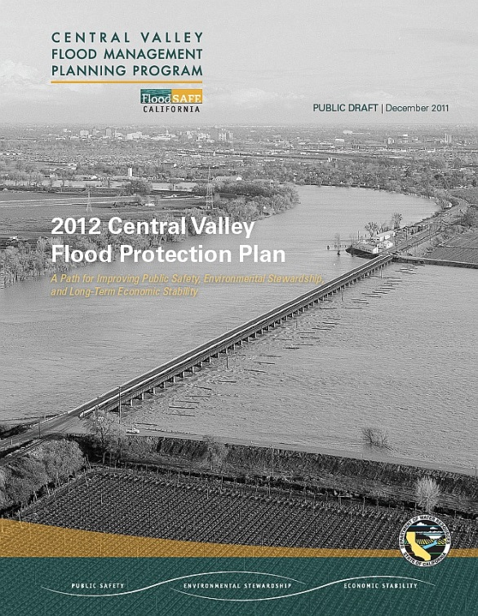
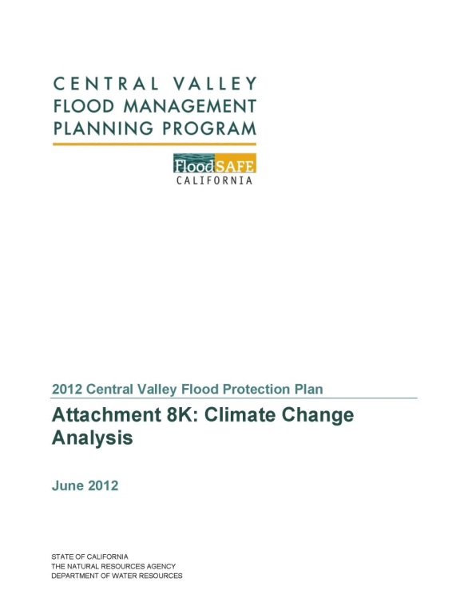
Climate Change Considerations in 2012 CVFPP
Adaptation Strategy (CVFPP Section 3.8)
  System elements
  Other local-initiated components
Quantitative Analysis
  New Methodology Development
  Pilot Study
Notes:
2012 CVFPP
Program level adaptation strategy
System Elements in SSIA provide climate change adaptations
Bypasses increase conveyance capacity and flexibility
Changes in reservoir operations (F-CO and F-BO)
Potential for instream storage, floodplain storage
New Methodology: Threshold Analysis Approach
Developed in collaboration with climate experts from NOAA, USGS, USACE, and Reclamation
Focus on atmospheric rivers with possible surrogates while the information under development

Slide 6
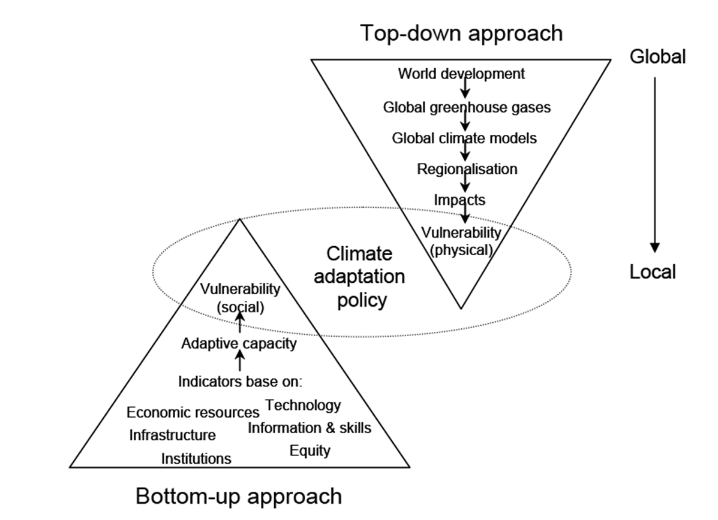
2012 CVFPP Quantitative Analysis
Notes:
Threshold analysis
With Atmospheric Rivers in mind and the knowledge development schedule
Uncertainties associated climate change evaluations and projections
Top down approach often causes challenges due to the evolution of understanding
For decision making on investment purposes,
More and more, adaptation strategy is vulnerability assessments in the context of climate change.
Vulnerability could be physical, economic, and social. [long-term sustainability considerations]
Understanding of vulnerability could help investment prioritization
Understanding of potential threshold(s) that could push for different direction of long-term investment

Slide 7
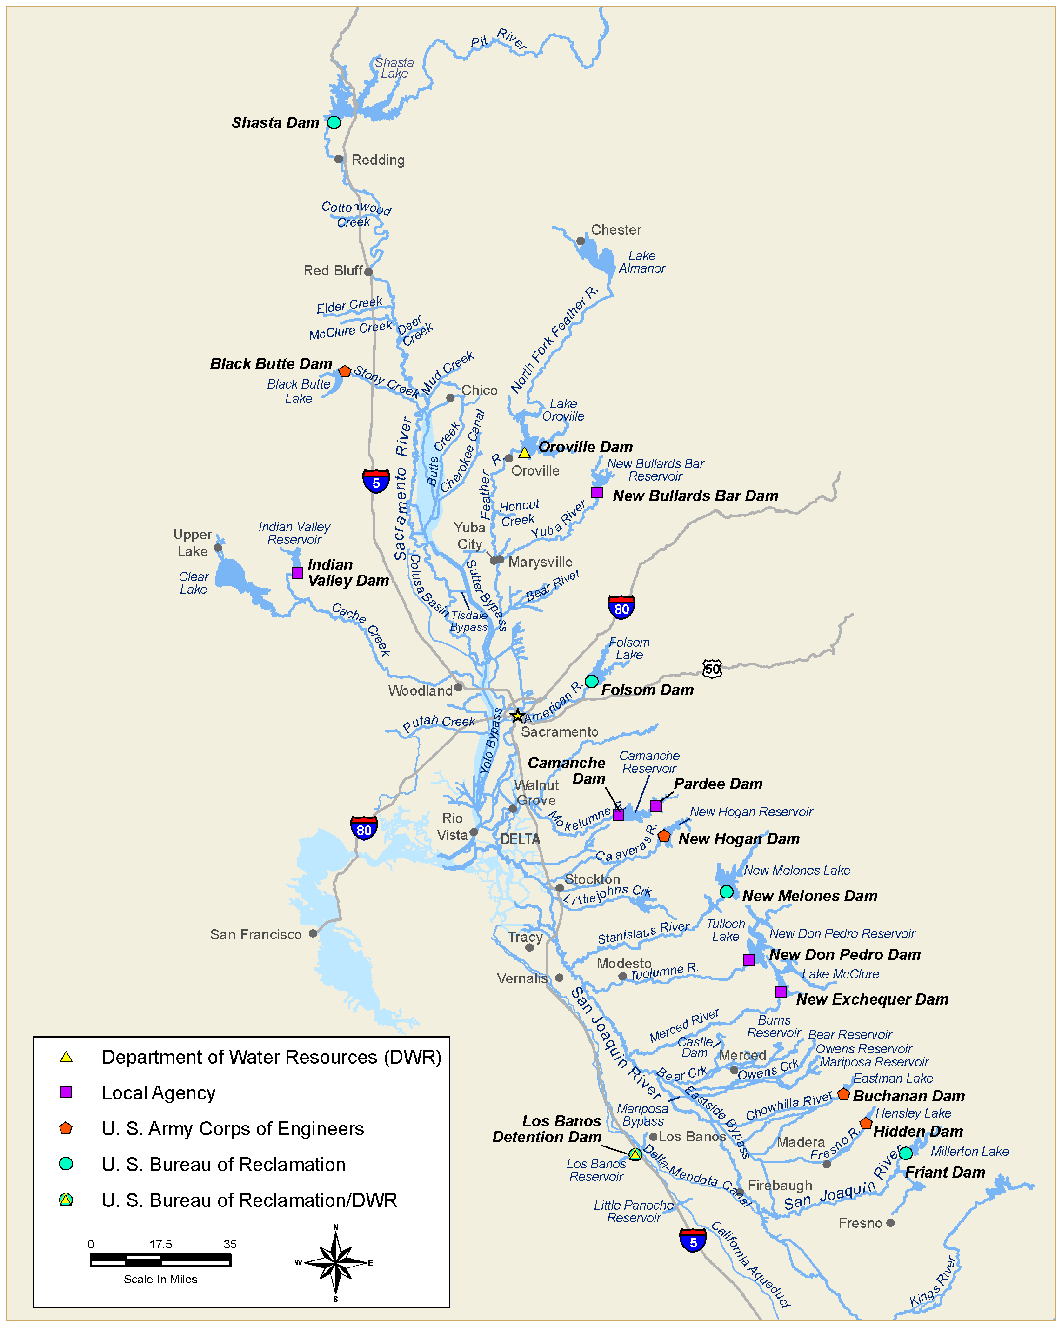
2012 CVFPP Quantitative Analysis
Pilot Study
  Proof of concept
  Question: Will the subsystem experience physical vulnerability for Oroville Dam under climate change conditions?
Notes:
Pilot Study
Assessed vulnerabilities of the Feather/Yuba River system under a range of scaled reservoir inflows (10% to 50%)
Atmospheric River analysis indicated that a 30% increase in intensity is not unreasonable for long-term planning purposes
Methodology useful for identifying vulnerability and prudent investments in flood management system
For example, we have seen that from physical vulnerability viewpoint,
The Oroville Dam may not be at risk under the CC and thus, we don’t need to completely shift the planning premise to dam safety or increase in storage
The Yuba system is more vulnerable and specifically, the release capacity of NBB dam could be the restrictive factor
The pilot study only on physical vulnerability, not social and economic vulnerabilities (such as what would make people and/or business to leave?)

Slide 8
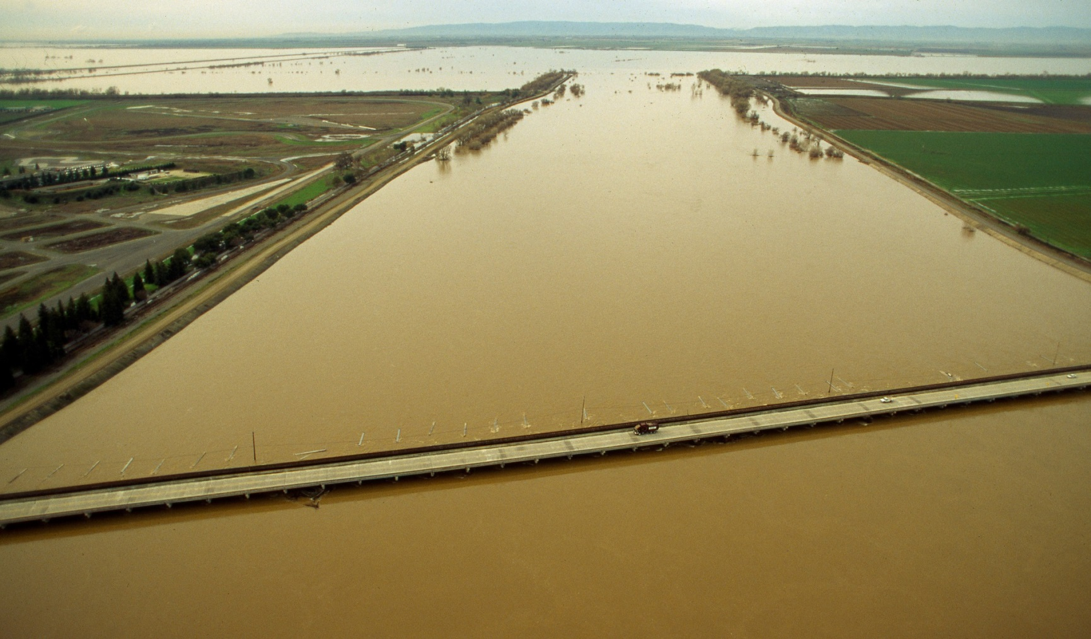
BWFS Climate Change Quantitative Analysis to Date
Notes:
Expanded on the methodology from the 2012 CVFPP pilot study for exploratory purposes
Modeled entire Sacramento River Basin for vulnerability evaluation
We could do the same as the pilot study with the full range of potential intensity change (from 0 to 50%); however, with a combination of budgetary, schedule, and intended purposes of this exploratory efforts, we completed a set of scenarios with 30% increase
Explored existing vulnerabilities within the system
Evaluated performance of several bypass system options
Included modifications to Sacramento Weir and Bypass and Fremont Weir

Slide 9
Looking Forward…
Advance research and application of knowledge of atmospheric rivers for the long-term vision
Use surrogate information to advance current planning process
Incorporate continued development of systemwide and regional planning findings, discussion, affordability, and other considerations
Include future updates in long-term CVFPB briefing schedule
Notes:
Will provide Board with continued updates
If the long term climate change analysis framework can not be completed on time, surrogates will be used
Extent of climate change adaptation actions will depend on:
Board and public input
Regional Planning Outcomes
Affordability
Region may use some pieces of the system elements for their ULOP needs; the Climate change adaptation is taken care of by the whole system elements.

Slide 10
Questions?

