Slide 1

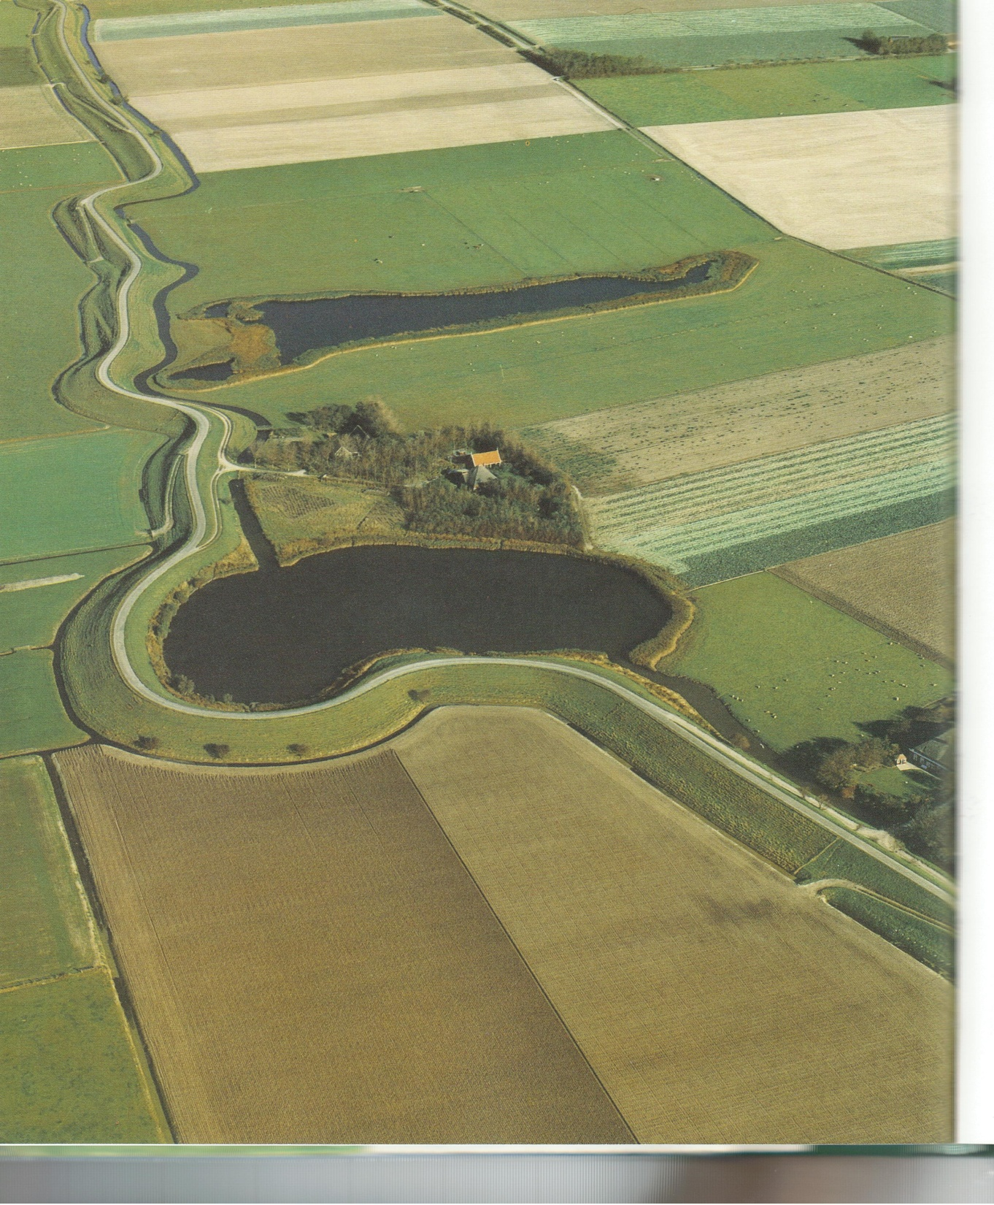
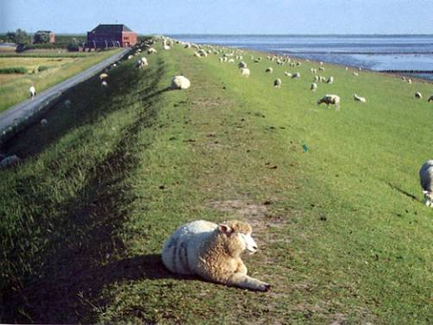
Fall 2012 DWR Inspection Data Translated to USACE Ratings
Presentation to CVFPB by:
Rachael Hersh-Burdick, PE
USACE – Sacramento District
July 12, 2013

Slide 2
Outline
Purpose
What is this translated data?
How translated data is helpful
  Leveraging resources
  Why does CA inspect levees?
  Aligning USACE and DWR inspection programs
  Ways we can leverage resources in the future
Next Steps
Request for CVFPB help

Slide 3
Purpose
Leverage limited local, state and Federal government resources
Allow USACE and LMAs to make even better use of the data that the CVFPB has tasked DWR to collect during their inspections
Fall 2012 DWR translated data is for informational purposes only

Slide 4
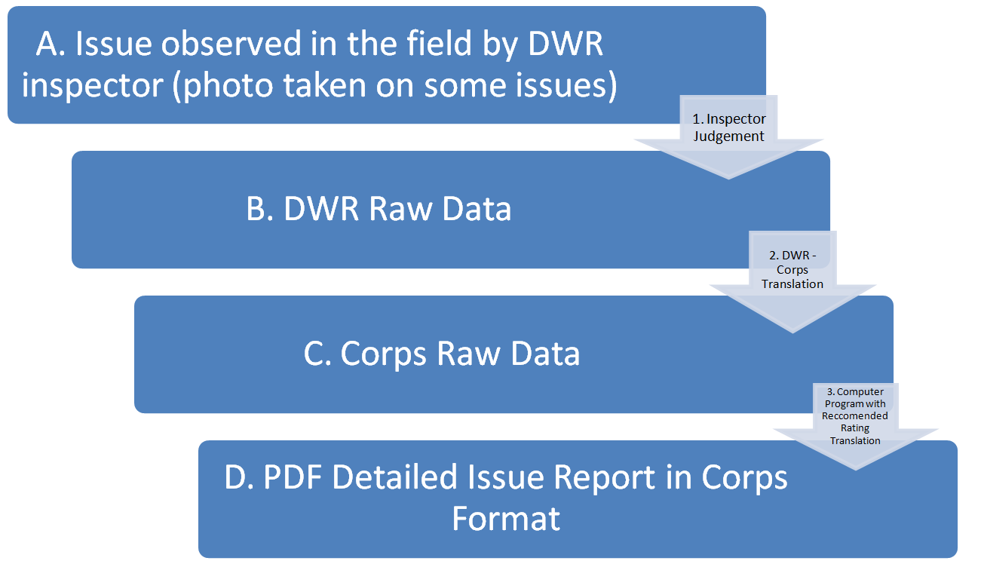
What is this translated data?

Slide 5
Translated Data Sent To CVFPB:
Photo report: all yellow issues *
Photo report: all red issues *
Photo report: all issues
The complete translated .mdb file
5) Photo reports: generated by segment
6) Excel spreadsheet: summarizes all ratings *
* Sample printed

Slide 6
Leveraging Resources
USACE Sacramento District has approx. 1800 miles of levee in the RIP
DWR inspects approx.1600 miles of levees

Slide 7
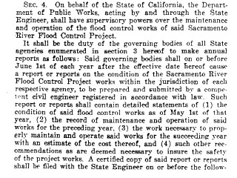
Why does CA inspect levees?
1917 – Original Flood Control Act established CVFPB’s need to inspect
1939 - Corps requested the State of California be responsible for inspection.
1939 – State Law
1952 – SPK Memo to SPD on why State inspects and SPK does “spot checks”
1953 – MOU between USACE and CVFPB
1939 State Law requiring the State Inspect
[Modified from slide presented by Meegan Nagy to HQ June 2010]
Notes:
It shall be the duty of, and the governing bodies of all state agencies, enumerated in Section 3 hereof, shall, on or before June 1st of each year after the effective date hereof, cause a report or reports on the condition of the Sacramento River Flood Control Project works within the jurisdiction of each respective agency prepared and submitted by a competent civil engineer, registered in accordance with law. Such report of reports shall contain a detailed statement of the conditions of said flood control works, the maintenance and operation thereof, and the work necessary to properly maintain and operate said works for the succeeding year with an estimate of the cost thereof and such other recommendations as may seem proper to insure the safety of said project works…”

Slide 8
Why align USACE and DWR inspection programs?
Facilitate DWR QC (by back checking with USACE inspections)
Facilitate USACE QA of DWR data
Facilitate communication with maintainers
  Consistent messages
  Help them know what to expect on PIs and CEIs
Color coding facilitates action by CVFPB

Slide 9
Potential Leveraging Resources
DWR Inspects
USACE Translates DWR data to USACE ratings
CVFPB informs LMAs of DWR Translated Data so they can:
- Prepare for USACE inspections
- Prioritize maintenance activities
USACE pre-loads DWR data before inspecting segment
USACE analyses DWR translated data (coordinating with CVFPB assigned staff??) to inform and improve USACE (and DWR??) inspections
CVFPB assigns someone to review these reports and provide feedback to USACE to improve the translation for the future (??)

Slide 10
Next Steps
CVFPB / DWR review results
Data to LMA partners
Forum to discuss data with LMA partners
USACE QA of data
  Discrepancies
  Comparison with USACE inspection results
  Report card comparison

Slide 11
Request for Help From CVFPB
Will CVFPB assign someone to review these reports and provide feedback to USACE? If yes, when will they plan to submit their feedback to USACE?
How will CVFPB convey this data to the LMA partners? When? Electronic vs hardcopy?
When will there be a forum where this data can be presented and discussed with the LMAs?

Slide 12

Questions / Comments
Contact:
Rachael Hersh-Burdick
Rachael.Hersh-Burdick@usace.army.mil

