Slide 1
DWR’s Involvement in Flood Risk Notification
Central Valley Flood Protection Board
August 9, 2013
Presented by:
Michael Mierzwa
California Department of Water Resources

Slide 2
DWR Briefs the Board
Past Presentations
Proposed Urban Level of Flood Protection Criteria 2012 Inspection and Local Maintaining Agency Report Central Valley Floodplain Evaluation and Delineation Program Regional Flood Management Planning activities (Kim Floyd) Folsom Dam Modification Project update California’s Flood Future Report Basin-Wide Feasibility Study Progress Update Periodic Inspections Results Atmospheric River-Based Design Storm for Flood Planning Central Valley Integrated Flood Management Study and Proposed Feasibility Cost Sharing Agreement Amendment (Board, USACE, DWR)

Slide 3
DWR Briefs the Board
Today’s Presentation
DWR’s Involvement in Flood Risk Notification
Future Presentations
Flood system hydrology and hydraulics update Mapping activities and notification Pre-season readiness briefings Flood system O&M: Flood system preparedness evaluation Permitting approaches Annual inspection/LMA reporting FloodSAFE Annual Accomplishments Central Valley Flood Protection Plan Update Flood system O&M: Rehabilitation and structural replacement

Slide 4
Flood Risk Awareness Programs
California Flood Preparedness Week
High Water Mark Initiative
DWR’s Flood Risk Notification
National Flood Insurance Program
Community Rating System
Local Notification Efforts

Slide 5
California Flood Preparedness Week
November 4-9, 2013
Social media campaign
Flood preparedness website
High Water Mark Initiative kick-off
Flood fight training
Cal OES preparedness event
Local safety fairs
Sacramento County media campaign
Flood Preparedness Website:
www.water.ca.gov/floodsafe/ca-flood-preparedness/fpw_home.cfm

Slide 6
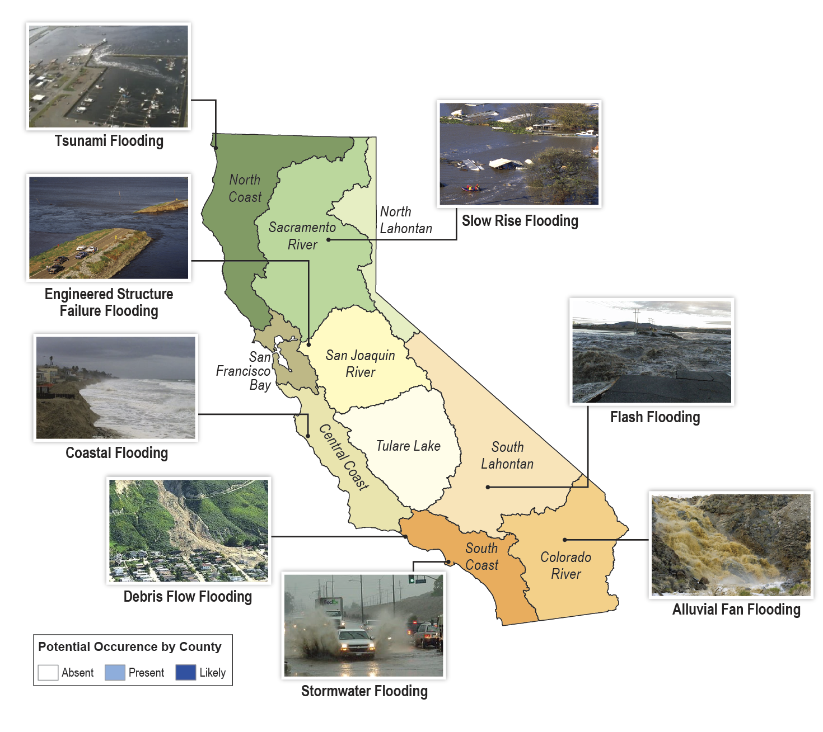
Types of Flooding in California

Slide 7
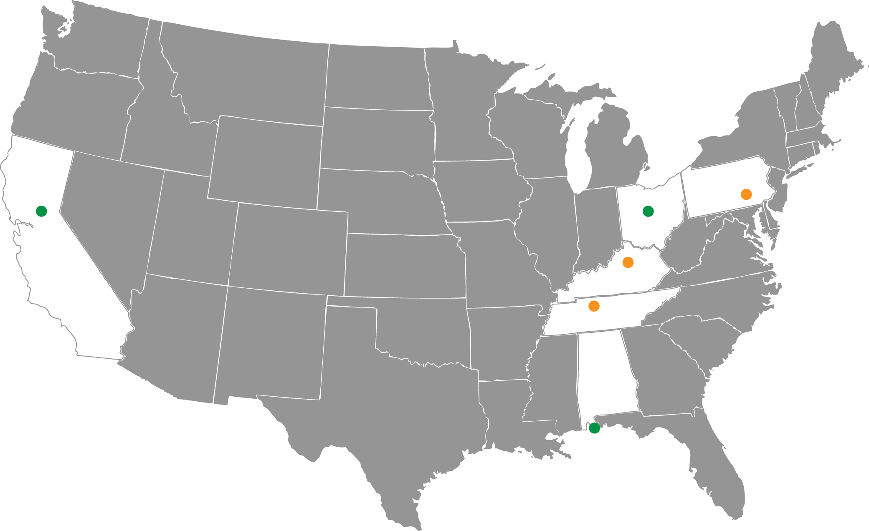
High Water Mark Initiative
“Know Your Line: Be Flood Aware” initiative developed to:
Improve the public’s awareness of flood risk
Encourage them to take action to reduce it.
Roseville
Sacramento
Participating Federal Agencies
FEMA | U.S. Department of Agriculture, Natural Resources Conservation Service
National Oceanic and Atmospheric Administration | U.S. Department of Housing and Urban Development
National Park Service | U.S. Geological Survey
U.S. Army Corps of Engineers | U.S. Small Business Administration
Notes:
Orange dots=existing projects; green=future rollout
To date, three pilot projects have been launched in Frankfort and Franklin County, KY, Harrisburg, PA,
and Nashville, TN, with two additional pilots planned for Orange Beach, AL and Columbus, OH.
A national rollout of the initiative is planned for fall 2013, which will open enrollment to all interested communities
nationwide.
(source: Silver Jackets newsletter, July 2013, pg. 3
From FEMA website:
FEMA and seven other federal agencies developed the “Know Your Line: Be Flood Aware” initiative to improve the public’s awareness of flood risk and encourage them to take action to reduce it. The initiative helps communities showcase their local flooding history and motivate their residents to take action by posting high water mark signs in prominent places to show how high flood waters have risen in the past.
Communities are encouraged to hold a high profile event to announce the initiative, followed by supporting outreach to remind residents of their flood risk over time and prompt them to take steps to reduce it.
Flexible Tools and Materials
FEMA and its partners developed tools, templates, and other materials that communities can customize to launch their own Know Your Line initiative. This flexibility allows communities to choose materials and outreach tactics that work best for them.
Benefits of Community Participation
Communities that launch their own Know Your Line initiative:
Underscore their commitment to the well-being of residents and the local business community
Galvanize their community to take steps now to reduce the often devastating impact of floods
Can receive Community Rating System Rating (CRS) points to reduce the cost of flood insurance
Can put existing applicable Federal and state mitigation assistance funds to work
Participating Federal Agencies
FEMA
National Oceanic and Atmospheric Administration
National Park Service
U.S. Army Corps of Engineers
U.S. Department of Agriculture, Natural Resources Conservation Service
U.S. Department of Housing and Urban Development
U.S. Geological Survey
U.S. Small Business Administration
Last Updated: 07/12/2013 - 12:14

Slide 8
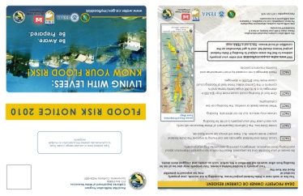
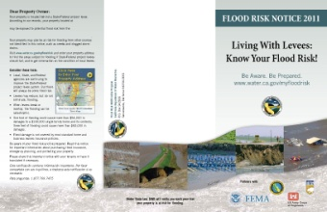
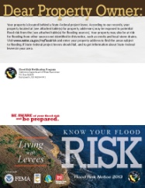
DWR’s Flood Risk Notification
2011
2013
2010
2012

Slide 9
FRN: Making it Real
For more information: www.water.ca.gov/myfloodrisk

Slide 10
NFIP in California
National Flood Insurance Program (NFIP):
Administered by the Federal Emergency Management Agency
Property owners in participating communities can purchase insurance
525 NFIP (approximately 99 percent) participating communities in California
255,378 flood insurance policies (4th largest policy count nationwide)

Slide 11
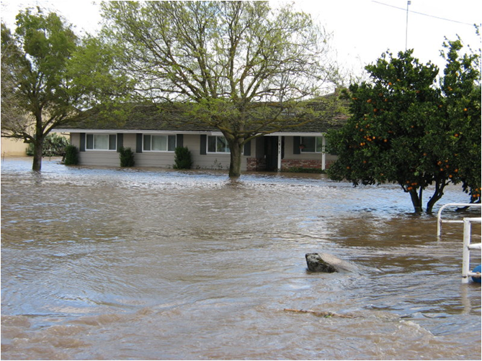
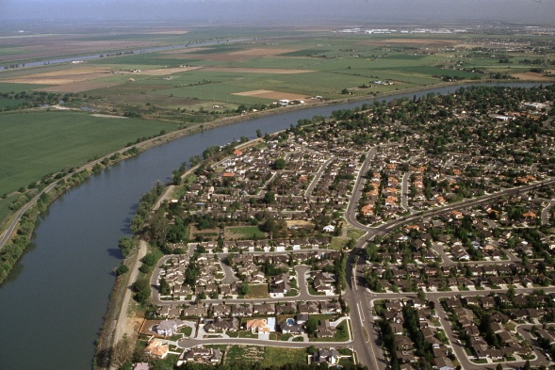
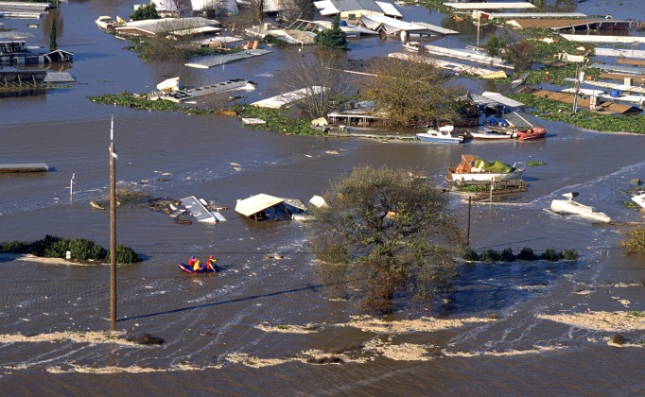
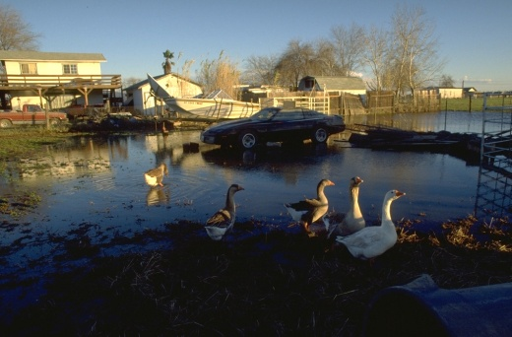
NFIP in California: Flood Facts
Nearly $500 million paid to 44,820 flood insurance claims since 1978 (California)
190,000 parcels are protected by Central Valley levees
96,000 NFIP policies protected by project levees
Approximately 53% of parcels in Central Valley currently covered by flood insurance

Slide 12
CRS Premium Discounts
Class | Points | Premium Reduction SFHA | Premium Reduction Non-SFHA**
1 | 4,500+ | 45% | 10%
2 | 4,000-4,499 | 40% | 10%
3 | 3,500-3,999 | 35% | 10%
4 | 3,000-3,499 | 30% | 10%
5 | 2,500-2,999 | 25% | 10%
6 | 2,000-2,499 | 20% | 10%
7 | 1,500-1,999 | 15% | 5%
8 | 1,000-1,499 | 10% | 5%
9 | 500-999 | 5% | 5%
10 | 0-499 | 0 | 0
*Special Flood Hazard Area **Preferred Risk Policies are available only in B, C, and X Zones for properties that are shown to have a minimal risk of flood damage. The Preferred Risk Policy does not receive premium rate credits under the CRS because it already has a lower premium than other policies. The CRS credit for AR and A99 Zones are based on non-Special Flood Hazard Areas (non-SFHAs) (B, C, and X Zones). Credits are: classes 1-6, 10% and classes 7-9, 5%. Premium reductions are subject to change.

Slide 13
Overview of Community Rating System
Goals of the CRS:
Reduce flood damage to insurable property;
Strengthen and support the insurance aspects of the NFIP, and
Encourage a comprehensive approach to floodplain management.
California: 86 CRS communities
As of August 2, 2013
City of Sacramento
Roseville
Sacramento Co.
Class

Slide 14
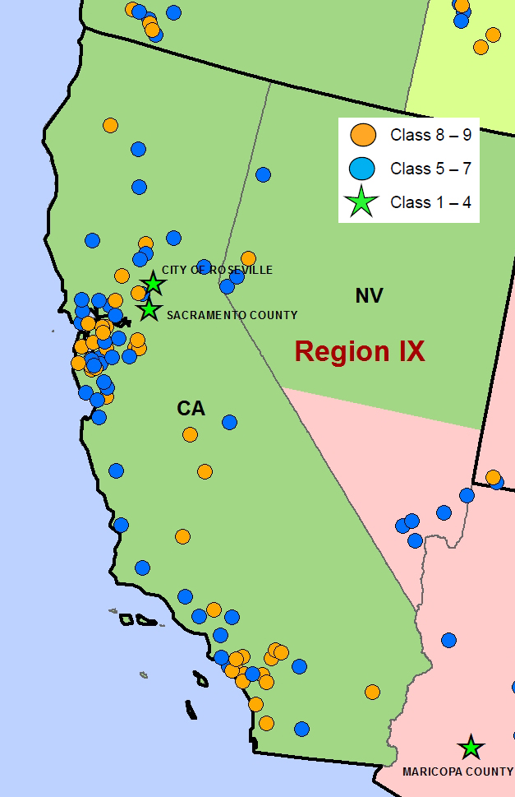
CRS Covers:
16% of the state’s NFIP communities
67% of the state’s NFIP policies
Concentrations:
Bay Area
Southern California
Southern California Users Group

Slide 15
CRS Benefits: Sacramento and Roseville
 | City of Sacramento | City of Roseville
Number of policies (as of 8/2/13) | 46,758 | 356
Annual premiums paid | $23,565,964 (after 25% discount) | $215,864 (after 45% discount)
Every 5% premium adjustment saves policy holders a total of | $1,119,917 | $92,339
Class and reduction (savings) | Class 5 qualifies for 25% reduction ($5,599,585 annually) | Class 1 qualifies for 45% reduction ($831,051 annually)

Slide 16
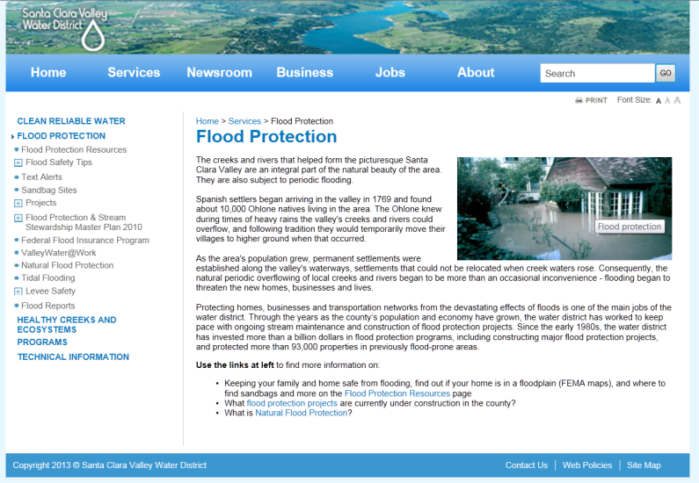
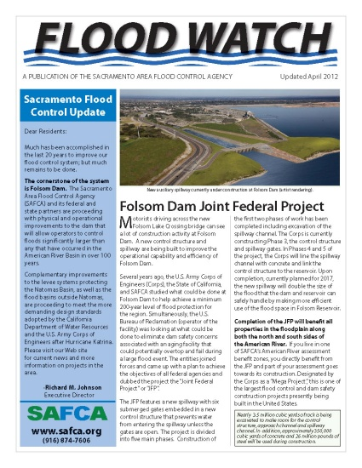
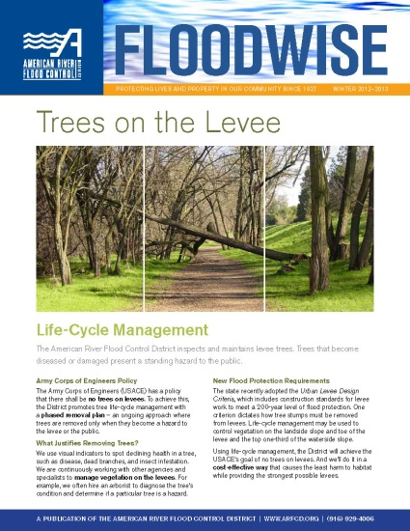
Examples of Local Notification Efforts
Mailers
Newsletters
Texting flood alerts
Websites
Sources: American River Flood Control District, City of Sacramento, SAFCA, Sacramento County, Santa Clara Valley Water District

Slide 17
Contacts
Program | Contact Name | Email and Phone Number
Chief, FloodSAFE Program Management Office | Michael Mierzwa | Michael.Mierzwa@water.ca.gov 916-574-0645
California Flood Preparedness Week and High Water Mark Initiative | Maria Lorenzo-Lee | Maria.Lorenzo-Lee@water.ca.gov 916-574-0625
DWR’s Community Rating System Coordinator | Jim Eto | Jim.Eto@water.ca.gov 916-574-1409
Flood Risk Notification Program | Christina Kuo | Christina.Kuo@water.ca.gov 916-574-1414

