Slide 1
CVFPB Meeting July 26, 2013 USACE INSPECTION RESULTS Ryan Larson, P.E.

Slide 2
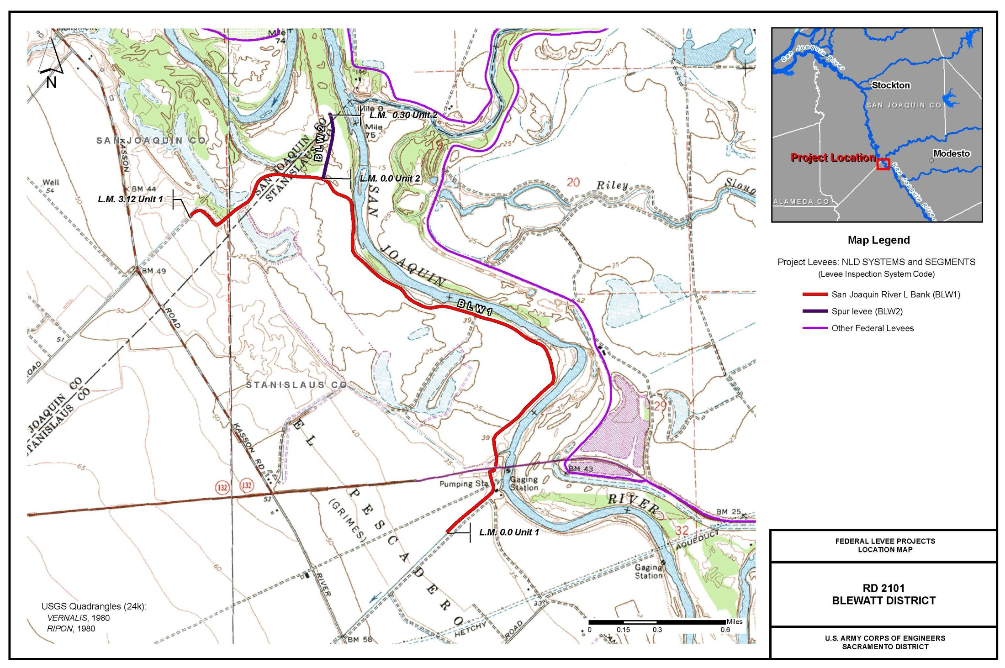
RD 2101 – Blewatt District

Slide 3
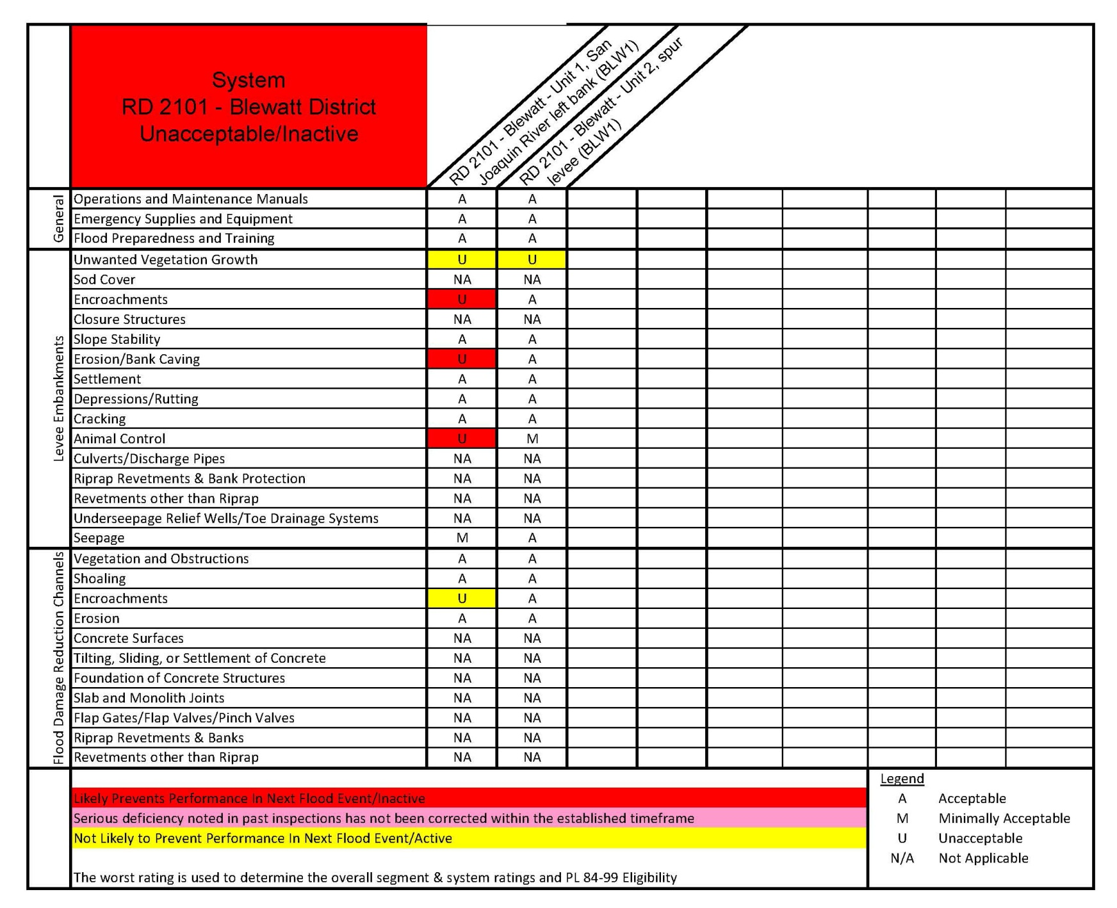

Slide 4
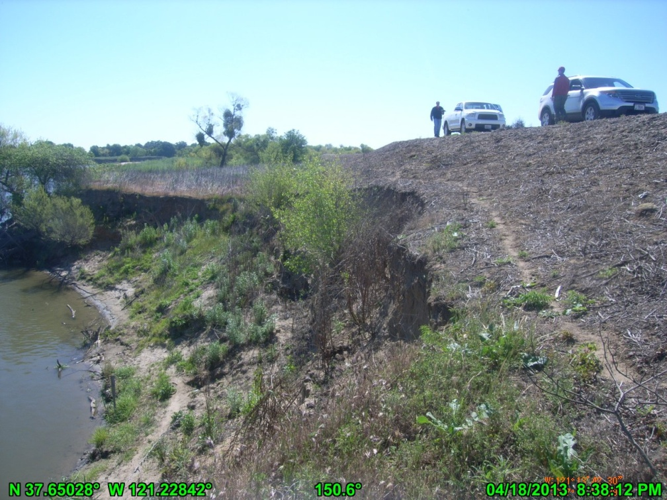
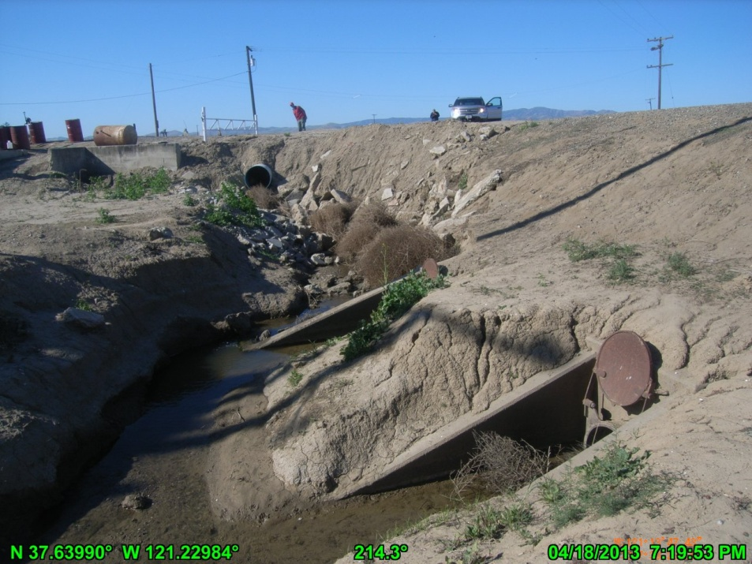
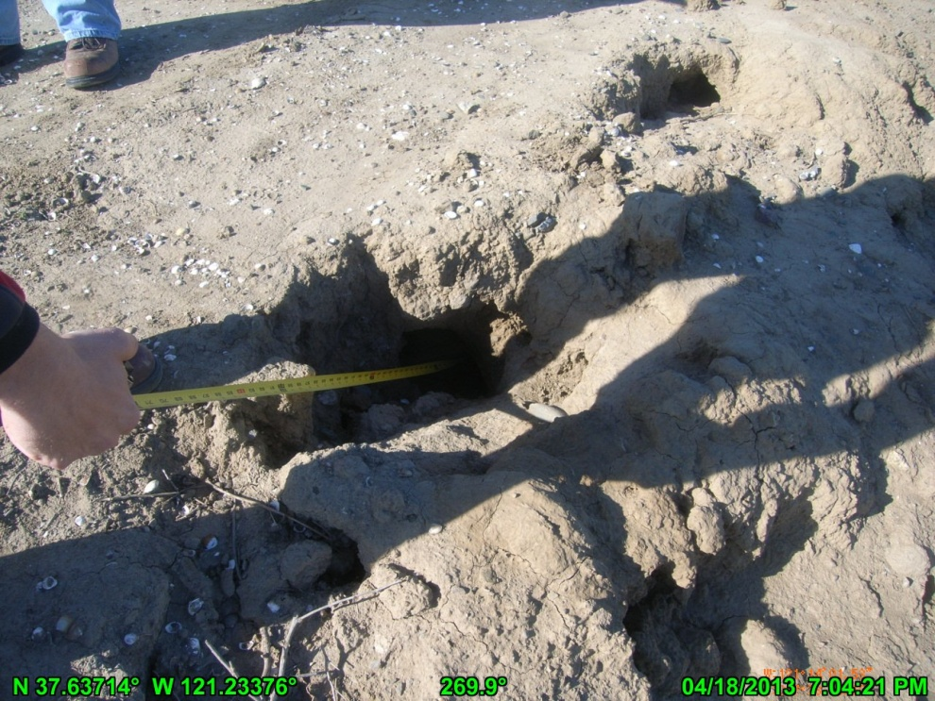
Notes:
Top Left: Erosion greater than 2 feet into levee prism. Approximately 120 feet long.
Top Right: 2 pipes thru levee. No positive closure devices. Flap gates stuck in open position.
Bottom: Rodent holes on both sides of levee. Up to 3’ deep and 2” wide.

Slide 5
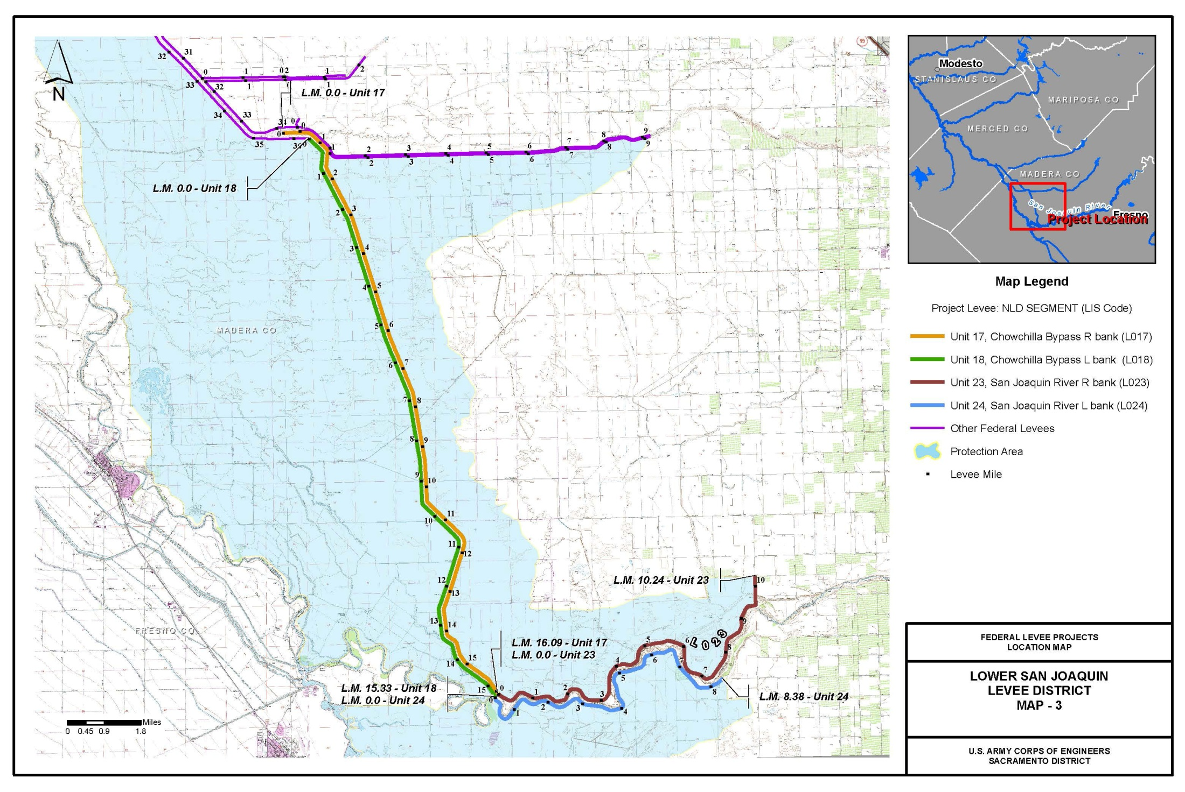
LSJLD – Unit 24

Slide 6
