Slide 1
Sutter Bypass Two-Dimensional (2D) Hydraulic Model
Informational Briefing
Presented By Board Staff and CH2MHill Consultants
Model Funded by CVFPB, DWR, USF&WS
March 22, 2013

Slide 2
Key Points to Discuss
Board Resolutions in 2008 and 2009 established initial goals
Analysis of carrying capacity of the “1957 design flow”
What capacity existed in 1950’s?
What capacity exists today?
Impact of the Sutter National Wildlife Refuge (SNWR) on capacity
Model type, geographic extent, boundary conditions
Development, calibration and verification
Initial conveyance and freeboard results for “1957 design” flows
How has available freeboard at 1957 flows changed since the 1950s?
Sensitivity runs demonstrate capabilities for CVFPP Regional and Basinwide planning analyses
Final reviews to publish a User Manual, Final Report, and Technical Memo
Turnover to DWR FloodSAFE Library of Models

Slide 3
Board Directions / Model Objectives
Resolution 2008-19:
Work with DWR and USACE to develop model to ascertain impacts of vegetation and structures on carrying capacity
Confer with DWR and USACE to determine applicable design flows
Resolution 2009-11:
Coordinate with DWR, USACE and USFWS to assess effect of SNWR on carrying capacity
Determine if stated goals of flood management and stakeholder interests are achievable in the Bypass
How does vegetation impact capacity?
Do bridges and other structures impact capacity?
Are there areas of compromised flood protection? If so what?

Slide 4
Project Development / Study Area
Hired CH2M HILL consultants
Assisted by MBK Engineers
Peer reviewed by David Ford Engineers
Use RMA2 2D model (USACE)
Calibrated to 2006 event
Verified against 1997 event
Evaluate capacity for a range of design conditions
1957 design profile
O&M manual flows
100-year event
200-year event
Conduct sensitivity runs to determine capabilities to evaluate a variety of potential management practices and remedial measures
Sutter Buttes
Yuba City
SR 20 Bridge
Feather River
Sacramento River at Fremont Weir
LOWER LIMITS
YOLO BYPASS

Slide 5
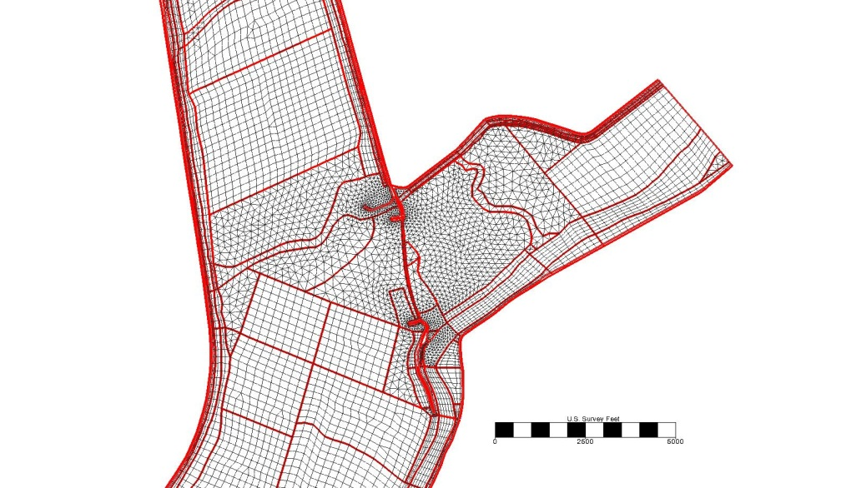
Model Details (CH2M)
Surface represented by a grid
Over 43,000 elements
Average size 1/2 acre (about 150 x 150 square feet)
Each element assigned unique characteristics
Ground cover/land use (assigned to unique friction “n” values)
Current elevation data based on 2010-11 CVFED LiDAR surveys (accuracy of +/- 0.3 feet)
Can modify element characteristics to evaluate change in land use, vegetation type, elevation, etc.

Slide 6
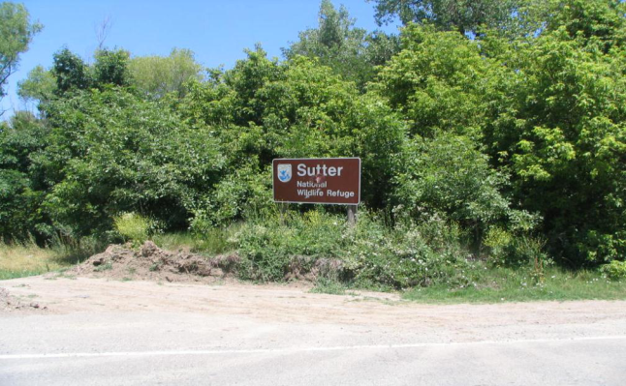
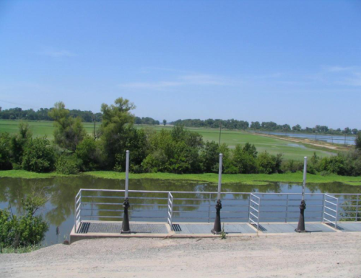
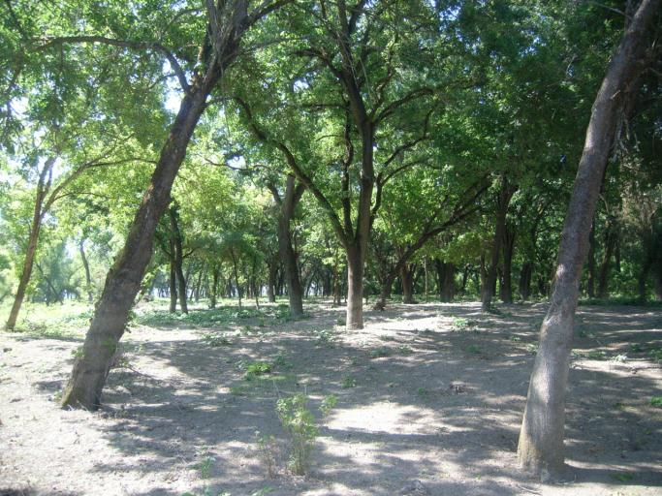
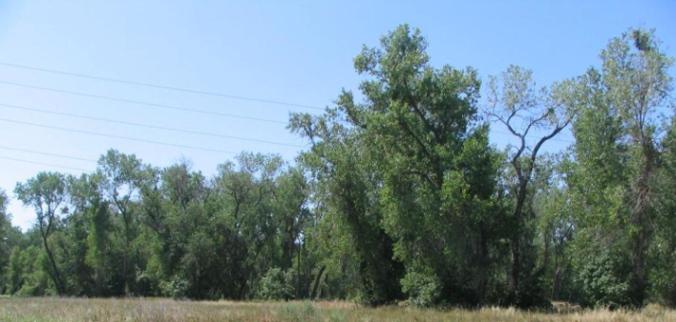
RMA2 Model Answers Complex Questions (1/3)
Allows us to simulate impacts of vegetation, land forms and structures in considerable detail

Slide 7
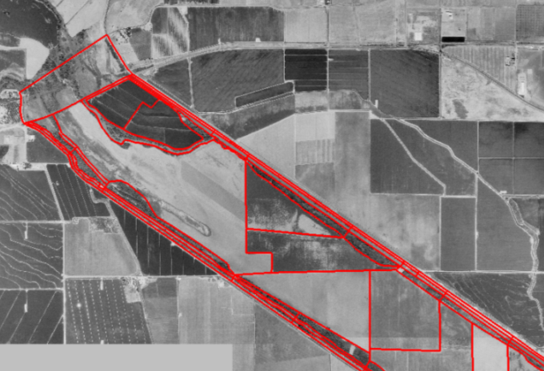
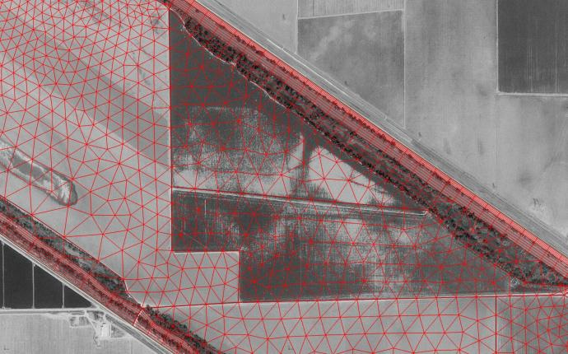
RMA2 Model Answers Complex Questions (2/3)
Allows us to simulate impacts of vegetation, land forms and structures in considerable detail
Model resolution allows assignment of site-specific features to determine localized impacts

Slide 8
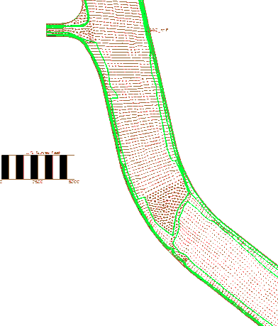
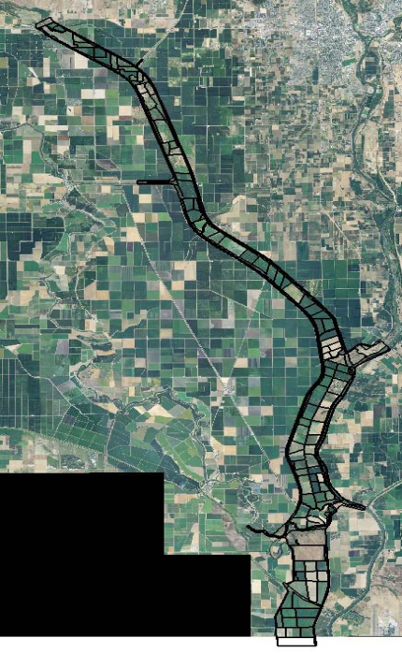
The Model Provides an Important Tool
Once delivered to DWR’s FloodSAFE Library of Models, it will provide a common platform to support the Basin-wide and Regional planning studies for the 2017 CVFPP update
Assess impacts of potential management actions including changes in land use, vegetation type and pattern, sediment removal, structural changes, etc.
Assess impacts of future maintenance practices
Determine if existing top of levee profiles are sufficient to achieve current and future design standards

Slide 9
Flow Comparison

Slide 10
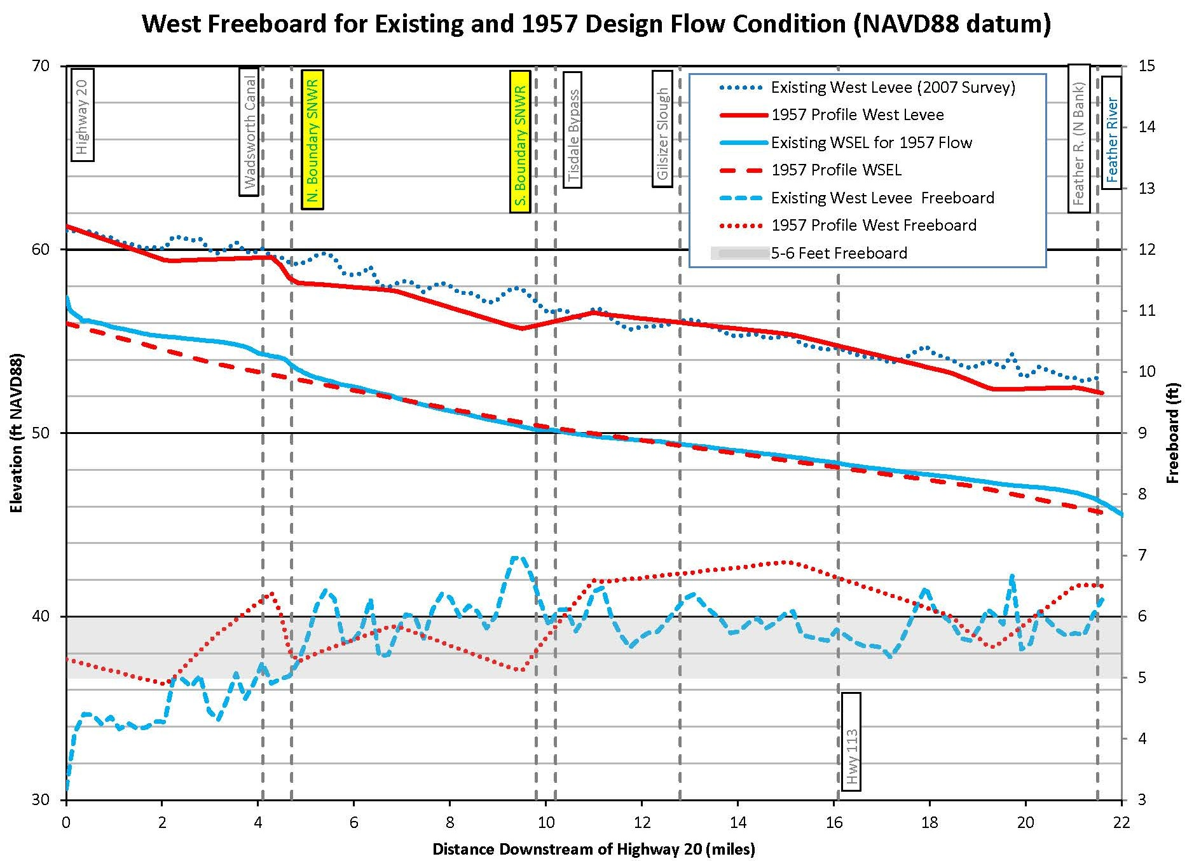
West Levee Freeboard Profiles (1957 design flow)
(2010 land use)
SNWR

Slide 11
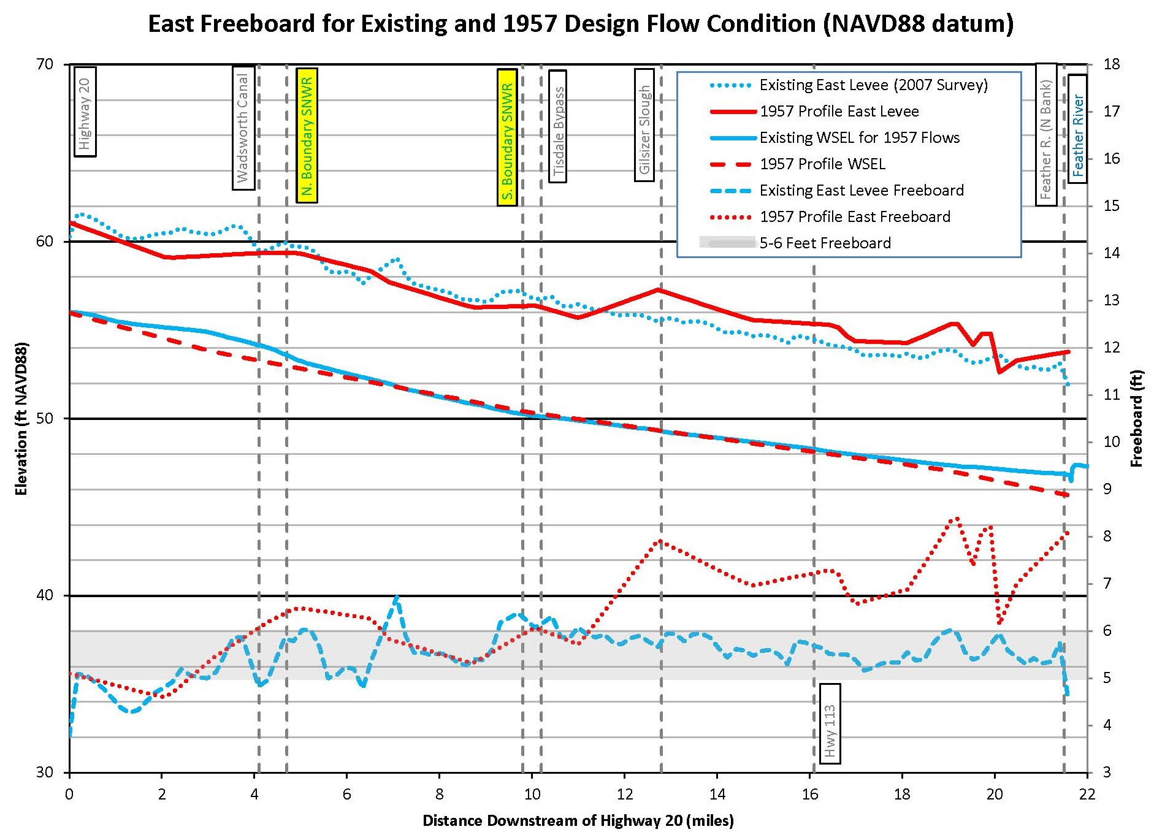
East Levee Freeboard Profiles (1957 design flow)
(2010 land use)
SNWR

Slide 12
Areas of Freeboard < 5 feet with 1957 flows and 1950’s Top of Levee (design) profiles

Slide 13
Areas of Freeboard < 5 feet with 1957 flows and 2007 Top of Levee (DWR Survey) profile

Slide 14
Areas of Freeboard < 6 feet with 1957 flows and 1950’s Top of Levee (design) profiles

Slide 15
Areas of Freeboard < 6 feet with 1957 flows and 2007 Top of Levee (DWR Survey) profile

Slide 16
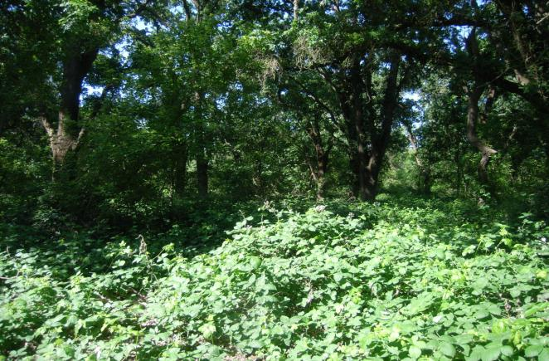
Multiple Sensitivity Runs Conducted
Three Initial Vegetation Scenarios
2006 vegetation (baseline)
2010-11 vegetation after thinning of 25 acres in the SNWR (existing conditions)
Fully vegetated condition (120 % of baseline “n” values)
A range of conditions representing various maintenance and management activities were simulated to determine model capabilities

Slide 17
Sensitivity Run - Extensive Vegetation Management
(2006 Land Use) with Vegetation Management
SNWR
3.2 feet max. reduction in WSEL.

Slide 18
Sensitivity Run - Moderate Vegetation Management
(2010 Land Use) with Vegetation Management
SNWR
0.75 feet max reduction in WSEL

Slide 19
Sensitivity of Moderate Sediment Removal
(2010 Land Use) with Sediment Removal
SNWR
(2010 Land Use) with Sediment Removal
0.19 feet max reduction in WSEL.

Slide 20
Conversion of SNWR to Ag use
SNWR
1.5 feet max reduction in WSEL.

Slide 21
Summary and Next Steps
A robust model has been developed
Capable of evaluating changes in land use, vegetation type, sediment removal, levee and channel alignment, location and size of structures
Model results indicate that flows equivalent to the 1957 design WSEL can be conveyed by the Bypass without overtopping, but with less than the original design target of 5 to 6 feet of freeboard
Board staff will deliver the model and a final report, technical memo, and user guide to DWR’s FloodSAFE Library of Models for use by agencies, organizations and consultants
Board staff will also make documentation available on our website
Model will support the Basin wide and Regional flood planning processes to support the 2017 Central Valley Flood Protection Plan update
Board staff will inform Bypass landowners regarding the Board’s existing flowage easements

Slide 22
Questions & Discussion
Electronic copies of the Report and User Guide will soon be available via our website
Board Staff
Dr. Sungho Lee, Engineer, Water Resources
(916) 574-2384, sungho.lee@water.ca.gov
David Williams, PE, Project Section Chief
(916) 574-2379, david.r.williams@water.ca.gov
Eric Butler, PE, Projects and Environmental Branch Chief
(916) 574-0707, eric.butler@water.ca.gov
CH2M Hill
Mark Glidden, PE
(720) 286-5135, mark.glidden@ch2m.com

