Slide 1
Small Erosion Repair Program
(SERP)
Keith Swanson
Flood Maintenance Office
Department of Water Resources

Slide 2
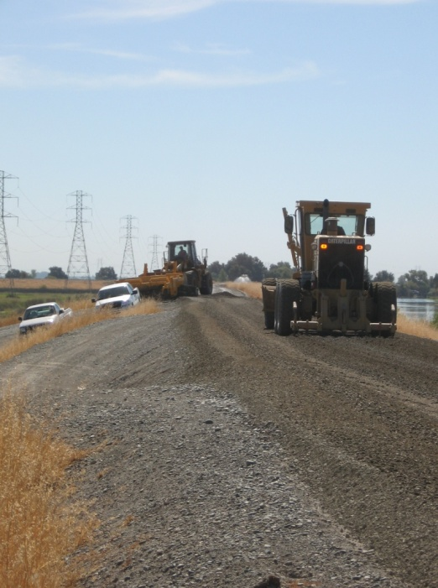
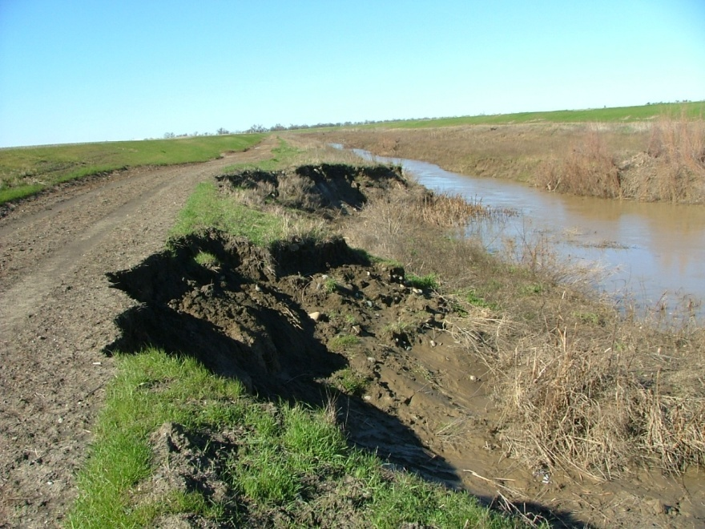
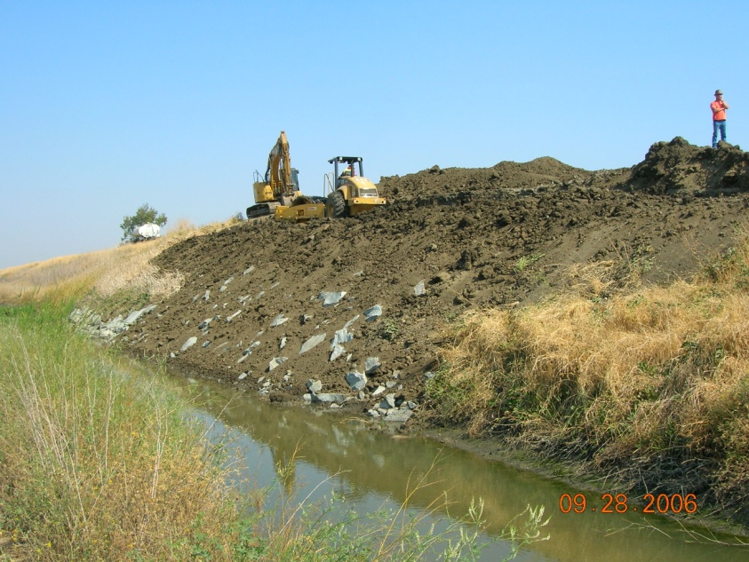
DELIVERING LEVEE MAINTENANCE
FOR PUBLIC SAFETY

Slide 3
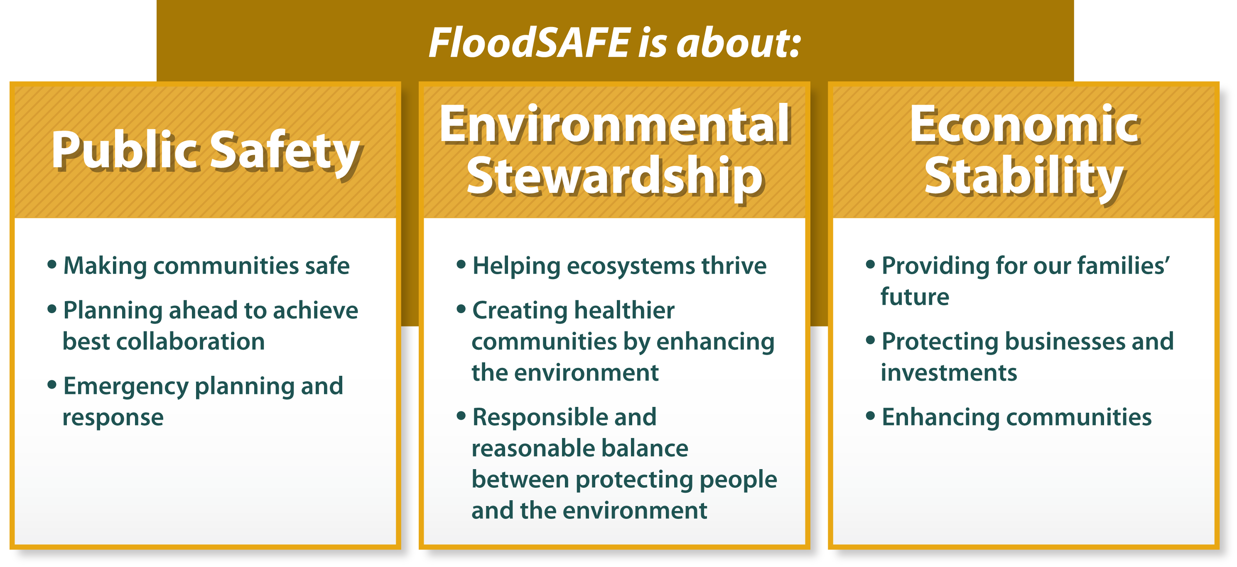
SERP is on the Forefront !

Slide 4

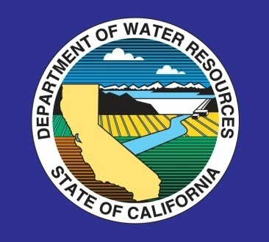


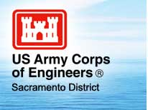


Small Erosion Repair Program
Interagency Flood Management Collaborative Group
Notes:
Interagency Flood management Collaborative Group is a group of Federal and State regulatory and resource agencies that discuss flood issues and try to find solution on how to deal with them. SERP subcommittee formed under the direction of the Interagency Flood Management Collaborative Group. The SERP subcommittee has a representative from each of the Collaborative Group agencies for representation. charged with what defines a small erosion repair and determine what appropriate repair designs would adequately protect the levee system while avoiding substantial adverse effects on environmental resources.

Slide 5
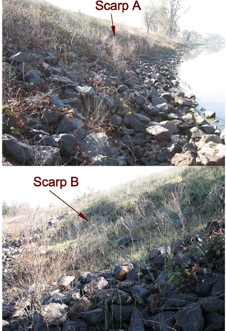
Small Erosion Repair Program
SERP PROGRAM
Proactive Collaboration to Develop Programmatic ‘PILOT’ Program
5-year Program: DWR-Maintained Levees
15 Maintenance Erosion Repairs Annually
Potential for Expansion to other LMAs

Slide 6
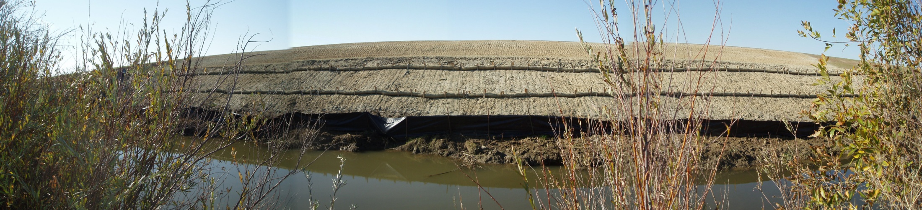
Small Erosion Repair Program
EXPEDITING THE PERMITTING PROCESS
Pre-defined Small Erosion Sites (size/type)
Standardized Field Assessment/Notification
Standardized Review Process
Standardized Guidance Design Templates
Opt Out at Any Time

Slide 7
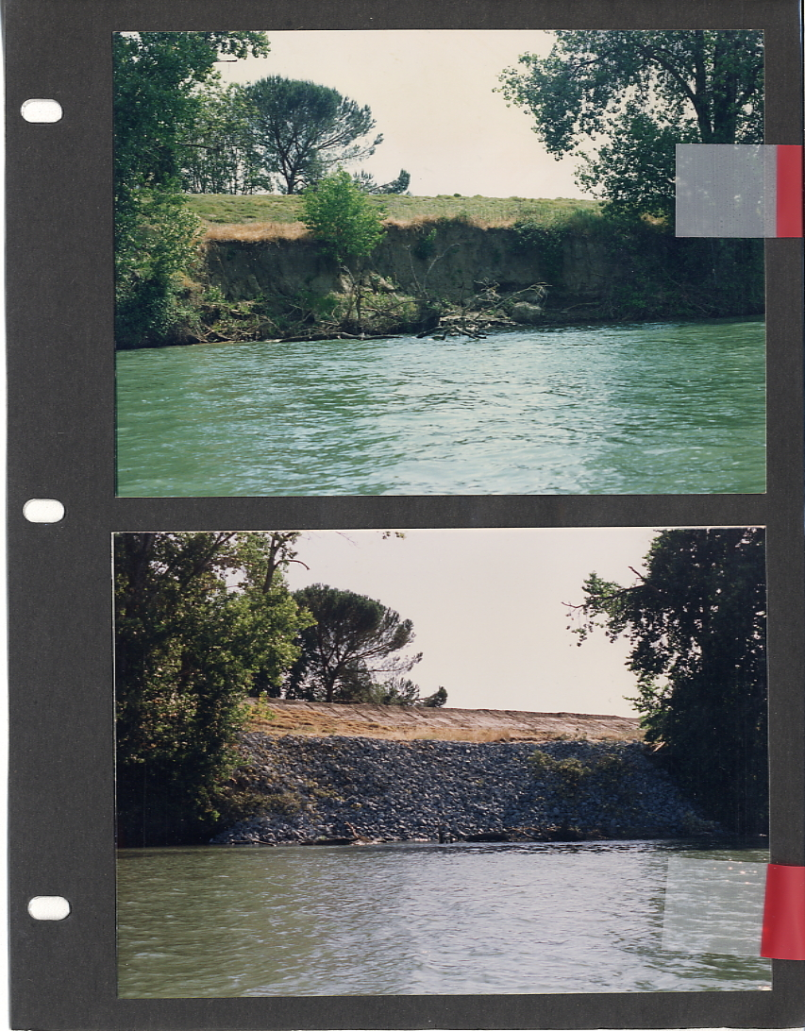
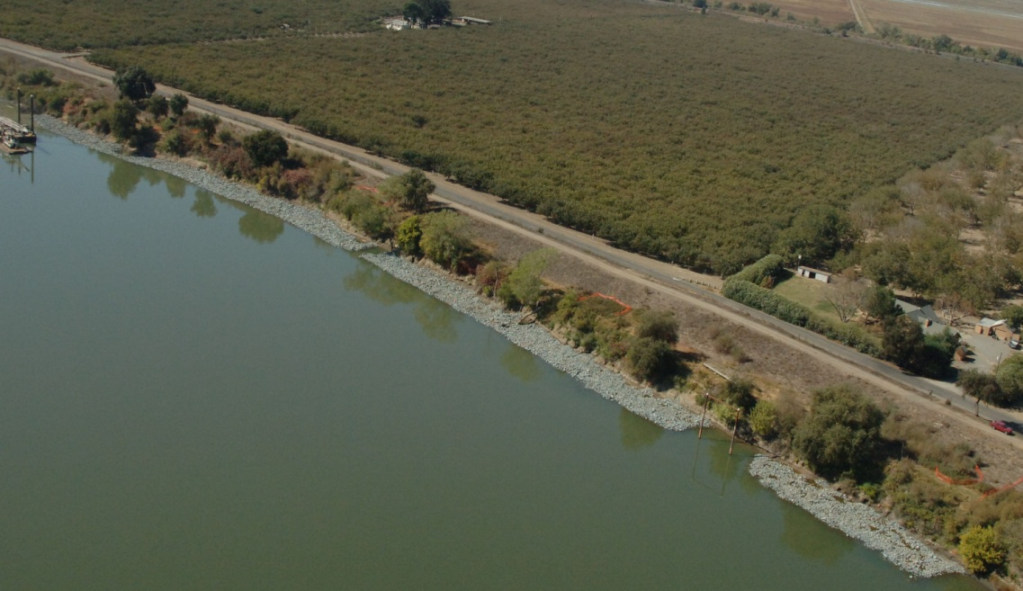
Small Erosion Repair Program
KEY PROGRAM BENEFITS/ADVANTAGES
(Public Safety/Environmental Stewardship)
Reduce Number of Large Scale Repairs ($6,000 per linear foot)
Preventing Escalating Loss of Existing Vegetation
Small Maintenance Erosion Sites
Becoming Large Scale Repairs

Slide 8
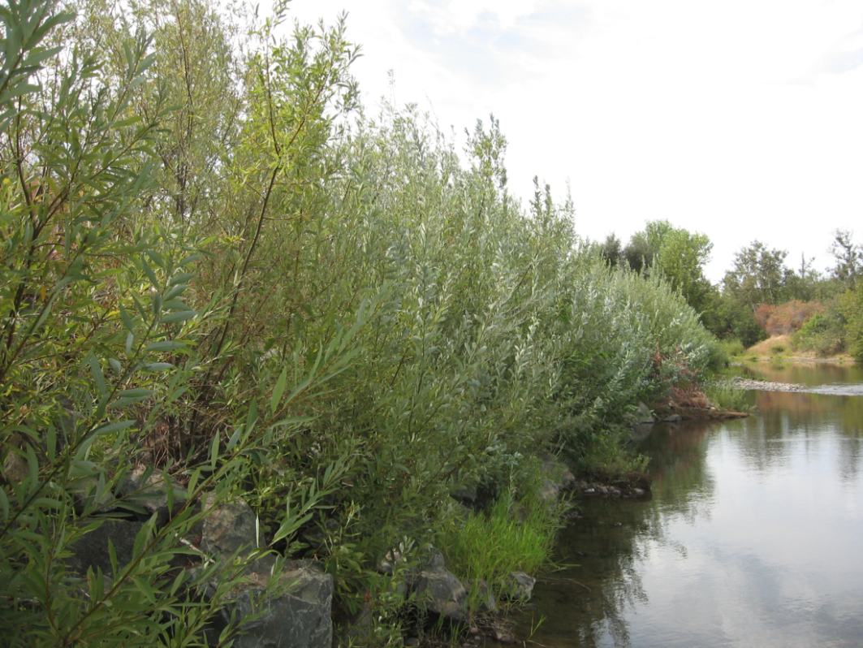
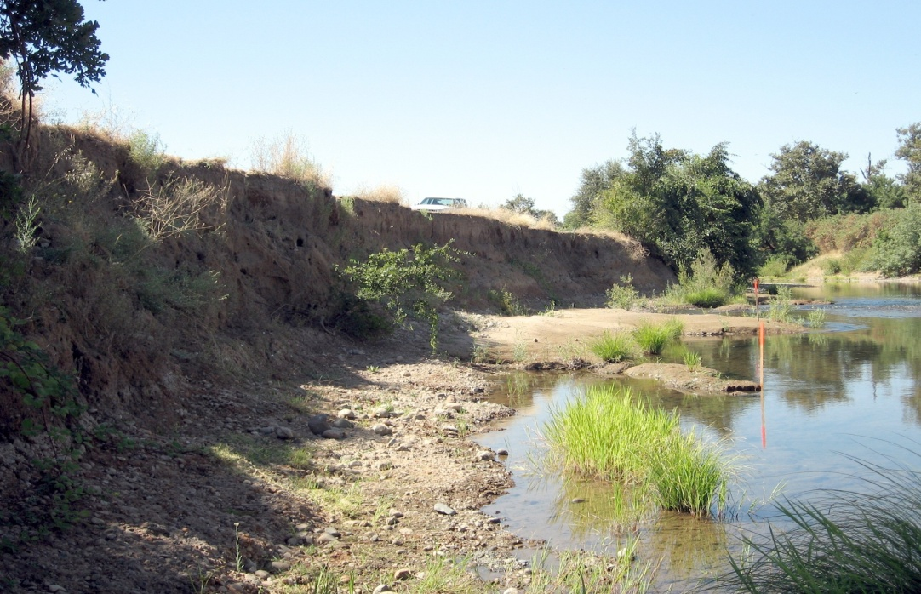
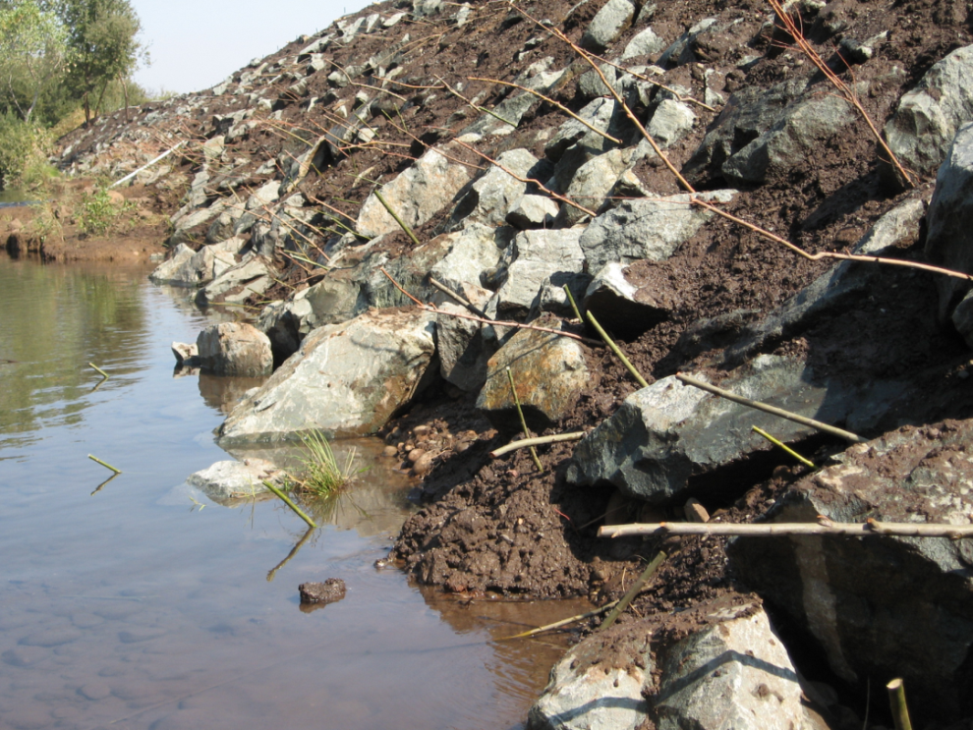
Small Erosion Repair Program
KEY PROGRAM BENEFITS/ADVANTAGES
(Public Safety/Environmental Stewardship)
More Maintenance Repairs Before Next Flood Season
Designs that Aide in Erosion Control and Support Resource Agencies: Enhancing Environment Near Waterways
BEFORE
AFTER

Slide 9
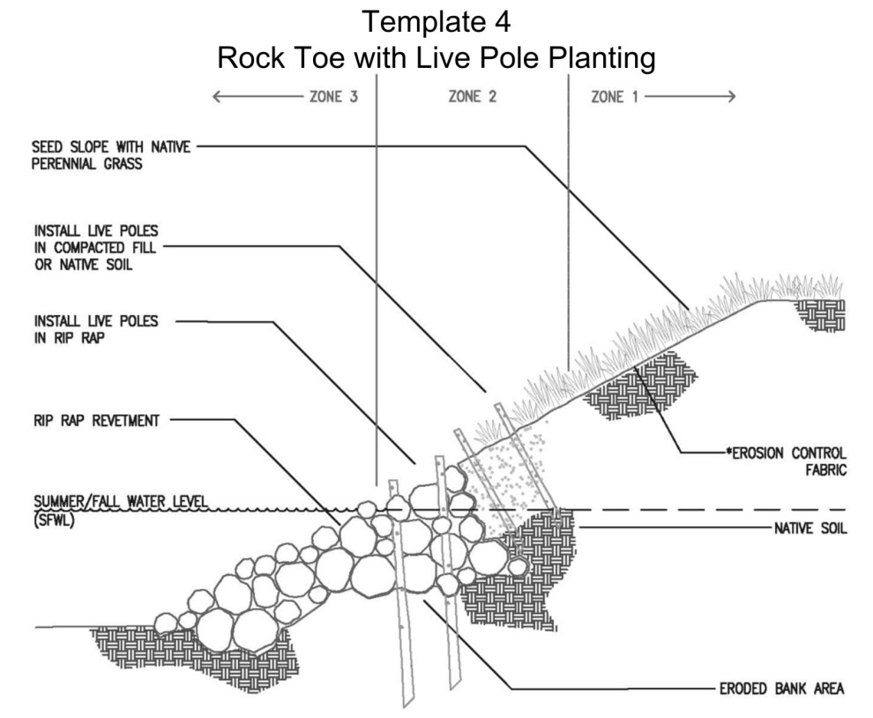
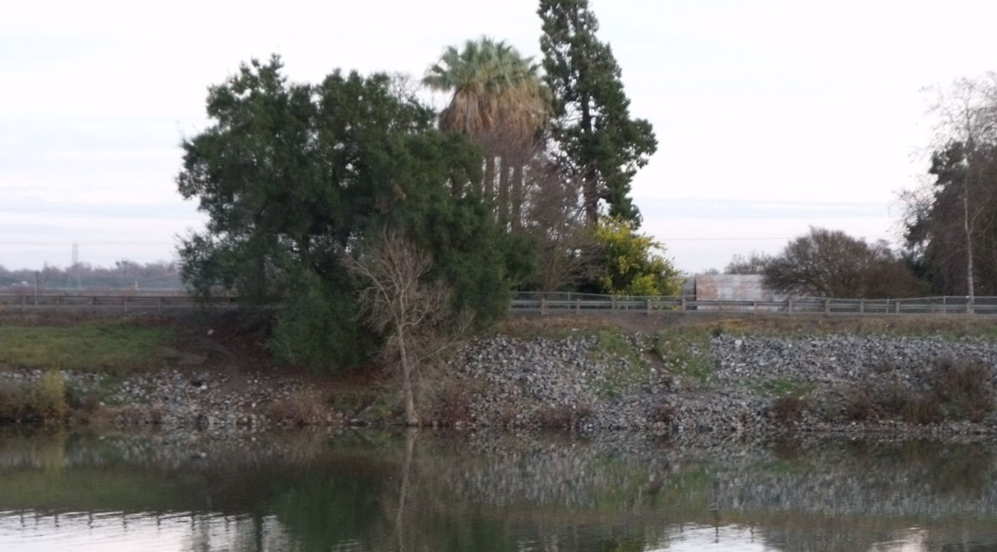
Small Erosion Repair Program
CHALLENGES
DWR Asserts Design Templates are ‘Maintenance’
Board staff are Concerned about Vegetation Component

Slide 10
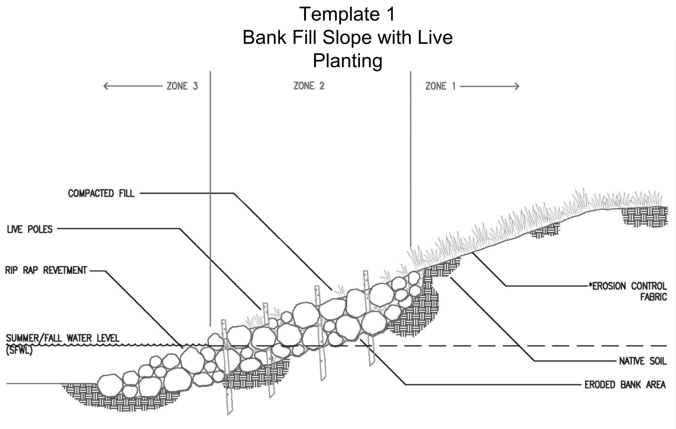
Small Erosion Repair Program

Slide 11
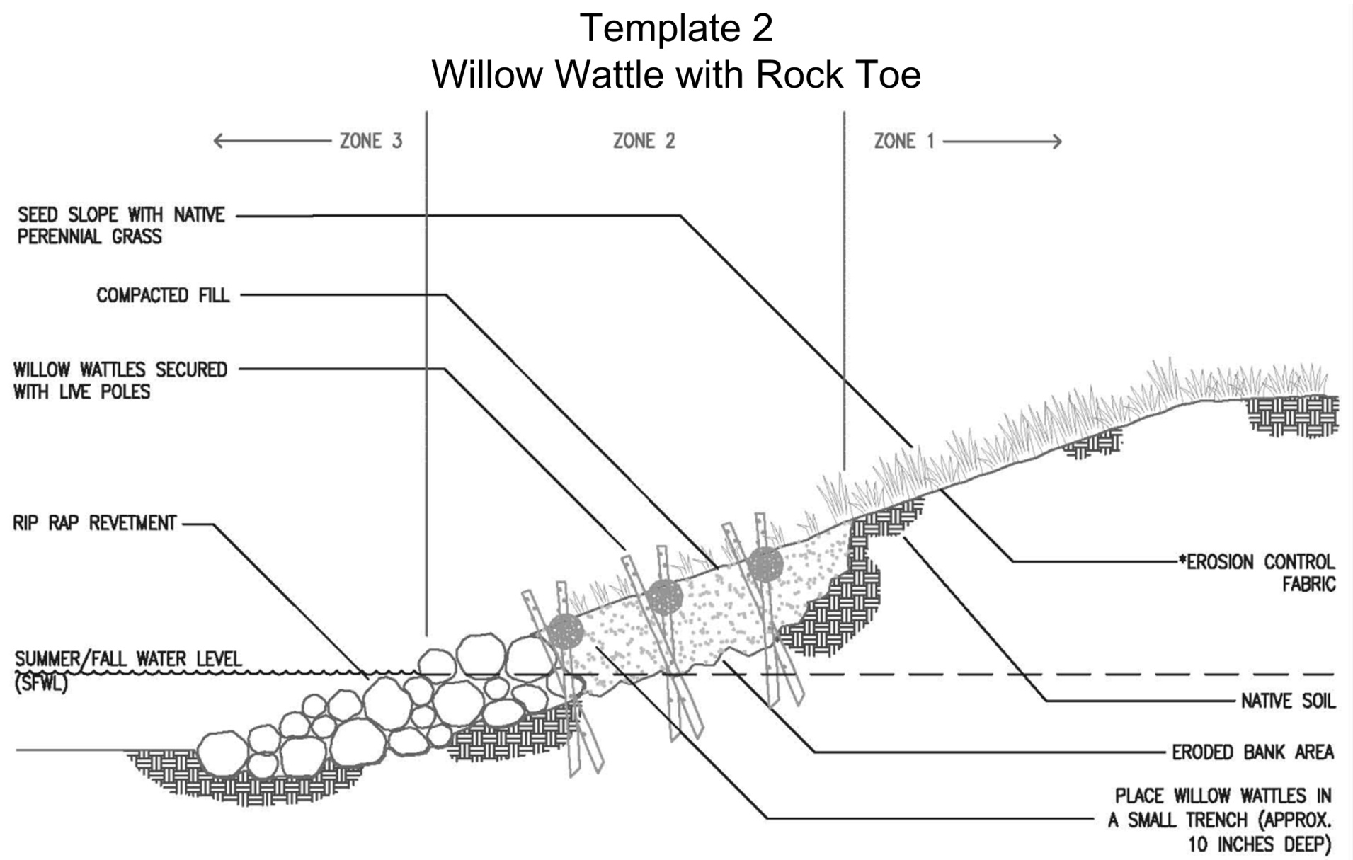
Small Erosion Repair Program

Slide 12
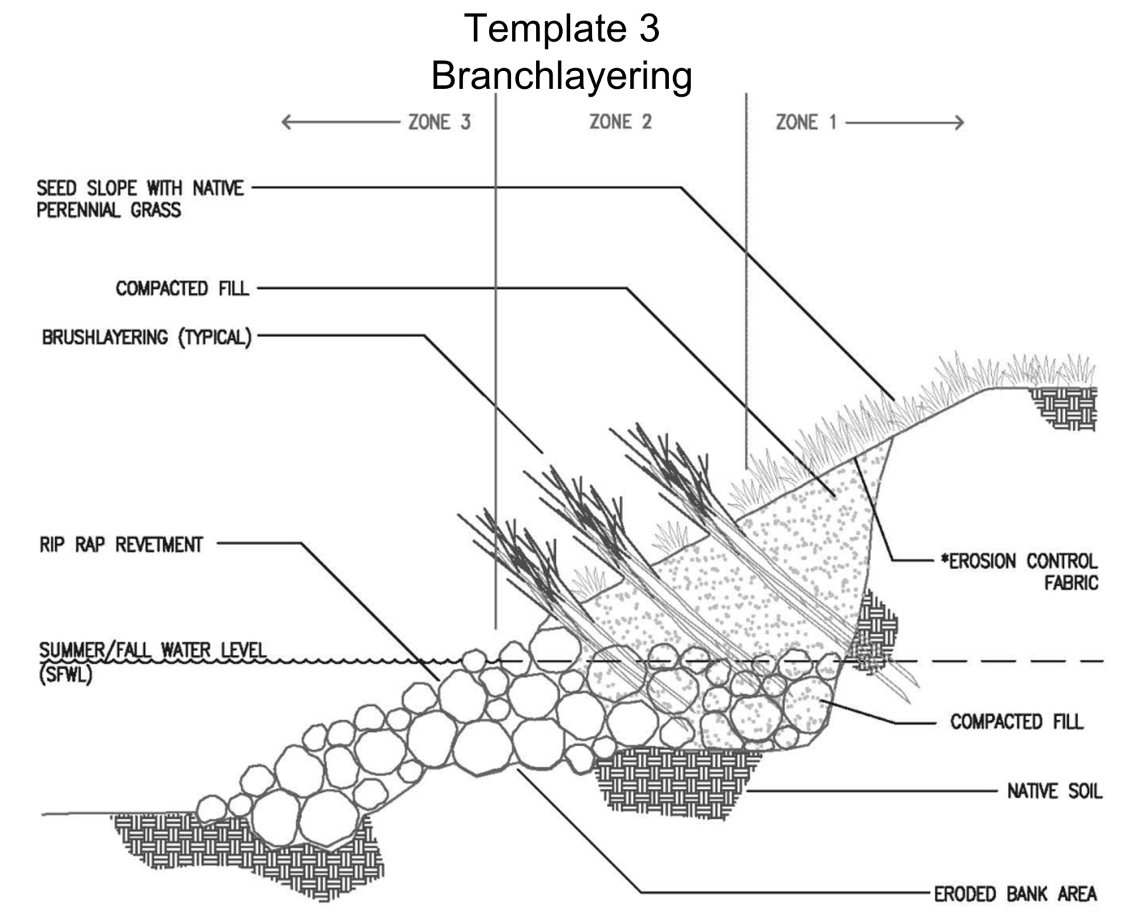
Small Erosion Repair Program

Slide 13
Small Erosion Repair Program
CHALLENGES
Staff has pledged to continue to work with us, but no identified path forward for timely Board Approval
Sacramento Corps District –ETL conflicts- However do not regulate maintenance
Board staff helped -timely review process-suggestions on how to address vegetation issue, safe harbor type of agreement?
Had hoped to present unified approach-we are not there yet
Hope to be back next month with agreement or be able to articulate why we can’t proceed

