Slide 1
Central Valley Flood Protection Board Workshop
Central Valley Flood Control Projects Update
May 10, 2019 SAFCA

Slide 2
Sacramento’s Path Forward on Flood Risk Reduction Projects
Three projects under active construction:
(All three projects are partnerships with the USACE, CVFPB/DWR, and SAFCA)
Folsom Dam Raise
Natomas Improvements (WRDA 2014)
American River Common Features (WRDA 2016)

Slide 3
Folsom Dam Raise
Project consists of:
Raising all dikes and wing dams 3.5-feet
Modify Gates on Existing Dam
Update water control manual
First Contract award 2019
Project completion Jan 2024
All federal funds are in place to complete the project

Slide 4
American Rivers Common Features – Natomas Basin (WRDA 2014)
Improve 42 miles of levee surrounding Natomas.
18 miles were completed by SAFCA/DWR/CVFPB under the EIP program
Remaining miles to be completed by USACE
Construction by USACE is underway
Expected completion in 2025

Slide 5
American River Common Features General Re-evaluation Report ( WRDA 2016)
Project addresses:
Embankment and foundation stability
Erosion
Widens Sacramento Bypass
Project Completion is Jan 2024
All federal funds are in place to complete the project

Slide 6
ARCF 2016 -Features
American River:
Up to 11 miles erosion protection
Sacramento River:
Up to 9 miles of underseepage (construction starts this year)
Up to 10 miles of erosion protection
Eastside Tributaries
Up to 4 miles of underseepage (complete)
Sacramento Weir and Bypass:
Lengthen Weir 1500-feet and set levee back by 1500-feet

Slide 7
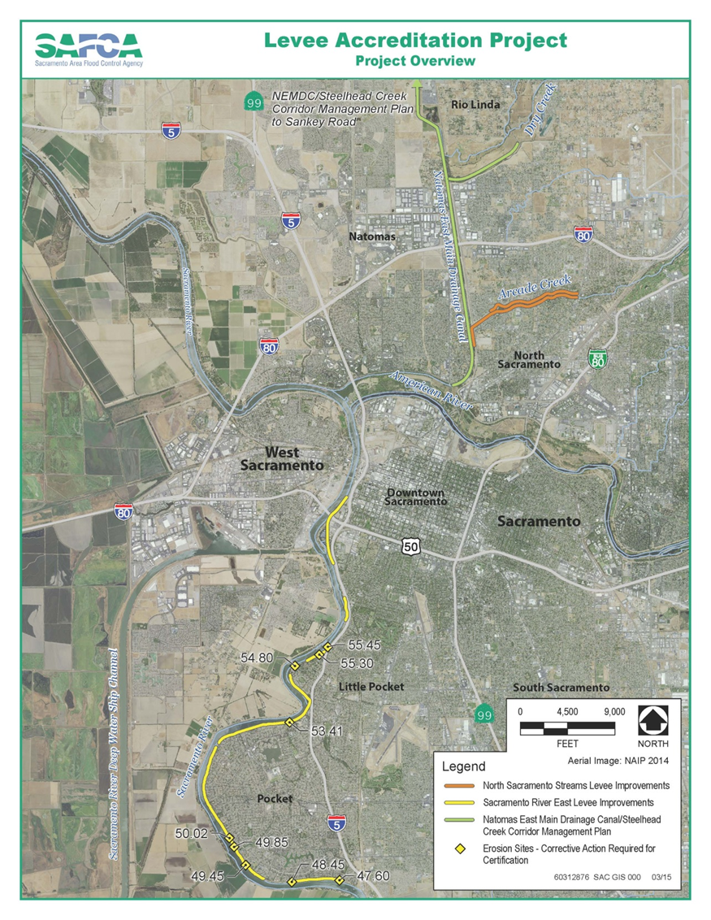
SAFCA’s Levee Accreditation Program
SAFCA’s lead role has been replaced by the USACE

Slide 8
SAFCA Activities to support projects
LERRDS
Real Estate
Utility Relocations
Encroachments
Provide work-in-kind services as requested by USACE

Slide 9
Closeout Activities
There are three federally authorized projects in closeout:
American River Common Features WRDA 96/99
South Sacramento Streams Group
Folsom Dam Joint Federal Project
Remaining actions vary from final accounting documents, project turnover (O&M manuals), real estate, punch list items, etc.

