Slide 1
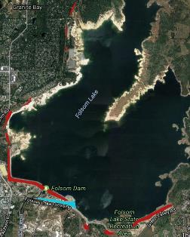
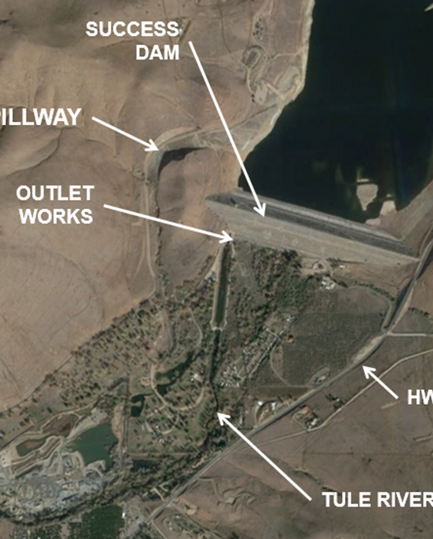
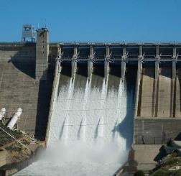
CW Budget Process
Beth Salyers
Civil Works Project Management Branch Chief
Sacramento District, USACE
May 10, 2019
Notes:
Pictures:
SPN - South San Francisco Shoreline
SPK – Folsom Dam - Release
SPA – Alamogordo Phase VIII
SPL – Port of Los Angeles

Slide 2
Agenda
Introduction
Civil Works Project Cycle
Program and Funding Timetable
Budget Cycle
WorkPlan Development
Budget Requirements
Non-Federal Sponsor Input

Slide 3
CW Project Cycle
Feasibility phase
Product = Feasibility Report
Agreement = Feasibility Cost Sharing Agreement (FCSA)
Investigations Funding
Feasibility Report Completion
Chief’s Report
Pre Construction Engineering and Design phase
Product = Detailed Design Report
Agreement= Design
Investigations Funding
Study Authorization
Letter of Intent
PLANNING
DESIGN
PROJECT INITIATED BY LOCAL SPONSOR
Construction Authorization
PROJECT
INITIATION
CONSTRUCTION
Construction phase
Product is built
Agreement =Project Partnering Agreement (PPA)
Construction Funding
O&M phase
Product = O&M Manuals, Inspection Reports
Agreement = none. Generally undertaken by sponsor except for Federal NAV and FDR projects
O&M Funding
OPERATIONS
AND
MAINTENANCE

Slide 4
Program and Funding Timetable
FY19 |  |  |  |  |  |  |  |  | FY20 |  |  |  |  |  |  |  |  |  |  |  | FY21
Jan | Feb | Mar | Apr | May | Jun | Jul | Aug | Sep | Oct | Nov | Dec | Jan | Feb | Mar | Apr | May | Jun | Jul | Aug | Sep | Oct | Nov | Dec | Jan | Feb | Mar | Apr | May | Jun | Jul | Aug | Sep
FY19 PROGRAM
EXECUTE
FY20 PROGRAM
DEFEND |  |  |  |  |  |  |  |  | EXECUTE
FY21 PROGRAM
DEVELOP |  |  |  |  |  |  | DEFEND |  |  |  |  |  |  |  |  |  |  |  |  |  | EXECUTE
 |  |  |  |  |  |  |  |  |  |  |  | FY22 PROGRAM
 |  |  |  |  |  |  |  |  |  |  |  | DEVELOP |  |  |  |  |  |  | DEFEND
 |  |  |  |  |  |  |  |  |  |  |  |  |  |  |  |  |  |  |  |  |  |  |  | FY23 PROGRAM
 |  |  |  |  |  |  |  |  |  |  |  |  |  |  |  |  |  |  |  |  |  |  |  | DEVELOP |  |  |  |  |  |  | DEFEND
DEVELOP
FEB INITIAL OMB CEILING AND COST ESTIMATE UPDATE
MAR PROGRAM AND BUDGET ENGINEER CIRCULAR
APR PROGRAM SUBMISSION
JUN OMB CEILING REVISION
JUL HEADQUARTERS PROGRAM REVIEW
DEFEND
AUG ASA(CW) REVIEW
SEP OMB SUBMISSION AND OMB HEARINGS
NOV OMB PASSBACK
FEB PRESIDENT'S BUDGET
MAR ASSISTANT SECRETARY OF THE ARMY (CIVIL WORKS) AND CORPS APPROPRIATIONS HEARINGS
JUN HOUSE APPROPRIATIONS BILL
JUL SENATE APPROPRIATIONS BILL
AUG CONFERENCE
EXECUTE
SEP APPROPRIATIONS ACT
OCT APPORTIONMENT, WORK ALLOWANCES, AND IMPLEMENTATION PLANS
DEC-JAN SCHEDULES OF OBLIGATIONS AND EXPENDITURES (2101)
EOY REVIEW PROGRESS AND REPROGRAM FUNDS AS NEEDED

Slide 5
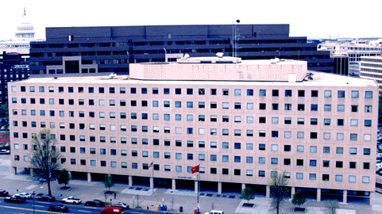
2) HQ Provides Program Guidance ( Mar )
4) HQ Review & Approval
( May -Jun )
1) OMB Provides Budget
Guidance (Jan)
3) Field Offices Develop
Program Requirements
( Apr )
13) Districts Execute current FY Program
( Oct - Sep )
Develop the Program
12) Funding Allocations to Field Offices
( Oct - Dec )
The Program Cycle
5) Program Presented
to Secretary of the Army
(Jul - Aug )
Execute the Program
Defend the Program
9) Congressional Hearings ( Mar - Apr )
6) Program Submitted to OMB ( Sep )
11) President Signs Appropriations Bill
( Sep - Oct )
7) OMB Passback
( Nov-Dec )
10) Appropriations Bills
( Jul - Sep )
8) President’s Budget
to Congress ( Feb )

Slide 6

CW Workplan Development
11a) Continuing Resolution
( Sep - ??? )
12a) Pro-rated funding allocations for CR Period
10) DRAFT Appropriations Bills
( Jul - Sep )
16a) Funding arrives
13a) Full year funding Bill
15a) Workplan Published
14a) Workplan Process & funding allocation decisions

Slide 7
PERFORMANCE BASED BUDGETING
President’s Budget switched to Performance-Based Budgeting in compliance with the Government Performance and Results Act of 1993 (GPRA) to maximize the use of the federal dollars
Performance measures are used to:
  Rank competing investments from each business line
  Justify funding allocations for continuing and new projects
Goal: Fund highest priority work at an efficient rate

Slide 8
Budget REQUIREMENTS
  Investigations:
  SMART 3x3 compliant – with Compliance memo or exemption
  New Study after WRRDA 2014
  Federal Interest
  Non-Federal sponsor and local support
  Compliance with NEPA and other Environmental regulations
  Completed and approved Sec 216 Review of Completed Projects
  Construction:
  Authorized for Construction
  Approved Chief’s report, major rehabilitation report or Dam Safety Modification Report
  High economic return and benefit-to-cost (BCR) ratio of 2.5 to 1 or higher calculated at 7% discount rate
  New start and new investment decisions - High performance measures, a Decision Document approval prior to budget submission and Current economic analysis
Notes:
Investigation:
Eligibility and Ranking:
SMART compliant
Compliance Memo, Exemption, or a new Feasibility study after WRRDA 2014
Have Federal Corps interest
Matter of urgency for implementation of the problem solution
Non-Federal sponsor and local support (Letter of Intent within 5 months of MSC budget submission date – net 1 Dec 2018)
In compliance with NEPA and other environmental regulations
Standard funding stream: 36 months over 4 FY; $200K/$600K/$600K/$100K
Construction:
Eligibility:
Authorized for Construction
Approved Chief’s report, major rehabilitation report or Dam Safety modification report
Ongoing projects funded based on their economic return and have a benefit-to-cost (BCR) ration of 2.5 to 1 or higher calculated at 7% discount rate
Continuing PED and Construction need economic update no older than 5 years from budget submission (1 May 2014 for a FY21 Budget request.
New start and new investment decisions
High performance measures
Decision Document approval prior to budget submission
Current economic analysis (no older than 3 years from submission (1 May 2016 for a FY21 budget request)

Slide 9
NF Partner Input
Letters of Intent
Project Delivery Team Members
  LERRDS
  Optimal Funding Stream (Fed and NF)
  Program Execution
Communication
  Consistent
  Transparent

Slide 10
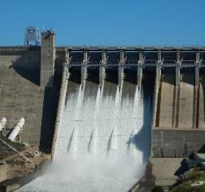
QUESTIONS

