Slide 1
DWR Streamgage North American Vertical Datum of 1988 Update of October 2019 July 26, 2019
Mitch Russo, P.E.
Hydrology and Flood Operations Office, DWR

Slide 2
Purpose
All CA DWR Gages on same Zero reference
Modeling Advantages
River profiles – slope downstream
Most recent flood studies in NAVD88
Recent LiDAR – NAVD88
USACE studies
Only the numbers are changing!
New Monitor and Flood Stage Values

Slide 3
Efforts To Date
2006
Sac/San Joaquin Delta
44 Total Gages
4 Official NWS Forecast Points
40 Data Points
2016
Sacramento Region
Lower Sacramento River
Lower American River
Lower Feather River
5 Total Locations
4 Official NWS Forecast Points
Sacramento Weir Operating Criteria

Slide 4
2019 Datum Change October 1, 2019
Sacramento and Feather Rivers
21 Total Gages
12 Official NWS Forecast Points
9 Data Points
Calculations:
NGVD29 – Correction Factor = NAVD88

Slide 6
Gage Datum Conversion Schedule
Finalize Conversion Values, Primary Stakeholder List
Outreach to Primary Stakeholders
Finalize Material for Secondary Stakeholders, Coordinate with CDEC Staff
Outreach to Secondary Stakeholders
Finalize All Technical Resources
LAUNCH
Oct 1, 2019
Refine approach, if needed, based on primary stakeholders responses
Q1
2019
Q2
2019
Q3
2019

Slide 7
2019 Datum Change October 1, 2019
Sacramento River at Red Bluff Diversion Dam
Correction Factor: -2.6’
NGVD29 – Correction Factor = NAVD88
Monitor Stage: 250.0’ – (-2.6’) = 252.5’ *
Flood Stage: 253.0’ – (-2.6’) = 255.5’ *
* Monitor and Flood Stages are rounded to the nearest half foot due to forecast limitations.

Slide 8
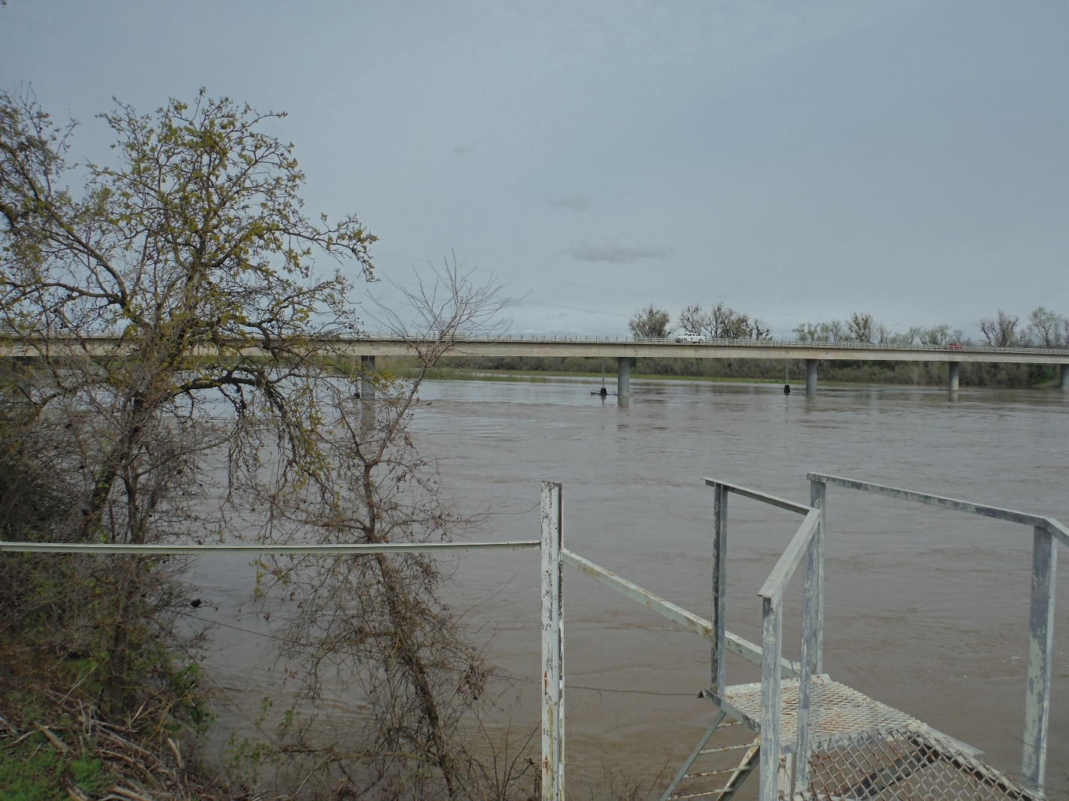
Only the numbers are changing!
Old Datum (USED)
97.1’
New Datum (NAVD88)
96.9’
=
February 25, 2016

Slide 9
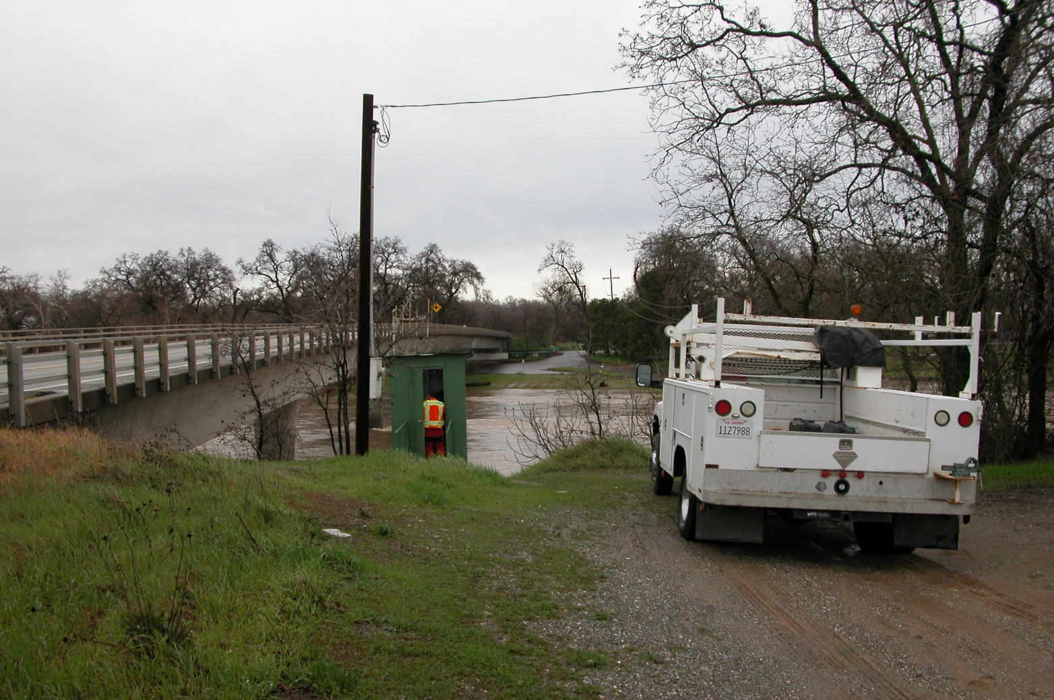
Only the numbers are changing!
Old Datum (USED)
177.5’
New Datum (NAVD88)
177.4’
=
January 21, 2010

Slide 10
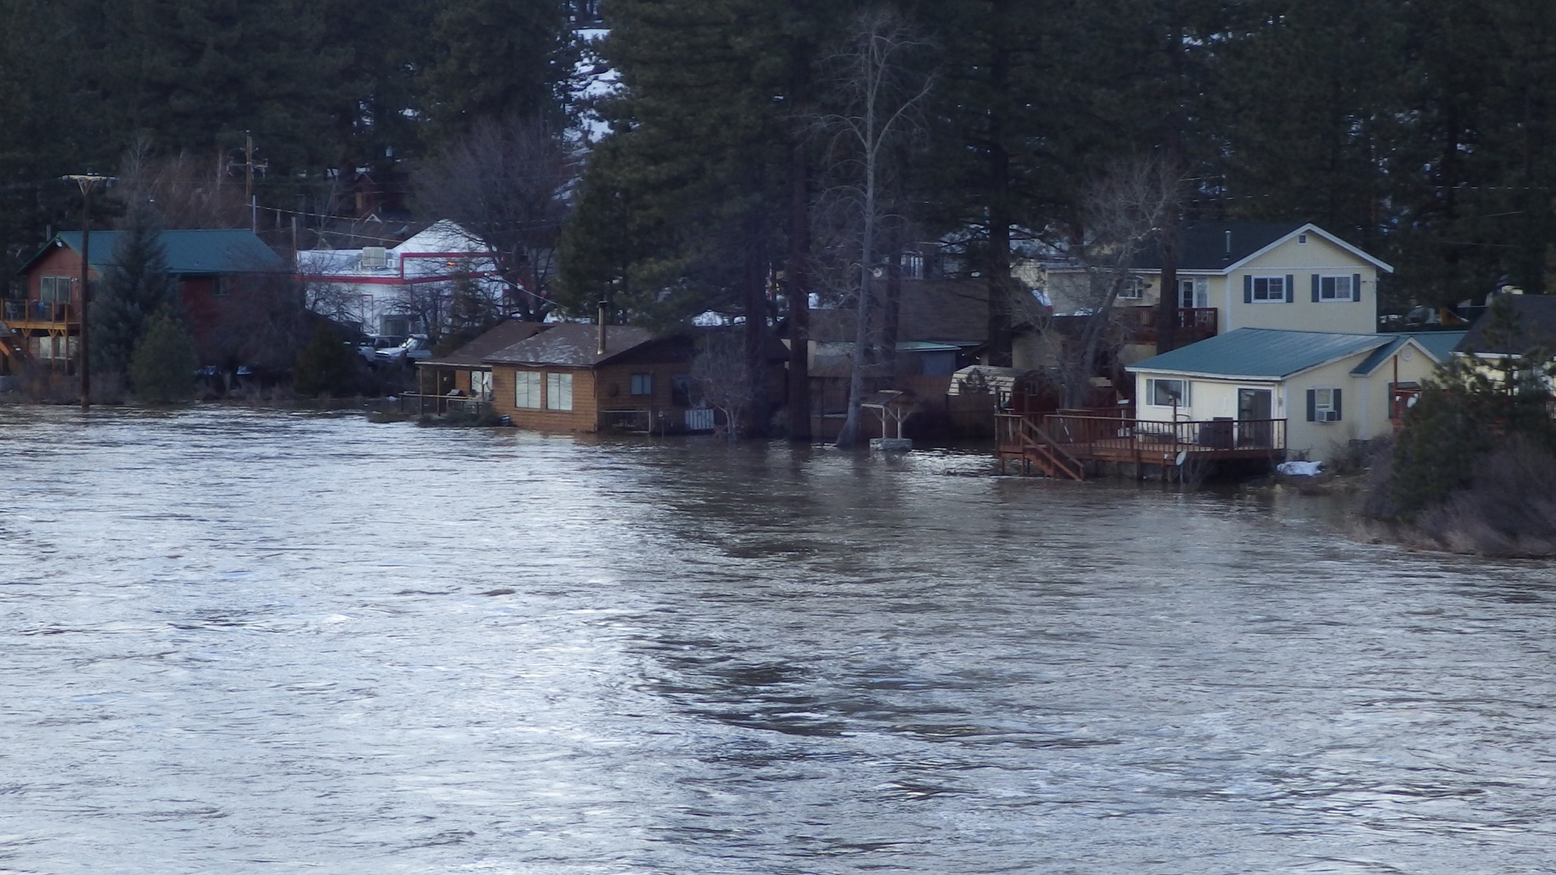
Only the numbers are changing!
Old Datum (NGVD29)
11.85’
=
New Datum (NAVD88)
4855.45’
2/11/2017 ~1500 hrs

Slide 11
NWS Actions Prior to October 1, 2019
Update E-19s and Internal Documentation
Translate Impacts to new NAVD88 datum values
Staff Training
Social Media notices – Public Outreach
CNRFC model and calibration modifications

Slide 12
DWR Actions Prior to October 1, 2019
Move staff gages to reflect NAVD 88
Reset DCP’s to report data in NAVD 88
CDEC staff to apply temporary shift
Temporary shift will be removed on Oct 1
Provide information to attendees of Pre-season Flood Outreach meetings

Slide 13
Local Agency Impacts
Flood Hazard Plan/Annex?
Operating procedures?
Staff Training?
County Webpages?
Public Outreach?
Etc?

Slide 14
Contacts
DWR
Boone Lek Boone.Lek@water.ca.gov
Mitch Russo Mitchel.Russo@water.ca.gov
NWS
Cindy Matthews Cindy.Matthews@noaa.gov
Tim Bardsley Tim.Bardsley@noaa.gov

