Slide 1
AMERICAN RIVER watershed COMMON FEATURES 2016 PROJECT ENVIRONMENTAL UPDATE Informational Briefing Agenda No. 9A
Miles Claret, Environmental Scientist
Flood Projects Office, DWR
October 25, 2019

Slide 2
OVERVIEW
Environmental Background
Sacramento River East Levee Contract 1 Project
Environmental Update
Next Steps

Slide 3
Lead Agencies
USACE, Sacramento District = NEPA lead agency
CVFPB = CEQA lead agency

Slide 4
American River Watershed Common Features GRR Final EIS/EIR
Certified in 2016
Analyzed:
Sacramento River seepage and stability
American and Sacramento Rivers erosion
Sacramento Weir and Bypass widening

Slide 5
Recent Components of ARCF16
Reach D Contract 1 (Front Street) Project
Seepage and stability improvement to Sacramento River
Beach Stone Lakes Mitigation Site Project
Advanced mitigation site for vegetation and wildlife impacts associated with Sacramento River levee improvements for ARCF 16.

Slide 6
Sacramento River East Levee Contract 1 (SREL C1) Project

Slide 7
SREL C1 Project Description
What? Seepage and stability improvements to SREL, including cutoff walls and stability berms.
Why? Reduce risk of levee failure.
When? Construction anticipated in 2020. Tree removal as early as December 2019.

Slide 8
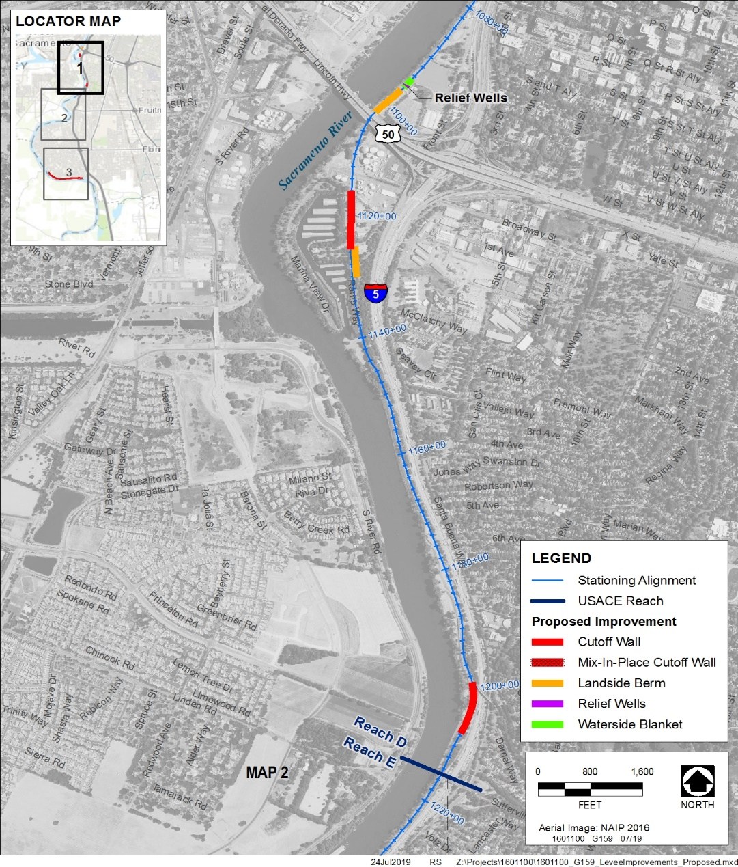
SREL C1 Project Location

Slide 9
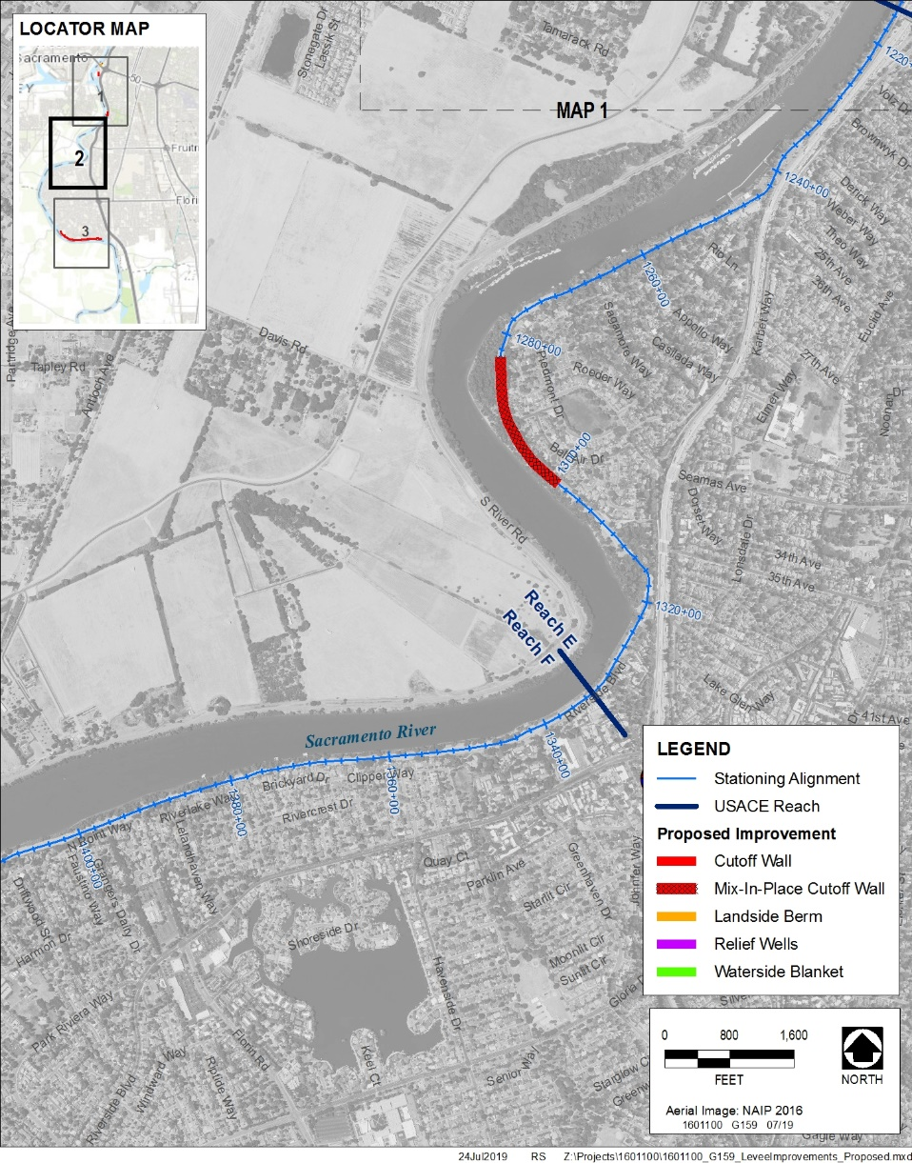
SREL C1 Project Location

Slide 10
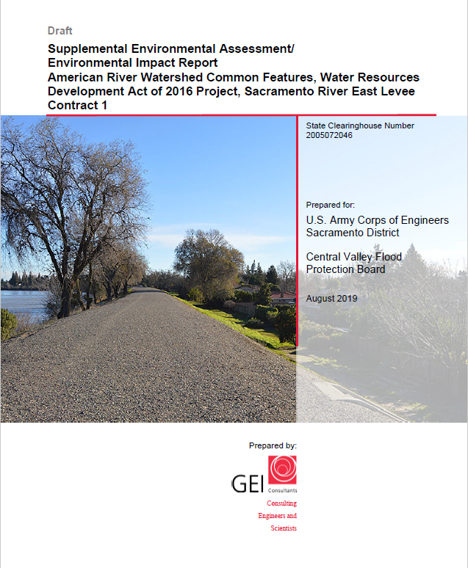
Draft Supplemental EA/EIR
Avoidance
Minimization
Mitigation
Significant and Unavoidable Effects

Slide 11
Potentially Significant and Unavoidable Environmental Impacts
Aesthetics
Vegetation and Wildlife
Cultural Resources
Recreation
Transportation and Circulation
Notes:
Changes in scenic vista and existing visual character (staging, short term construction). Long term visual impacts were less than significant due to the majority of veg being left on the river and the site being restored.
Traffic due to local traffic on streets. Traffic management plan and road maintenance plan.
Veg and wildlife short term due to temporal veg impacts.
Recreation due to limit public use areas and trails (bike trail near Garcia Bend, various parks). MM include community outreach, signage, detours, repairing all facilities to pre-project conditions.
Cultural resources due to CR-1 adverse effects are unknown (PA, but no CEQA process)

Slide 12
Public Involvement
Public circulation, 45 days: August 23 – October 7, 2019
Public meeting: September 12, 2019, Elk’s Lodge in the Pocket Neighborhood.

Slide 13
CEQA
Findings – Significant and Unavoidable Impacts to:
Aesthetics
Vegetation and Wildlife
Cultural Resources
Recreation
Traffic and Circulation
Statement of Overriding Considerations
Mitigation Monitoring and Reporting Plan

Slide 14
Next Steps
November CVFPB Meeting:
Present to CVFPB for consideration to certify the SEA/EIR &
Adoption of Findings, Statement of Overriding Considerations, and MMRP.
Begin Construction in 2020 (one construction season anticipated)
Tree removal between December 2019 – February 2020.

Slide 15
Questions
Flood Projects Office
Division of Flood Management
Department of Water Resources
Miles Claret
Miles.Claret@water.ca.gov

