Slide 1
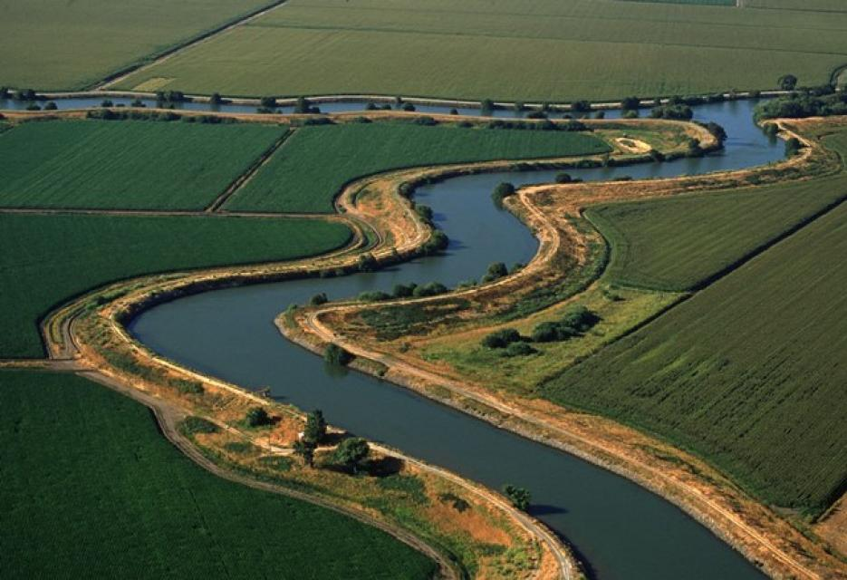
Central Valley Flood Protection Board
The Board’s Role in Resolutions of Necessity; An Overview of the Process
July 26, 2019
Item 10A
Presented by: Linus Paulus
Chief, Acquisition and Appraisal Section
California Department of Water Resources

Slide 2
1. Authorities 2. Definitions 3. Overview of Eminent Domain 4. Resolution of Necessity 5. Considerations of Board
Presentation Overview

Slide 3
Eminent Domain – The right of the government to take private property for public use, with just compensation. Condemnation – The process of eminent domain. Resolution of Necessity - The public entity’s formal decision to acquire property by eminent domain. The Resolution of Necessity must be adopted before the condemning agency can commence an eminent domain action in court.
Definitions

Slide 4
U.S. Constitution – 5th Amendment California Constitution Article I, Section 19(a) California Water Code Section 8590 California Water Code Section 8593 California Code of Civil Procedure Section 1245.210(b) California Code of Civil Procedure Section 1245.240 – 1245.270
Eminent Domain Authorities
(a) Acquire either within or outside the boundaries of the drainage district, by purchase, condemnation or by other lawful means in the name of the drainage district, all lands, rights-of-way, easements, property or material necessary or requisite for the purpose of bypasses, weirs, cuts, canals, sumps, levees, overflow channels and basins, reservoirs and other flood control works, and other necessary purposes, including drainage purposes.

Slide 5
Just Compensation – The Legislature has determined that just compensation is the fair market value. Appraisal – An opinion of value First Written Offer – Formal offer for just compensation
Definitions

Slide 6
1. Mapping and Deeds 2. Appraisal 3. Offer 4. Negotiations - Accepted as offered/proposed - Accepted as modified - Condemnation (impasse) 5. Memorandum of Settlement 6. Escrow
Acquisition Process

Slide 7
Notice of Intent to adopt: – Landowner is notified by mail prior to hearing. – If Landowner chooses to be heard, they must inform the Board within 15 days. – Landowner may also choose to respond in writing.
Notice of Intent

Slide 8
Board Package includes: – Copy of proposed Resolution of Necessity (RON) – Staff Report – Project information – Copy of CEQA compliance/Notice of Determination – Acquisition Summary Sheet and owner response, if any – Copy of Notice of Intent to landowner – Exhibit Map – Deed
Resolution of Necessity

Slide 9
Board Considerations: – Whether the public interest and necessity require the project; – Whether the project and acquisition are planned or located in the manner that is the most compatible with the greatest public good and least private injury; – Whether the property to be acquired is necessary for the project; and – Whether the written offer required by Government Code § 7267.2 has been made to the owner of record or whether the offer has not been made because the owner cannot be located.
Resolution of Necessity

Slide 10
1. Impasse 2. Notice of Intent to Adopt a RON 3. RON Hearing 4. Lis pendens 5. Summons and Complaint 6. Order of Possession 7. Discovery 8. Trial
Condemnation Process

Slide 11
Thank You
Linus.Paulus@water.ca.gov
(916) 653-3947

