Slide 1
West Sacramento Area Flood Control Agency Southport Levee Improvement Project, Yolo County September 13, 2013
APPLICATION NO. 18313-3

Slide 2
BOARD ACTION
Consider approval to:
send a letter to the U.S. Army Corps of Engineers (USACE), Sacramento District requesting permission to alter a portion of the Sacramento River Flood Control Project (SRFCP) based on Application No. 18313-3 and pursuant to U.S. Title 33, Section 408 (USC 408).
Notes:
This is not a flood system improvement project hearing, and no construction permit is being considered for issuance at this time.
Board staff is requesting that the proposed letter be sent to USACE Sacramento District to initiate the review process for the proposed project alteration.

Slide 3
AUTHORITY OF THE BOARD
California Code of Regulations, Title 23, Division 1 (CCR 23) § 6 – Need for a Permit
CCR 23 § 106 – Existing Encroachments within an Adopted Plan of Flood Control
CCR 23 § 116 – Borrow and Excavation
CCR 23 § 120 – Levees
CCR 23 § 121 – Erosion Control
CCR 23 § 123 – Pipelines, Conduits, and Utility Lines
CCR 23 § 124 – Abandonment of Pipelines
CCR 23 § 130 – Patrol Roads and Access Ramps
CCR 23 § 131 – Vegetation
Rivers and Harbors Act of 1899, Title 23, Section 408 (USC 408)

Slide 4
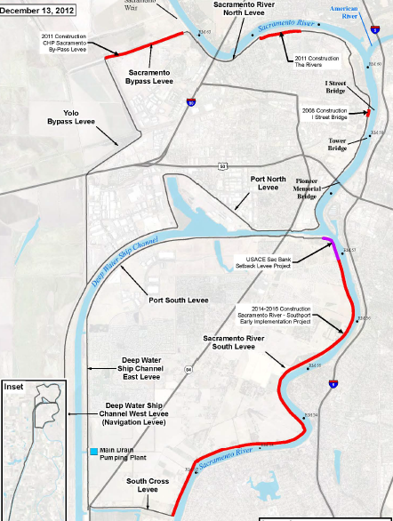
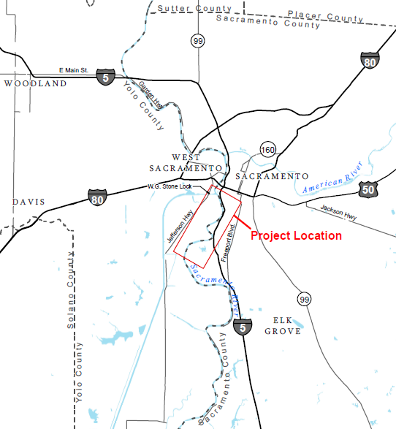
PROJECT LOCATION
CHP EIP
(18313-1)
North Basin
Rivers EIP
(18313-2)
In Yolo County
South of Interstate-80
West of Interstate 5
Along right (west) bank of the Sacramento River
I Street
(18336)
South Basin
I-80
Yolo County
Proposed Southport Project
I-5

Slide 5
PROJECT BACKGROUND
The West Sacramento Levee Improvement Program (WSLIP) is a multiphase program for reducing flood risk in the City of West Sacramento (City)
Three Early Implementation Projects (EIP) have been constructed by WSAFCA:
I Street Bridge (18336) – cutoff wall downstream of the bridge
CHP Academy (18313-1) – cutoff wall and slope flattening along Sac Bypass
The Rivers (18313-2) – cutoff wall and slope flattening along Sac River
All three EIPs are located in the North Basin
Levees surrounding the City protect over 11,000 acres, approximately 50,000 residents, and billions in infrastructure
100-year event (believed to fail the Southport levee in its current condition) could prevent timely and safe evacuation for its inhabitants
In order for the City to be compliant with federal and State standards, improvements are needed to reduce the current level of flood risk

Slide 6
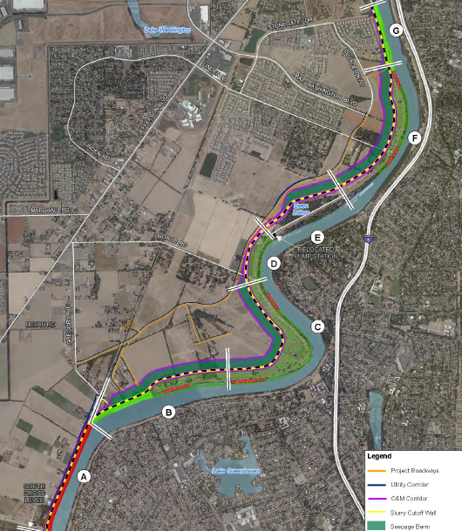
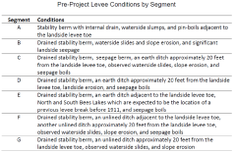
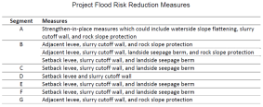
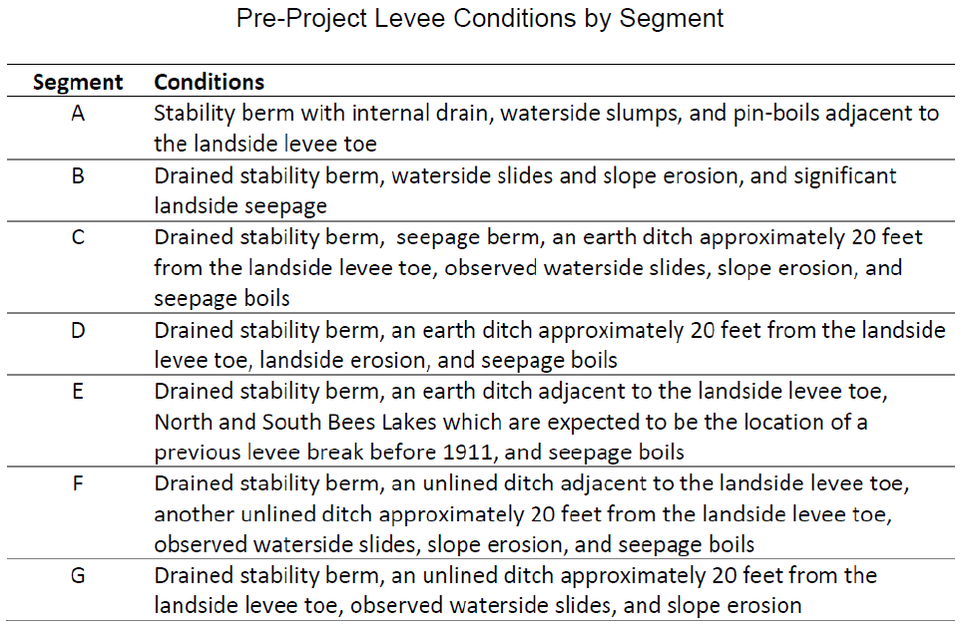
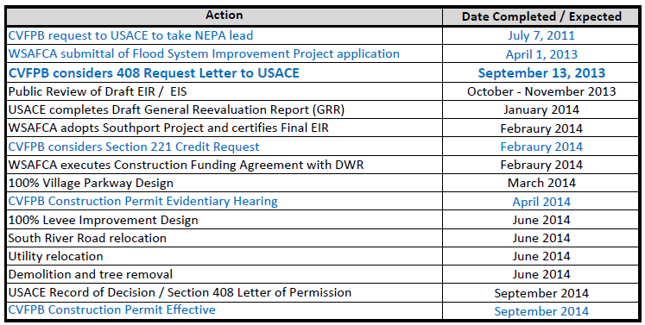
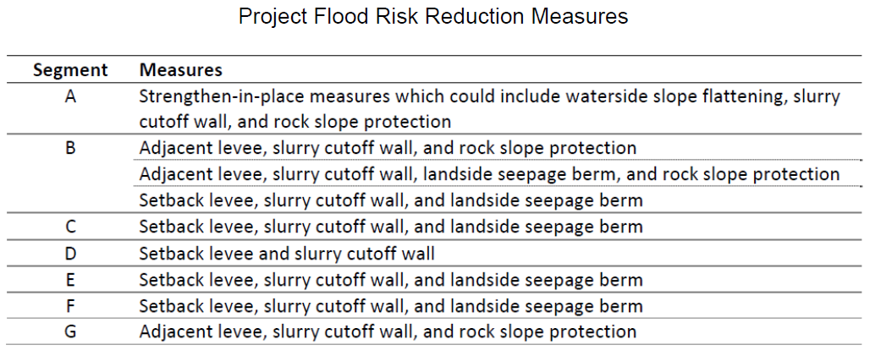
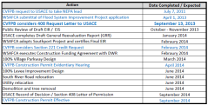
PROJECT DESIGN
G
Adjacent levee, slurry cutoff wall, rock slope protection
Board staff has reviewed the following technical documents provided by WSAFCA:
65 % Design Submittal
Draft 408 Project Summary Report
65% Design Documentation Report
Hydraulic Impact Analysis Report for the Southport Sacramento River EIP
Conditional Risk Analysis for the WSLIP
Work proposed:
Project includes approximately 1.5 miles of strengthen-in-place measures and 4 miles of setback or adjacent levee measures (divided into 7 segments) including:
Installation of slurry walls and seepage berms
Placement of rock slope protection
Construction of adjacent and setback levees
Degradation / Breeching of a portion of existing Project Levee
Setback are floodway enlargement and enhancement
Removal and / or relocation of utilities and encroachments
Construction is intended to be phased to mitigate impacts and reduce risk
F
Setback levee, slurry cutoff wall, landside seepage berm
E
Setback levee, slurry cutoff wall, landside seepage berm
D
Setback levee and slurry cutoff wall
B
Adjacent levee, slurry cutoff wall, rock slope protection, landside seepage berm
C
Setback levee, slurry cutoff wall, landside seepage berm
A
Strengthen-in-place (slope flattening, slurry cutoff wall, rock slope protection.

Slide 7
HYDRAULIC SUMMARY
Hydraulic Summary:
WSAFCA evaluated the project as both an individual incremental action, and as a component of a larger cumulative project (including the Folsom Dam Modifications)
When modeled incrementally, an isolated maximum increase in water surface elevation (WSE) of 0.17 feet occurs near the Pocket area neighborhood
WSAFCA is coordinating with SAFCA to ensure the rise is accounted for in the planned Pocket Levee Improvements (SAFCA letter)
WSAFCA has proposed the construction be phased to minimize temporary risks
Cumulatively, the improvements will reduce flood stages by approximately 1.2 feet
Staff expects no significant adverse hydraulic impacts based on current design
Staff will continue to work with WSAFCA, the USACE, and DWR to make sure the final project design complies with all federal and State design criteria
Notes:
What is the incremental reduction in WSE with the exception of the bump?

Slide 8
GEOTECHNICAL SUMMARY
Geotechnical Summary:
WSAFCA’s scope for 65% design, included the following:
steady-state seepage analysis to evaluate underseepage
steady-state stability analysis to evaluate landside stability
rapid drawdown stability analysis to evaluate waterside stability conditions
consolidation analysis to estimate settlement
seismic vulnerability analysis
At this time, staff expects no significant adverse geotechnical impacts or need for variances to Board Standards based on the current information
Staff will continue to work with WSAFCA, the USACE, and DWR to make sure the final project design complies with all federal and State design criteria

Slide 9
ENVIRONMENTAL REVIEW
The environmental analysis of the project is underway and a Draft Environmental Impact Report / Environmental Impact Statement (EIR / EIS) is expected to be released for public review during October through November 2013.

Slide 10
PROJECT BENEFITS
Reduces flood risk for the City by addressing known levee deficiencies along the Southport reach
Advances WSAFCA’s goal to achieve a minimum 200-year flood protection
Constructs levee improvements quickly to reduce flood risk as soon as possible
Constructs improvements that are consistent with the adopted 2012 Central Valley Flood Protection Plan (CVFPP)
Provides multi-benefit uses, including ecosystem restoration and public recreation, that are consistent with CVFPP and regional flood-risk-reduction goals
Allows for continuing federal assistance for levee repairs and maintenance

Slide 11
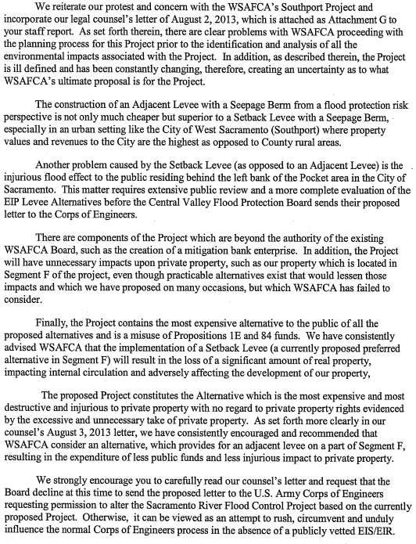
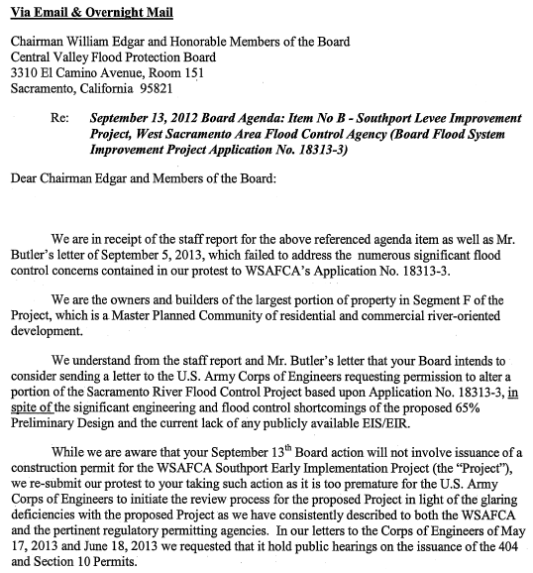
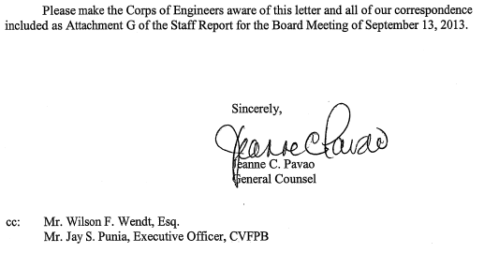
ADJACENT LANDOWNER PROTEST
Environmental Impacts will be addressed during the EIS/EIR public process (Oct-Nov) and must be finalized prior to a permit hearing. Levee Improvement Projects typically go through stages of refinement, but when a permit is considered design will be finalized.
A protest letter was received on August 5, 2013 (as discussed in the staff report)
Board staff responded to the protestant by sending a letter to clarify the Board’s process for USC 408 major modification:
No construction permit is being considered in this action
Board staff will consider the protestant’s concerns that are of a flood control nature prior to a construction permit hearing
Board staff will notify the protestant when a construction permit hearing is scheduled
Protestant was notified that they may bring their concerns to either public action being taken by the Board (today’s 408 request and the future permit hearing)
Protestant was notified and encouraged to comment on the public draft of the EIS/EIR for this project, which is expected in October or November of this year
Do to the late receipt of this letter, staff decided it should be included in the public record to address this request, since it was not included in the Staff Report like the protest package and staff’s response was (public record).
Costs of alternatives and which is chosen is not the Board’s jurisdiction and is not a flood control issue. Handled in EIS/EIR.
SAFCA staff (flood control agency responsible for the Pocket area) has sent a letter in support of the Southport project (should have handout)
Environmental impacts and impacts on private property should be addressed in public EIS/EIR process.
Costs and alternatives are not within the Board’s jurisdiction to dictate. Review of the project is based on public safety and compliance with State and federal regulations.
65% is a preliminary design and is the typical stage at which we engage in the USC 408 Request and often the Environmental Documents have not yet been finalized
These letters are in reference to federal permits to be obtained by the USACE. At the hearing for a construction permit, a DRAFT permit that may be proposed will contain language stating that these permits must be obtained. No further jurisdiction by this Board.
Staff has read the letter referenced and will consider the comments raised concerning flood control in our review and advancement of this project toward a construction permit hearing. Staff has encouraged the protestant to be involved in the EIR/EIS public process and will notify the protestant of upcoming actions.

Slide 12
STAFF RECOMMENDATION
Board Staff is Recommending that the Board:
approve sending the draft letter to the USACE, Sacramento District requesting permission pursuant to U. S. Title 33, Section 408 to alter a portion of the Sacramento River Flood Control Project levee along the right (west) bank of the Sacramento River as proposed in Application No. 18313-3 submitted by the West Sacramento Area Flood Control Agency.

Slide 13
QUESTIONS
Presented/prep/reviewed: Nancy C. Moricz, P.E. – Senior Engineer

