Slide 1
Colors

Slide 2
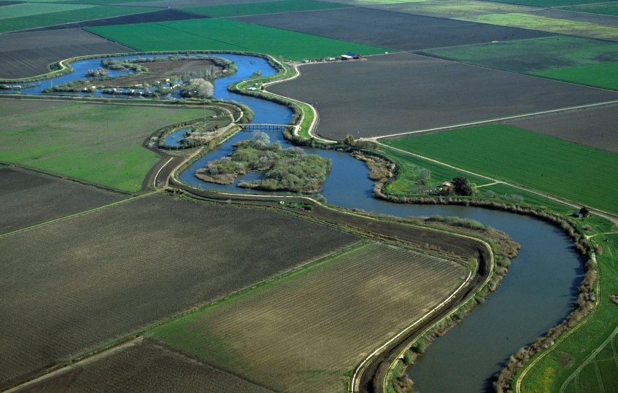
DELTA LEVEES MAINTENANCE SUBVENTIONS PROGRAM
Sandi Maxwell, P.E.
Presented at the
Central Valley Flood Protection Board
Sacramento, California
September 13, 2013
Notes:
Good Morning Board President and members of the Board.
My name is Sandi Maxwell, I am a Senior Engineer
with the Delta Levees Subventions Program.

Slide 3
Why are we here today?
Subventions Program Overview
Update on Recent Activities
Request approval of the funding plan in the amount of $12 million for the Delta Levees Subventions Program for fiscal year 2013/2014.
Request authorization for DWR to proceed with preparation and circulation of the Subventions Program work agreements for signature by the Board’s Executive Officer.
Notes:
I am here today to provide you
an overview of the Delta Levee Subventions Program
an update of Recent Activities
Request approval of the 2013/14 Subventions funding plan
And
Request authorization to precede with the preparation and circulation of the Subventions Program work agreements

Slide 4
Overview
Helping the Delta
Notes:
The Delta Levees Maintenance Subventions Program provides technical and financial assistance to local levee maintaining agencies in the Sacramento – San Joaquin Delta for maintenance and rehabilitation of non-project and eligible project levees.
Nonproject and project levees are defined in the Water Code, Section 12980.
Nonproject levees are local, non-federal flood control levees (page 38 of the Delta Atlas. ) Project levees are federal flood control levees (page 40 of the Delta Atlas.)
The legal Delta, the Primary and Secondary Zones, and Project and non-project levees are described in the Delta Atlas

Slide 5
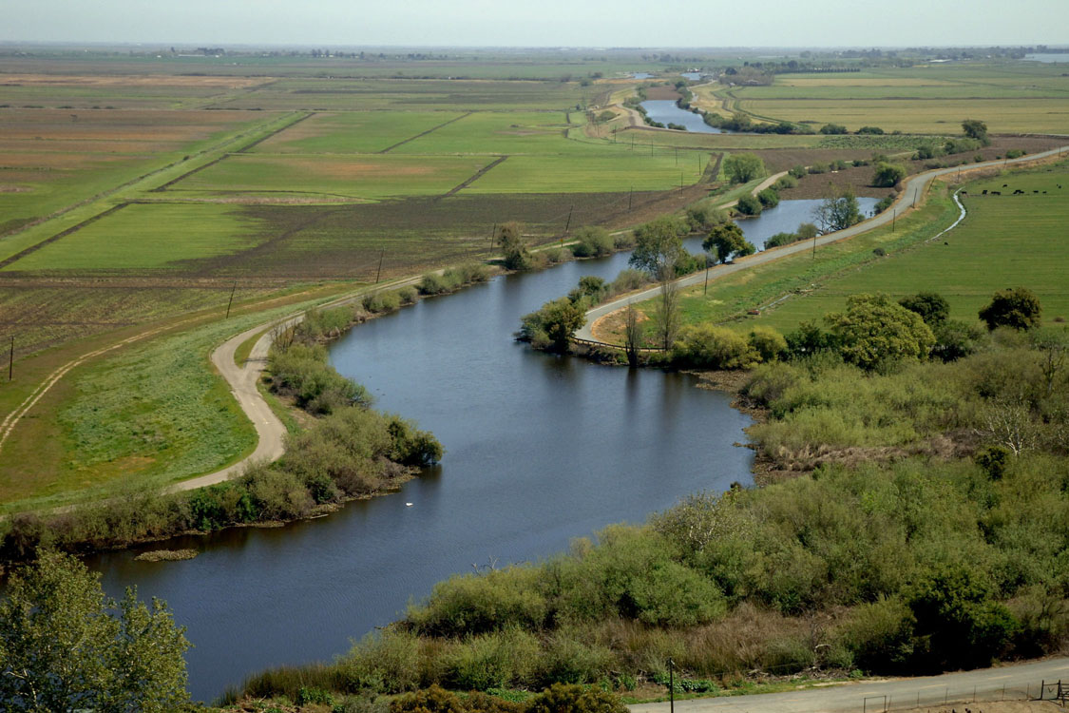
Overview
THE DELTA
Estuary - Network of Levees and Channels that Work Together as a System
~ 738,000 Acres
~ 70 Islands/Tracts
~ 1,100 Miles of Levee
Notes:
The Delta is a network of levees and channels that work together as a system.
The 1100 miles of levees within the Delta protects many valuable resources

Slide 6
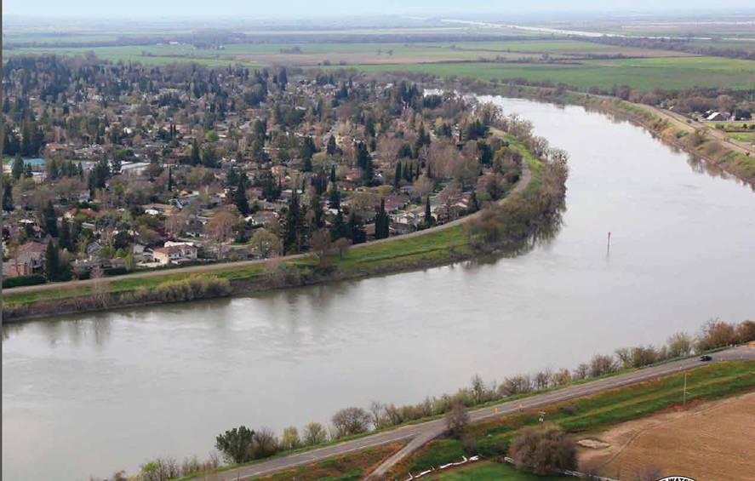
Overview
LEVEES PROTECT Urban Areas
Notes:
Urban Areas
There are over 64,000 acres of urban areas.
There are over 64,000 acres of urban and commercial lands.

Slide 7
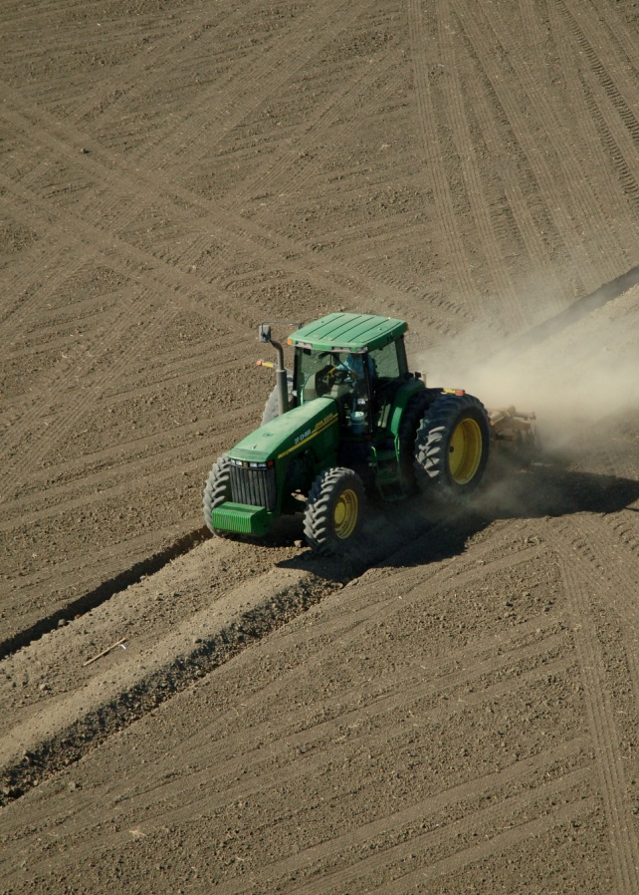
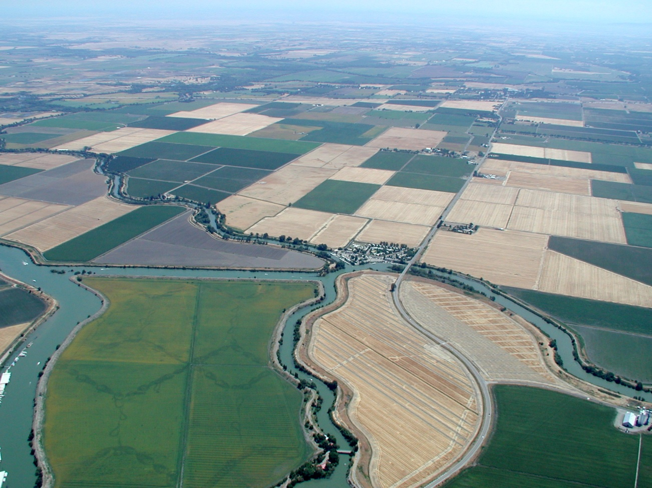
Overview
LEVEES PROTECT Agriculture
Notes:
425,700 acres of agricultural lands

Slide 8
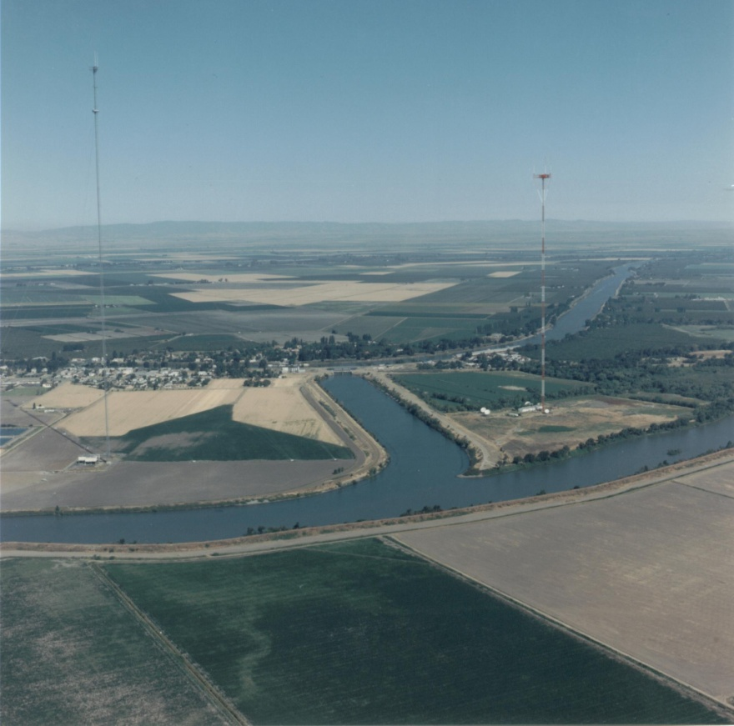
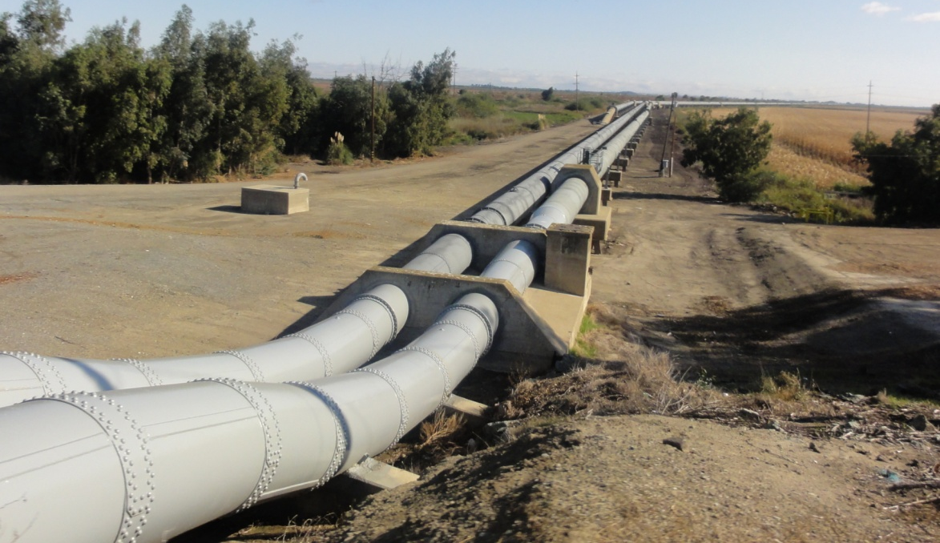
Overview
LEVEES PROTECT INFRASTRUCTURE
Notes:
Miles of infrastructure

Slide 9
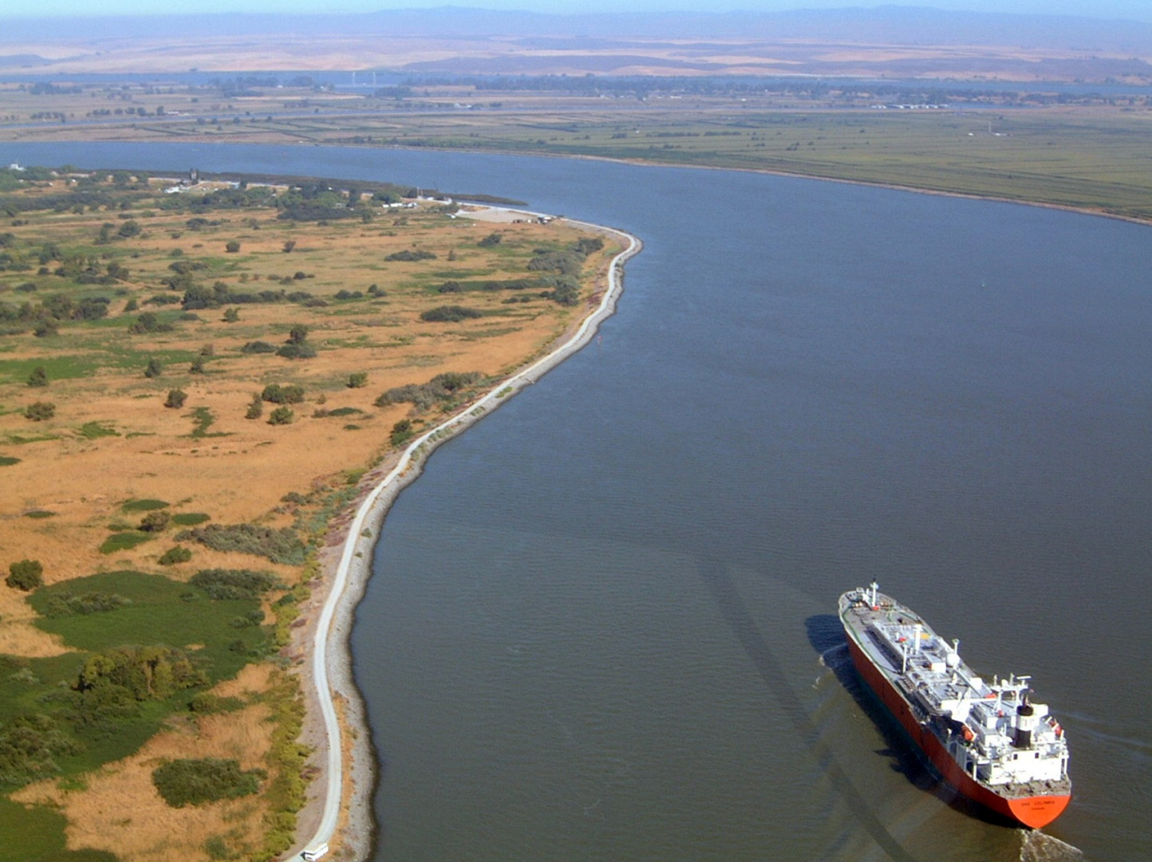
Overview
LEVEES PROTECT Transportation
Notes:
Including transportation corridors

Slide 10
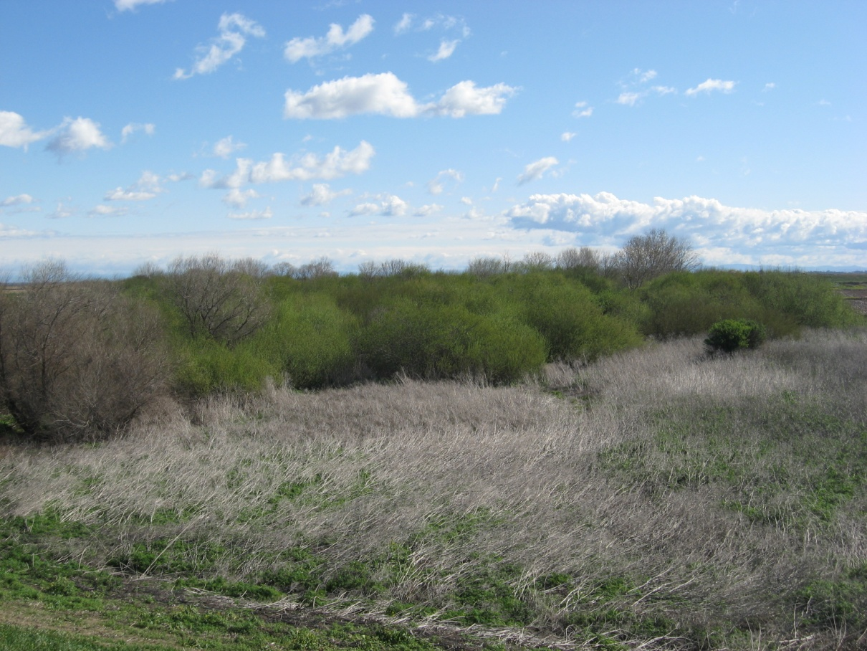
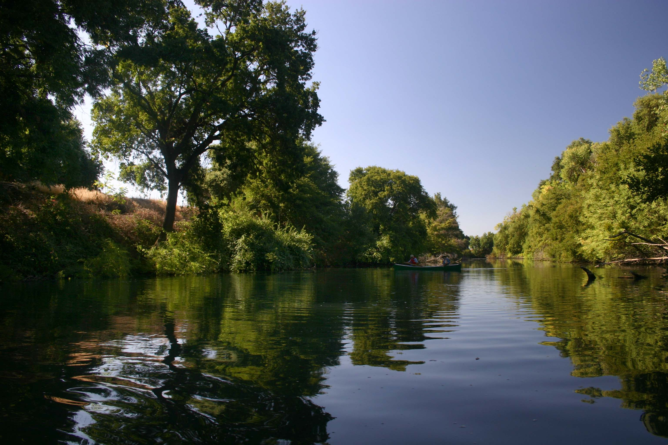
Overview
LEVEES PROTECT Habitat
Notes:
Levees also protect habitat and wildlife.

Slide 11
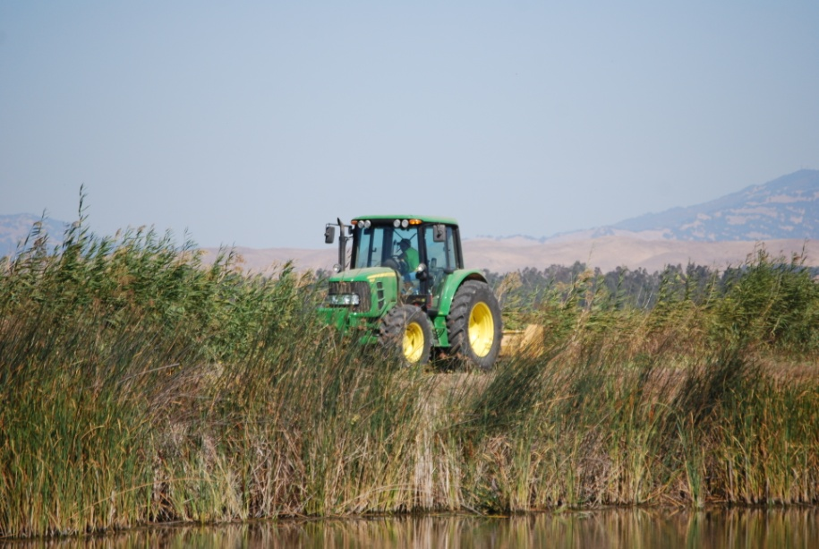
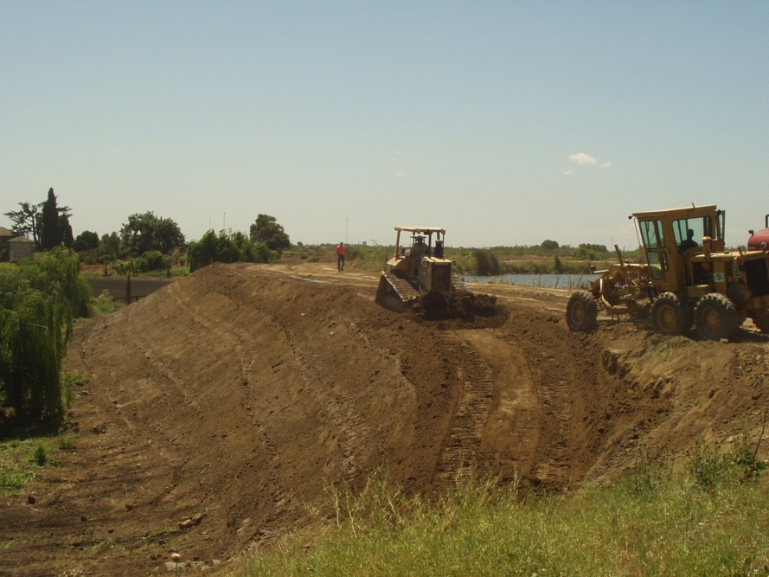
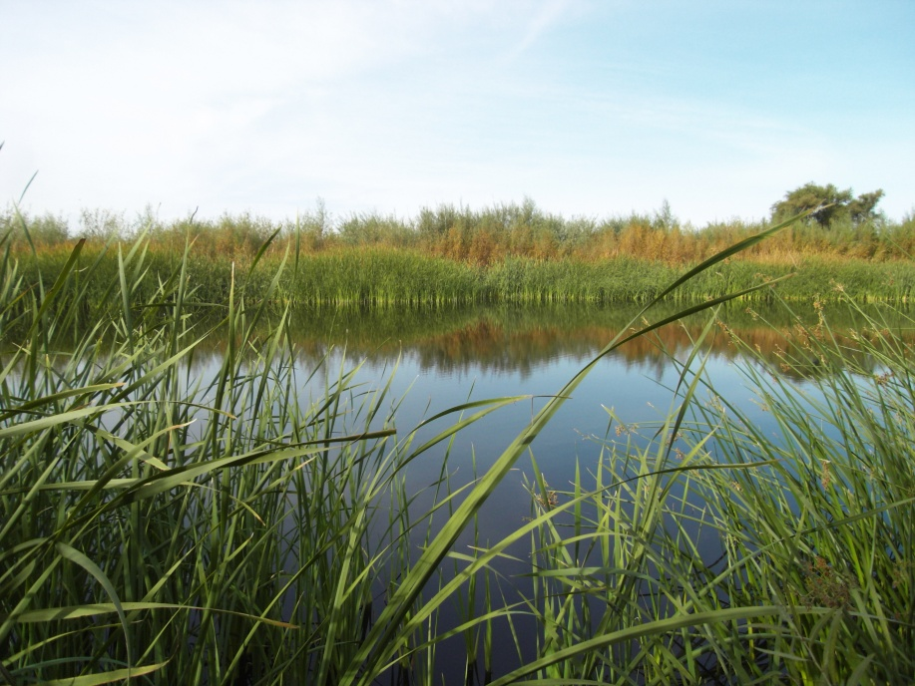
Subventions Program
California Water Code Sections 12980-12995
Rehabilitation
Maintenance
No-Net loss of Habitat
Notes:
The California Water Code Sections 12980-12995
authorizes DWR to provide local agencies with funding for annual Maintenance and Rehabilitation through the Subventions Program. The program has been in effect since the passage of the Way Bill (SB 541) in 1973 and modified in 1988, 1991 and 1996 to implement the Delta Flood Protection Act
The goal of the Program, is to preserve the physical characteristics of the Delta essentially in their present form while at the same time ensuring no net loss of habitat.
DWR’s Delta Levees Subventions Program is authorized by the California Water Code Sections12980 – 12995. The goal of the Program is to preserve the physical characteristics of the Delta essentially in their present from while at the same time ensuring no net loss of habitat.

Slide 12
Subventions Program
California Water Code Sections 12980-12995
Annual program by fiscal year: July 1st – June 30th
Provides funding for levee maintenance and rehabilitation to local agencies with:
Nonproject levees as defined in WC § 12980(e) within the Legal Delta
Project levees as defined in WC § 12980(f) within the Primary Zone of the Legal Delta
Local agencies is responsible for the first $1,000 per levee mile
Program reimburses up to 75% of eligible costs
Notes:
The Water Codes States
The Subventions Program be an Annual program
Beginning July 1 and ends June 30 of the following year
The program will provide funding for annual maintenance and rehabilitation for non-project levees and eligible project levees.
The local agencies are responsible for the first $1,000 per levee mile.
The Subventions Program is a cost share program reimbursing up to 75% of all eligible costs.
The Subventions Program is an Annual program which allows reimbursement to local levee maintaining agencies of up to 75% to non-project and eligible project levee participants after the expenditure of $1000 per maintained levee mile is made for levee maintenance and improvement work.

Slide 13
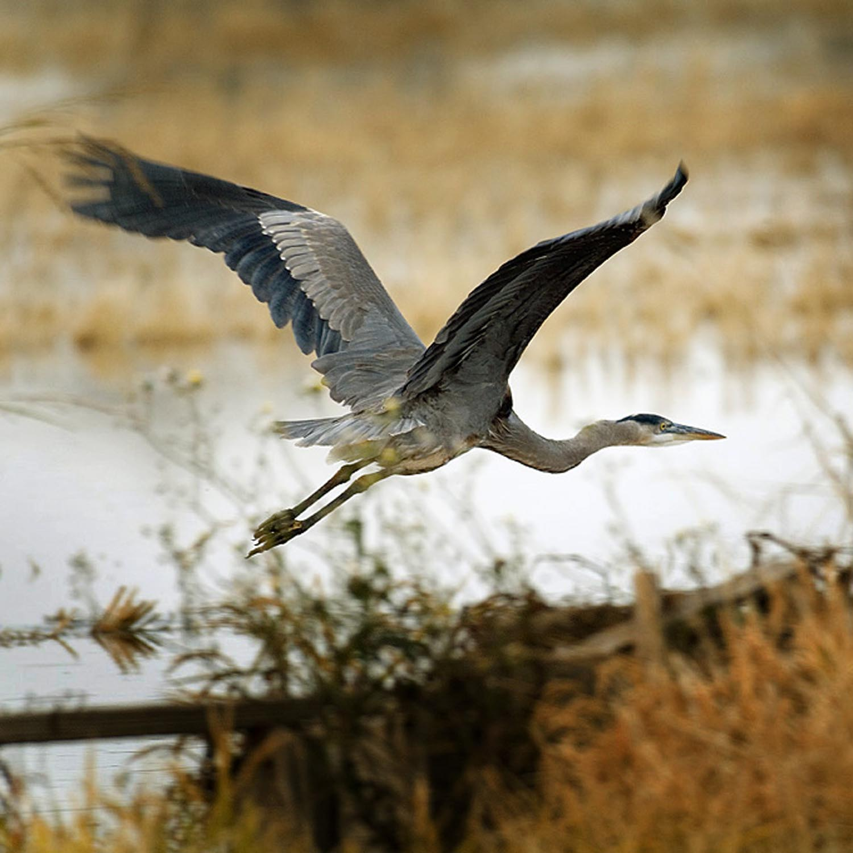
Subventions Program
Habitat
California Water Code Section 12984
Annual Joint CDFW/ DWR Inspection
No Net Long-term Loss of Habitat
Habitat Enhancement
Notes:
Habitat mitigation and enhancment are important parts of our program.
DWR and CDFW work together to ensure no net loss of habitat loss
And also provide program wide enhancement

Slide 14
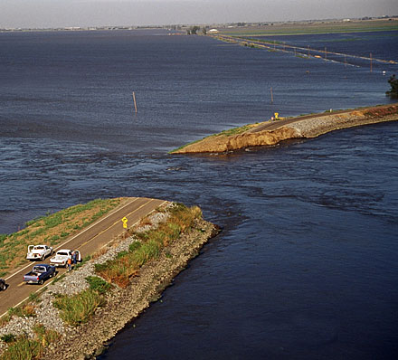
Subventions Program
Emergency Response
California Water Code Section 12994
Emergency Response
$200,000 Annually
$50,000 per Site
Jones Tract Levee Failure - 2004
Notes:
Subventions funds are also used for Emergency response.
Up to $200,000 annually
The subventions program contributed funds towards emergency repairs to the Jones Tract levee failure in 2004
After the $50,000 then special projects funds are used

Slide 15
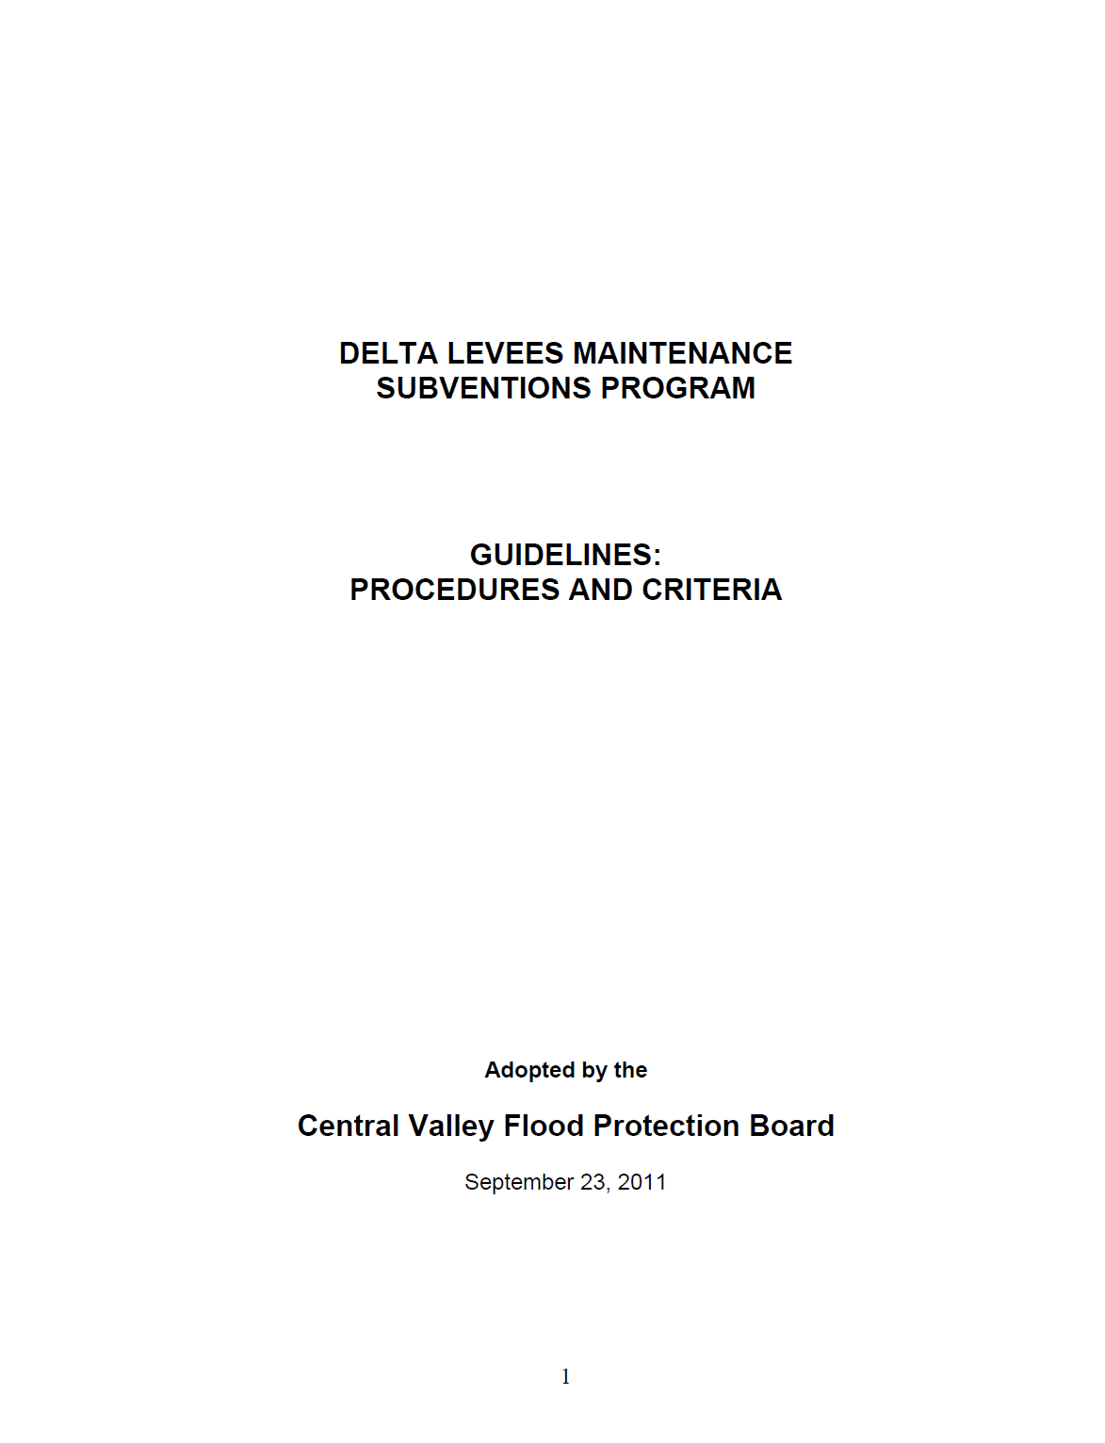
Subventions Program
Guidelines
California Water Code Section 12984
Guide administration of the program
Eligibility
Requirements
Reimbursement
Notes:
The Latest Subventions Program – Guidelines: Procedures and Criteria were adopted by the Board in 2011.
The guidelines discuss
Eligibility – Who is eligible to receive subventions funds?
(LMA’s with project and non-project levees -primary zone,
non project levees -secondary zone)
Requirements – What requirements are needed for applying and receiving funds?
(public agency, submit application, sign a work agreement and submit a final claim by due dates)
And
Reimbursement – What costs are eligible for reimbursement?
(engineering, labor, materials, equipment)

Slide 16
Subventions Program
Priority of Funding
MAINTENANCE (Capped at $20,000/mile)
REHABILITATION
Capped $100,000 per levee mile
Cat 1: Reclamation Board’s Highest Priority
Cat 2: F&W habitat protective measures
Cat 3: HMP Expenditures
Cat 4: Bulletin 192-82 Expenses
Priority 1
Priority 2
Priority 1 over $100,000 per mile
Priority 3
Rehabilitation in excess of Bulletin 192-82
Notes:
Also described in the guidelines are our funding priorities.
Our main goal is to fund all maintenance activities up to $20,000 per mile.
Maintenance activities might include:
Vegetation and rodent control Erosion control and repair
Access Road repairs Rip rap replacement
Clearing drains and ditches Regular inspections
If there are additional funds available we fund rehabilitation activities
(Rehabilitation activities are activities that improve the levee)
Priority 1, rehabilitation activities include
Meeting the Boards highest priorities,
Protecting the enhancing fish and wildlife habitat,
Improving levees to meet the HMP or B192-82 standards
If there are additional funds still available Priority 2 and 3 can be met
HMP – Hazard Mitigation Plan standards (to receive FEMA funds)
Bulletin 192-82 levee design criteria beyond HMP and PL84-99

Slide 17
Subventions Program
Process
May - Announce deadlines to local agencies
July 1 - Receive applications from local agencies
September - Make recommendations for Board approval
Between Board approval and end of fiscal year:
Execute work agreements with local agencies and Board
Local agencies do the work: July 1 – June 30
November 1 - Local agencies submit final claims
After DWR receive claims:
Audit the claims
Conduct joint inspections with DFG and Local Agency
Make payments for eligible reimbursement
Notes:
How do the local agency’s receive subventions funds?
In early May the Subventions program announces the availability of Subventions Funds and requests local agencies to apply for funding
(letters are sent out to known stakeholders, info on website also)
The applications are due July 1 – Letter saying they want to participate in the program and a plan for maintenance and rehabilitation activities in the coming construction season
In September the Subventions Program comes to the board to request
Approval of the annual funding plan and request authorization to prepare work agreements for signature
Locals perform maintenance and rehabilitation activities
15 months later on November 1 all final claims are due and
DWR begins the re-imbursement process - Review claims, Perform levee inspections,
Summarize expenditures for Re-imbursement
Subventions is a re-imbursement program

Slide 18
Program Funding
FloodSAFE Funding
Fiscal Year | Approved funding | Source of funding | Claims received | Total eligible work | State reimbursement
2007/2008 | $26 million | Prop. 84 | 60 | $23 million | $16 million
2008/2009 | $20 million | Prop. 84 | 63 | $17 million | $12 million
2009/2010 | $18 million | Prop. 84 | 62 | $13 million | $9 million
2010/2011 | $15 million | Prop. 84 | 62 | $16 million | $11 million
2011/2012 | $12 million | Prop. 1E | 61 | $11 million | $8 million
Notes:
Since the program’s inception in 1973, the Subventions Program has spent over $160 million for maintenance and rehabilitation activities on delta levees
with an additional $120 million spent by the locals.
With the passage of Propostions 1E and 84
The program has been able to fund between 11 and 23 million dollars of work annually
with a state reimbursement of 8 to 16 million dollars.
The program has historically been a 2 million dollar program until the passage of Proposition 1E and 84. Since then the program has been able to fund between 13 and 17 million dollars of work annually with a state cost share of 9 to 12 million dollars. Last fiscal year (FY 11/12) the program was funded at 12 million dollars and due by November 1st.
The funding for this fiscal year (12/13) is proposed at 12 million dollars. This amount was decided by looking at past years and through discussions with the stakeholders. This amount has been allocated by Table 2 the staff report to the 67 local agencies that applied.

Slide 19
Program Funding
Fiscal Year 2011/2012 Details
 | Eligible work | State reimbursement (75%)
Maintenance | $6,071,898 | $4,553,924
Total Priority 1 | $3,799,024 | $2,849,268
Total Priority 2 | $411,833 | $308,874
Total Priority 3 | $0 | $0
Maintenance Deductable ($1,000/levee mile) | -$724,800
Total | $11,007,555 | $7,712,066
Notes:
FY 2011/12 Local agencies performed $11 million dollars of eligible work
The Program reimbursed $7.7 million for levee maintenance and rehabilitation activities.
In 2011, the Board allocated $12 million for the Subventions Program,
After the $1000 per levee mile deduction and the 75 % cost share

Slide 20
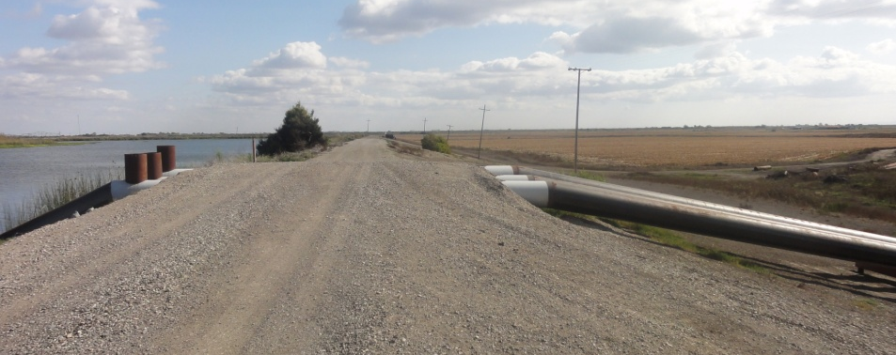
Program Funding
Maintenance Activities FY 2011/2012
Rip Rap on Upper Roberts
Toe Ditch Cleaning on Venice
Mowing on Grand
Encroachment raising on Bacon
Seepage Blanket on Grand
Notes:
Activities -included general maintenance,
rip rap placement, ditch clearing,
seepage control, encroachment removal, and
regular levee inspections.
Consistent funding has supported nearly 40 years of levee maintenance and rehabilitation activities
creating the most well maintained levees in the history of the program.

Slide 21
Program Funding
Fiscal Year 2012/2013 Details
Approved funding - $12 million
Source of funding – Proposition 1E
Applications Received – 67
Final Claims due November 1, 2013
Notes:
Last fiscal year (FY 12/13) the program was funded for $12 million and received 67 applications for funding.
Final claims for these applications are due November 1 of this year.

Slide 22
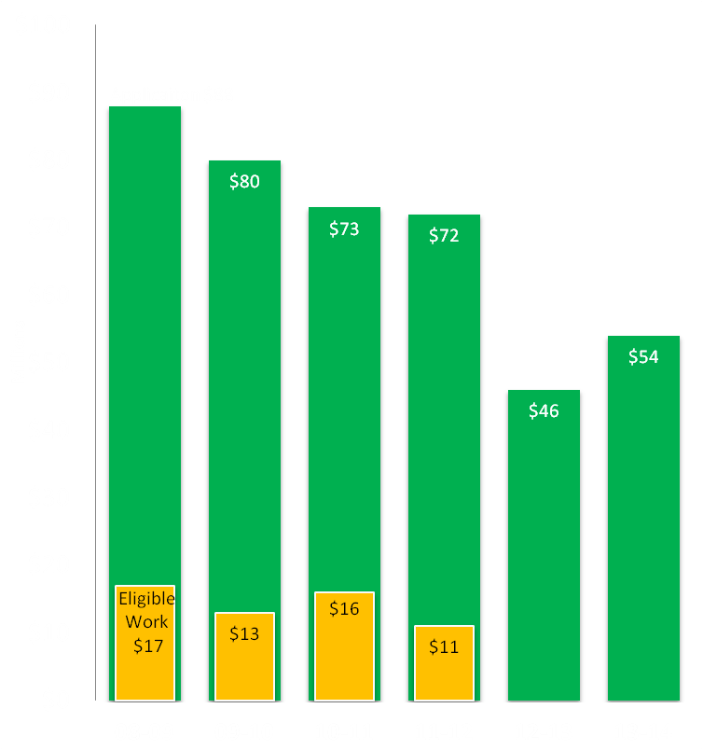
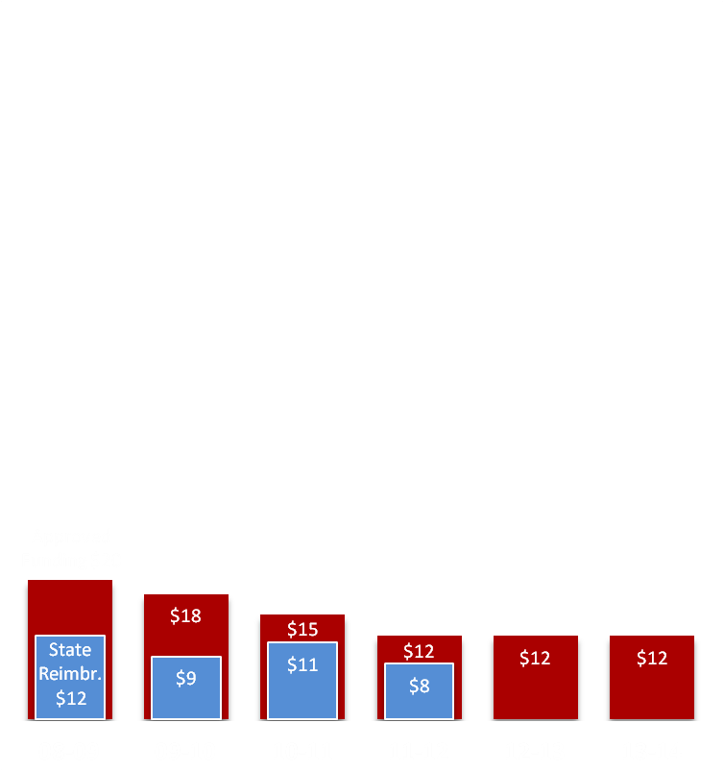
Program Funding
Application vs. Eligible Work
Approved Funding vs. State Reimbursement
Notes:
This slide shows the Application amounts vs Eligible expenses and Approved funding vs State reimbursement.
As you can see every year shown, the application requests have been considerably greater than the actual eligible work claimed.
Allows available funding in their work agreement for unexpected repairs, emergency activities or a change in plans.
The Subventions program funding requests are based on discussions with the applicants and historical spending.
The local agencies apply for considerably more funding then they plan to perform to allow flexibility in funding their maintenance activities.
Example –
In their applications local agencies apply for funding for all possible levee maintenance and rehab activities with the intention of performing only some of the work. Because they have included all of the activities possible they might want to perform in their application they have the flexibility to do what ever is need with out surpassing the funds requested in their application
Work Agreement funds are based on the applications.

Slide 23
Program Funding
Proposed Funding for Board Approval
Fiscal Year | Proposed funding | Source of funding | Applications received
2013/2014 | $12 million | Prop. 1E | 67
Final claims due November 1, 2014
Proposed funding decided based on past funding and through discussion with stakeholders.
Notes:
This year the subventions program received 67 applications requesting nearly $54 million dollars.
We are requesting the board approve the $12 million funding plan for FY 13/14. This amount is a reasonable funding level and is the outcome of discussions between staff and the local agencies. As well as historical levels of applicant spending.
The funding for this fiscal year (12/13) is proposed at 12 million dollars. This amount was decided by looking at past years and through discussions with the stakeholders. This amount has been allocated by Table 2 the staff report to the 67 local agencies that applied.

Slide 24
Staff Recommendations
DWR staff recommend the Board:
Approve the funding plan in the amount of $12 million for the Delta Levees Subventions Program for fiscal year 2013/2014.
Authorize DWR to proceed with preparation and circulation of the Subventions Program work agreements for signature by the Board’s Executive Officer.
Notes:
DWR staff recommends the Board Approve the $12 million Funding Plan for the Delta Levees Subventions Program for fiscal year 2013/2014.
Authorize DWR to proceed with preparation and circulation of the Subventions Program work agreements for signature by the Board’s Executive Officer.

Slide 25
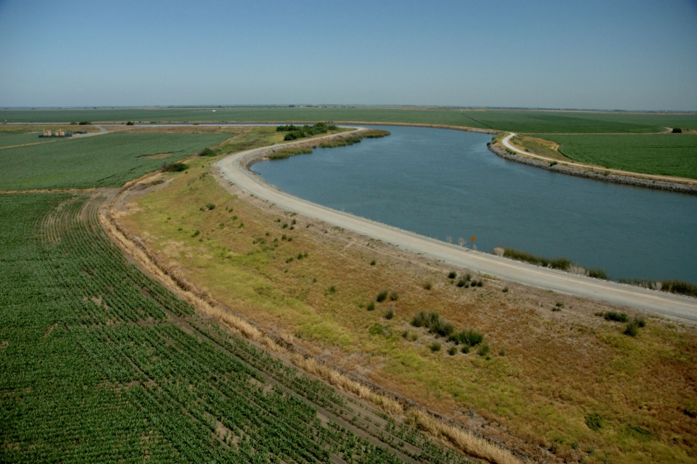
QUESTIONS?

